Slide 1
Chapter 7
Atomic Physics

Slide 2

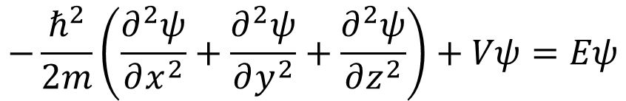
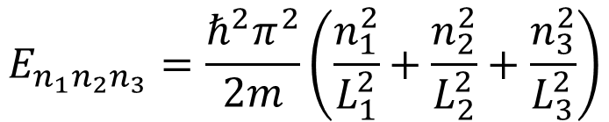
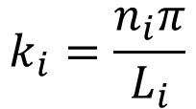
Schrödinger Equation in 3D infinite square well
$$−\frac{ℏ^{2}}{2m}\left(\frac{∂^{2}ψ}{∂x^{2}}+\frac{∂^{2}ψ}{∂y^{2}}+\frac{∂^{2}ψ}{∂z^{2}}\right)+Vψ=Eψ$$
$$ψ\left(x,y,z\right)=ψ_{1}\left(x\right)ψ_{2}\left(y\right)ψ_{3}\left(z\right)$$
$$ψ\left(x,y,z\right)=Asin\left(k_{1}x\right)sin\left(k_{2}y\right)sin\left(k_{3}z\right)$$
$$E_{n_{1}n_{2}n_{3}}=\frac{ℏ^{2}π^{2}}{2m}\left(\frac{n_{1}^{2}}{L_{1}^{2}}+\frac{n_{2}^{2}}{L_{2}^{2}}+\frac{n_{3}^{2}}{L_{3}^{2}}\right)$$
$$k_{i}=\frac{n_{i}π}{L_{i}}$$

Slide 3
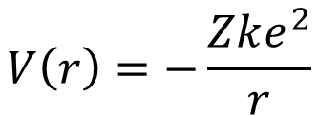
Schrödinger Equation in 3D Spherical Coordinate
Electrons in hydrogen-like atom
$$−\frac{ℏ^{2}}{2μ}\frac{1}{r^{2}}\frac{∂}{∂r}\left(r^{2}\frac{∂ψ}{∂r}\right)−\frac{ℏ^{2}}{2μ}\frac{1}{r^{2}}\left[\frac{1}{sinθ}\frac{∂}{∂θ}\left(sinθ\frac{∂ψ}{∂θ}\right)+\frac{1}{\sin^{2}θ}\frac{∂^{2}ψ}{∂φ^{2}}\right]+Vψ=Eψ$$
$$V\left(r\right)=−\frac{Zke^{2}}{r}$$

Slide 4
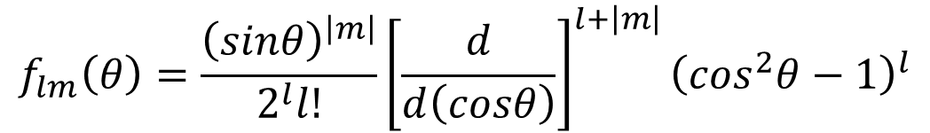


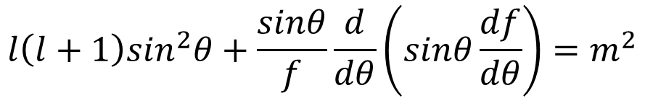
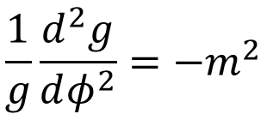
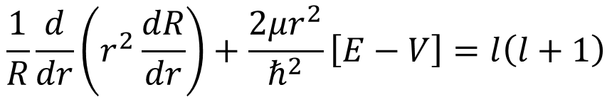
Schrödinger Equation in 3D Spherical Coordinate
$$−\frac{ℏ^{2}}{2μ}\frac{1}{r^{2}}\frac{∂}{∂r}\left(r^{2}\frac{∂ψ}{∂r}\right)−\frac{ℏ^{2}}{2μ}\frac{1}{r^{2}}\left[\frac{1}{sinθ}\frac{∂}{∂θ}\left(sinθ\frac{∂ψ}{∂θ}\right)+\frac{1}{\sin^{2}θ}\frac{∂^{2}ψ}{∂φ^{2}}\right]−\frac{Zke^{2}}{r}ψ=Eψ$$
$$ψ\left(r,θ,φ\right)=R\left(r\right)f\left(θ\right)g\left(φ\right)$$
$$\frac{1}{R}\frac{d}{dr}\left(r^{2}\frac{dR}{dr}\right)+\frac{2μr^{2}}{ℏ^{2}}\left[E−V\right]=l\left(l+1\right)$$
$$\frac{1}{g}\frac{d^{2}g}{dφ^{2}}=−m^{2}$$
$$g_{m}\left(φ\right)=e^{imφ}$$
$$l\left(l+1\right)\sin^{2}θ+\frac{sinθ}{f}\frac{d}{dθ}\left(sinθ\frac{df}{dθ}\right)=m^{2}$$
$$f_{lm}\left(θ\right)=\frac{{\left(sinθ\right)}^{\left|m\right|}}{2^{l}l!}{\left[\frac{d}{d\left(cosθ\right)}\right]}^{l+\left|m\right|}{\left(\cos^{2}θ−1\right)}^{l}$$

Slide 5

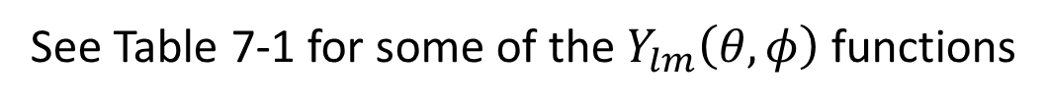
Schrödinger Equation in 3D Spherical Coordinate
$$Y_{lm}\left(θ,φ\right)=f_{lm}\left(θ\right)g\left(φ\right)=e^{imφ}\frac{{\left(sinθ\right)}^{\left|m\right|}}{2^{l}l!}{\left[\frac{d}{d\left(cosθ\right)}\right]}^{l+\left|m\right|}{\left(\cos^{2}θ−1\right)}^{l}$$
$$ψ\left(r,θ,φ\right)=R_{nl}\left(r\right)Y_{lm}\left(θ,φ\right)$$
See Table 7-1 for some of the $Y_{lm}\left(θ,φ\right)$ functions

Slide 6
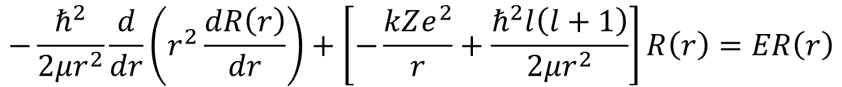
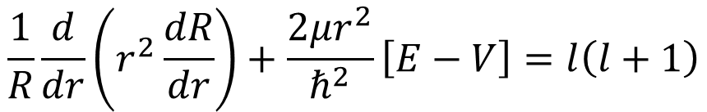
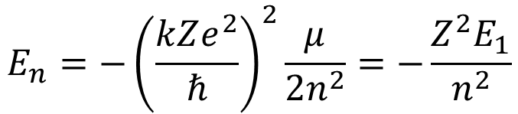
Radial Function of Schrödinger Equation
$$\frac{1}{R}\frac{d}{dr}\left(r^{2}\frac{dR}{dr}\right)+\frac{2μr^{2}}{ℏ^{2}}\left[E−V\right]=l\left(l+1\right)$$
$$−\frac{ℏ^{2}}{2μr^{2}}\frac{d}{dr}\left(r^{2}\frac{dR\left(r\right)}{dr}\right)+\left[−\frac{kZe^{2}}{r}+\frac{ℏ^{2}l\left(l+1\right)}{2μr^{2}}\right]R\left(r\right)=ER\left(r\right)$$
$$E_{n}=−{\left(\frac{kZe^{2}}{ℏ}\right)}^{2}\frac{μ}{2n^{2}}=−\frac{Z^{2}E_{1}}{n^{2}}$$

Slide 7
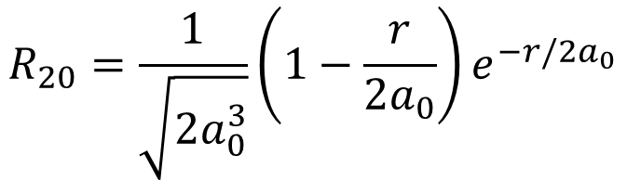
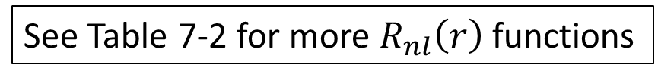
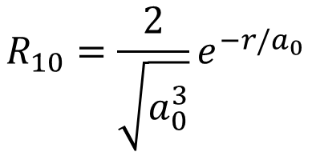
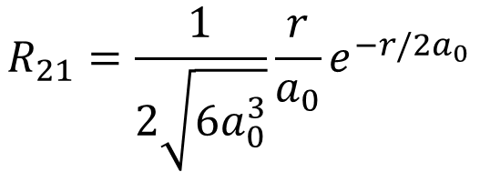
Radial Function of Schrödinger Equation
See Table 7-2 for more $R_{nl}\left(r\right)$ functions
$$R_{10}=\frac{2}{\sqrt{a_{0}^{3}}}e^{−r/a_{0}}$$
$$R_{20}=\frac{1}{\sqrt{2a_{0}^{3}}}\left(1−\frac{r}{2a_{0}}\right)e^{−r/{2a}_{0}}$$
$$R_{21}=\frac{1}{2\sqrt{6a_{0}^{3}}}\frac{r}{a_{0}}e^{−r/{2a}_{0}}$$

Slide 8



Summary of the Quantum Numbers
$$ψ\left(r,θ,φ\right)=R_{nl}\left(r\right)Y_{lm}\left(θ,φ\right)$$
Principal quantum number:
$$n=1,2,3,…$$
Angular momentum (orbital) quantum number:
$$l=0,1,2,3,…,(n−1)$$
Magnetic quantum number:
$$m=−l,−l+1,…,−2,−1,0,1,2,…,l−1,l$$

Slide 9
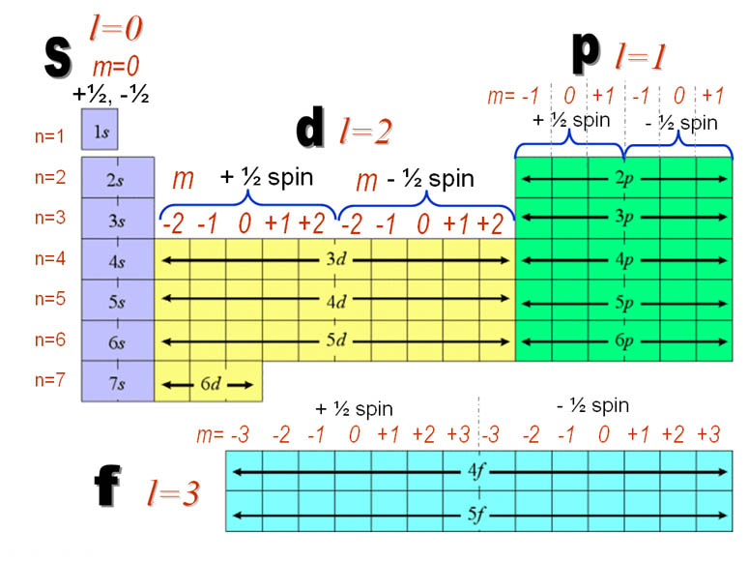
Periodic Table and Quantum Numbers

Slide 10


Angular Momentum
$$−ℏ^{2}\left[\frac{1}{sinθ}\frac{∂}{∂θ}\left(sinθ\frac{∂}{∂θ}\right)+\frac{1}{\sin^{2}θ}\frac{∂^{2}}{∂φ^{2}}\right]Y_{lm}\left(θ,φ\right)=l\left(l+1\right)ℏ^{2}Y_{lm}\left(θ,φ\right)$$
$${\left(L^{2}\right)}_{op}Y_{lm}\left(θ,φ\right)=l\left(l+1\right)ℏ^{2}Y_{lm}\left(θ,φ\right)=L^{2}Y_{lm}\left(θ,φ\right)$$
$$L=\sqrt{l\left(l+1\right)}ℏ$$
$$L_{z}=mℏ$$

Slide 11


Spectroscopy transitions and selection rules
$$∆m=0 or ±1$$
$$∆l=±1$$

Slide 12
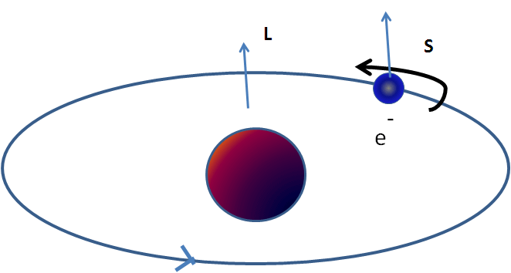
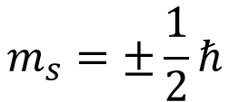

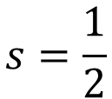
Electron Spin
$$\left|\overset{⃑}{S}\right|=S=\sqrt{s\left(s+1\right)}ℏ$$
$$m_{s}=±\frac{1}{2}ℏ$$
$$s=\frac{1}{2}$$

Slide 13
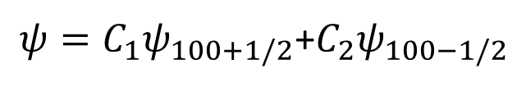

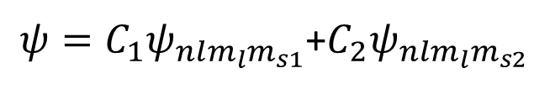
Complete Hydrogen Atom Wave Function
$$ψ_{100}\left(r,θ,φ\right)=C_{100}R_{10}\left(r\right)Y_{00}\left(θ,φ\right)$$
$ψ=C_{1}ψ_{nlm_{l}m_{s1}}$+$C_{2}ψ_{nlm_{l}m_{s2}}$
$ψ=C_{1}ψ_{100+1/2}$+$C_{2}ψ_{100−1/2}$
Pauli Exclusion Principle: Valid for particles with half integer spin (Fermions)
No more than one electron may occupy a given quantum state specified by a particular set of single-particle quantum numbers, n, l, m_{l}, m_{s}

Slide 14
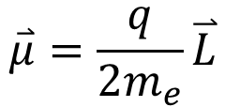

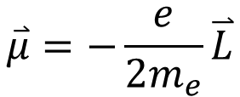
Magnetic Moment
Define: Magnetic dipole moment
$$\overset{⃑}{μ}=I\overset{⃑}{A}$$
A loop of current is a magnetic dipole moment!!
Electrons in an atom
Orbital motion:
$$\overset{⃑}{μ}=\frac{q}{2m_{e}}\overset{⃑}{L}$$
$$\overset{⃑}{μ}=−\frac{e}{2m_{e}}\overset{⃑}{L}$$

Slide 15

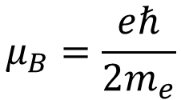

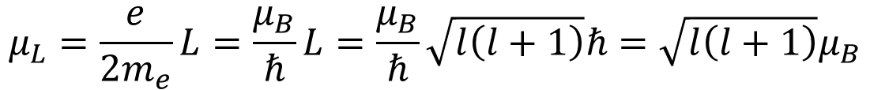
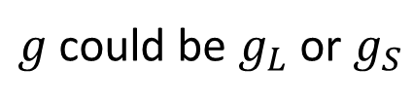



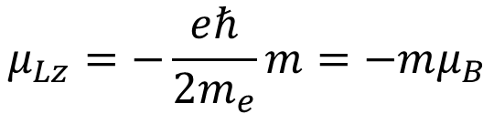

Magnetic Moment of Electron Orbital
$$μ_{L}=\frac{e}{2m_{e}}L=\frac{μ_{B}}{ℏ}L=\frac{μ_{B}}{ℏ}\sqrt{l\left(l+1\right)}ℏ=\sqrt{l\left(l+1\right)}μ_{B}$$
In general:
$$μ=\sqrt{l\left(l+1\right)}gμ_{B}$$
$$μ_{B}=\frac{eℏ}{2m_{e}}$$
Bohr magneton:
$$\overset{⃑}{μ}=−\frac{gμ_{B}}{ℏ}\overset{⃑}{L}$$
$$μ_{z}=−mgμ_{B}$$
$$μ_{Lz}=−\frac{eℏ}{2m_{e}}m=−mμ_{B}$$
Gyromagnetic ratio (g-factor):
$$μ_{L}=\sqrt{l\left(l+1\right)}μ_{B}$$
$g$ could be $g_{L}$ or $g_{S}$
$$μ_{Lz}=−μ_{B}m$$
$$g_{L}=1$$

Slide 16
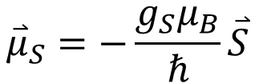
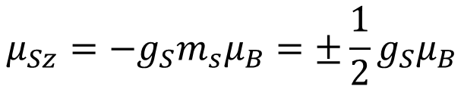
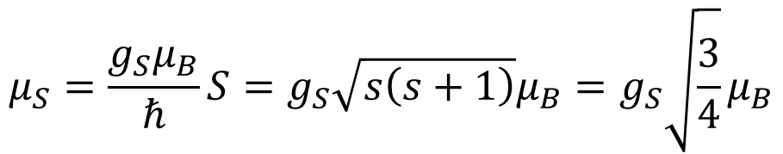

Magnetic Moment of Electron Spin
$$μ_{S}=\frac{g_{S}μ_{B}}{ℏ}S=g_{S}\sqrt{s\left(s+1\right)}μ_{B}=g_{S}\sqrt{\frac{3}{4}}μ_{B}$$
$${\overset{⃑}{μ}}_{S}=−\frac{g_{S}μ_{B}}{ℏ}\overset{⃑}{S}$$
$$μ_{Sz}=−g_{S}m_{s}μ_{B}=±\frac{1}{2}g_{S}μ_{B}$$
From Stern-Gerlach experiment:
$$g_{S}=2.002319$$

Slide 17







Total Angular Momentum
$$\overset{⃑}{J}=\overset{⃑}{L}+\overset{⃑}{S}$$
$$\left|\overset{⃑}{J}\right|=\sqrt{j\left(j+1\right)}ℏ$$
$$j=l+s$$
or
$$j=\left|l−s\right|$$
$$J_{z}=m_{j}ℏ$$
Total angular momentum of two electrons with different L
$$\overset{⃑}{J}={\overset{⃑}{L}}_{1}+{\overset{⃑}{L}}_{2}$$
$$j=l_{1}+l_{2},l_{1}+l_{2}−1, …, \left|l_{1}−l_{2}\right|$$

Slide 18
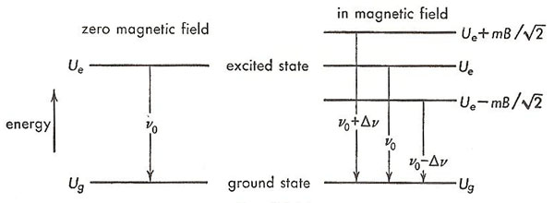


Magnetic Moment in Magnetic Field
$$\overset{⃑}{τ}=\overset{⃑}{μ}×\overset{⃑}{B}$$
$$U_{m}=−\overset{⃑}{μ}∙\overset{⃑}{B}$$

Slide 19


Stern-Gerlach Experiment
$$\overset{⃑}{F}=−∇U_{m}=−∇\left(−\overset{⃑}{μ}∙\overset{⃑}{B}\right)$$
$$F_{z}=μ_{z}\left(dB/dz\right)=−mgμ_{B}\left(dB/dz\right)$$

Slide 20
Stern-Gerlach Experiment
Reality for Silver (l = 0):
Expected:
Electron Spin made it so!
l = 1
l = 0

Slide 21
Electron Configurations and Hund’s Rule
Ag: [Kr] 4d¹⁰ 5s¹
Hund’s Rule (finding the ground state electron configuration):
Maximize total electron spin quantum number
Maximize total orbital quantum number
For the outermost subshell, if it is half-filled or less, lowest J has the lowest energy; otherwise, the highest J has the lowest energy.
O: [He] 2s² 2p⁴
N: [He] 2s² 2p³
C: [He] 2s² 2p²

Slide 22
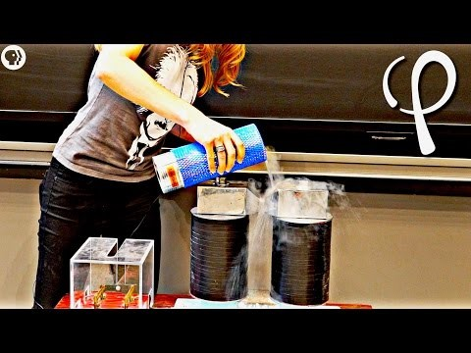

Slide 23





Spectroscopic Notation
$$n^{2s+1}l_{j}$$
$$1^{2}S_{1/2}$$
(n=1; l=0; s=1/2; j=1/2)
$$2^{2}S_{1/2}$$
(n=2; l=0; s=1/2; j=1/2)
$$2^{2}P_{1/2}$$
(n=2; l=1; s=1/2; j=1/2)
$$2^{2}P_{3/2}$$
(n=2; l=1; s=1/2; j=3/2)

Slide 24
Spin-Orbit Coupling
$$U_{m}=−\overset{⃑}{μ}∙\overset{⃑}{B}$$

