Slide 1
Chapter 6
The Schrödinger Equation

Slide 2
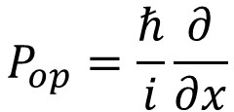

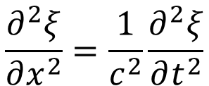


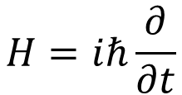
The Schrödinger Equation
$$\frac{∂^{2}ξ}{∂x^{2}}=\frac{1}{c^{2}}\frac{∂^{2}ξ}{∂t^{2}}$$
Wave equation of E&M wave
$$ξ\left(x,t\right)=ξ_{0}e^{i\left(kx−ωt\right)}$$
$$P_{op}ξ\left(x,t\right)=pξ\left(x,t\right)$$
$$Hξ\left(x,t\right)=Eξ\left(x,t\right)$$
Postulates:
$$P_{op}=\frac{ℏ}{i}\frac{∂}{∂x}$$
$$H=iℏ\frac{∂}{∂t}$$

Slide 3
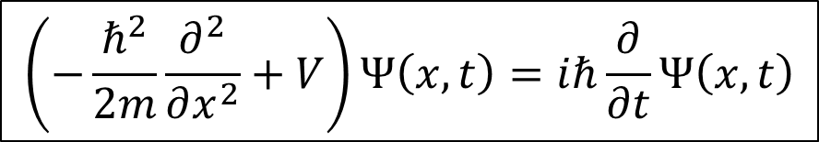
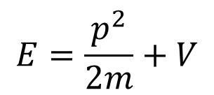
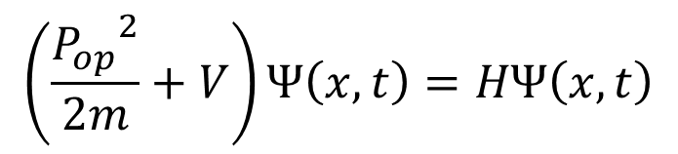
The Schrödinger Equation
$$E=\frac{p^{2}}{2m}+V$$
$$\left(\frac{{P_{op}}^{2}}{2m}+V\right)Ψ\left(x,t\right)=HΨ\left(x,t\right)$$
$$\left(−\frac{ℏ^{2}}{2m}\frac{∂^{2}}{∂x^{2}}+V\right)Ψ\left(x,t\right)=iℏ\frac{∂}{∂t}Ψ\left(x,t\right)$$

Slide 4
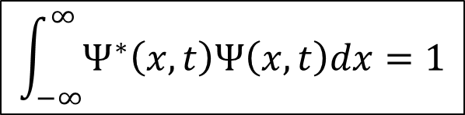
The Schrödinger Equation
Wave function is an imaginary function.
Wave function of matter is not a measurable function/quantity.
Instead, it is the probability interpretation of the particle.
$$P\left(x,t\right)dx=Ψ^{∗}\left(x,t\right)Ψ\left(x,t\right)dx={\left|Ψ\left(x,t\right)\right|}^{2}dx$$
$$\int_{−∞}^{∞}{Ψ^{∗}\left(x,t\right)Ψ\left(x,t\right)dx}=1$$

Slide 5
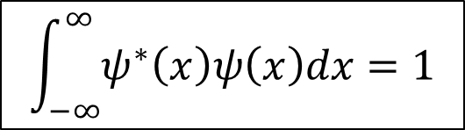

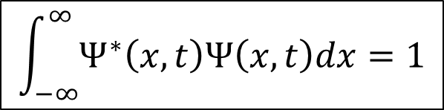

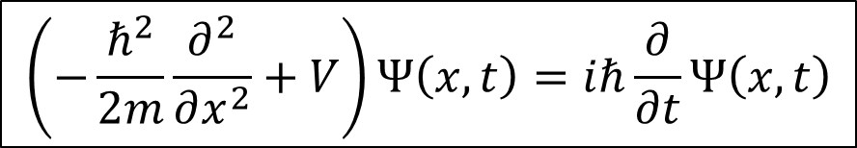
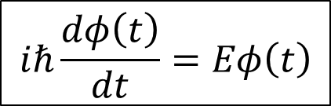
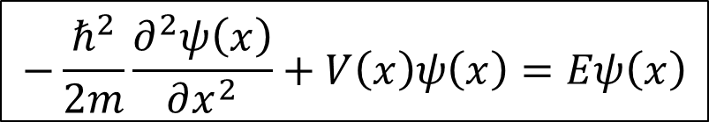
Separation of Time and Space Variables
$$\left(−\frac{ℏ^{2}}{2m}\frac{∂^{2}}{∂x^{2}}+V\right)Ψ\left(x,t\right)=iℏ\frac{∂}{∂t}Ψ\left(x,t\right)$$
$$Ψ\left(x,t\right)=ψ\left(x\right)φ\left(t\right)$$
$$−\frac{ℏ^{2}}{2m}\frac{∂^{2}ψ\left(x\right)}{∂x^{2}}+V\left(x\right)ψ\left(x\right)=Eψ\left(x\right)$$
$$iℏ\frac{dφ\left(t\right)}{dt}=Eφ\left(t\right)$$
$$φ\left(t\right)=e^{−iEt/ℏ}$$
$$\int_{−∞}^{∞}{Ψ^{∗}\left(x,t\right)Ψ\left(x,t\right)dx}=1$$
$$\int_{−∞}^{∞}{ψ^{∗}\left(x\right)ψ\left(x\right)dx}=1$$

Slide 6

Example
Show that for a free particle of mass m moving in one dimension, the function $ψ\left(x\right)=Asinkx+Bcoskx$ is a solution to the time-independent Schrödinger equation for any values of the constants A and B.

Slide 7
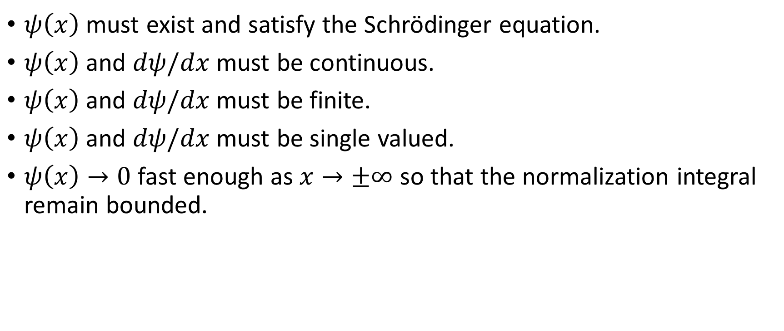
Conditions for Acceptable Wave Functions
$ψ\left(x\right)$ must exist and satisfy the Schrödinger equation.
$ψ\left(x\right)$ and $dψ/dx$ must be continuous.
$ψ\left(x\right)$ and $dψ/dx$ must be finite.
$ψ\left(x\right)$ and $dψ/dx$ must be single valued.
$ψ\left(x\right)→0$ fast enough as $x→±∞$ so that the normalization integral remain bounded.

Slide 8
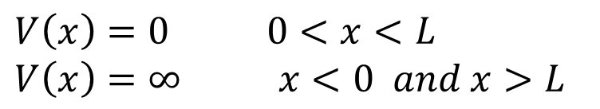
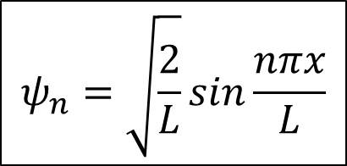
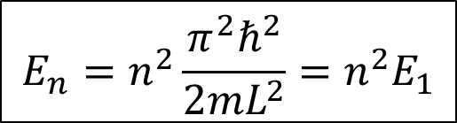
The Infinite Square Well
$$V\left(x\right)=0 0<x<L$$
$$V\left(x\right)=∞ x<0 and x>L$$
Standing Wave method
Solving Schrödinger equation
$$ψ_{n}=\sqrt{\frac{2}{L}}sin\frac{nπx}{L}$$
$$E_{n}=n^{2}\frac{π^{2}ℏ^{2}}{2mL^{2}}=n^{2}E_{1}$$

Slide 9
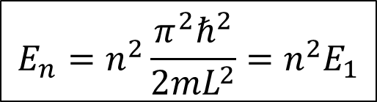
The Infinite Square Well
$$E_{n}=n^{2}\frac{π^{2}ℏ^{2}}{2mL^{2}}=n^{2}E_{1}$$

Slide 10
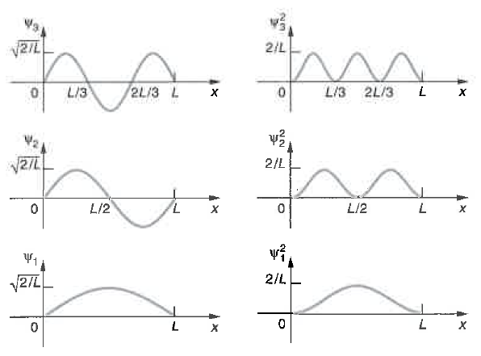
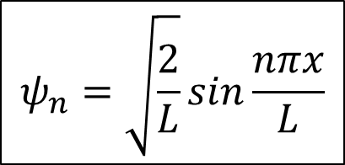
The Infinite Square Well
$$ψ_{n}=\sqrt{\frac{2}{L}}sin\frac{nπx}{L}$$

Slide 11


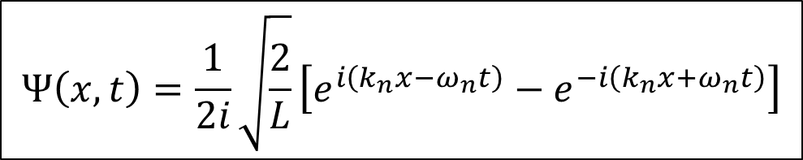

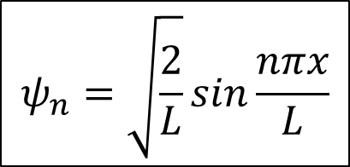
The Infinite Square Well – the Complete Wave Function
$$Ψ\left(x,t\right)=ψ\left(x\right)φ\left(t\right)$$
$$ψ_{n}=\sqrt{\frac{2}{L}}sin\frac{nπx}{L}$$
$$φ\left(t\right)=e^{−iEt/ℏ}$$
$$φ_{n}\left(t\right)=e^{−iE_{n}t/ℏ}$$
$$Ψ\left(x,t\right)=\frac{1}{2i}\sqrt{\frac{2}{L}}\left[e^{i\left(k_{n}x−ω_{n}t\right)}−e^{−i\left(k_{n}x+ω_{n}t\right)}\right]$$

Slide 12
Example
An electron moving in a thin metal wire is a reasonable approximation of a particle in a one-dimensional infinite well. The potential inside the wire is constant on average but rise sharply at each end. Suppose the electron is in a wire 1.0 cm long. (a) Compute the ground-state energy for the electron. (b) If the electron’s energy is equal to the average kinetic energy of the molecules in a gas at T = 300 K, about 0.03 eV, what is the electron’s quantum number n?

Slide 13
Example
Suppose that the electron in the above example could be “seen” while in its ground state. (a) What would be the probability of finding it somewhere in the region 0 < x < L/4? (b) What would be the probability of finding it in a very narrow region Δx = 0.01 L wide centered at x = 5L/8?

Slide 14
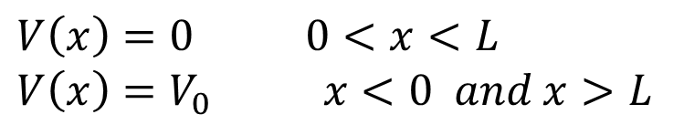
The Finite Square Well
$$V\left(x\right)=0 0<x<L$$
$$V\left(x\right)=V_{0} x<0 and x>L$$

Slide 15
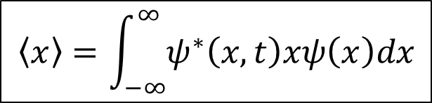
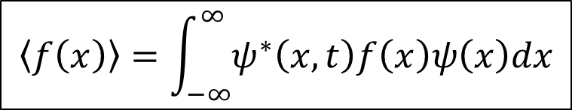
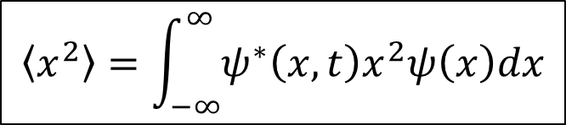
Expectation Values
$$\left\langle f\left(x\right)\right\rangle =\int_{−∞}^{∞}{ψ^{∗}\left(x,t\right)f\left(x\right)ψ\left(x\right)dx}$$
$$\left\langle x\right\rangle =\int_{−∞}^{∞}{ψ^{∗}\left(x,t\right)xψ\left(x\right)dx}$$
$$\left\langle x^{2}\right\rangle =\int_{−∞}^{∞}{ψ^{∗}\left(x,t\right)x^{2}ψ\left(x\right)dx}$$
How about <p>?

Slide 16
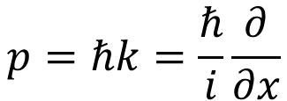
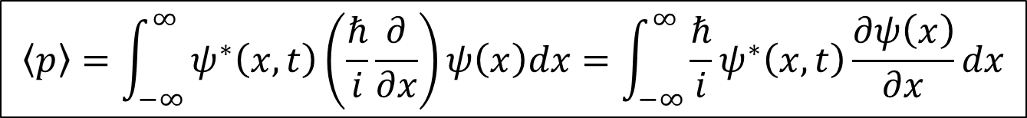
Expectation Values and Operators
$$p=ℏk=\frac{ℏ}{i}\frac{∂}{∂x}$$
$$\left\langle p\right\rangle =\int_{−∞}^{∞}{ψ^{∗}\left(x,t\right)\left(\frac{ℏ}{i}\frac{∂}{∂x}\right)ψ\left(x\right)dx}=\int_{−∞}^{∞}{\frac{ℏ}{i}ψ^{∗}\left(x,t\right)\frac{∂ψ\left(x\right)}{∂x}dx}$$
$$\left\langle p^{2}\right\rangle =\int_{−∞}^{∞}{ψ^{∗}\left(x,t\right)\left(\frac{ℏ}{i}\frac{∂}{∂x}\right)\left(\frac{ℏ}{i}\frac{∂}{∂x}\right)ψ\left(x\right)dx=−\int_{−∞}^{∞}{ℏ^{2}ψ^{∗}\left(x,t\right)\frac{∂^{2}ψ\left(x\right)}{∂x^{2}}dx}}$$

Slide 17

Example
Find $\left\langle p\right\rangle$ and $\left\langle p^{2}\right\rangle$ for the ground-state wave function of the infinite square well.

Slide 18

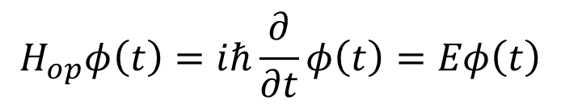
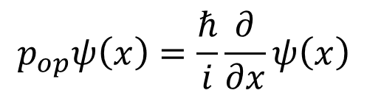
Operators in Quantum Mechanics
Position operator
$$x_{op}ψ\left(x\right)=xψ\left(x\right)$$
$$p_{op}ψ\left(x\right)=\frac{ℏ}{i}\frac{∂}{∂x}ψ\left(x\right)$$
Momentum operator
Hamiltonian (energy operator) in time-independent
$$H_{op}ψ\left(x\right)=\left(\frac{p_{op}^{2}}{2m}+V(x) \right)ψ\left(x\right)=−\frac{ℏ^{2}}{2m}\frac{∂^{2}ψ\left(x\right)}{∂x^{2}}+V\left(x\right)ψ\left(x\right)=Eψ\left(x\right)$$
Hamiltonian (energy operator) in time-dependent
$$H_{op}φ\left(t\right)=iℏ\frac{∂}{∂t}φ\left(t\right)=Eφ\left(t\right)$$

Slide 19
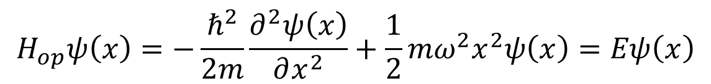
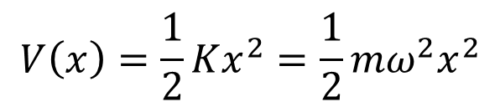
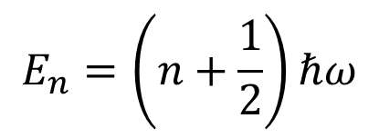
Simple Harmonic Oscillator
$$V\left(x\right)=\frac{1}{2}Kx^{2}=\frac{1}{2}mω^{2}x^{2}$$
$$H_{op}ψ\left(x\right)=−\frac{ℏ^{2}}{2m}\frac{∂^{2}ψ\left(x\right)}{∂x^{2}}+\frac{1}{2}mω^{2}x^{2}ψ\left(x\right)=Eψ\left(x\right)$$
$$E_{n}=\left(n+\frac{1}{2}\right)ℏω$$

Slide 20
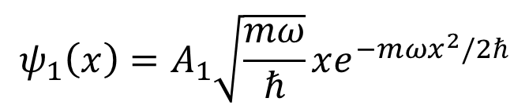

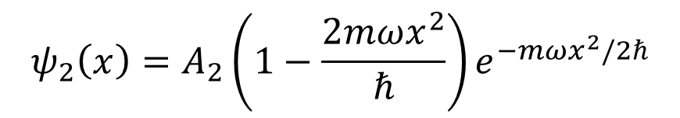
Simple Harmonic Oscillator
$$ψ_{0}\left(x\right)=A_{0}e^{−mωx^{2}/2ℏ}$$
$$ψ_{2}\left(x\right)=A_{2}\left(1−\frac{2mωx^{2}}{ℏ}\right)e^{−mωx^{2}/2ℏ}$$
$$ψ_{1}\left(x\right)=A_{1}\sqrt{\frac{mω}{ℏ}}xe^{−mωx^{2}/2ℏ}$$

Slide 21


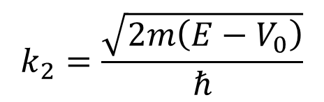
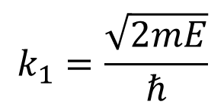
Reflection and Transmission
$$k_{1}=\frac{\sqrt{2mE}}{ℏ}$$
$$k_{2}=\frac{\sqrt{2m\left(E−V_{0}\right)}}{ℏ}$$
$$ψ_{1}\left(x\right)=Ae^{ik_{1}x}+Be^{−ik_{1}x}$$
$$ψ_{2}\left(x\right)=Ce^{ik_{2}x}+De^{−ik_{2}x}$$

Slide 22
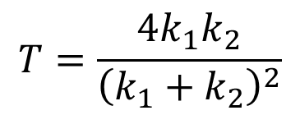
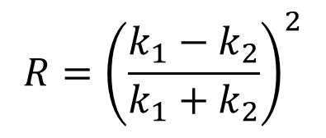
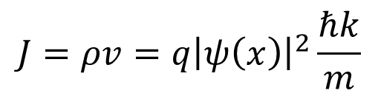

Reflection and Transmission
Current Density
$$R={\left(\frac{k_{1}−k_{2}}{k_{1}+k_{2}}\right)}^{2}$$
$$J=ρv=q{\left|ψ\left(x\right)\right|}^{2}\frac{ℏk}{m}$$
$$T=\frac{4k_{1}k_{2}}{{\left(k_{1}+k_{2}\right)}^{2}}$$
$$R+T=1$$

Slide 23


Reflection and Transmission
$$R=1$$
$$T=0$$

Slide 24
Reflection and Transmission

Slide 25
Potential Barrier

Slide 26
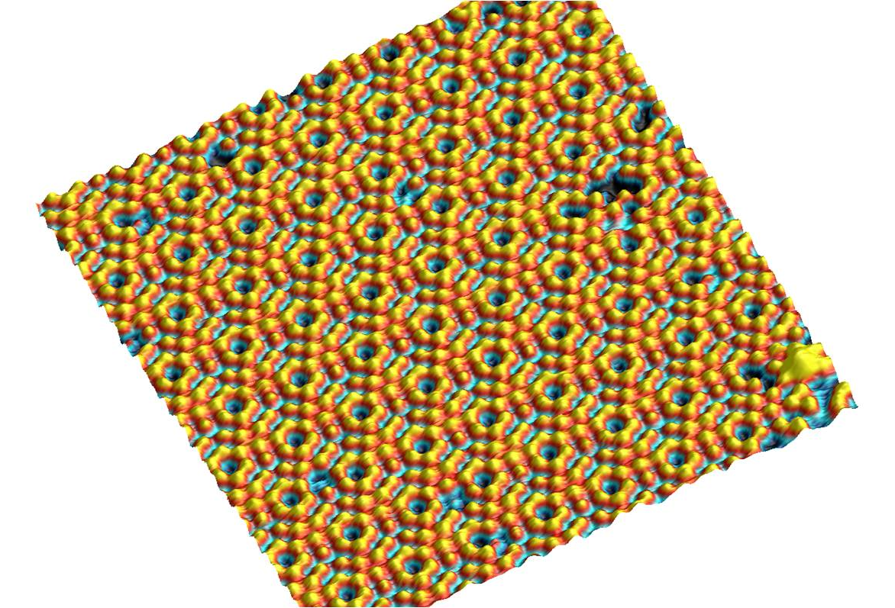
Scanning Tunneling Microscopy
A
Feedback loop
Si (111) 7x7 reconstruction
Image Credit: Andrew Yost

Slide 27
Scanning Tunneling Microscopy

