Slide 1
Chapter 5
The Wavelike Properties of Particles

Slide 2
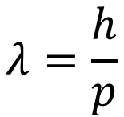
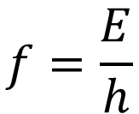
The de Broglie Hypothesis (1925)
Electrons could be considered as wave and the frequency and the wavelength are related to energy and momentum as;
$$f=\frac{E}{h}$$
$$λ=\frac{h}{p}$$
This gives physical interpretation of Bohr’s quantization of the angular momentum of the electron in hydrogenlike atoms.

Slide 3
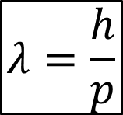

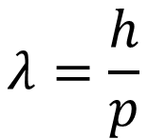

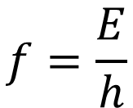
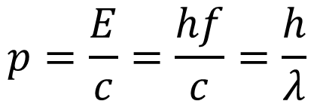


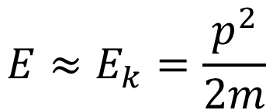
Review of E and P vs f and λ
Non-relativistic massive particle
Massive particle
$$λ=\frac{h}{p}$$
$$E≈E_{k}=\frac{p^{2}}{2m}$$
$$E=γmc^{2}=\sqrt{{\left(mc^{2}\right)}^{2}+{\left(pc\right)}^{2}}$$
$$p=\sqrt{2mE_{k}}$$
Massless particle (E&M wave)
$$p=\frac{E}{c}=\frac{hf}{c}=\frac{h}{λ}$$
$$E=pc$$
$$E=hf$$
$$f=\frac{E}{h}$$
$$λ=\frac{h}{p}$$

Slide 4
Example
Compute the de Broglie wavelength of an electron whose kinetic energy is 10 eV.

Slide 5
Quiz
How to test if electron has wave-property? Type in your creative answer.

Slide 6
Electron Double Slit Experiments
https://www.youtube.com/watch?v=7u_UQG1La1o

Slide 7
The Davisson-Germer Experiment (1927)

Slide 8
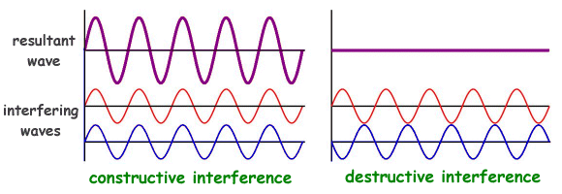
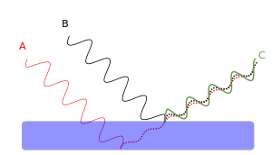

Interference/Diffraction with wave
$$nλ=2d sinθ$$
θ
d

Slide 9


Crystal lattice of atoms
$$nλ=2d sinθ$$
D is a intrinsic property of a particular crystal, a single value
d varies depend on the plane you are considering
d
d
D
d

Slide 10


Electron Diffraction
$$nλ=2d sinθ$$
d: spacing between certain set of planes
$$nλ=D sin2α$$
D: spacing between lattice points
The first diffraction angle (smallest measurable angle with constructive interference) is associated with the largest d, which is D.

Slide 11

Example
Calculate the constructive diffraction angle, $φ$, of Ni (D = 0.215 nm) for this particular crystal planes (indicated by red line), when using electrons with 54 eV energy. Assuming the crystal is square/cubic.

Slide 12
Electron Diffraction of Al Foil (1927)
G. P. Thomson (son of J. J. Thomson) shared the Nobel Prize in Physics in 1937 with Davisson
G. P. Thomson

Slide 13
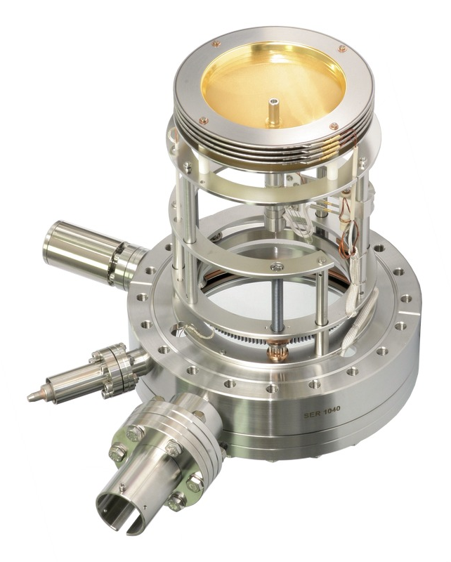
State-of-the-art electron diffraction instrument: Low Energy Electron Diffraction optics
Cu(001) crystal with 134 eV electron

Slide 14
Diffraction with Other Particles
Oxygen nuclei with proton
Cu with neutron
NaCl with neutron
LiF with He
All matter has wavelike as well as particlelike properties.

Slide 15
Example
Compute the wavelength of a neutron with kinetic energy of 0.0568 eV. Cu has lattice constant (atom-atom distance) of 0.36 nm. If you use this neutron beam to do the diffraction experiment, what would be the first angle you could see the diffraction?

Slide 16


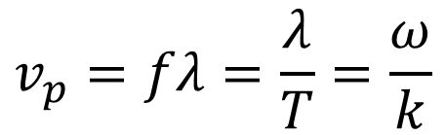
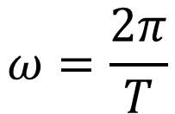

Wave Packets
The matter wave describe the probability of finding the particle
$$\frac{∂^{2}y}{∂x^{2}}=\frac{1}{v^{2}}\frac{∂^{2}y}{∂t^{2}}$$
Wave Equation
$$y\left(x,t\right)=y_{0}cos\left(kx−ωt\right)$$
$$k=\frac{2π}{λ}$$
Wave number
$$v_{p}=fλ=\frac{λ}{T}=\frac{ω}{k}$$
Phase velocity
$$ω=\frac{2π}{T}$$
Angular(phase) frequency

Slide 17
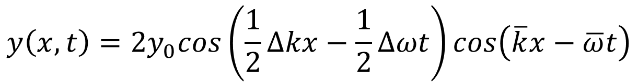
Wave Packet
$$y\left(x,t\right)=y_{0}cos\left(k_{1}x−ω_{1}t\right)+y_{0}cos\left(k_{2}x−ω_{2}t\right)$$
$$y\left(x,t\right)=2y_{0}cos\left(\frac{1}{2}∆kx−\frac{1}{2}∆ωt\right)cos\left(\overline{k}x−\overline{ω}t\right)$$
http://www.acs.psu.edu/drussell/Demos/superposition/beats.gif

Slide 18
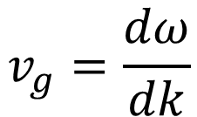
Wave Packet (adding more than two waves)
$$v_{g}=\frac{dω}{dk}$$

Slide 19
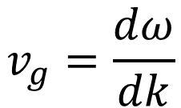
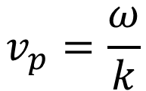
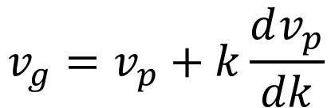
Group velocity and phase velocity
$$v_{g}=\frac{dω}{dk}$$
$$v_{p}=\frac{ω}{k}$$
Group velocity
Phase velocity
Directly related to particle velocity
Non-dispersive medium: phase velocity is independent of k
(sound waves in air, E&M wave in vacuum)
Dispersive medium: phase velocity varies with k
(E&M wave in medium, water wave, electron wave)
$$v_{g}=v_{p}+k\frac{dv_{p}}{dk}$$
https://upload.wikimedia.org/wikipedia/commons/thumb/b/bd/Wave_group.gif/440px-Wave_group.gif
https://upload.wikimedia.org/wikipedia/commons/c/c7/Wave_opposite-group-phase-velocity.gif

Slide 20

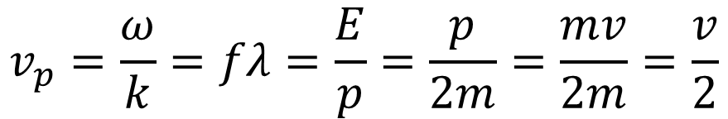
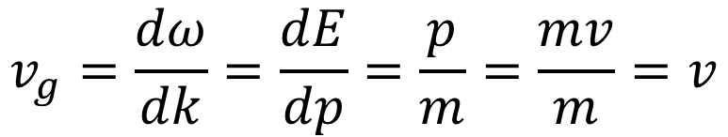
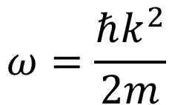
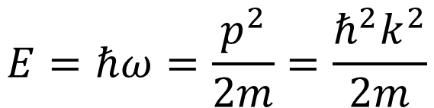
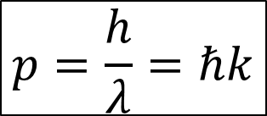
Particle Wave Packets
$$E=ℏω=\frac{p^{2}}{2m}=\frac{ℏ^{2}k^{2}}{2m}$$
$$E=hf=ℏω$$
$$p=\frac{h}{λ}=ℏk$$
$$ω=\frac{ℏk^{2}}{2m}$$
$$v_{p}=\frac{ω}{k}=fλ=\frac{E}{p}=\frac{p}{2m}=\frac{mv}{2m}=\frac{v}{2}$$
$$v_{g}=\frac{dω}{dk}=\frac{dE}{dp}=\frac{p}{m}=\frac{mv}{m}=v$$

Slide 21
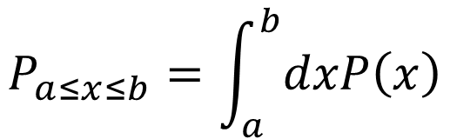

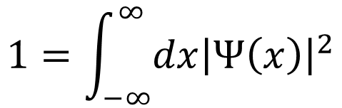
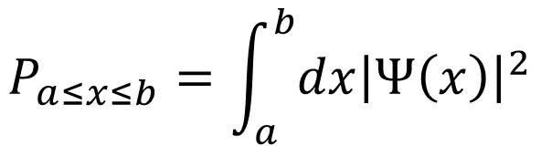
Probability interpretation of wave functions
$$P_{a≤x≤b}=\int_{a}^{b}{dx{\left|Ψ\left(x\right)\right|}^{2}}$$
$$1=\int_{−∞}^{∞}{dx{\left|Ψ\left(x\right)\right|}^{2}}$$
$$P_{a≤x≤b}=\int_{a}^{b}{dxP\left(x\right)}$$
$$P\left(x\right)dx=dx{\left|Ψ\left(x\right)\right|}^{2}$$

Slide 22
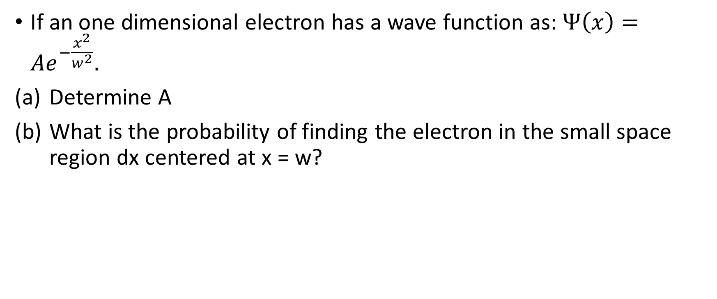
Example
If an one dimensional electron has a wave function as: $Ψ\left(x\right)=Ae^{−\frac{x^{2}}{w^{2}}}.$
Determine A
What is the probability of finding the electron in the small space region dx centered at x = w?

Slide 23


Uncertainty Relation (Classical)
$$∆k∆x\sim 1$$
$$∆ω∆t\sim 1$$

Slide 24
Example
The frequency of the alternating voltage produced at electric generating stations is carefully maintained at 60.00 Hz (in North America). The frequency is monitored on a digital frequency meter in the control room. For how long must the frequency be measured and how often can the display be updated if the reading is to be accurate to within 0.01 Hz?

Slide 25
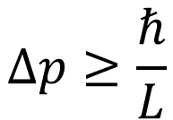



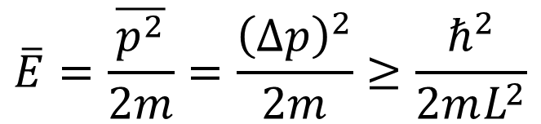
Uncertainty Relation (Quantum)
$$∆p∆x\sim ℏ$$
$$∆E∆t\sim ℏ$$
Particle confined in a 1D box with length of L
$$∆p≥\frac{ℏ}{L}$$
$$∆p∆x≥ℏ$$
$${\left(∆p\right)}^{2}={\left(p−\overline{p}\right)}_{ave}^{2}={\left(p^{2}−2p\overline{p}+{\overline{p}}^{2}\right)}_{ave}=\overline{p^{2}}−{\overline{p}}^{2}$$
$$\overline{E}=\frac{\overline{p^{2}}}{2m}=\frac{{\left(∆p\right)}^{2}}{2m}≥\frac{ℏ^{2}}{2mL^{2}}$$

Slide 26
Example
If the particle in a one-dimensional box of length L = 0.1 nm (about the diameter of an atom) is an electron, what will be its zero-point energy?

Slide 27

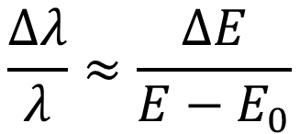
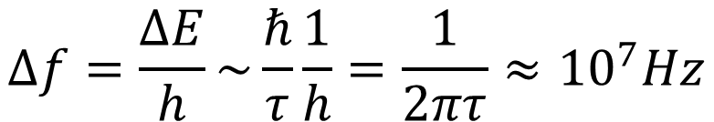
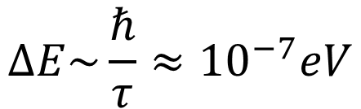
Lifetime of an energy state
Uncertainty Principle for energy and time
$$∆E∆t\sim ℏ$$
If for a particular atomic spectrum transition, the lifetime, τ, is in the order of 10 ns (${10}^{−8}s$), there is an energy uncertainty as:
$$∆E\sim \frac{ℏ}{τ}≈{10}^{−7}eV$$
Thus, the uncertainty in frequency of the emitted light is:
$$∆f=\frac{∆E}{h}\sim \frac{ℏ}{τ}\frac{1}{h}=\frac{1}{2πτ}≈{10}^{7}Hz$$
$$\frac{Δλ}{λ}≈\frac{ΔE}{E−E_{0}}$$
Then, the uncertainty in wavelength is:

Slide 28
Example
When you measure a spectrum emitted by He atom, you found out there is a peak width in intensity vs energy spectrum is around 0.1 meV. Assuming this peak width originates from the energy uncertainty of the excited state of He atom, find out the lifetime of the excited state of He atom.

Slide 29
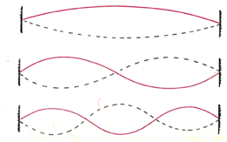
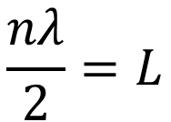
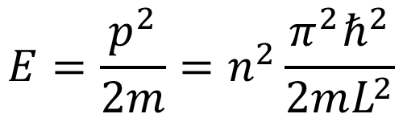
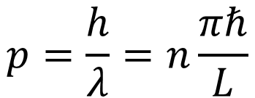
Spatial Confinement
Consider an electron is confined in a one-dimensional space with length of L.
$$\frac{nλ}{2}=L$$
Standing wave condition
$$p=\frac{h}{λ}=n\frac{πℏ}{L}$$
$$E=\frac{p^{2}}{2m}=n^{2}\frac{π^{2}ℏ^{2}}{2mL^{2}}$$

