Slide 1
Chapter 4
The Nuclear Atom

Slide 2
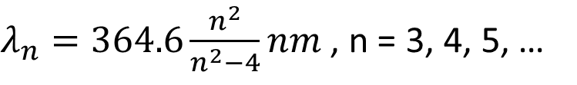
Atomic Spectra: Balmer series (1885)
Balmer series
$λ_{n}=364.6\frac{n^{2}}{n^{2}−4}nm$ , n = 3, 4, 5, …
Balmer suggested that his formula might be a special case of a more general expression applicable to the spectra of other elements when ionized to a single electron – hydrogenlike elements.

Slide 3

Atomic Spectra: Rydberg-Ritz formula (1908)
Rydberg-Ritz formula
$\frac{1}{λ_{mn}}=R\left(\frac{1}{m^{2}}−\frac{1}{n^{2}}\right)$, for n > m. $R_{H}=1.096776×{10}^{7}m^{−1}$
$$R_{∞}=1.097373×{10}^{7}m^{−1}$$
The hydrogen Balmer series reciprocal wavelengths are those given by Eq. 4-2 with m = 2 and n = 3, 4, 5, ….

Slide 4
Example
The hydrogen Balmer series reciprocal wavelengths are those given by Eq. 4-2 with m = 2 and n = 3, 4, 5, …. Other series of hydrogen spectral lines were found for m = 1 (by Lyman) and m = 3 (by Paschen). Compute the wavelengths of the first lines of the Lyman and Paschen series.

Slide 5
JJ Thomson’s Nuclear Model
Cannot explain the atomic spectra and cannot explain Rutherford’s experiment.

Slide 6
Rutherford’s Nuclear Model
(1913)
Rutherford and his students Geiger and Marsden found the α particle’s q/m value is half that of the proton.
Spectral line of α particle confirmed that it is helium nucleus.
It is found that some α particles were deflected as large as 90° or more, even 180° was possible.

Slide 7
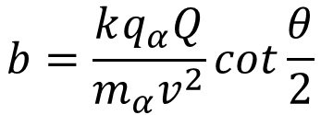
Rutherford’s Scattering Theory
$$b=\frac{kq_{α}Q}{m_{α}v^{2}}cot\frac{θ}{2}$$

Slide 8
Steps to find the relationship
Use initial and final momentum relationship, plot the isosceles triangle.
Use law of sine to find the relationship between the initial momentum and change of momentum
Use force at all position, find the change of momentum as function of angle.
Integrate it over time.
Change variable from time to angle
Use angular momentum conservation to replace angular velocity in integration.

Slide 9
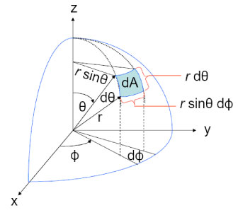
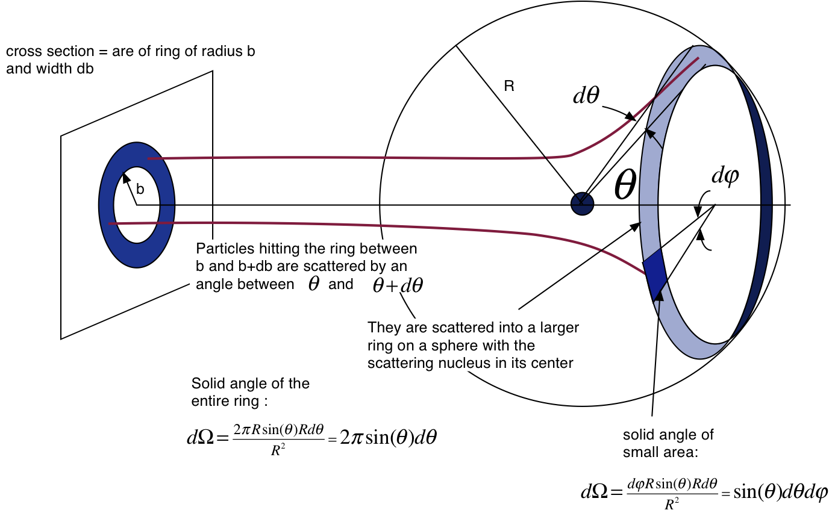

Cross section and Solid angle
Cross section
$$σ=πb^{2}$$

Slide 10

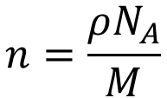
Scattered fraction
Scattered fraction larger than a certain scattering angle
$$n=\frac{ρN_{A}}{M}$$
$$f=πb^{2}nt$$

Slide 11

Example
Calculate the fraction of an incident beam of α particles of kinetic energy 5 MeV that Geiger and Marsden expected to see for θ ≥ 90° from a gold foil (Z = 79) ${10}^{−6}$ m thick. The density of gold is 19.3 $g/{cm}^{3}$; M = 197.

Slide 12
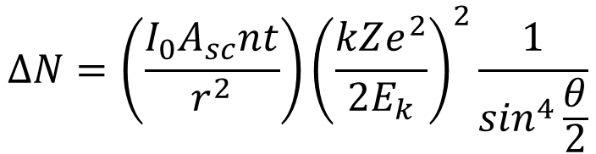
More quantitative agreements
$$∆N=\left(\frac{I_{0}A_{sc}nt}{r^{2}}\right){\left(\frac{kZe^{2}}{2E_{k}}\right)}^{2}\frac{1}{\sin^{4}\frac{θ}{2}}$$

Slide 13
Steps to get this relationship
Find the infinitesimal area of the impact area would scattered to the detector for a single nuclear.
Find the fraction of the particle scattered to the detector for a foil.
Find the number of the particle scattered to the detector, considering a thickness of the metal foil.
Need to use the relationship between the area of the detector and the solid angle.

Slide 14

Example
A beam of α particles with $E_{k}$ = 6.0 MeV impinges on a silver foil 1.0 μm thick. The beam current is 1.0 nA. How many α particles will be counted by a small scintillation detector of area equal to 5 ${mm}^{2}$ located 2.0 cm from the foil at an angle of 75°? (For Silver Z = 47, ρ = 10.5 $gm/{cm}^{3}$, and M = 108).

Slide 15
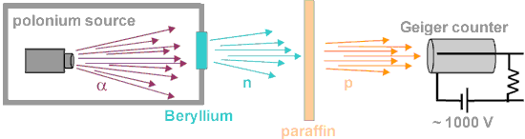
Discoveries of proton and neutron
Proton: Rutherford (~1920)
Change one element to another by emitting hydrogen nuclei.
The emitted hydrogen nuclei were later (late 20s) referred as proton, which was first coined by Rutherford in 1920.
Neutron: Chadwick (1932)

Slide 16
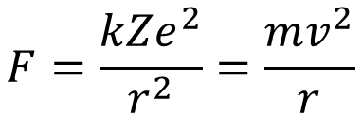
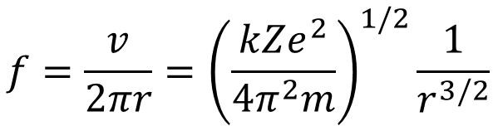
Nuclear Model of Hydrogen Atom
Classical Mechanics
Classical Electromagnetism
$$f=\frac{v}{2πr}={\left(\frac{kZe^{2}}{4π^{2}m}\right)}^{1/2}\frac{1}{r^{3/2}}$$
$$F=\frac{kZe^{2}}{r^{2}}=\frac{mv^{2}}{r}$$
Electrons could orbit at any value of r.
Electrons with acceleration would emit radiation as E&M wave.

Slide 17
Quiz
If the hydrogen atom (one electron orbiting around a proton) follows the classical theory, what kind of atomic spectrum you are expecting to measure?
Discrete spectrum as we discussed in the beginning of the chapter
Continuous spectrum, in which all wavelength has certain spectrum intensity.
Bands like spectrum, in which certain energy range, as bands of energy, show intensity while other energies with zero intensity.

Slide 18

Bohr Model of Hydrogen Atom (1913)
Bohr’s postulates
Electrons could move in certain orbits without radiating – stationary state.
The atom radiates when the electron makes a transition from one stationary state to another and that the frequency f of the emitted radiation is related to the energy difference between them.
In the limit of large orbits and large energies, quantum calculations must agree with classical calculations.
$$hf=E_{i}−E_{f}$$

Slide 19
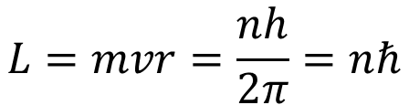
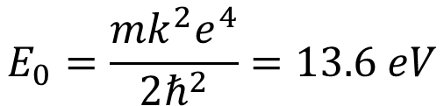
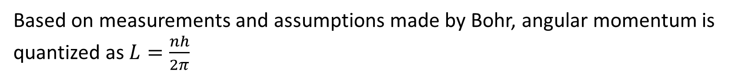
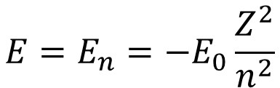
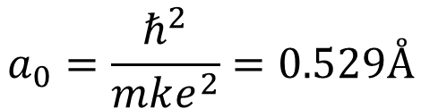
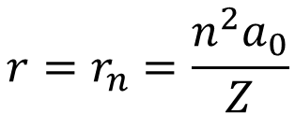
Stationary State/Orbital in Hydrogen Atom
Based on measurements and assumptions made by Bohr, angular momentum is quantized as $L=\frac{nh}{2π}$
$$L=mvr=\frac{nh}{2π}=nℏ$$
$$r=r_{n}=\frac{n^{2}a_{0}}{Z}$$
$$a_{0}=\frac{ℏ^{2}}{mke^{2}}=0.529Å$$
where
(Bohr radius)
$$E=E_{n}=−E_{0}\frac{Z^{2}}{n^{2}}$$
$$E_{0}=\frac{mk^{2}e^{4}}{2ℏ^{2}}=13.6 eV$$
where

Slide 20
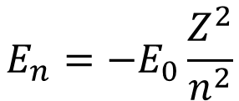



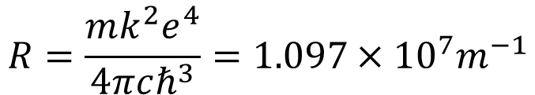
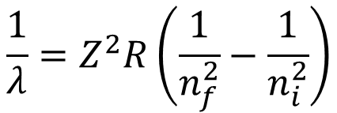
Bohr’s Radiation Energy
$$E_{n}=−E_{0}\frac{Z^{2}}{n^{2}}$$
$$hf=E_{i}−E_{f}$$
$$\frac{1}{λ}=Z^{2}R\left(\frac{1}{n_{f}^{2}}−\frac{1}{n_{i}^{2}}\right)$$
$$R=\frac{mk^{2}e^{4}}{4πcℏ^{3}}=1.097×{10}^{7}m^{−1}$$
where
Recall, from measurements
$$R_{H}=1.096776×{10}^{7}m^{−1}$$
$$R_{∞}=1.097373×{10}^{7}m^{−1}$$

Slide 21
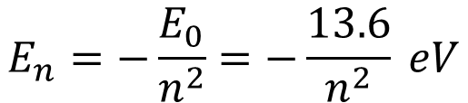
Bohr’s Radiation Energy in Hydrogen Atom
$$E_{n}=−\frac{E_{0}}{n^{2}}=−\frac{13.6}{n^{2}} eV$$

Slide 22

Example
Compute the wavelength of the $H_{β}$ spectral line, that is, the second line of the Balmer series predicted by Bohr’s model. The $H_{β}$ line is emitted in the transition from $n_{i}=4$ to $n_{f}=2$.

Slide 23
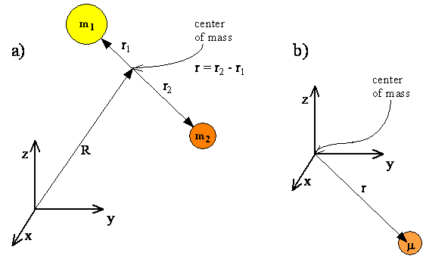
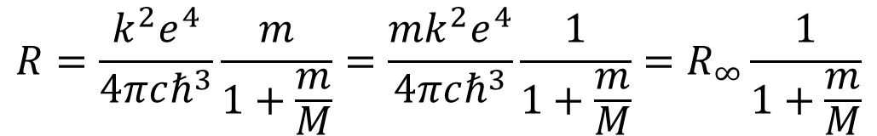
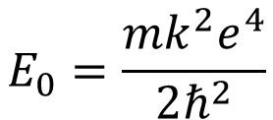
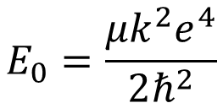
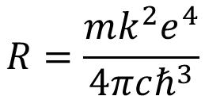
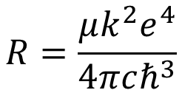
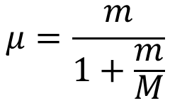
Reduced Mass Correction
$$R=\frac{mk^{2}e^{4}}{4πcℏ^{3}}$$
$$R=\frac{μk^{2}e^{4}}{4πcℏ^{3}}$$
$$E_{0}=\frac{mk^{2}e^{4}}{2ℏ^{2}}$$
$$E_{0}=\frac{μk^{2}e^{4}}{2ℏ^{2}}$$
$$μ=\frac{m}{1+\frac{m}{M}}$$
$$R=\frac{k^{2}e^{4}}{4πcℏ^{3}}\frac{m}{1+\frac{m}{M}}=\frac{mk^{2}e^{4}}{4πcℏ^{3}}\frac{1}{1+\frac{m}{M}}=R_{∞}\frac{1}{1+\frac{m}{M}}$$

Slide 24

Example
Compute the Rydberg constants for H and He⁺ applying the reduced mass correction (m = $9.1094×{10}^{−31}kg$; $m_{p}=1.6726×{10}^{−27}kg$; $m_{α}=6.6447×{10}^{−27}kg$).

Slide 25
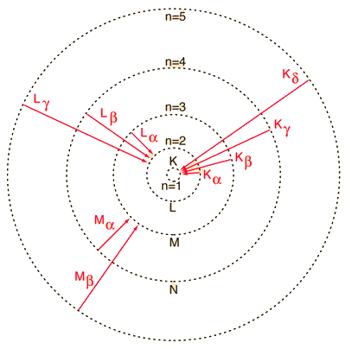
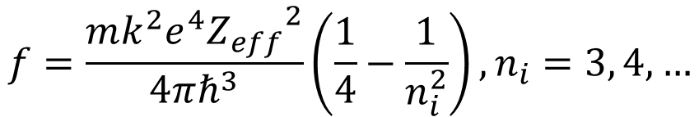
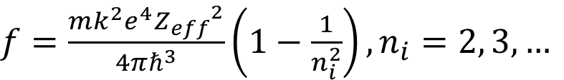
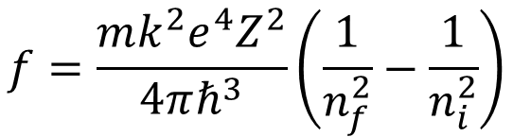
X-ray spectra
Bohr’s model
$$f=\frac{mk^{2}e^{4}Z^{2}}{4πℏ^{3}}\left(\frac{1}{n_{f}^{2}}−\frac{1}{n_{i}^{2}}\right)$$
K series
$f=\frac{mk^{2}e^{4}{Z_{eff}}^{2}}{4πℏ^{3}}\left(1−\frac{1}{n_{i}^{2}}\right), n_{i}=2, 3, …$
L series
$$f=\frac{mk^{2}e^{4}{Z_{eff}}^{2}}{4πℏ^{3}}\left(\frac{1}{4}−\frac{1}{n_{i}^{2}}\right), n_{i}=3, 4, …$$

Slide 26
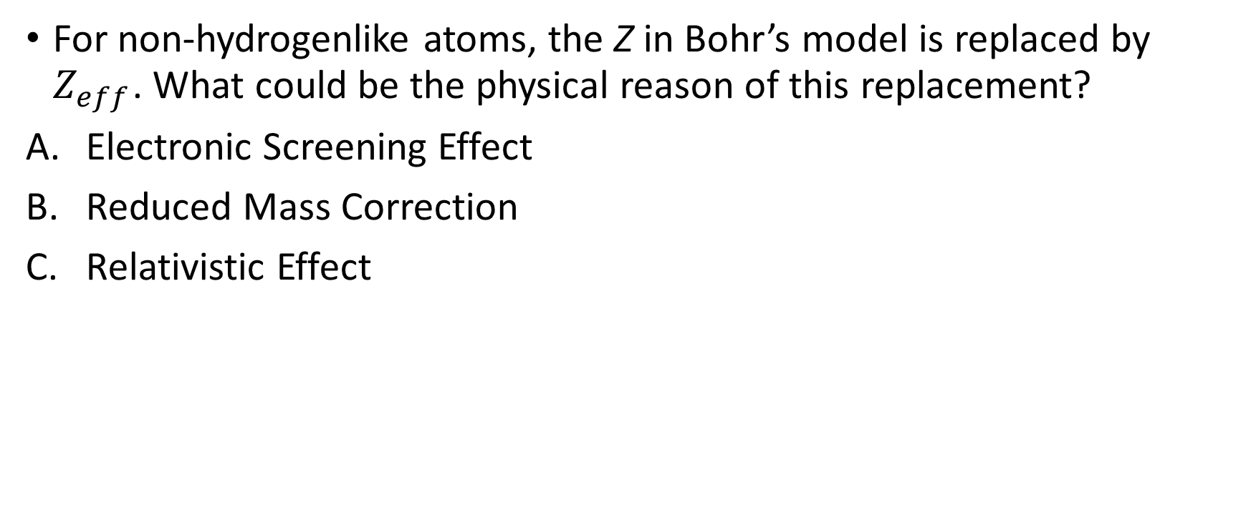
Quiz
For non-hydrogenlike atoms, the Z in Bohr’s model is replaced by $Z_{eff}$. What could be the physical reason of this replacement?
Electronic Screening Effect
Reduced Mass Correction
Relativistic Effect

Slide 27



X-ray spectra
Moseley plot
$$f^{1/2}=A_{n}Z_{eff}=A_{n}(Z−b)$$
K series
$$f^{1/2}=A_{1}(Z−1)$$
L series
$$f^{1/2}=A_{2}(Z−7.4)$$

Slide 28

Example
Calculate the wavelength of the $K_{α}$ line of molybdenum (Z = 42), and compare the result with the value $λ=0.0721 nm$ measured by Moseley and with the spectrum in Figure 3-15b (page 141)

Slide 29
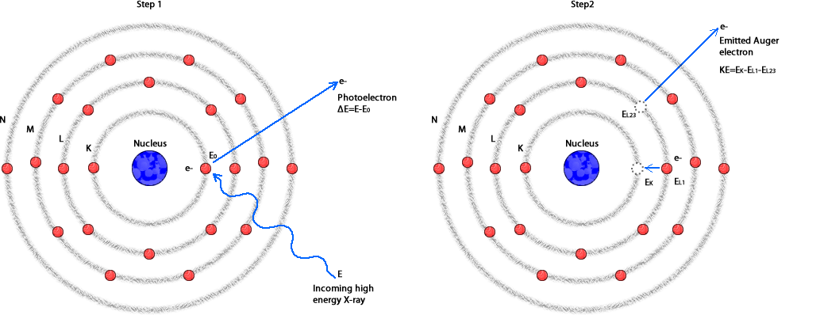
Auger Electrons

Slide 30
Franck-Hertz Experiment

Slide 31
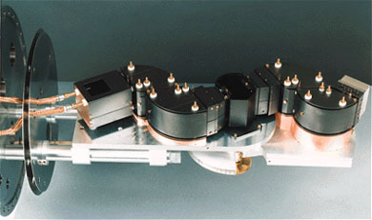
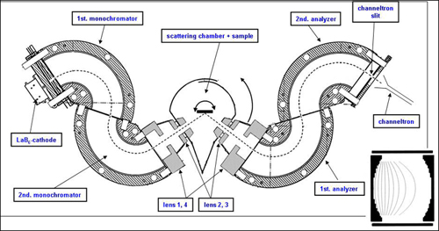
Electron Energy Loss Spectroscopy (EELS)

