Slide 1
Chapter 3
Quantization of Charge, Light, and Energy

Slide 2

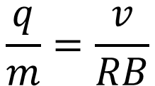
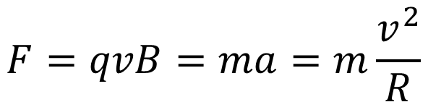
Discovery of the Electrons
J. J. Thomson in 1897. Before that, people already know “charge” and “current”. Also, scientists know “cathode” could emit “cathode rays” and they are negative electric charge.
Cathode rays in magnetic field
$$\overset{⃑}{F}=q\overset{⃑}{v}×\overset{⃑}{B}$$
In circular motion
$$F=qvB=ma=m\frac{v^{2}}{R}$$
$$\frac{q}{m}=\frac{v}{RB}$$

Slide 3

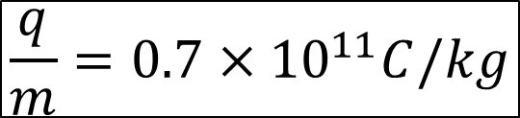
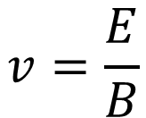

Discovery of the Electrons (1897)
Make the particles move straight by adjusting E and B
$${\overset{⃑}{F}}_{tot}={\overset{⃑}{F}}_{E}+{\overset{⃑}{F}}_{B}=0$$
$$qE=qvB$$
$$v=\frac{E}{B}$$
$$\frac{q}{m}=0.7×{10}^{11}C/kg$$

Slide 4


Millikan’s Experiment (1909): Measuring the Electric Charge
Use oil spray. The oil droplets are charged due to the friction before coming out of the nozzle.
The droplets are in the electric field produced by capacitor.
The motion of the droplets were measured and the charge were found to be always in integer multiples of a fundamental unit, e.
$$e=1.601×{10}^{−19}C$$
$$e=1.60217653×{10}^{−19}C$$

Slide 5
Thermal Radiation

Slide 6


Blackbody Radiation
A body that absorbs all radiation incident on it is called an “ideal blackbody”.
Stefan-Boltzmann Law (1879)
$$R=σT^{4}$$
$$σ=5.6703×{10}^{−8}W/m^{2}K^{4}$$
Radiation power
Object not ideal blackbodies:
$$R=εσT^{4}$$
Emissivity, always less than 1.

Slide 7

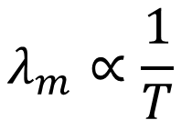
Blackbody Radiation Spectrum
$$λ_{m}∝\frac{1}{T}$$
or
$$λ_{m}T=2.898×{10}^{−3}m∙K$$

Slide 8
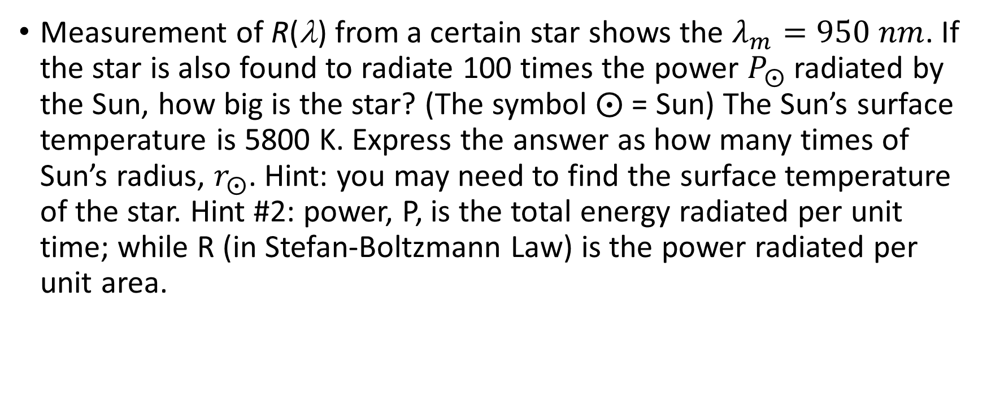
Example
Measurement of R(λ) from a certain star shows the $λ_{m}=950 nm$. If the star is also found to radiate 100 times the power $P_{⨀}$ radiated by the Sun, how big is the star? (The symbol $⨀$ = Sun) The Sun’s surface temperature is 5800 K. Express the answer as how many times of Sun’s radius, $r_{⨀}$. Hint: you may need to find the surface temperature of the star. Hint #2: power, P, is the total energy radiated per unit time; while R (in Stefan-Boltzmann Law) is the power radiated per unit area.

Slide 9
How to understand this?

Slide 10





Classical Kinetic Theory – Rayleigh-Jeans Equation
$$R\left(u\right)∝u(λ)$$
Energy density due to E&M wave
$$u\left(λ\right)=\overline{E}n(λ)$$
Average energy per mode
Number of modes per unit volume
$$n\left(λ\right)=8πλ^{−4}$$
$$\overline{E}=kT$$
$$u\left(λ\right)=kT8πλ^{−4}$$

Slide 11
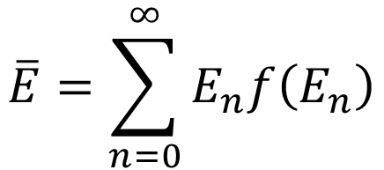





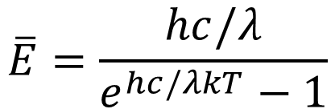

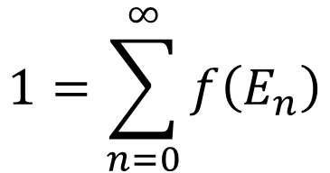
Planck’s Law
Average Energy in Classical Kinetic Theory
$$\overline{E}=\int_{0}^{∞}{Ef\left(E\right)dE}$$
$$1=\int_{0}^{∞}{f\left(E\right)dE}$$
Probability function (distribution function)
$$f\left(E\right)=Ae^{−E/kT}$$
Maxwell-Boltzmann distribution function
$$\overline{E}=kT$$
Planck’s assumption:
$$E_{n}=nε=nhf$$
$$n=0,1,2,…$$
$$\overline{E}=\sum_{n=0}^{∞}{E_{n}f\left(E_{n}\right)}$$
$$1=\sum_{n=0}^{∞}{f\left(E_{n}\right)}$$
$$\overline{E}=\frac{hc/λ}{e^{hc/λkT}−1}$$

Slide 12




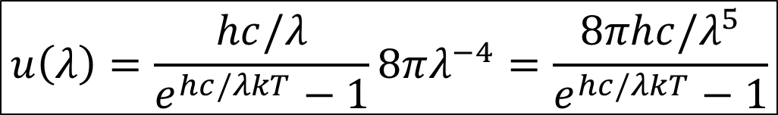
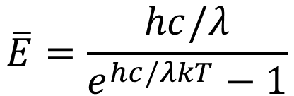
Planck’s Law
$$\overline{E}=\frac{hc/λ}{e^{hc/λkT}−1}$$
$$u\left(λ\right)=\overline{E}n(λ)$$
$$n\left(λ\right)=8πλ^{−4}$$
$$u\left(λ\right)=\frac{hc/λ}{e^{hc/λkT}−1}8πλ^{−4}=\frac{8πhc/λ^{5}}{e^{hc/λkT}−1}$$
For large λ
$$u\left(λ\right)=kT8πλ^{−4}$$
Rayleigh-Jeans Equation
$$h=6.626×{10}^{−34}J∙s$$

Slide 13
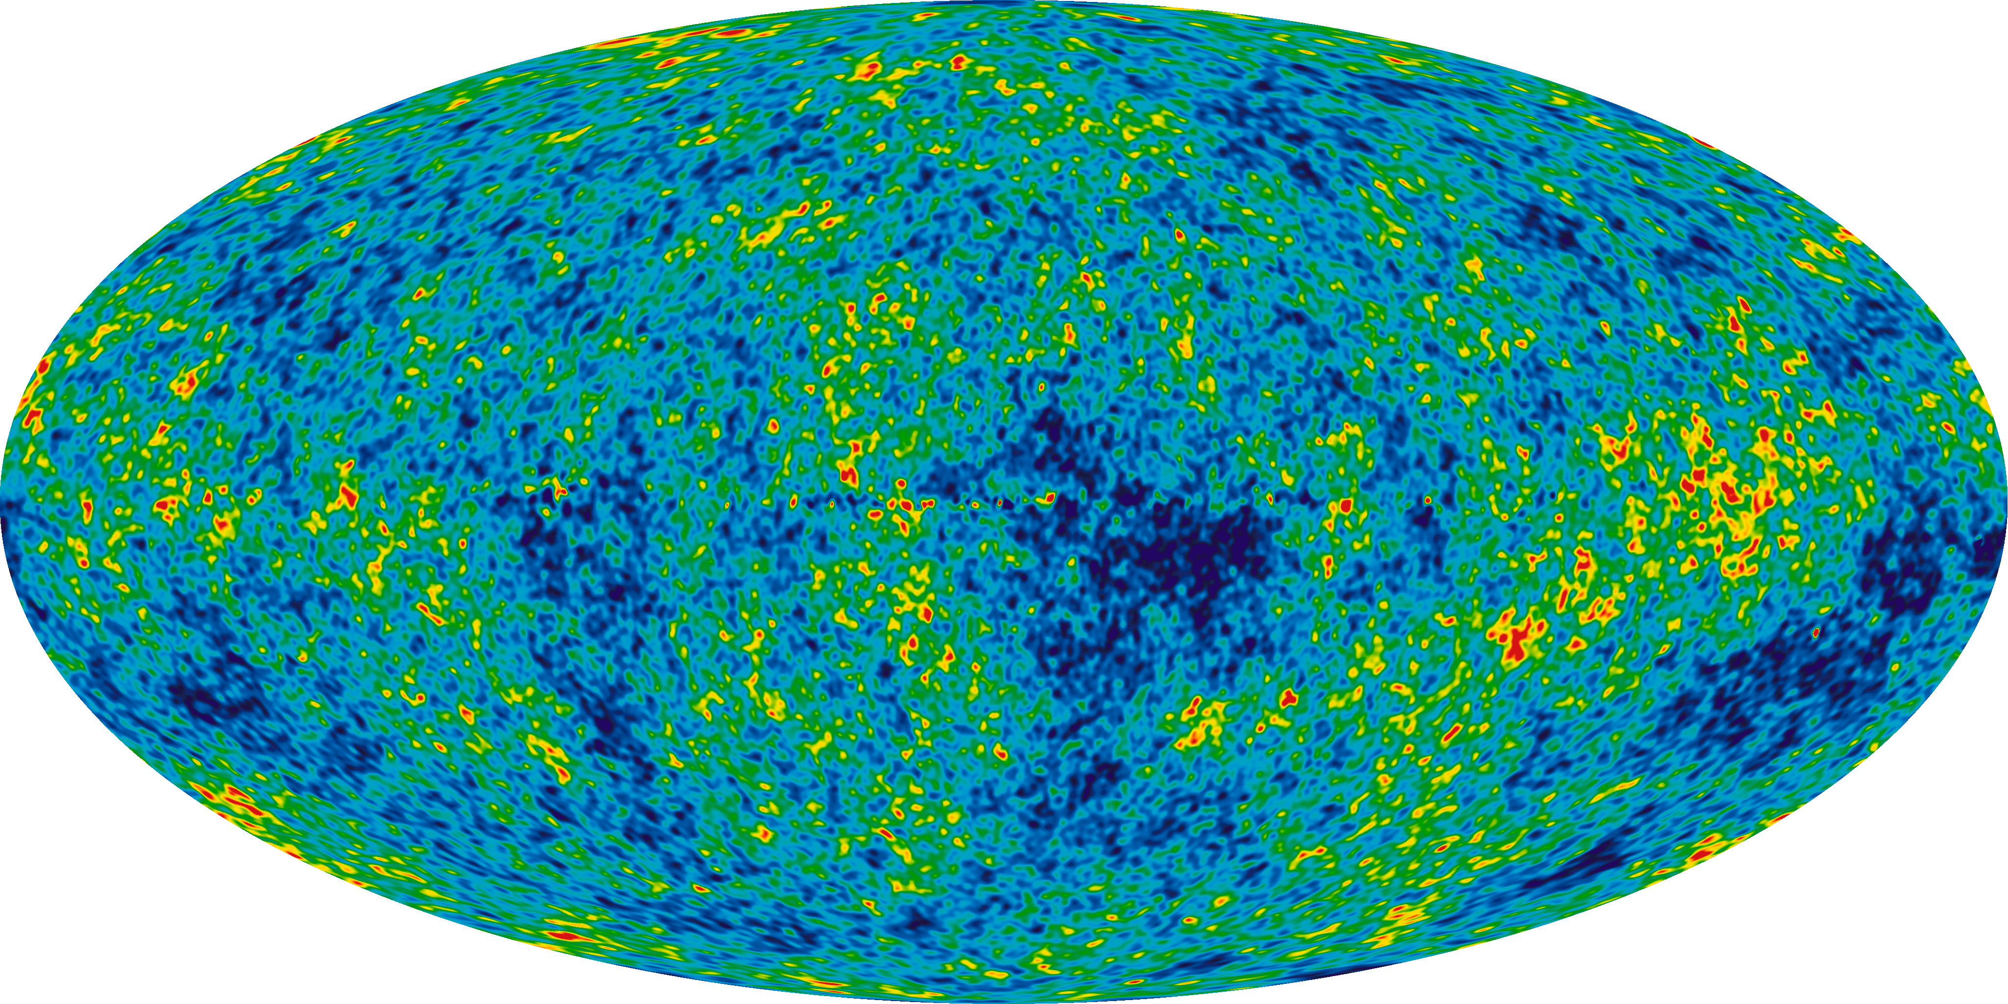
Cosmic microwave background radiation
All-sky map of the CMB, created from 9 years of WMAP data.
T = 2.725 K

Slide 14
Example
With the energy density per volume, u(λ), calculated by Planck, find the temperature dependence of the total energy density, U.

Slide 15
Photoelectric effect
Stopping voltage infers to the maximum kinetic energy of electrons
Higher current infers to more electrons reached the electrode.

Slide 16


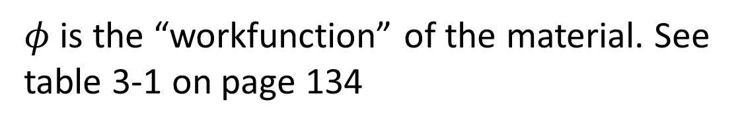
Einstein’s Photoelectric effect theory
$$E_{k,max}=eV_{0}=hf−φ$$
$φ$ is the “workfunction” of the material. See table 3-1 on page 134
$$φ=hf_{t}=\frac{hc}{λ_{t}}$$

Slide 17
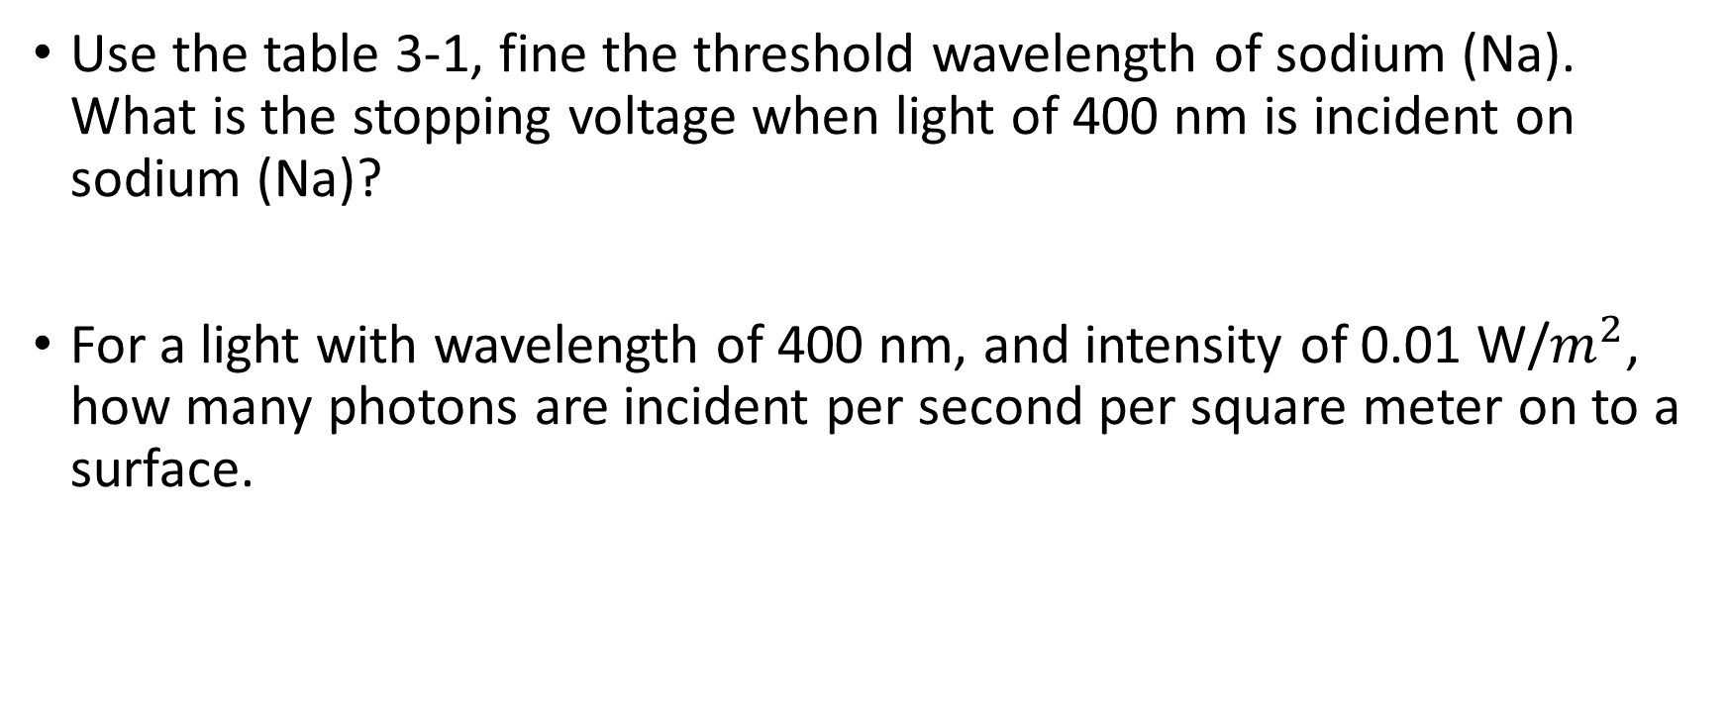
Example
Use the table 3-1, fine the threshold wavelength of sodium (Na). What is the stopping voltage when light of 400 nm is incident on sodium (Na)?
For a light with wavelength of 400 nm, and intensity of 0.01 W/$m^{2}$, how many photons are incident per second per square meter on to a surface.

Slide 18
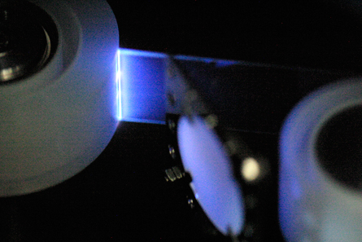
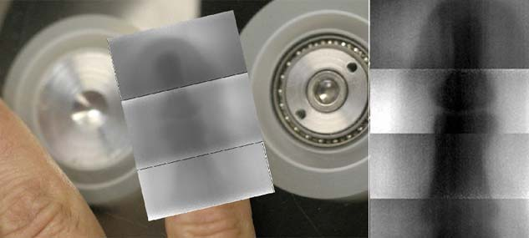
X-ray
1895
2008

Slide 19
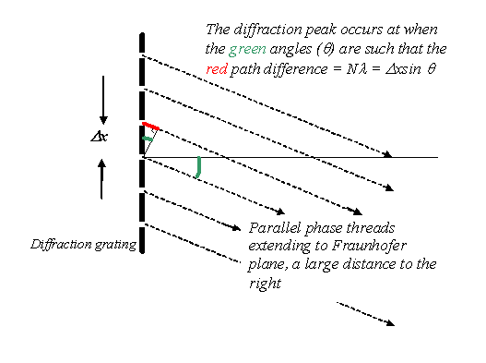


X-ray
NaCl crystal. Lattice constant: 0.56 nm
$$2dsinθ=nλ$$
$$λ≈{10}^{−10}m=0.1 nm$$
Wavelength of the light has to be comparable to the slit distance (scattering source distance).

Slide 20
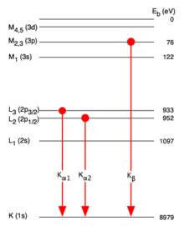
X-ray spectrum produced by vacuum tube

Slide 21
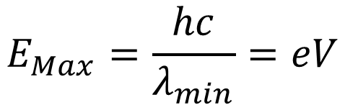
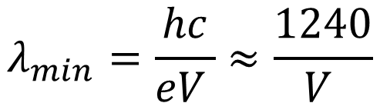
X-ray spectrum produced by vacuum tube
$$E_{Max}=\frac{hc}{λ_{min}}=eV$$
$$λ_{min}=\frac{hc}{eV }≈\frac{1240}{V }$$

Slide 22
Compton Effect

Slide 23
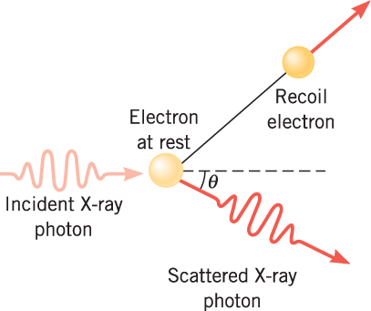
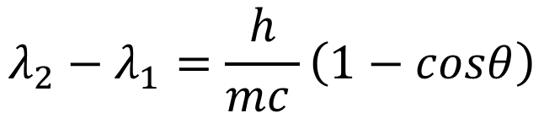
Compton Effect – inelastic collision between photon and electron
$$λ_{2}−λ_{1}=\frac{h}{mc }\left(1−cosθ\right)$$

