Slide 1
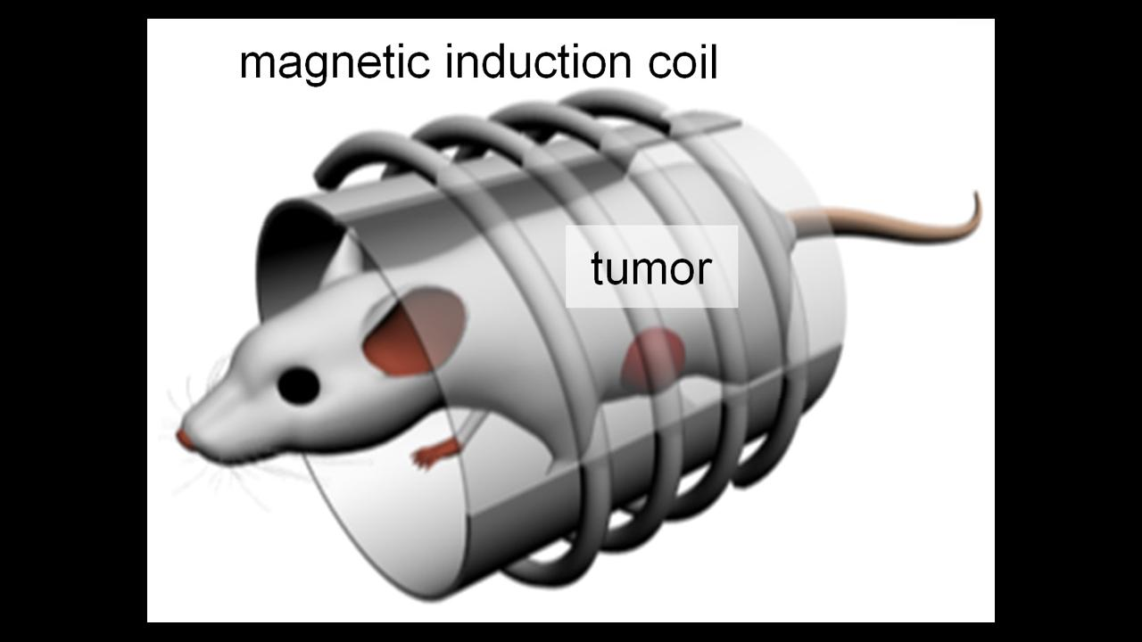
Magnetic Nanoparticle Killing Cancer Cells

Slide 2
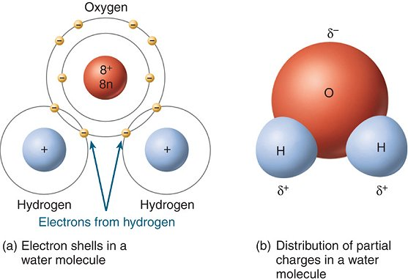
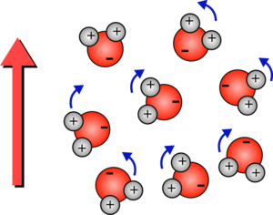

Dipole Moments and Field
$$\overset{⃑}{τ}=\overset{⃑}{p}×\overset{⃑}{E}$$

Slide 3
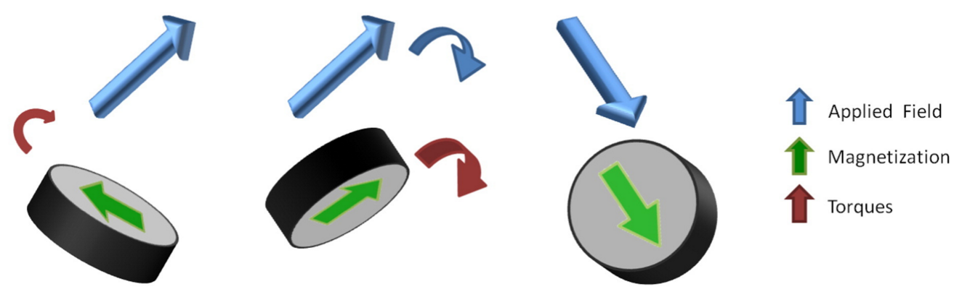
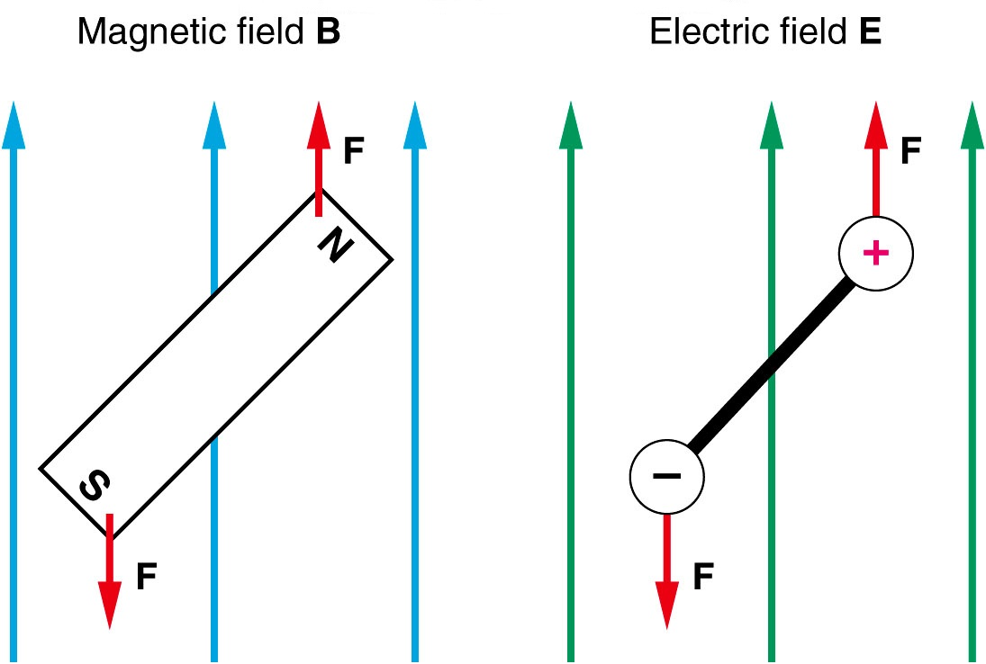
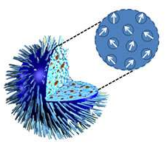


Dipole Moments and Field
$$\overset{⃑}{τ}=\overset{⃑}{m}×\overset{⃑}{B}$$
$$\overset{⃑}{τ}=\overset{⃑}{p}×\overset{⃑}{E}$$

Slide 4
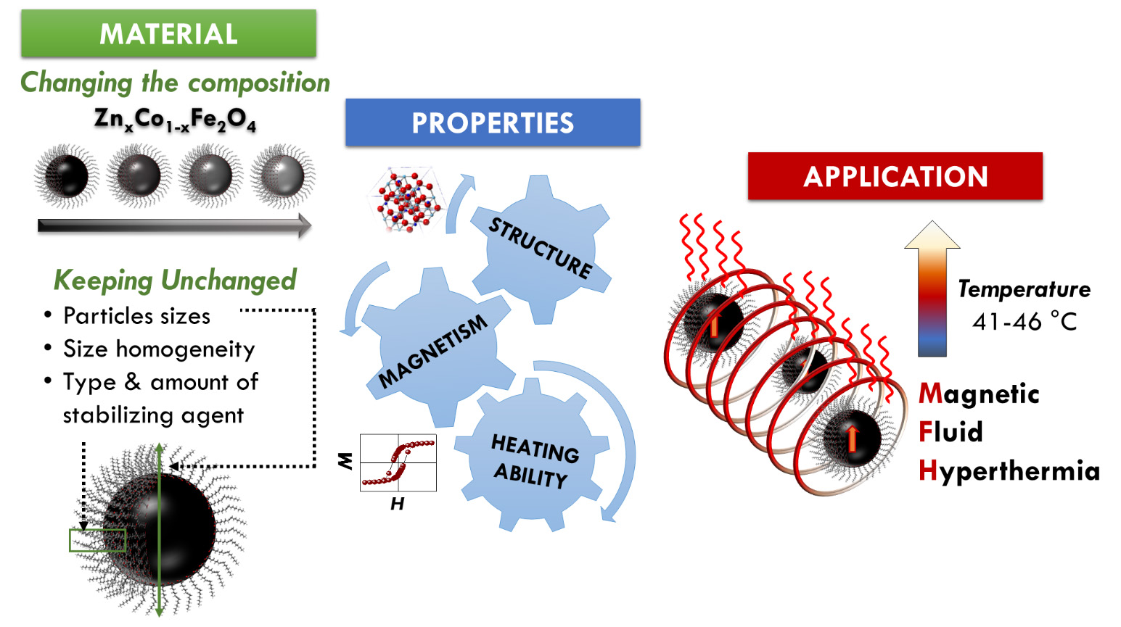
Applications

