Slide 1
PHYS 2320 Modern Physics
Instructor: TeYu Chien (簡德宇)
Lecture Time and Place: TR 9:35am-10:50am; Classroom Building 214
Office: Physical Science Building 224
Office Hours: TRF 1pm-2pm (you can also email me to arrange office meeting)
Office Phone: 766-6534
Website: http://physics.uwyo.edu/~teyu
Online Syllabus: http://physics.uwyo.edu/~teyu/class/Spring2016PHYS2320.html
Email: tchien@uwyo.edu

Slide 2
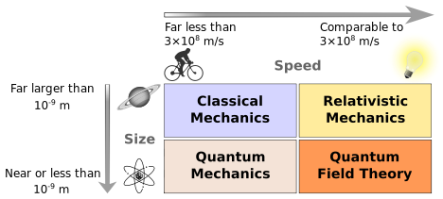
What is Modern Physics?
Among the branches of theory included in classical physics are:
Classical mechanics
Classical electrodynamics (Maxwell's Equations)
Classical thermodynamics
It is generally assumed that a consistent description of these observations will incorporate elements of quantum mechanics & relativity.
in practice, quantum effects typically involve distances comparable to atoms (roughly 10⁻⁹ m), while relativistic effects typically involve velocities comparable to the speed of light (roughly 10⁸ m/s)

Slide 3
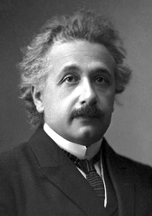
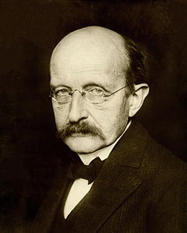
Modern Physics
Relativity
Something very fast
Quantum Theory
Something very small
German physicist Albert Einstein, founder of the
theory of relativity.
German physicist
Max Planck,
founder of
quantum theory.

Slide 4
Topics to be covered:
Relativity
Quantum Physics
Atomic Physics
Statistical Physics
Molecular Spectra
Solid State Physics
Nuclear Physics (optional)
Particle Physics (optional)
Astrophysics and Cosmology (optional)

Slide 5
Required Materials
Text: Modern Physics, Sixth Edition, by Paul A. Tipler/Ralph A. Llewellyn
Poll Everywhere for interactive in-class activities and attendance: You need to register at http://www.polleverywhere.com. See instruction below.

Slide 6
Grading
Exams: 50% (mid-term and final, 25% each)
Homework: 40%
Attendance: 10%
Total: 100%
Scale: A: (> 90%); A-: (86.66-89.99%); B+: (83.33-86.66%); B: (80-83.33%); B-: (76.66-79.99%); C+: (73.33-76.66%); C: (70-73.33%); C-: (66.66-69.99%); D+: (63.33-66.66%); D: (60-63.33%); F: (< 60%)

Slide 7
Policies
Partial credit: Partial credit will be given to solutions of the problems that are partially completed, have minimal algebra mistakes, wrong sign, or units. The steps in the solution must be presented, skipping steps means skipping points that you can earn, and no grade will be given to a problem showing only a solution (such as a number) without showing the intermediate steps to get there.
Homework: We will have homework for each chapter whenever we finish one chapter. Students may work in groups to discuss the homework, however, be sure to write the homework alone to prevent from plagiarism. Students involved with plagiarized homework will be investigated. Homework considered as plagiarism will be graded as zero point, even you are the original copy. No homework grade will be dropped. The deadline for each homework assignment is typically in the beginning of the class one week after it is assigned. Be advised not to wait till the last minute and use the office hour frequently. It is your responsibility to hand-in your homework before the deadline. Late homework will miss 10 % of points per day, and accumulative.

Slide 8
Policies
Bonus Homework: We will have one bonus homework, which will be hands out in the last week of the class. The due day will be on the final exam day right at the beginning of the exam. No late submission is allowed for the bonus homework.
Quiz: Quiz will be a short conceptual question asked in lecture through polleverywhere, but not every lecture. The quiz will not be included in grading, but will be count for attendance. The time for the quiz will be based on the progress of the lecture. So be sure to attend the lecture to take the quiz. The quiz will be conducted through Polleverywhere, please see below about how to sign it up correctly.
Attendance: Attendence will be counted with the quiz through the Polleverywhere. The attendance will be calculated based on the total number of votes made through the Polleverywhere through the semester (include both Quiz and Think About It). It is your responsibility to make sure you are in the polleverywhere system (by checking with me) and your vote is successfully inputed every time.

Slide 9
Policies
Disability Statement:If you have a physical, learning, or psychological disability and require accommodations, please let me know as soon as possible. Contact University Disability Support Services in SEO, room 330 Knight Hall.
Academic honesty: Academic dishonesty is defined in University Regulation 802, Revision 2 as “an act attempted or performed which misrepresents one’s involvement in an academic task in any way, or permits another student to misrepresent the latter’s involvement in an academic task by assisting the misrepresentation.? And there are rules and procedures to handle such cases, and serious penalties will be imposed. Note that a student who copies and a student who let’s another student copy are both covered by the university rules.

Slide 10
General expectations
Attend and participate in each lecture and do homework on time.
You are required to read each chapter before and after it is discussed in class.
Live up to your responsibility to understand the material presented. If you have difficulty of understanding it, please get good use of office hours.
Take notes during lectures as appropriate.
Complete reading assignments and homework.
Be ready for exams.
Work in compliance with the university code of academic honesty.
Ask questions. There are no stupid questions.
Have fun.

Slide 11
Exams:
Homework will contain mostly quantitative problems, whereas lectures will deal with largely conceptual, multiple-choice questions. Hence, the exams will contain both quantitative and conceptual problems. The exams will be closed book and closed notes. I will provide a "cheat sheet" with useful formulas and constants. No make-up exams will be given. All exams are mandatory and no grade will be dropped or replaced. There will be two exams: mid-term and final.
 | Time and Place | Covered Chapters
Mid-term | 3/10/2016 (Thursday), Place: TBA, 5:00 pm - 7:00 pm | Chapters 1-5
Final | 5/10/2016 (Tuesday), CR 214, 10:15 am - 12:15 pm | Chapters 6-10

Slide 12
Polleverywhere
Go to http://www.polleverywhere.com
Create an account. I need to be able to determine who you are, so use your uwyo email address to register, and your FULL name
De-select "I am an educator"
Select "United States" (not "United States - Education")
Once your account has been created, register your cell phone number (ignore this if you will use a laptop).
Go under "Settings" to add the number (with your area code). Follow instructions to certify your cell number.
Please allow me to see your name: Under "Settings" choose "Voter Registration". Select "Register as a voter". On the next page you should enter my email ("tchien@uwyo.edu").
Go to http://www.polleverywhere.com/teyu
Bring your cell phone or laptop to each class.
Standard text messaging rates may apply.

