Slide 1
Chapter 9: Current and resistance
What is electric current? And What is resistance?
Ohm’s law
Electromotive force
Symbols in circuits
Power in circuits

Slide 2
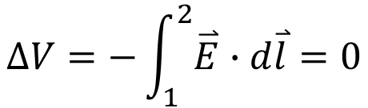
What is electric current?
In conductor:
If all charges are stationary ⬅➔ no electric field
$$∆V=−\int_{1}^{2}{\overset{⃑}{E}∙d\overset{⃑}{l}}=0$$
If all charges are stationary ⬅➔ no potential difference

Slide 3
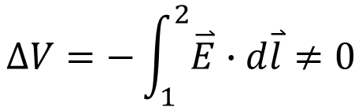
What is electric current?
In conductor:
If charges are moving ⬅➔ electric field
$$∆V=−\int_{1}^{2}{\overset{⃑}{E}∙d\overset{⃑}{l}}≠0$$
If charges are moving ⬅➔ potential difference
Electric field has the same direction with the current, despite the sign of the moving charges.

Slide 4
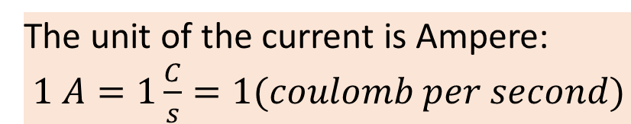
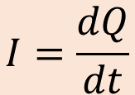
What is electric current?
Electric current is defined as how much Positive charge passing through a certain cross-section of materials.
$$I=\frac{dQ}{dt}$$
The unit of the current is Ampere:
$1 A=1\frac{C}{s}=1(coulomb per second)$

Slide 5
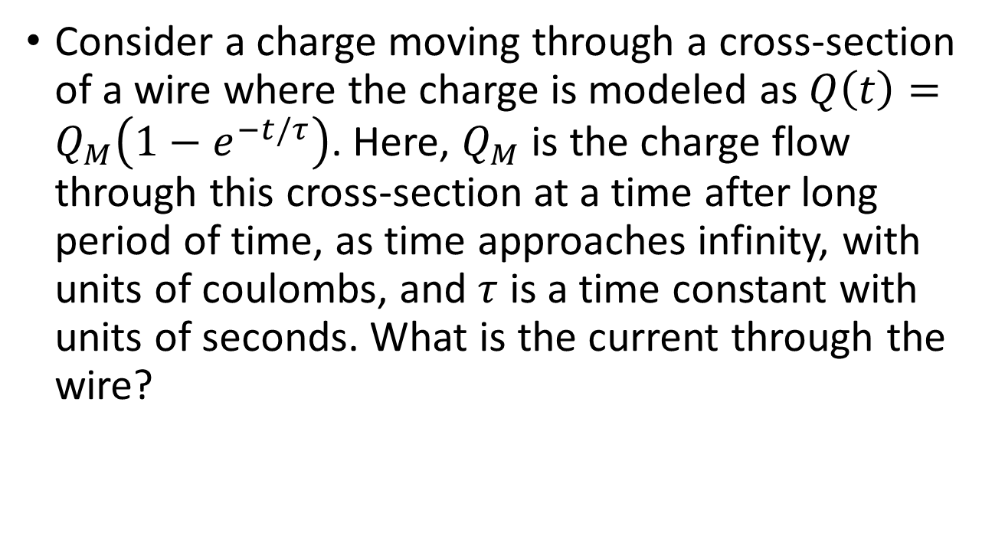
Example 9.2
Consider a charge moving through a cross-section of a wire where the charge is modeled as $Q\left(t\right)=Q_{M}\left(1−e^{−t/τ}\right)$. Here, $Q_{M}$ is the charge flow through this cross-section at a time after long period of time, as time approaches infinity, with units of coulombs, and $τ$ is a time constant with units of seconds. What is the current through the wire?

Slide 6
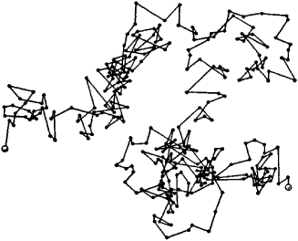
What is resistance?
We say: charges could move freely in conductor. But how free?
Brownian Motion: random walk

Slide 7
What is resistance?
With electric field:
Black: electron motion without electric field
Red: electron motion with electric field

Slide 8
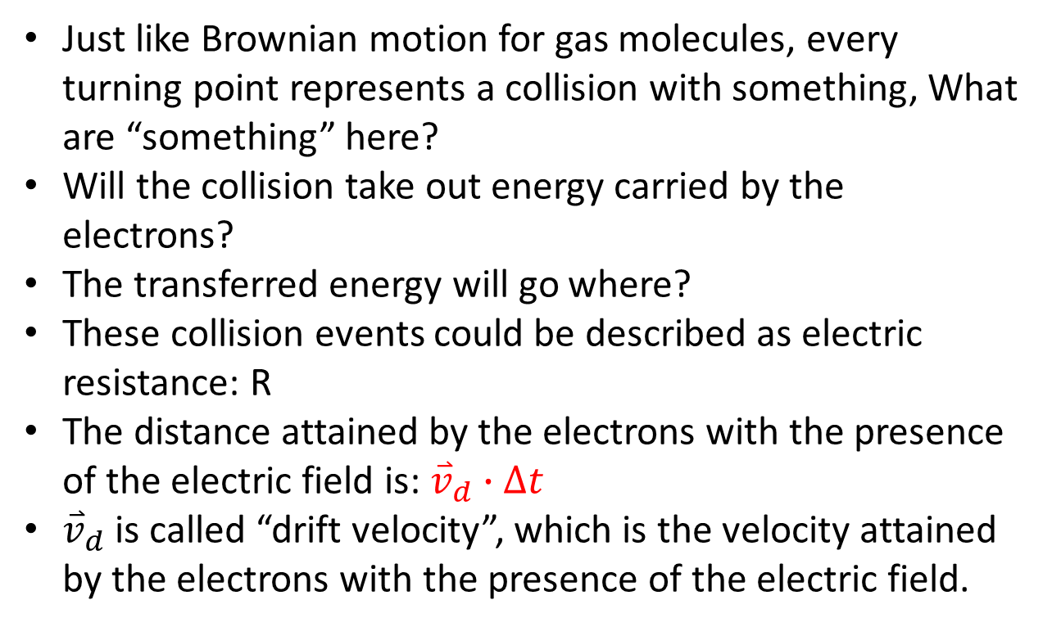
What is resistance?
Just like Brownian motion for gas molecules, every turning point represents a collision with something, What are “something” here?
Will the collision take out energy carried by the electrons?
The transferred energy will go where?
These collision events could be described as electric resistance: R
The distance attained by the electrons with the presence of the electric field is: ${\overset{⃑}{v}}_{d}∙∆t$
${\overset{⃑}{v}}_{d}$ is called “drift velocity”, which is the velocity attained by the electrons with the presence of the electric field.

Slide 9












What is “flux”? And What is “electric flux”?
Flux: How much “something” flows through a certain area.
Electric flux: How much electric field (lines) flow through a certain area.
$$\overset{⃑}{v}$$
$$a$$
$$\frac{dV}{dt}=a∙\left|\overset{⃑}{v}\right|=A∙cosθ∙\left|\overset{⃑}{v}\right|=\overset{⃑}{v}∙A\hat{n}=\overset{⃑}{v}∙\overset{⃑}{A}$$
$$A$$
$$θ$$
$$a$$
$$\hat{n}$$
$$A$$
$$flux=\overset{⃑}{v}∙\overset{⃑}{A}$$
$$\overset{⃑}{v}$$
$$θ$$
$$\hat{n}$$

Slide 10
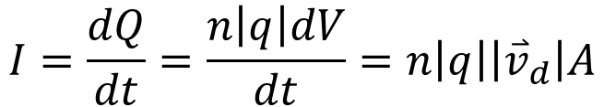
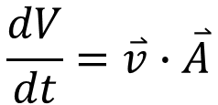

What is current?
Volume flux:
$$\frac{dV}{dt}=\overset{⃑}{v}∙\overset{⃑}{A}$$
$$I=\frac{dQ}{dt}=\frac{n\left|q\right|dV}{dt}=n\left|q\right|\left|{\overset{⃑}{v}}_{d}\right|A$$
Current:
$$I=n\left|q\right|\left|{\overset{⃑}{v}}_{d}\right|A$$

Slide 11
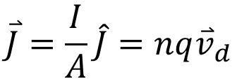

What is current density?
$$\overset{⃑}{J}=\frac{I}{A}\hat{J}=n{q\overset{⃑}{v}}_{d}$$
or
$$dI=\overset{⃑}{J}∙d\overset{⃑}{A}=JdAcosθ$$

Slide 12
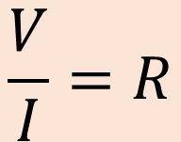

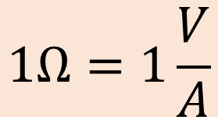
Ohm’s law
$$\frac{V}{I}=R$$
$$I∝V$$
(Resistance)
$$1Ω=1\frac{V}{A}$$
The unit of the resistance is Ohm, Ω:
The resistance represents how difficult the current flows

Slide 14


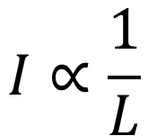


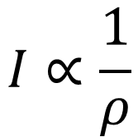
Ohm’s law
Let’s look at the current, I
$$I∝\frac{1}{L}$$
Long
Short
Small
Big
$$I∝A$$
$$I∝\frac{1}{ρ}$$
Cu
Wood
$$I∝ΔV$$
$$ΔV=1V$$
$$ΔV=10V$$

Slide 15
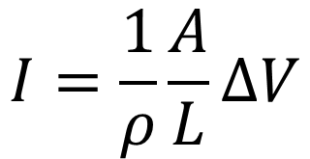
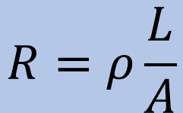

Ohm’s law
Let’s look at the current, I
$$I=\frac{1}{ρ}\frac{A}{L}ΔV$$
Long
Short
Small
Big
$$\frac{V}{I}=R$$
Cu
Wood
$$R=ρ\frac{L}{A}$$
Resistivity
See table 25.1 (page 823)
The unit of resistivity is: Ωm
$$ΔV=1V$$
$$ΔV=10V$$

Slide 16

Example 9.5
Calculate the current density, resistance, and electrical field of a 5-m long cylindrical copper wire with a diameter of 2.053 mm carrying a current of I = 10 mA. The resistivity of copper is $ρ=1.68×{10}^{−8}Ω∙m$.

Slide 17
Quiz
We learned that the resistance of a piece of material is a function of length, L, cross-section area, A, and material dependent resistivity, ρ.
Consider a copper wire with length L, cross-section area A, with a resistance R. Now, this copper wire is elongated to 2L, thus the cross-section reduced to A/2 (volume does not change). What is the resistance of the copper wire after the elongation?
(a) 4R
(b) 2R
(c) R
(d) R/2
(e) R/4

Slide 18
Example
What diameter must a copper wire have if its resistance is to be the same as that of an equal length of aluminum wire with diameter 3.26 mm?
An aluminum cube has sides of length 1.80 m. What is the resistance between two opposite faces of the cube?

Slide 19
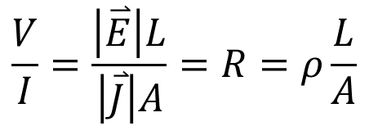
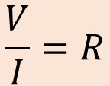
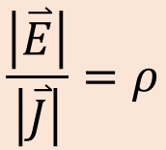
Ohm’s law: Another form
Ohm’s law
$$\frac{V}{I}=R$$
$$\frac{V}{I}=\frac{\left|\overset{⃑}{E}\right|L}{\left|\overset{⃑}{J}\right|A}=R=ρ\frac{L}{A}$$
$$\frac{\left|\overset{⃑}{E}\right|}{\left|\overset{⃑}{J}\right|}=ρ$$
Ohm’s law in microscopic view

Slide 20
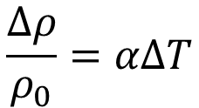
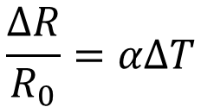
Temperature dependence
$$\frac{Δρ}{ρ_{0}}=αΔT$$
$$\frac{ΔR}{R_{0}}=αΔT$$
Let’s use “linear approximation”

Slide 21
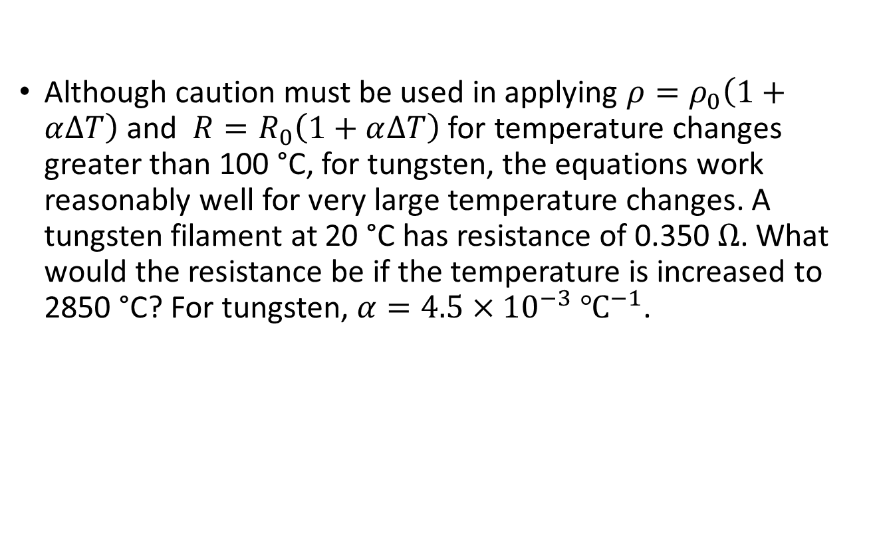
Example 9.6
Although caution must be used in applying $ρ=ρ_{0}\left(1+α∆T\right)$ and $R=R_{0}\left(1+α∆T\right)$ for temperature changes greater than 100 °C, for tungsten, the equations work reasonably well for very large temperature changes. A tungsten filament at 20 °C has resistance of 0.350 $Ω$. What would the resistance be if the temperature is increased to 2850 °C? For tungsten, $α=4.5×{10}^{−3} ℃^{−1}$.

Slide 22
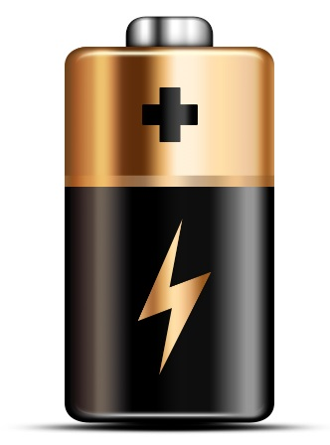
Electromotive force (emf, ε)
A circuit is a closed connections many electronic devices.
Current is flowing from high electric potential toward low electric potential
In a circuit, the current is usually kept flowing (steady state). There much be something in the circuit serves as “electric potential pump”. Such as Batteries (Electrochemical reaction)

Slide 23
Resistance ➔ Potential drop

Slide 24




Internal resistance in battery (source)
Almost all materials have resistance, include materials in battery.
➔ Battery has internal resistance (r):
$$r$$
$$ε$$
$$V$$
$$V=ε−I∙r$$

Slide 26

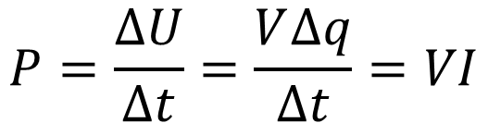
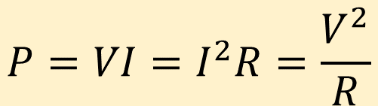

Power in circuit
$$P=\frac{∆U}{∆t}=\frac{V∆q}{∆t}=VI$$
$$P=VI$$
use
$$V=IR$$
$$P=VI=I^{2}R=\frac{V^{2}}{R}$$
Which to use? Depends on what you know.

Slide 27
Example 9.9
A DC winch motor is rated at 20.00 A with a voltage 0f 115 V. When the motor is running at its maximum power, it can lift an object with a weight of 4900.00 N a distance of 10.00 M, in 30.00 s, at a constant speed. (a) What is the power consumed by the motor? (b) What is the power used in lifting the object? Ignore air resistance. (c) Assuming that the difference in the power consumed by the motor and the power used lifting the object are dissipated as heat by the resistance of the motor, estimate the resistance of the motor.

