Slide 1
Chapter 8: Capacitance
Capacitor: a device store electric energy
How to define capacitance
In parallel and/or in series
Electric energy stored in a capacitor
Dielectric materials

Slide 2
Capacitor: a device store electric energy
Charging
I (gradually becomes zero)
q
(gradually reach the maximum amount)
-q
(gradually reach the maximum amount)
Discharging
I (gradually becomes zero)
q
(gradually reach zero)
-q
(gradually reach zero)

Slide 3
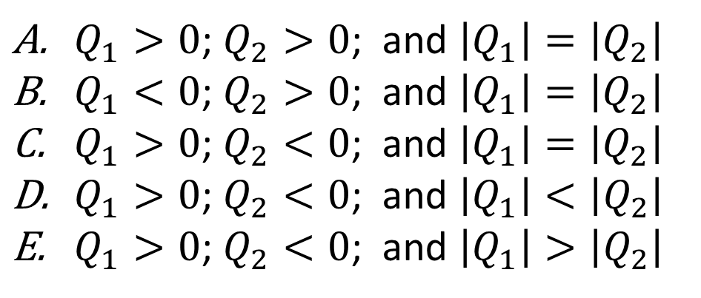
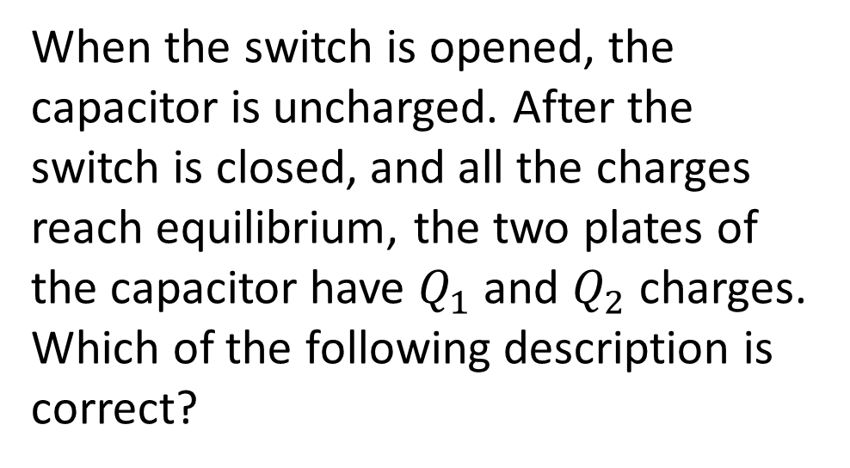


When the switch is opened, the capacitor is uncharged. After the switch is closed, and all the charges reach equilibrium, the two plates of the capacitor have $Q_{1}$ and $Q_{2}$ charges. Which of the following description is correct?
$Q_{1}>0$; $Q_{2}>0$; and $\left|Q_{1}\right|=\left|Q_{2}\right|$
$Q_{1}<0$; $Q_{2}>0$; and $\left|Q_{1}\right|=\left|Q_{2}\right|$
$Q_{1}>0$; $Q_{2}<0$; and $\left|Q_{1}\right|=\left|Q_{2}\right|$
$Q_{1}>0$; $Q_{2}<0$; and $\left|Q_{1}\right|<\left|Q_{2}\right|$
$Q_{1}>0$; $Q_{2}<0$; and $\left|Q_{1}\right|>\left|Q_{2}\right|$
$$Q_{1}$$
$$Q_{2}$$

Slide 4
Capacitor: a device store electric energy
Any two separated conductors could be used as a capacitor (electric energy storage device)
In circuit, a capacitor is shown as:

Slide 5
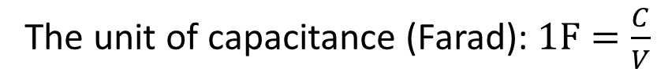
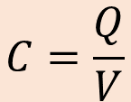
How to define capacitance
Capacitance: How much charge could be stored per volt
$$C=\frac{Q}{V}$$
The unit of capacitance (Farad): $1F=\frac{C}{V}$

Slide 6

Example
$$C=\frac{Q}{V}$$
Strategy
Q ⬄ E ⬄ V
Find the capacitance of the parallel plates capacitance

Slide 7
Example 8.2
Suppose you wish to construct a parallel-plate capacitor with a capacitance of 1.0 F. What area must you use for each plate if the plates are separated by 1.0 mm?

Slide 8
A
B
+ + + + + + + + + + + + + + +
- - - - - - - - - - - - - -
D
C
What is the relationship of the electric potential at these four positions?
A>B>C>D
A>B>D>C
A=B>C=D
A>B=D>C
A>C>B=D

Slide 9







$$V_{2}$$
$$Q_{2}$$
$$Q_{1}$$
Three different capacitors are connected in a circuit shown in the figure. Which of the following is true?
$$Q_{3}$$
$$V_{1}$$
$$V_{3}$$
$V_{1}=V_{2}$
$V_{2}=V_{3}$
$V_{1}=V_{2}+V_{3}$
$V_{2}=V_{1}+V_{3}$
$V_{3}=V_{2}+V_{1}$
V

Slide 10

$$V_{2}$$
$$Q_{2}$$
$$Q_{1}$$
Three different capacitors are connected in a circuit shown in the figure. Which of the following is true?
$$Q_{3}$$
$$V_{1}$$
$$V_{3}$$
$Q_{1}=Q_{2}$
$Q_{2}=Q_{3}$
$Q_{1}=Q_{2}+Q_{3}$
$Q_{2}=Q_{1}+Q_{3}$
$Q_{3}=Q_{2}+Q_{1}$
V

Slide 11
In parallel and/or in series
Charges are the same for the two capacitors
Potential drop are the same for the two resistor

Slide 12

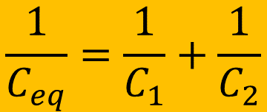
In parallel and/or in series
$$\frac{1}{C_{eq}}=\frac{1}{C_{1}}+\frac{1}{C_{2}}$$
$$C_{eq}=C_{1}+C_{2}$$

Slide 13
After the capacitor is charged, how much electric energy is stored in the capacitor?
Q
C
+ + + + + + + + + + + + + + +
V
- - - - - - - - - - - - - -
QV
QV/2
2CV
CV
Q/C

Slide 14

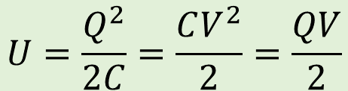
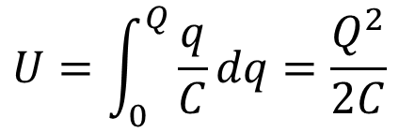

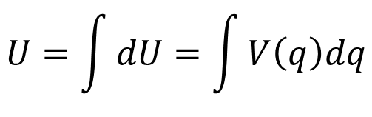
Energy stored in capacitor
$$dU=dqV(q)$$
Q
$$U=\int{dU}=\int{V\left(q\right)dq}$$
C
+ + + + + + + + + + + + + + +
V
- - - - - - - - - - - - - -
q
$$C=\frac{q}{V}$$
V
$$U=\int_{0}^{Q}{\frac{q}{C}dq}=\frac{Q^{2}}{2C}$$
$$U=\frac{Q^{2}}{2C}=\frac{CV^{2}}{2}=\frac{QV}{2}$$

Slide 15
Time dependence behavior
V
When the switch is closed, count as t = 0, the capacitor has charge 0 and increases to it’s maximum Q. ➔ the charge on the capacitor is changing over time!!!

Slide 16
The capacitor was initially uncharged. When the switch is just closed, what is the potential difference across the resistor?
V
p
q
0
V
Smaller than V
Larger than V

Slide 17
The capacitor was initially uncharged. When the switch has been closed for very long time, what is the potential difference across the resistor?
V
p
q
0
V
Smaller than V
Larger than V

Slide 18
Quiz:
When the switch is closed, which types of the diagrams best describe the (1) current in the loop; (2) potential drop across the resistance; (3) potential drop across the capacitor; and (4) the amount of charge on the capacitor as a function of time? Assuming the capacitor was initially uncharged.
V
Type I
Types I, II, I, II
Types I, I, I, I
Types I, II, II, II
Types II, II, I, I
Types I, II, I, I
Type II

Slide 19
How to calculate
V

Slide 20
When an insulator (dielectric material) is placed in between the two plates of the capacitor, what will happen to the insulator?
+ + + + + + + + + + + + + + +
- - - - - - - - - - - - - -
Nothing will happen
It will be polarized with the top/bottom surfaces (near the “+”/”-” metal plate) more negative/positive.
It will be polarized with the top/bottom surfaces (near the “+”/”-” metal plate) more positive/negative.
It will be polarized with the right/left of the material more positive/negative.
I am not sure.

Slide 21
There will be polarized to as shown. The polarized charges are less since these charges could not move.

Slide 22
Compare to “without” the insulator, what would be expected regarding the electric field and the capacitance?
The electric field will become zero in the materials. The capacitance will become larger.
The electric field will become larger in the materials. The capacitance will become smaller.
The electric field will become smaller in the materials. The capacitance will become larger.
The electric field will become smaller and reverse the direction in the materials. The capacitance will be the same.
The electric field will become smaller and reverse the direction in the materials. The capacitance will become larger.

Slide 23
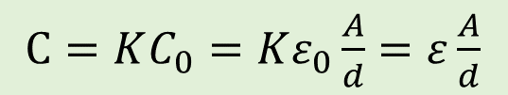
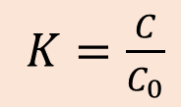
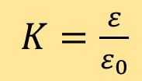

The capacitance become larger due to the dielectric materials, and it depends on how easy the material could be polarized.
Dielectric constant:
$K=\frac{C}{C_{0}}$
See Table 24.1 on page 801 for K values for different materials
$C=KC_{0}=Kε_{0}\frac{A}{d}=ε\frac{A}{d}$
$Kε_{0}=ε$
or
$K=\frac{ε}{ε_{0}}$
Each material has a break down threshold electric field, named dielectric strength (just like atmosphere when lightning happens). This puts an upper limit of the possible potential you can apply to the capacitor.

