Slide 1
Chapter 7: Electric Potential
Defining Electric Potential Energy
Defining Electric Potential
What is the relationship among electric force, field, potential energy, and potential?

Slide 2

Defining Electric Potential Energy
Conservative Forces: The forces depend only on the position.
Potential Energy could only be defined for conservative forces: The work done by the conservative force with a “-” sign.
$$∆U=−W$$

Slide 3


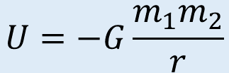
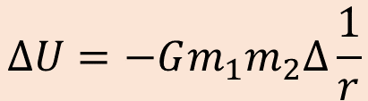
Gravitational Force vs Potential Energy
Near earth surface: gravitational force is a constant value for a particular object.
$$∆U=mg∆h$$
$$U=mgh$$
Far from earth surface: gravitational force is a function of distance.
$$∆U=−Gm_{1}m_{2}∆\frac{1}{r}$$
$$U=−G\frac{m_{1}m_{2}}{r}$$

Slide 4
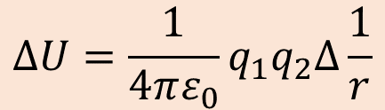


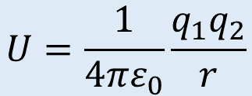
Electric Force vs Potential Energy
In an uniform electric field
$$∆U=q\left|\overset{⃑}{E}\right|∆y$$
$$U=q\left|\overset{⃑}{E}\right|y$$
For point charges
$$∆U=\frac{1}{4πε_{0}}q_{1}q_{2}∆\frac{1}{r}$$
$$U=\frac{1}{4πε_{0}}\frac{q_{1}q_{2}}{r}$$

Slide 5
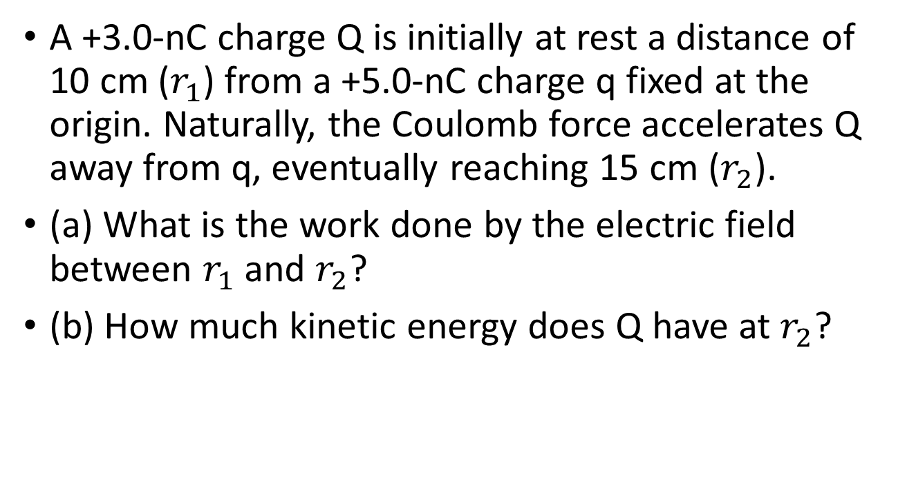
Example 7.1
A +3.0-nC charge Q is initially at rest a distance of 10 cm ($r_{1}$) from a +5.0-nC charge q fixed at the origin. Naturally, the Coulomb force accelerates Q away from q, eventually reaching 15 cm ($r_{2}$).
(a) What is the work done by the electric field between $r_{1}$ and $r_{2}$?
(b) How much kinetic energy does Q have at $r_{2}$?

Slide 6
Properties of Potential Energy
Potential Energy is a scalar, which mean they can be added without considering directions.

Slide 7
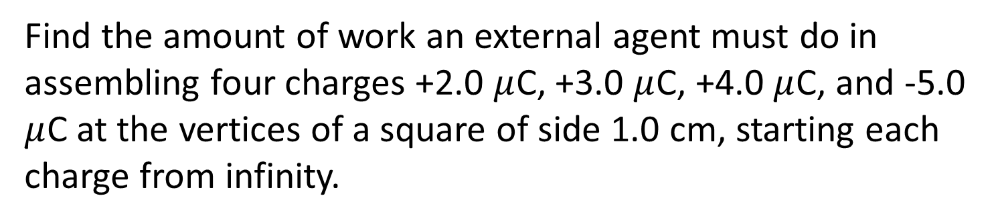
Example 7.3
Find the amount of work an external agent must do in assembling four charges +2.0 $μ$C, +3.0 $μ$C, +4.0 $μ$C, and -5.0 $μ$C at the vertices of a square of side 1.0 cm, starting each charge from infinity.

Slide 8
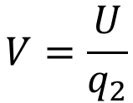
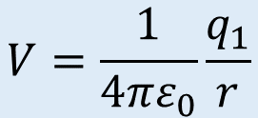

Defining Electric Potential
Recall that in Ch21:
$$V=\frac{U}{q_{2}}$$
$$U=q_{2}V$$
$$V=\frac{1}{4πε_{0}}\frac{q_{1}}{r}$$

Slide 9
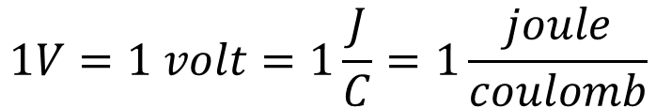
Defining Electric Potential
The unit of electric potential
$$1V=1 volt=1\frac{J}{C}=1\frac{joule}{coulomb}$$
Electric potential due to a collection of point charges:
Electric potential due to a continuous distribution of charges:

Slide 10
New unit for ENERGY: electron volt (eV)
1 eV = the electric potential energy gained by one electron with change of 1 V electric potential
$$1eV=∆U=q∆V=\left(1.602×{10}^{−19}C\right)\left(1V\right)=1.602×{10}^{−19}J$$
Note: CV = J
Note #2: eV is an unit of ENERGY; while V is an unit of electric potential

Slide 11
Example 7.4
You have a 12.0-V motorcycle battery that can move 5,000 C of charge, and a 12.0-V car battery that can move 60,000 C of charge. How much energy does each deliver? (Assume that the numerical value of each charge is accurate to three significant figures.)

Slide 12
Example 7.5
When a 12.0-V battery powers a single 30.0-W headlight, how many electrons pass through it each second?

Slide 13
Potential and Potential Energy

Slide 14
Quiz
Suppose a region of space has a uniform electric field pointing toward to the right hand side direction. An electron sit in this electric field and was observed to be moving toward the right hand side direction with a velocity, v, as shown in figure. Which statement about the electric potential and/or electric potential energy is true?
B
A
q = -e
v
C
The electric potential energy for this electron at point A is higher than that at point B because the electron is moving at the same direction as the electric field.
The potential at point A is the highest, the potential at point B is the second highest, and the potential at point C is the lowest.
The potential at points B and C are equal, and the potential at point A is higher than the potential at point B.
The electric potential energy for this electron at point A is higher than that at point B because the electron is moving at the opposite direction as the electric field.
The potential at points B and C are equal, and the potential at point A is lower than the potential at point B.

Slide 15
Electron Gun

Slide 16
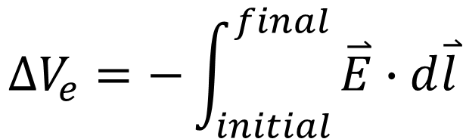
Another way of calculating V
$$∆V_{e}=−\int_{initial}^{final}{\overset{⃑}{E}∙d\overset{⃑}{l}}$$
Example 7.11
A demonstration Van de Graaff generator has a 25.0-cm-diameter metal sphere that produces a voltage of 100 kV near its surface. What excess charge resides on the sphere?

Slide 17
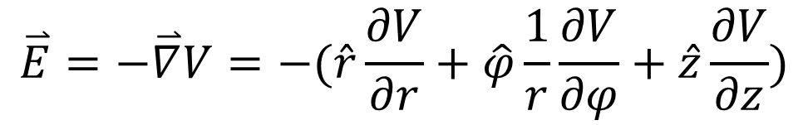
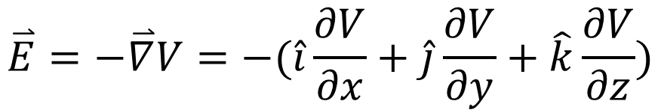
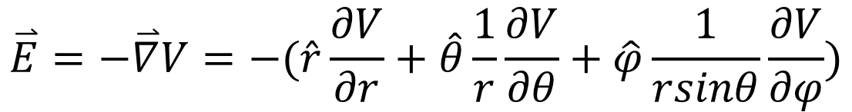
Potential Gradient
Cartesian Coordinate
$$\overset{⃑}{E}=−\overset{⃑}{∇}V=−(\hat{i}\frac{∂V}{∂x}+\hat{j}\frac{∂V}{∂y}+\hat{k}\frac{∂V}{∂z})$$
Cylindrical Coordinate
$$\overset{⃑}{E}=−\overset{⃑}{∇}V=−(\hat{r}\frac{∂V}{∂r}+\hat{φ}\frac{1}{r}\frac{∂V}{∂φ}+\hat{z}\frac{∂V}{∂z})$$
Spherical Coordinate
$$\overset{⃑}{E}=−\overset{⃑}{∇}V=−(\hat{r}\frac{∂V}{∂r}+\hat{θ}\frac{1}{r}\frac{∂V}{∂θ}+\hat{φ}\frac{1}{rsinθ}\frac{∂V}{∂φ})$$

Slide 18



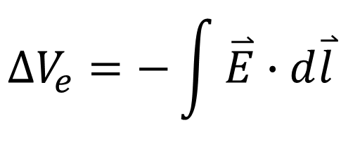



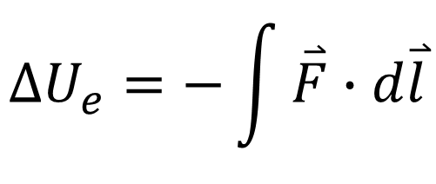




$$∆V_{e}=−\int{\overset{⃑}{E}∙d\overset{⃑}{l}}$$
$$q_{1}$$
q₁‘s influences in the space
$${\overset{⃑}{E}}_{e}$$
$$V_{e}$$
$$\overset{⃑}{E}=−\overset{⃑}{∇}V_{e}$$
$${\overset{⃑}{F}}_{e}=q_{2}{\overset{⃑}{E}}_{e}$$
$$U_{e}=q_{2}V_{e}$$
$$∆U_{e}=−\int{\overset{⃑}{F}∙d\overset{⃑}{l}}$$
$$q_{2}$$
The influences on q₂
$${\overset{⃑}{F}}_{e}$$
$$U_{e}$$
$$\overset{⃑}{F}=−\overset{⃑}{∇}U_{e}$$

Slide 19
Example 1:
Find the electric field and electric potential at point p.
Q
R
x
p
Example 2:
Find the electric field at a distance r from a very long line of charge with linear charge density (charge per unit length) λ through the electric potential.

Slide 20
Charge distribution on metal surfaces

