Slide 1




Chapter 6: Gauss’s Law
Goal of this chapter
Understand
$$\overset{⃑}{E}$$
$$Φ_{E}$$
Then, use
$$Φ_{E}$$
$$\overset{⃑}{E}$$

Slide 2
Electric field lines
Electric field strength = electric field line density. (you can use the electric field line to represent and think about how to calculate the electric field strength)
However, electric field lines are conceptual lines, there is no rule tells you how many lines should be plotted for a certain strength of electric field.

Slide 3












What is “flux”? And What is “electric flux”?
Flux: How much “something” flows through a certain area.
Electric flux: How much electric field (lines) flow through a certain area.
$$\overset{⃑}{v}$$
$$a$$
$$\frac{dV}{dt}=a∙\left|\overset{⃑}{v}\right|=A∙cosθ∙\left|\overset{⃑}{v}\right|=\overset{⃑}{v}∙A\hat{n}=\overset{⃑}{v}∙\overset{⃑}{A}$$
$$A$$
$$θ$$
$$a$$
$$\hat{n}$$
$$A$$
$$flux=\overset{⃑}{v}∙\overset{⃑}{A}$$
$$\overset{⃑}{v}$$
$$θ$$
$$\hat{n}$$

Slide 4


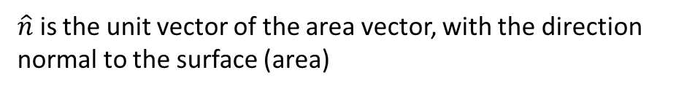


How to calculate electric flux?
Flux: How much “something” flows through a certain area.
Electric flux: How much electric field (lines) flow through a certain area.
$$\overset{⃑}{E}$$
$$a$$
$$electric flux=a∙\left|\overset{⃑}{E}\right|=A∙cosθ∙\left|\overset{⃑}{E}\right|=\overset{⃑}{E}∙A\hat{n}=\overset{⃑}{E}∙\overset{⃑}{A}$$
$$A$$
$$θ$$
$$a$$
$$\hat{n}$$
$$Φ_{E}=\overset{⃑}{E}∙\overset{⃑}{A}$$
$$A$$
$$\overset{⃑}{E}$$
$\overset{⃑}{A}=A\hat{n}$ is called “area vector”
$$θ$$
$$\hat{n}$$
$\hat{n}$ is the unit vector of the area vector, with the direction normal to the surface (area)

Slide 5
The direction of the area vector

Slide 6

Electric flux
$$Φ_{E}=\overset{⃑}{E}∙\overset{⃑}{A}=\left|\overset{⃑}{E}\right|∙A_{⊥}$$

Slide 7
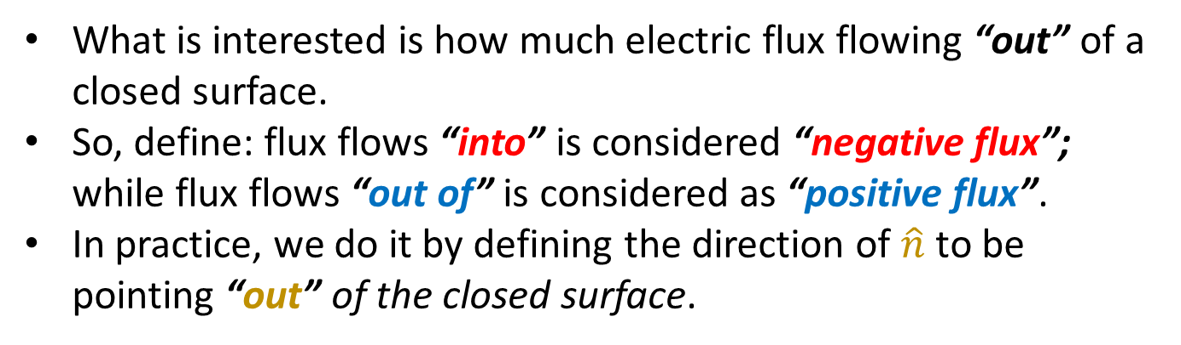
Electric flux for a closed surface
What is interested is how much electric flux flowing “out” of a closed surface.
So, define: flux flows “into” is considered “negative flux”; while flux flows “out of” is considered as “positive flux”.
In practice, we do it by defining the direction of $\hat{n}$ to be pointing “out” of the closed surface.

Slide 8
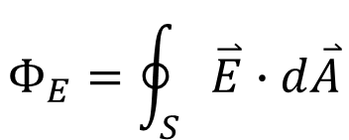
Electric flux for a closed surface
$$Φ_{E}=\oint_{S}{\overset{⃑}{E}∙d\overset{⃑}{A}}$$
“S” means “integrate over a closed surface S”. It is a conceptual symbol. Real integral depends on the geometry of the closed surface
The “circle” in the integral symbol means “a closed surface”.

Slide 9

Example 6.4
What is the total flux of the electric field $\overset{⃑}{E}=cy^{2}\hat{k}$ through the rectangular surface shown in the figure.

Slide 10



What is the source of the electric flux?
Remember: Electric field lines start at positive charges and end at negative charges.
If there is no charge in the closed surface: electric lines,
“in = out” ➔
If the total charge in the closed surface is positive (negative): electric lines,
“in < out” (“in > out”) ➔
$$Φ_{E}=0$$
$$Φ_{E}>0$$
$$(Φ_{E}<0)$$

Slide 11
Quiz
S4
S1
S2
S3
Which statement about the electric flux for each closed surface is correct:
S1 = 0; S2 > 0; S3 = 0; S4 < 0
S1 < 0; S2 > 0; S3 > 0; S4 = 0
S1 > 0; S2 = 0; S3 < 0; S4 < 0
S1 < 0; S2 > 0; S3 = 0; S4 = 0
S1 < 0; S2 < 0; S3 > 0; S4 > 0

Slide 12
Try it
Charge: q
Flux through a spherical closed surface with radius r

Slide 13
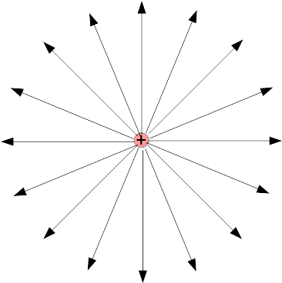
Try it
Charge: q
Flux through a cubical closed surface with side L

Slide 14
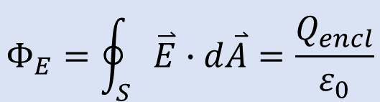
Try it
$$Φ_{E}=\oint_{S}{\overset{⃑}{E}∙d\overset{⃑}{A}}=\frac{Q_{encl}}{ε_{0}}$$
Charge: q
Flux through a irregular closed surface
The electric flux of a closed surface only depends on how much charge is enclosed in it.

Slide 15
How to use Gauss’s Law to calculate electric field?
If you need to calculate the electric flux, which shape would you like to do?

Slide 16
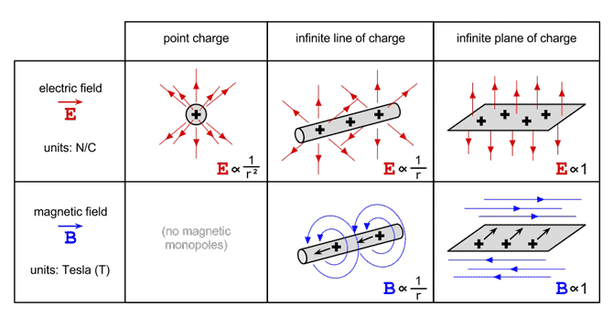
How to use Gauss’s Law to calculate electric field?
If you need to calculate the electric flux, which shape would you like to do?

Slide 17
How to use Gauss’s Law to calculate electric field?
Important trick: Find the symmetry of the electric field lines (patterns) before you choose what closed surface to calculate.
Make the area vector either perpendicular or parallel to the local electric field.
Make the magnitude of the electric field to be the same all over the surface for integration.
If you need to calculate the electric flux, which shape would you like to do?

Slide 18
Example 1
We place a total positive charge q on a solid conducting sphere with radius R.
Find the electric field at any point inside or outside the sphere.
Example 2
Electric charge is distributed uniformly along an infinitely long, thin wire. The charge per unit length is λ (assumed positive).
Find the electric field using Gauss’s Law.
Example 3
Use Gauss’s Law to find the electric field caused by a thin, flat, infinite sheet with a uniform positive surface charge density σ.

Slide 19
Example 4
Positive electric charge Q is distributed uniformly throughout the volume of an insulating sphere with radius R.
Find the electric field at any point inside or outside the sphere.

