Slide 1
Chapter 2: The Kinetic Theory of Gases
Molecular Model of an ideal gas
Pressure, temperature, and RMS speed
Heat Capacity and Equipartition of Energy
Distribution of Molecular Speeds

Slide 2
Confusing Notations (don't be confused):
N: number of molecules
n: number of moles
N_{A} : Avogadro's number: 6.02 × 10²³ .
M: molar mass (how much mass per mole)
m: mass of “ONE” molecule
m_{total}: total mass
p: pressure
P: momentum

Slide 3
What is “mole”; and what is “molar mass”?
I have 2.5 dozens of identical coins with total weight of 300 g. How much weight does one dozen of coins have? How much weight does one coin have?
I have 2.5 moles of identical molecules with total weight of 300 g. How much weight does one mole of molecules have? How much weight does one molecule have?
A “dozen” refers to “12” objects.
A “mole” refers to “6.02 x 10²³“ objects (we use N_{A} to represent 6.02 x 10²³)
# of dozens
# of moles
Molar mass
Single molecule mass

Slide 4


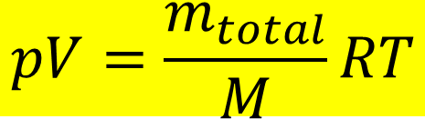
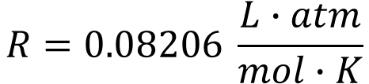

Equation of State
From experiments:
V is proportional to n
V is proportional to 1/p
p is proportional to T
$$pV=nRT$$
$$R=8.314472 J/mol∙K$$
$$R=0.08206 \frac{L∙atm}{mol∙K}$$
$$pV=\frac{m_{total}}{M}RT$$
$$pM=ρRT$$

Slide 5
Unit of Pressure
 | Pascal | Bar | Standard atmosphere | Torr | Pounds per square inch
 | (Pa) | (bar) | (atm) | (Torr) | (psi)
1 Pa | ≡ 1 N/m² | 10⁻⁵ | 9.8692×10⁻⁶ | 7.5006×10⁻³ | 1.450377×10⁻⁴
1 bar | 10⁵ | ≡ 100 kPa≡ 10⁶ dyn/cm² | 0.98692 | 750.06 | 14.50377
1 atm | 1.01325×10⁵ | 1.01325 | 1 | ≡ 760 | 14.69595
1 Torr | 133.3224 | 1.333224×10⁻³ | ≡ 1/760 ≈ 1.315789×10⁻³ | ≡ 1 Torr≈ 1 mmHg | 1.933678×10⁻²
1 psi | 6.8948×10³ | 6.8948×10⁻² | 6.8046×10⁻² | 51.71493 | ≡ 1 lbf /in²

Slide 6
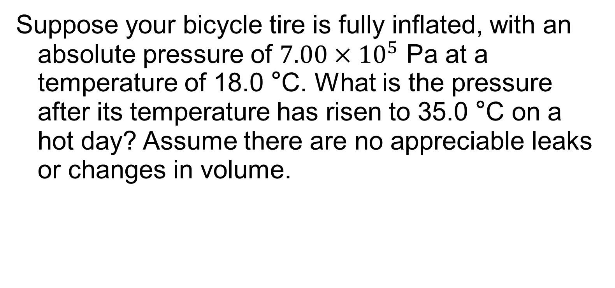
Example 2.1
Suppose your bicycle tire is fully inflated, with an absolute pressure of $7.00×{10}^{5}$ Pa at a temperature of 18.0 °C. What is the pressure after its temperature has risen to 35.0 °C on a hot day? Assume there are no appreciable leaks or changes in volume.

Slide 7
How to describe the status of a gas? And what is “ideal gas”?
Ideal gas:
(1) no inter-molecular interactions (each gas molecule does not feel the others);
(2) no volume (each gas molecule is considered as a “point mass” particle)
Corrections for non-ideal gas (van der Waals Equation):

Slide 8
p-V diagram
Ideal Gas
Non-Ideal Gas

Slide 9
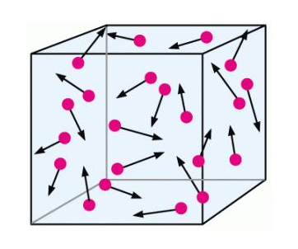
What is the origin of the “pressure”?
What is “pressure”?
Where does “Force” come from?
Air molecules hitting/bouncing the wall
Let's look at one molecule:

Slide 10


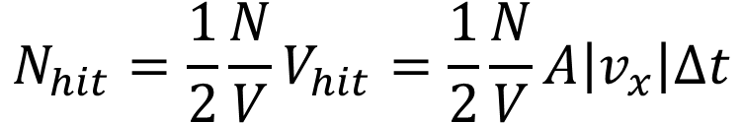
What is the origin of the “pressure”?
How many molecules hitting the wall within a certain time period?
Molecules with v_{x} within a volume could hit the wall
$$V_{hit}=A\left|v_{x}\right|∆t$$
Numbers of molecules that hit the wall:
$$N_{hit}=\frac{1}{2}\frac{N}{V}V_{hit}=\frac{1}{2}\frac{N}{V}A\left|v_{x}\right|∆t$$
Momentum change of one molecule that hit the wall
$$∆P_{x}=2m\left|v_{x}\right|$$
Sum of momentum changes of all molecules that hit the wall
$$∆P_{x,total}=N_{hit}∆P_{x}=2m\left|v_{x}\right|\frac{1}{2}\frac{N}{V}A\left|v_{x}\right|∆t=m\left|v_{x}^{2}\right|\frac{N}{V}A∆t$$

Slide 11
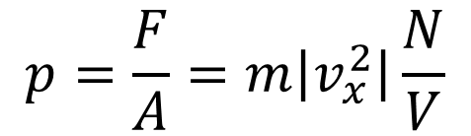
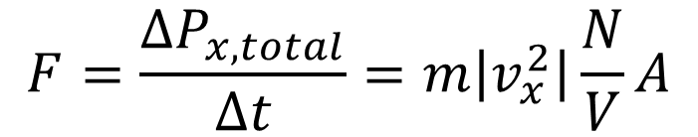
What is the origin of the “pressure”?
Total force due to the molecule collisions
$$F=\frac{∆P_{x,total}}{∆t}=m\left|v_{x}^{2}\right|\frac{N}{V}A$$
Pressure on the wall
$$p=\frac{F}{A}=m\left|v_{x}^{2}\right|\frac{N}{V}$$
Average v_{x} vs v

Slide 12
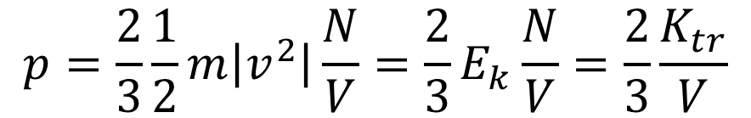
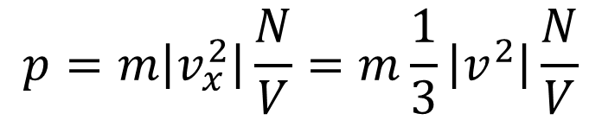
What is the origin of the “pressure”?
Pressure on the wall
$$p=m\left|v_{x}^{2}\right|\frac{N}{V}=m\frac{1}{3}\left|v^{2}\right|\frac{N}{V}$$
$$p=\frac{2}{3}\frac{1}{2}m\left|v^{2}\right|\frac{N}{V}=\frac{2}{3}E_{k}\frac{N}{V}=\frac{2}{3}\frac{K_{tr}}{V}$$
Average kinetic energy of ONE molecule
Total kinetic energy of ALL molecules

Slide 13
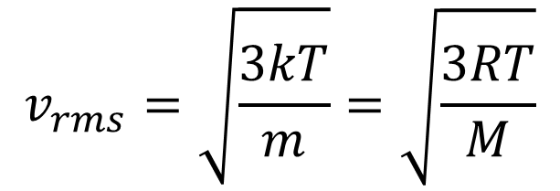

Kinetic energy of molecules vs Temperature
Total kinetic energy of all molecules
Average kinetic energy of one molecule
Root-mean-square speed (rms speed)
$$v_{rms}=\sqrt{{\left(v^{2}\right)}_{av}}$$
$$v_{rms}=\sqrt{\frac{3kT}{m}}=\sqrt{\frac{3RT}{M}}$$

Slide 14
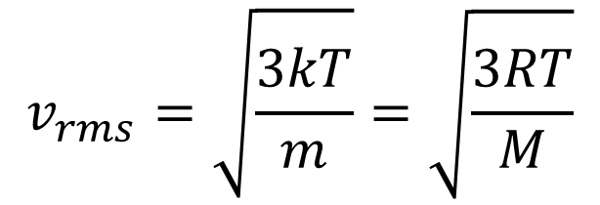
Summary
Average kinetic energy of single molecule on depends on temperature
Root-mean-square speed depends on both temperature and molecular mass
$$v_{rms}=\sqrt{\frac{3kT}{m}}=\sqrt{\frac{3RT}{M}}$$

Slide 15
Example 2.4
What is the average kinetic energy of a gas molecule at 20.0 °C?
Find the rms speed of a nitrogen molecule (N₂) at this temperature.

Slide 16
How do we know the specific heat for ideal gas?
Recall from Ch 1: Molar heat capacity
There are two types of Molar heat capacity

Slide 17
How do we know the specific heat for ideal gas?
For ideal gas, if you add heat into the system, where does the heat go?

Slide 18
Equipartition of Energy principle
Where does this “3” come from?
One degree of freedom gives one equipartition of energy

Slide 19
What is “degree of freedom”?
Monatomic vs Diatomic molecules
z
dof = 5
z
y
y
x
x
z
dof = 3
y
x

Slide 20

Degree of freedom vs $C_{V}$
Translation: dof: 3
Rotation: dof: 2
Vibration: dof: 2

Slide 21
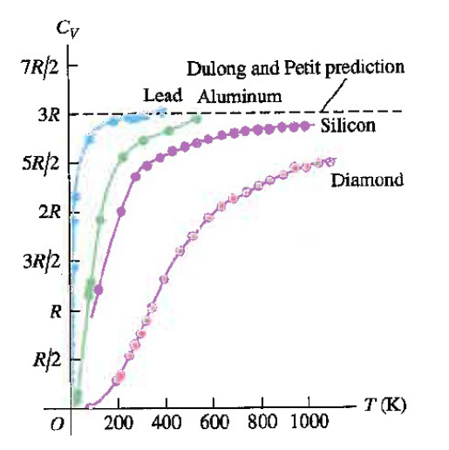
What is “degree of freedom”?
Kinetic energy
x, y, and z
dof = 6
Potential energy (vibration)
x, y, and z
In general, the following could contribute to dof.
Kinetic energy
Rotational energy
Vibration energy

Slide 22
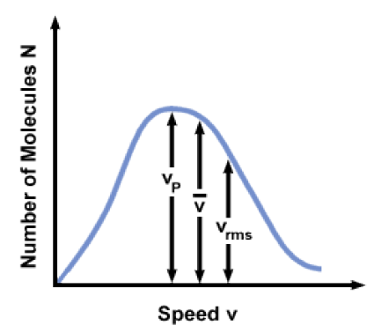
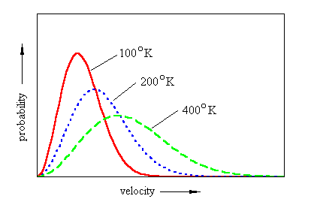
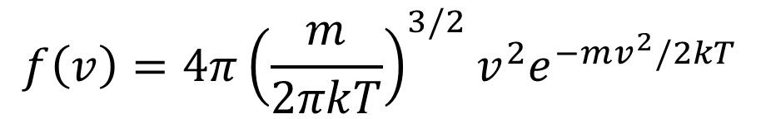
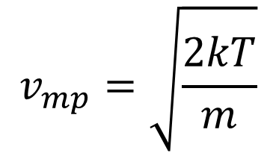
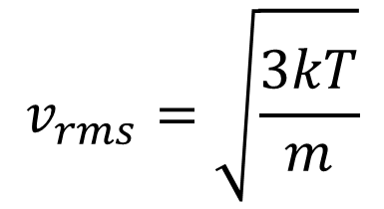
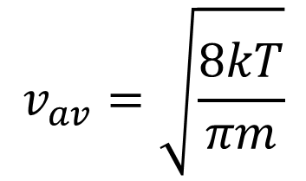
Do all the air molecules move with the same speed?
$$f\left(v\right)=4π{\left(\frac{m}{2πkT}\right)}^{3/2}v^{2}e^{−mv^{2}/2kT}$$
$$v_{mp}=\sqrt{\frac{2kT}{m}}$$
$$v_{av}=\sqrt{\frac{8kT}{πm}}$$
$$v_{rms}=\sqrt{\frac{3kT}{m}}$$

Slide 23
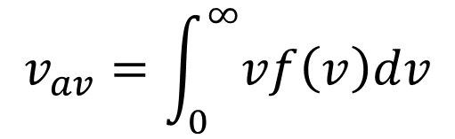
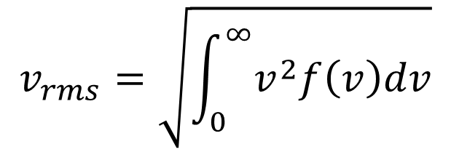
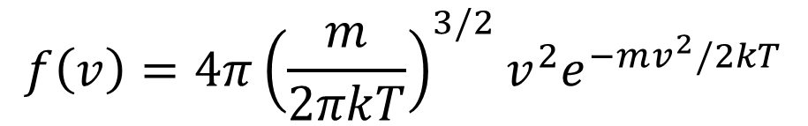
Speeds
$$f\left(v\right)=4π{\left(\frac{m}{2πkT}\right)}^{3/2}v^{2}e^{−mv^{2}/2kT}$$
Solve for v_{mp}
$$v_{av}=\int_{0}^{∞}{vf\left(v\right)dv}$$
$$v_{rms}=\sqrt{\int_{0}^{∞}{v^{2}f\left(v\right)dv}}$$

