Slide 1
Chapter 13: Electromagnetic Induction
Induction
Faraday’s Law
Maxwell’s Equations

Slide 2
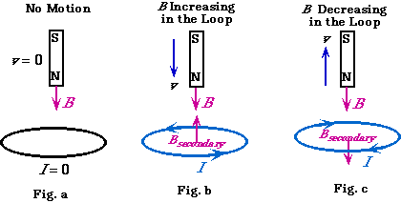
Induction: Lenz’s Law
Lenz’s Law: emf will be produced when the magnetic flux is changing as function of time.
The direction of the induced emf is as if the system is trying to maintain the original magnetic status; or equivalently, the direction of any magnetic induction effect is such as to oppose the cause of the effect.

Slide 3
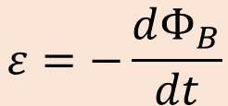
Faraday’s Law
$$ε=−\frac{dΦ_{B}}{dt}$$
(Faraday’s Law of induction)

Slide 4

emf in a conducting rod moving across a magnetic field
$$ε=vBL$$
This is closely related to Hall Effect

Slide 5
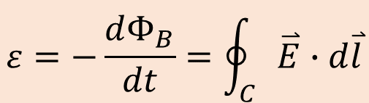
Faraday’s Law
$$ε=−\frac{dΦ_{B}}{dt}=\oint_{C}{\overset{⃑}{E}∙d\overset{⃑}{l}}$$
In any loop, the electric field in the path of the loop is related to the magnetic flux change enclosed in the loop

Slide 6
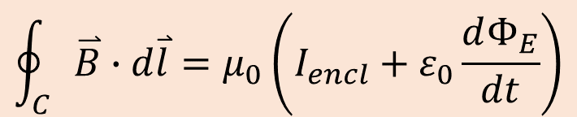
Revisit Ampere’s Law
(Equivalent to the current term)
$$\oint_{C}{\overset{⃑}{B}∙d\overset{⃑}{l}}=μ_{0}\left(I_{encl}+ε_{0}\frac{dΦ_{E}}{dt}\right)$$

Slide 7
Maxwell’s Equation

