Slide 1
Chapter 12: Sources of Magnetic Fields
Electric Current Generates Magnetic Field
Ampere’s Law

Slide 2


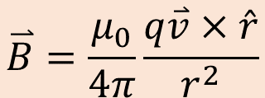



Electric Current Generates Magnetic Field
Magnetic field generated from a moving charge
$$\overset{⃑}{B}=\frac{μ_{0}}{4π}\frac{q\overset{⃑}{v}×\hat{r}}{r^{2}}$$
$$\overset{⃑}{B}$$
$$\overset{⃑}{r}$$
$$\hat{r}$$
$$q$$
$$\overset{⃑}{v}$$

Slide 3
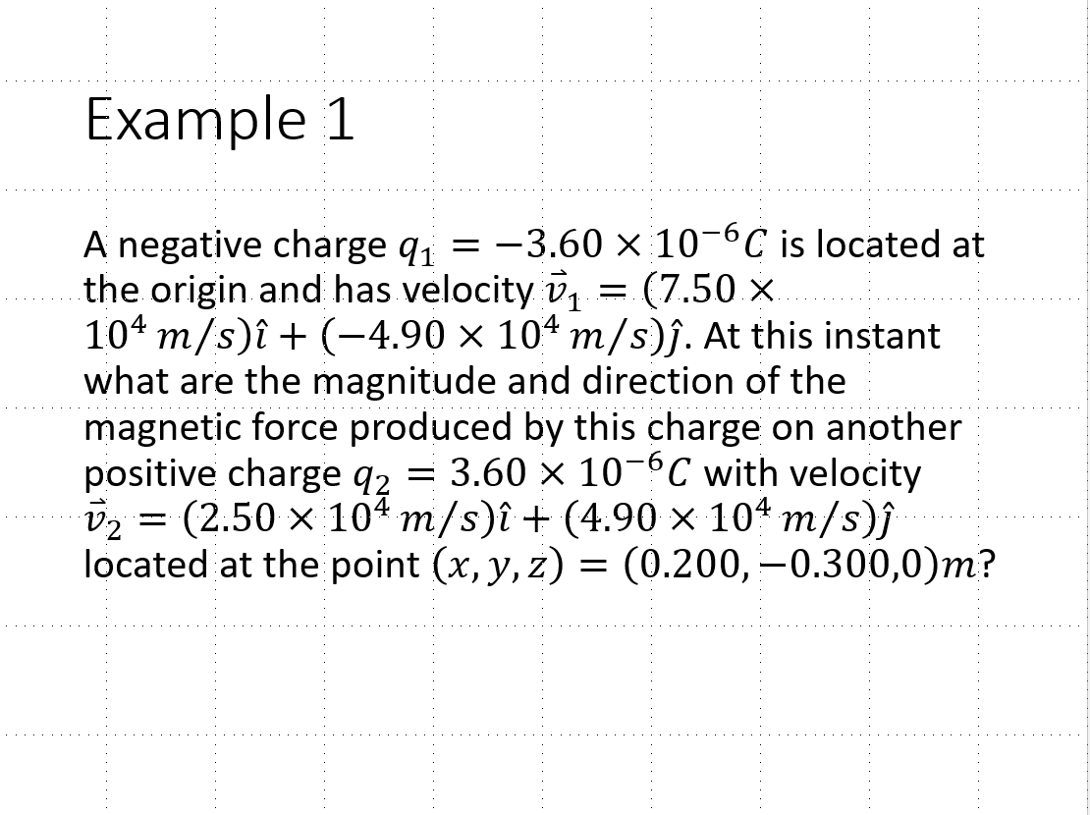

Slide 4


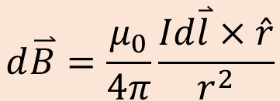



Electric Current Generates Magnetic Field
Magnetic field generated from a section of current (a group of moving charges)
$$d\overset{⃑}{B}=\frac{μ_{0}}{4π}\frac{Id\overset{⃑}{l}×\hat{r}}{r^{2}}$$
$$\overset{⃑}{B}$$
$$\overset{⃑}{r}$$
$$\hat{r}$$
$$I$$
$$d\overset{⃑}{l}$$

Slide 5
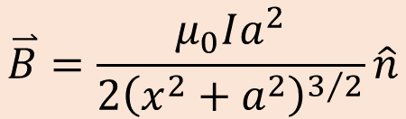
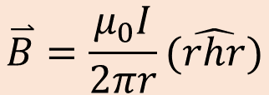
Electric Current Generates Magnetic Field
Magnetic field produced by an infinite long current-carrying wire.
$$\overset{⃑}{B}=\frac{μ_{0}I}{2πr}(\hat{rhr})$$
Magnetic field produced by a circular current-carrying loop. (with radius a, at a distance x away from the center of the loop along the axis)
$$\overset{⃑}{B}=\frac{μ_{0}Ia^{2}}{2{\left(x^{2}+a^{2}\right)}^{3/2}}\hat{n}$$

Slide 6
Example 12.2
A wire carries a current I in a circular arc with radius R swept through an arbitrary angle θ. Calculate the magnetic field at the center of this arc at point P.

Slide 7


Quiz
$$I$$
Two straight long current-carrying wires are placed next to each other in parallel. What directions of the forces do the two wires feel?
$$I$$
Attract each other
Repel each other
No force
The top wire experiences a force go into the screen; while the bottom wire experiences a force go out of the screen
The top wire experiences a force go out of the screen; while the bottom wire experiences a force go into the screen
What is the magnitude of the force?

Slide 8
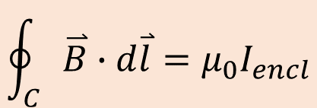
Ampere’s Law
$$\oint_{C}{\overset{⃑}{B}}∙d\overset{⃑}{l}=μ_{0}I_{encl}$$
For a closed “loop”
How to use it?
Choose a closed loop containing the point where you want to know the magnetic field.
The choice of the loop better to have all the segments of the loop are either (a) perpendicular to the magnetic field; or (b) parallel to the magnetic field.
Do the integration
Find all enclosed current in the loop.

Slide 9
Ampere’s Law
Try it!
Long straight current-carrying wire
Current-carrying solenoid
Current-carrying toroidal solenoid

