Slide 1
Chapter 10: Direct current circuit
Resistors in circuits
Equivalent resistance
The nature of the electric potential and current in circuit
Kirchhoff’s rules (for complicated circuit analysis)

Slide 2
Resistors in circuit
Use Ohm’s law for each individual resistors: Each resistor has it’s own resistance, potential drop and current flow

Slide 3

Equivalent resistance
Equivalent resistance is used to simplify circuit.
I
I
Any circuit
(or any part of the circuit)
V
V
$$R_{eq}=\frac{V}{I}$$
I
I

Slide 4
Parallel and series connections
Currents are the same for the two resistor
Potential drop are the same for the two resistor

Slide 5

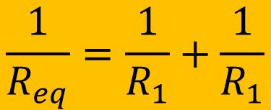
Parallel and series connections
$$\frac{1}{R_{eq}}=\frac{1}{R_{1}}+\frac{1}{R_{1}}$$
$$R_{eq}=R_{1}+R_{2}$$

Slide 6






Example
$$ε=60.0V$$
$$3.00 Ω$$
$$12.0 Ω$$
$$6.00 Ω$$
$$4.00 Ω$$
Find $R_{eq}$, and the current through each resistor

Slide 7
Equivalent resistance for complicated circuits
There are complicated circuits which could not be analyzed by the method mentioned above.

Slide 8
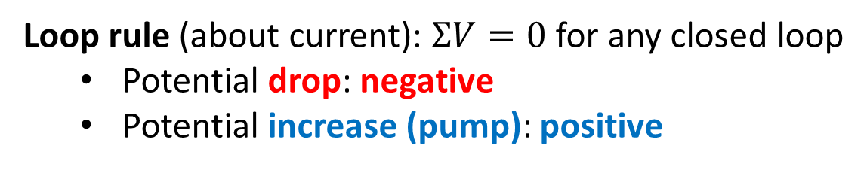
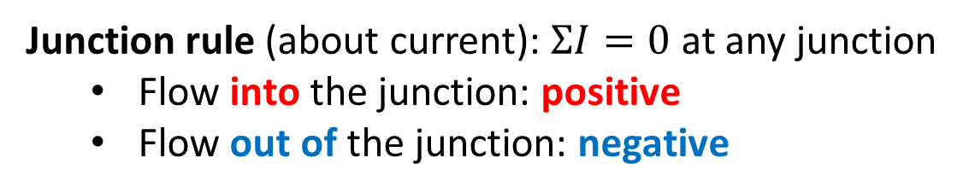
Kirchhoff’s rules (for complicated circuit analysis)
Junction rule (about current): $ΣI=0$ at any junction
  Flow into the junction: positive
  Flow out of the junction: negative
Loop rule (about current): $ΣV=0$ for any closed loop
  Potential drop: negative
  Potential increase (pump): positive

Slide 9
Kirchhoff’s rules (for complicated circuit analysis)
Strategy:
Define currents values and directions at each section of path in the circuit.
Use junction rule for each junction in the circuit. Each junction will give one equation.
Choose any certain point as starting point, then choose a travel route to complete a close loop (your choice, and has to go back to the starting point)
Use loop rule to construct electric potential equation for the loop you chose. (if the travel direction is the same with the current direction, the potential will drop; if opposite, the potential will raise).
Choose different closed loop which covers sections that were not covered by other loops (Some part of the route could be the same). Repeat step 4 until you cover all sections in the circuit)
Solve the unknown values using the equations constructed by junction rules and loop rules.

Slide 10






Example
a
$$100 Ω$$
b
$$50.0 Ω$$
$$75.0 Ω$$
$$25.0 Ω$$
$$40.0 Ω$$
$$50.0 Ω$$
If an ohmmeter is connected between points a and b, what will it read?

