Slide 1
Chapter 2
Relativity 2

Slide 2
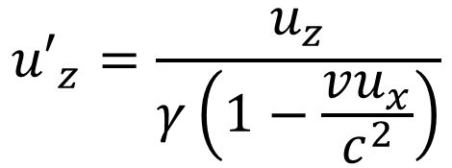

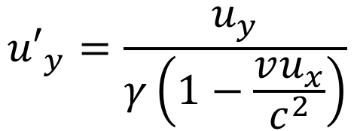

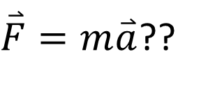
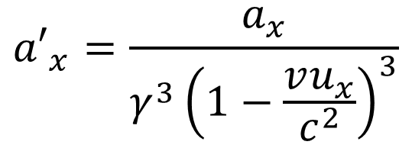
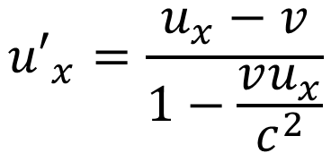
Acceleration transformation
$${u′}_{x}=\frac{u_{x}−v}{1−\frac{vu_{x}}{c^{2}}}$$
$${a′}_{x}=\frac{a_{x}}{γ^{3}{\left(1−\frac{vu_{x}}{c^{2}}\right)}^{3}}$$
$$x^{′}=γ\left(x−vt\right)$$
$${u′}_{y}=\frac{u_{y}}{γ\left(1−\frac{vu_{x}}{c^{2}}\right)}$$
$$t′=γ\left[t−\frac{v}{c^{2}}x\right]$$
$${u′}_{z}=\frac{u_{z}}{γ\left(1−\frac{vu_{x}}{c^{2}}\right)}$$
$\overset{⃑}{F}=m\overset{⃑}{a}$??

Slide 3
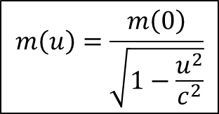
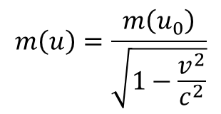
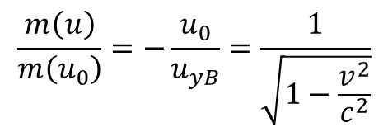
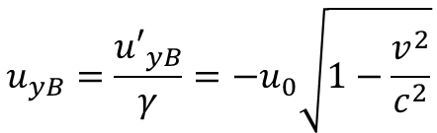
Conservation of momentum
p is conserved in collisions
p approaches mu as u/c approaches zero.
$$u_{yB}=\frac{{u′}_{yB}}{γ}=−u_{0}\sqrt{1−\frac{v^{2}}{c^{2}}}$$
Momentum Conservation:
$$m\left(u_{0}\right)u_{0}+m\left(u\right)u_{yB}=−m\left(u_{0}\right)u_{0}−m\left(u\right)u_{yB}$$
$$\frac{m\left(u\right)}{m\left(u_{0}\right)}=−\frac{u_{0}}{u_{yB}}=\frac{1}{\sqrt{1−\frac{v^{2}}{c^{2}}}}$$
$$m\left(u\right)=\frac{m\left(u_{0}\right)}{\sqrt{1−\frac{v^{2}}{c^{2}}}}$$
$$m\left(u\right)=\frac{m\left(0\right)}{\sqrt{1−\frac{u^{2}}{c^{2}}}}$$

Slide 4
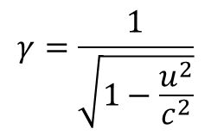
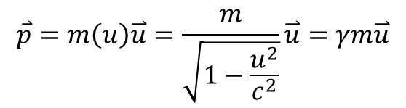
Momentum
$$\overset{⃑}{p}=m\left(u\right)\overset{⃑}{u}=\frac{m}{\sqrt{1−\frac{u^{2}}{c^{2}}}}\overset{⃑}{u}=γm\overset{⃑}{u}$$
$$γ=\frac{1}{\sqrt{1−\frac{u^{2}}{c^{2}}}}$$

Slide 5
Example
A high-speed interplanetary probe with a rest mass m = 50,000 kg has been sent toward Pluto at a speed u = 0.8 c. What is its momentum as measured by Mission Control on Earth? If, preparatory to landing on Pluto, the probe’s speed is reduced to 0.4 c, by how much does its momentum change?

Slide 6
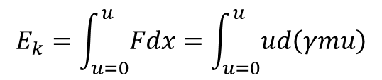
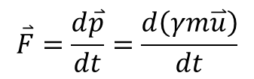

Relativistic Kinetic Energy
Total energy E of any isolated system is conserved
E will approach the classical value when u/c approaches zero
Force:
$$\overset{⃑}{F}=\frac{d\overset{⃑}{p}}{dt}=\frac{d\left(γm\overset{⃑}{u}\right)}{dt}$$
Kinetic Energy = Work done by the total force from rest. (1D)
$$E_{k}=\int_{u=0}^{u}{Fdx}=\int_{u=0}^{u}{ud\left(γmu\right)}$$
$$E_{k}=γmc^{2}−mc^{2}$$

Slide 7
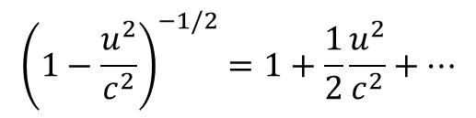
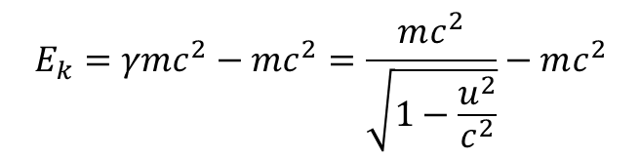
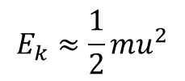
u/c approaches to zero (Energy)
$$E_{k}=γmc^{2}−mc^{2}=\frac{mc^{2}}{\sqrt{1−\frac{u^{2}}{c^{2}}}}−mc^{2}$$
Binomial Expansion (or Taylor expansion) gives
$$E_{k}≈\frac{1}{2}mu^{2}$$
$${\left(1−\frac{u^{2}}{c^{2}}\right)}^{−1/2}=1+\frac{1}{2}\frac{u^{2}}{c^{2}}+…$$

Slide 8



Relativistic Total Energy
$$E_{k}=γmc^{2}−mc^{2}$$
u dependent
u independent
$mc^{2}$ is defined as “rest energy”
Kinetic energy is the amount of energy equals to the work done by the force which change from $mc^{2}$ to $γmc^{2}$
$$E_{total}=E_{k}+mc^{2}=γmc^{2}$$

Slide 9
Example
In Chapter 1, muons produced as secondary particles by cosmic rays were used to illustrate both the relativistic length contraction and time dilation resulting from their high speed relative to observers on Earth. That speed is about 0.998 c. If the rest energy of a muon is 105.7 MeV, what will observers on Earth measure for the total energy of a cosmic-ray-produced muon? What will they measure for its mass as it moves relative to them?

Slide 10
List of rest masses of some particles
Electron (positron): 0.5110 MeV
Proton: 938.272 MeV
Neutron: 939.565 MeV
Muon: 105.7 MeV
See table 2-1 on page 83 for more.

Slide 11


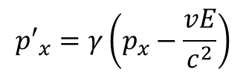
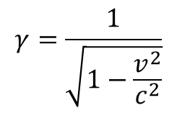



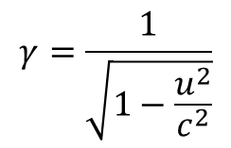
Lorentz Transformation of E and p
$${p′}_{x}=γ\left(p_{x}−\frac{vE}{c^{2}}\right)$$
$${p′}_{y}=p_{y}$$
$$γ=\frac{1}{\sqrt{1−\frac{v^{2}}{c^{2}}}}$$
$$E′=γ\left(E−vp_{x}\right)$$
$${p′}_{z}=p_{z}$$
Attention!
$$\overset{⃑}{p}=γm\overset{⃑}{u}$$
$$γ=\frac{1}{\sqrt{1−\frac{u^{2}}{c^{2}}}}$$
$$E_{total}=γmc^{2}$$

Slide 12

Example
Suppose a micrometeorite of rest mass ${10}^{−9}$ kg moves past Earth at a speed of 0.01 c. What values will be measured for the energy and momentum of the particle by an observer in a system S’ moving relative to Earth at 0.5 c in the same direction as the micrometeorite?

Slide 13


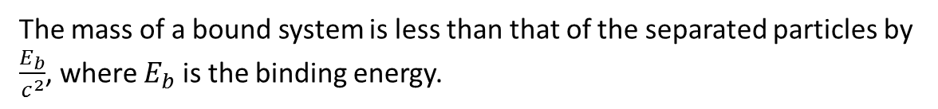

Mass and Binding Energy
A system with two particles bounded together with certain binding energy. Everything is at rest.
One particle
m
$$E_{total}=γmc^{2}=mc^{2}$$
Two separate particles
m
m
$$E_{total}=2mc^{2}$$
Two bound particles
m
m
$$E_{total}=Mc^{2}=−E_{b}+2mc^{2}$$
The mass of a bound system is less than that of the separated particles by $\frac{E_{b}}{c^{2}}$, where $E_{b}$ is the binding energy.

Slide 14
Example
The binding energy of the hydrogen atom (the energy needed to remove the electron from the atom) is 13.6 eV. How much mass is lost when an electron and a proton form a hydrogen atom?

Slide 15
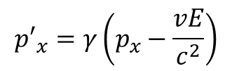










Invariant Mass
$$x^{′}=γ\left(x−vt\right)$$
Recall
$$y^{′}=y$$
Invariant spacetime interval
$${\left(∆s\right)}^{2}={\left(c∆t\right)}^{2}−\left(∆x^{2}+∆y^{2}+∆z^{2}\right)$$
$$z^{′}=z$$
$$t′=γ\left[t−\frac{v}{c^{2}}x\right]$$
$${p′}_{x}=γ\left(p_{x}−\frac{vE}{c^{2}}\right)$$
$${p′}_{y}=p_{y}$$
$${p′}_{z}=p_{z}$$
$$E′=γ\left(E−vp_{x}\right)$$
$$\overset{⃑}{p}=γm\overset{⃑}{u}$$
$${\left(mc^{2}\right)}^{2}=E^{2}−{\left(pc\right)}^{2}$$
$$E_{total}=γmc^{2}$$

Slide 16

Example
A particular object is observed to move through the laboratory at high speed. Its total energy and the components of its momentum are measured by lab workers to be (in SI unit) $E=4.5×{10}^{17}J$, $p_{x}=3.8×{10}^{8}kg∙m/s$, $p_{y}=3.0×{10}^{8}kg∙m/s$, and $p_{z}=3.0×{10}^{8}kg∙m/s$. What is the object’s rest mass?

Slide 17
System mass
The rest mass of the system: 10 kg
The total momentum of the system: 0
For the same system, what rest mass of an observer in S’, which moves relative to S at $β$=0.6, measures?

Slide 18


Massless particle
$${\left(mc^{2}\right)}^{2}=E^{2}−{\left(pc\right)}^{2}$$
$$E=pc$$
For m = 0
Remember that the rest energy of a system of particles is not the sum of the rest energies of the individual particles if they move relative to one another. This applied to photons too! Suppose two photons, one with energy 5 MeV and second with energy 2 MeV, approach each other along the x axis. What is the rest energy of this system?

Slide 19
Creation and Annihilation of Particles
Energy ⬅ ➔ Mass
positron
What is the minimum energy of the photon needed for the following to happen?

Slide 20
Example
What is the minimum or threshold energy that a photon must have in order to produce an electron-positron pair? Hint: the photon must hit something. Hint #2, in the minimum case, the created electron and positron carries no kinetic energy (at rest).

Slide 21
General Relativity
Einstein’s third postulate: A homogeneous gravitational field is completely equivalent to a uniformly accelerated reference frame.

Slide 22
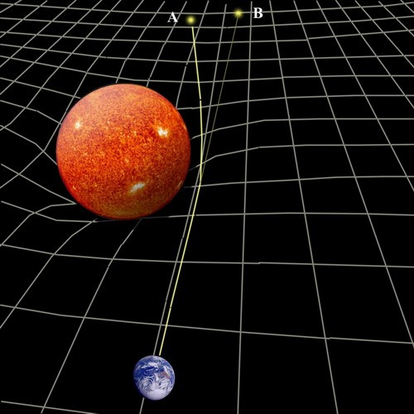
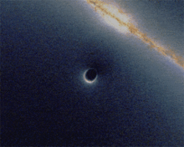
Deflection of starlight – Gravitational lens
Confirmed by Arthur Eddington in 1919 during total solar eclipse
Simulated gravitational lensing (black hole going past a background galaxy).

Slide 23
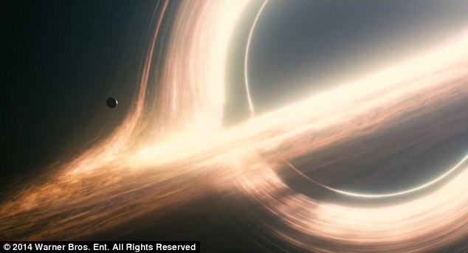
Gravitational lens
Simulated gravitational lensing (Interstellar (movie)).

Slide 24

Gravitational wave Explained by PHD Comics

Slide 25
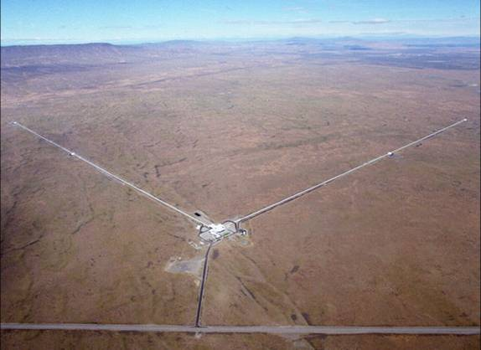
LIGO (Laser Interferometer Gravitational-Wave Observatory)
LIGO, Livingston, LA

Slide 26
Gravitational Wave Detected
Based on the details of the signal detected, the LIGO team estimates that the event that generated the gravitational waves occurred 1.3 billion years ago. That's when two black holes, one 29 times the mass of the Sun, the second 36 times, spiraled into each other. When the collision took place, the equivalent of three times the mass of the Sun was converted directly to energy and released in the form of gravitational waves. For a brief fraction of a second, this single event produced more power than the entire rest of the visible Universe combined.
"This detection is the beginning of a new era: the field of gravitational wave astronomy is now a reality," said Gabriela González of Louisiana State University. Black hole expert Kip Thorne stated, "With this new discovery, we humans are embarking on a marvelous new quest: the quest to explore the warped side of the Universe—objects and phenomena that are made from warped spacetime."
To provide more precision to that astronomy, the LIGO collaboration will be integrating with the European Virgo detector, which is based on a similar approach. And negotiations are under way to build a LIGO-like detector in India. With four in operation, we'll someday be able to say something more than "somewhere in the Southern Hemisphere."

