Slide 1


Monitoring Active Galactic Nuclei with Hbeta Asymmetry Using the
Wyoming Infrared Observatory
Prof. Michael Brotherton
University of Wyoming
The MAHA Collaboration
Collaborators: Pu Du (IHEP), Jian-Min Wang (IHEP), Kai Wang (IHEP), Zhengpeng Huang (IHEP), Chen Hu (IHEP), Yan-rong Li (IHEP), David H. Kasper (WY), William T. Chick (WY), My Nguyen (WY), Jaya Maithil (WY), Derek Hand (WY), Jin-Ming Bai (Yunnan Observatory), and Luis Ho (Kavli Institute of Astronomy and Astrophysics, Peking University)

Slide 2
How Can We Measure AGN Black Hole masses with reverberation mapping?
What Else can we learn from reverberation mapping?
Do supermassive black hole binaries power some agns?
Our search in wyoming

Slide 3
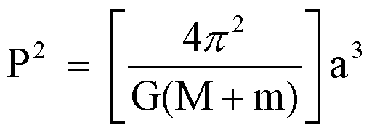
How Can We Measure Masses in space?

Slide 4
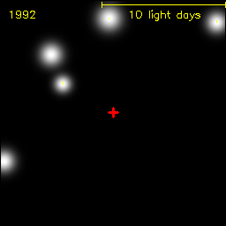
the galactic core
Groups at Max Planck (the source of this animation) and UCLA have been observing the center of the Milky Way for over two decades, tracing the orbits of stars. The mass of the central dark object lurking there is about 4 million solar masses.

Slide 5
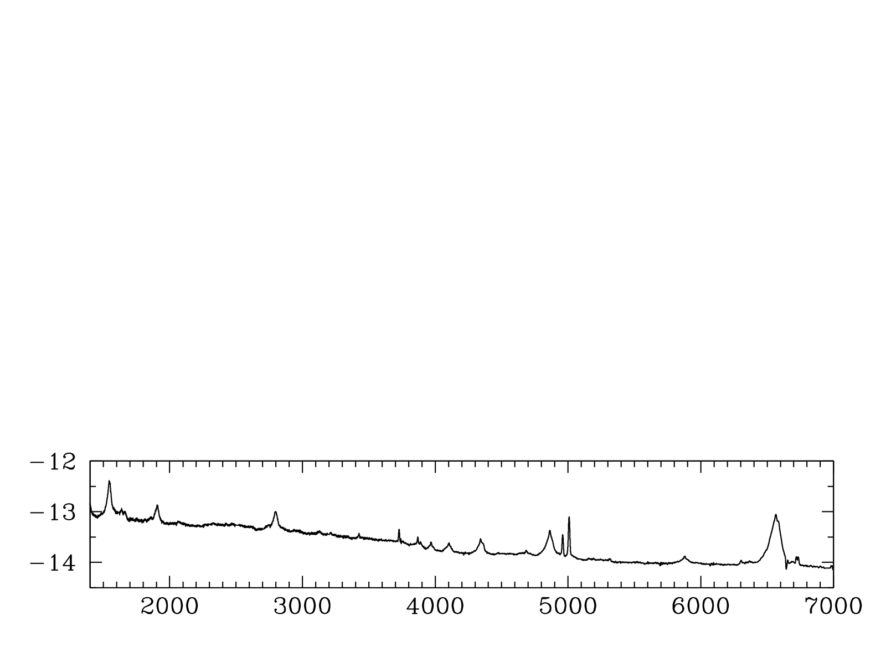
AN Ultraviolet-Optical AGN Spectrum
Note especially the Hbeta Line
Hβ
Hα
log(F_{λ})
C IV
Mg II
Rest λ (Angstroms)
The broad emission lines are Doppler broadened and indicate velocity of ionized gas near the AGN.
Notes:
Another important parameter in AGN is the black hole mass, which isn’t necessarily a typical SED project but I can really get at this with my quasi-simultaneous spectra.
How do you measure M in AGN?
Spectrum, CIV at high redshift and Hβ at low.
Ideally measurements using these lines in the same object would agree, but there’s scatter of a factor of a few between them.
I’m interested in understanding this scatter so that I can reduce it.

Slide 6
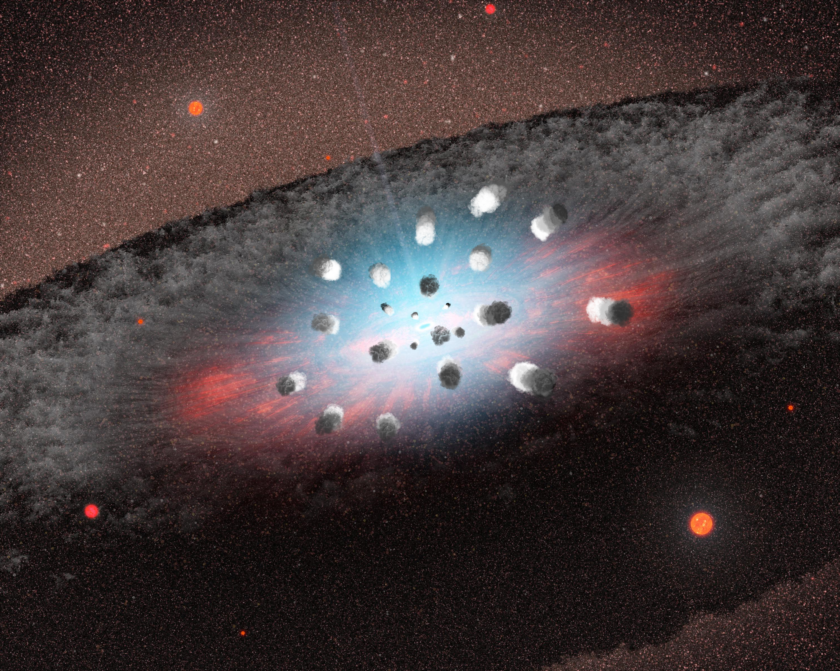
If We could resolve an AGN, then perhaps…
Broad Line Region (BLR)
Dusty Torus
Credit: Pu Du

Slide 7
Virial Black Hole Masses in Quasars
e.g., Vestergaard et al. (2006, 2009)
The factor f is geometric and on order of unity, calibrated using the M-σ* relation (e.g., McConnell & Ma 2013).
How to determine R ? AGNs too far away to be spatially resolved.
Notes:
Another important parameter in AGN is the black hole mass, which isn’t necessarily a typical SED project but I can really get at this with my quasi-simultaneous spectra.
How do you measure M in AGN?
Spectrum, CIV at high redshift and Hβ at low.
Ideally measurements using these lines in the same object would agree, but there’s scatter of a factor of a few between them.
I’m interested in understanding this scatter so that I can reduce it.

Slide 8
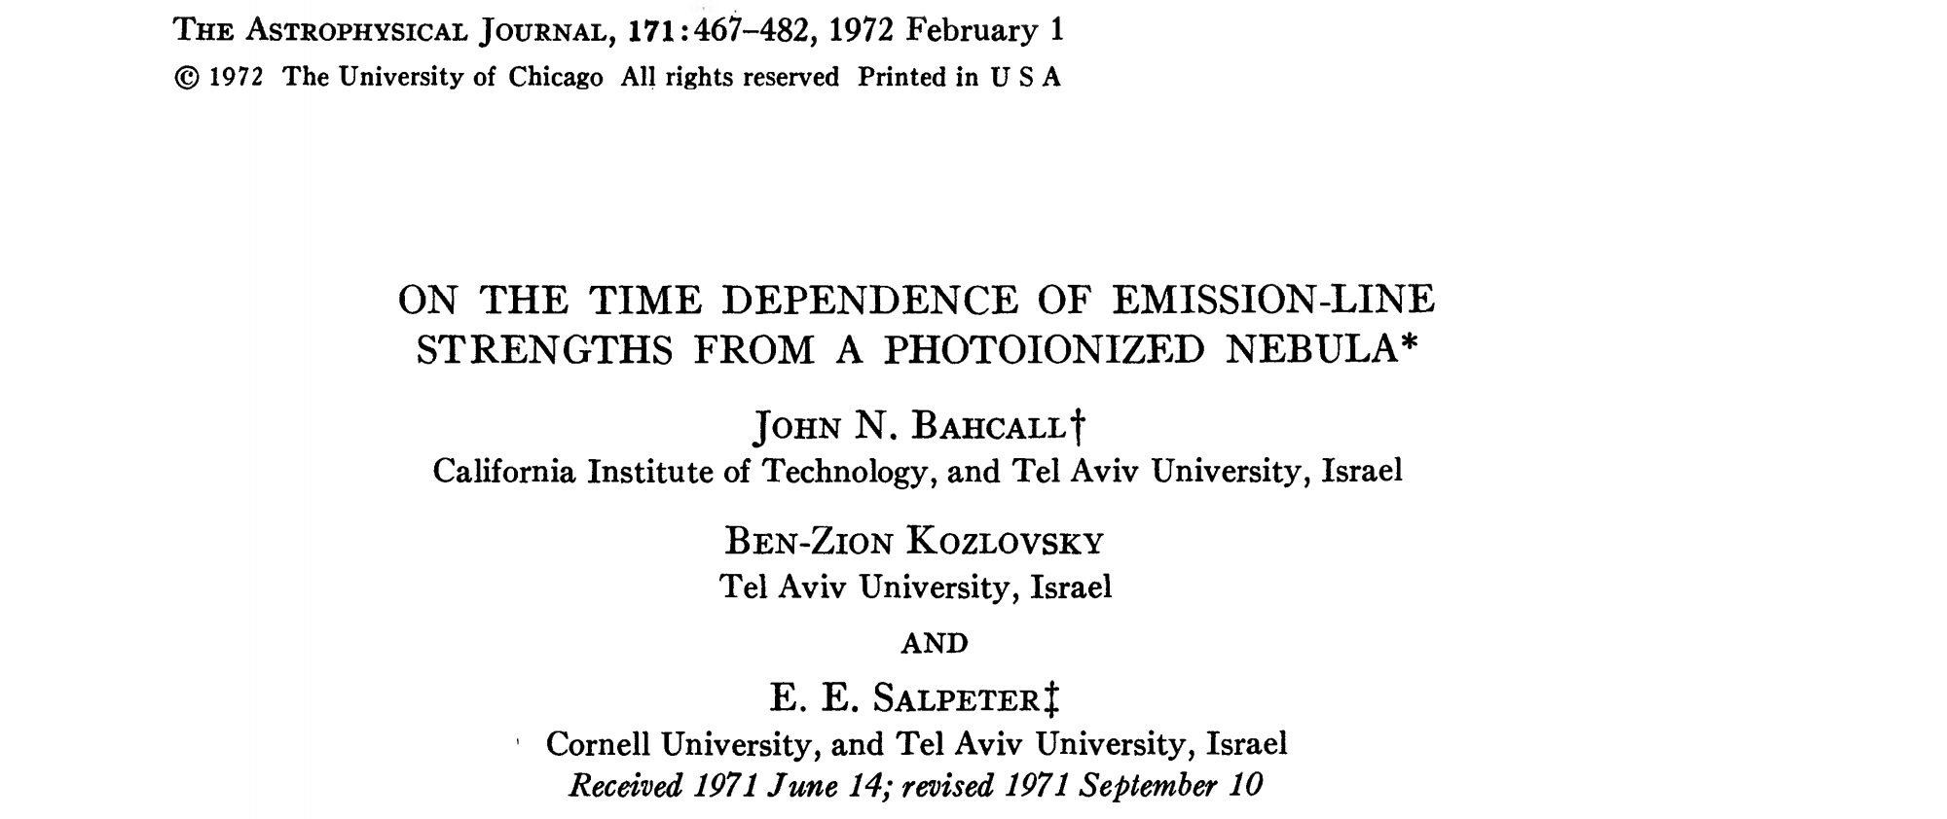
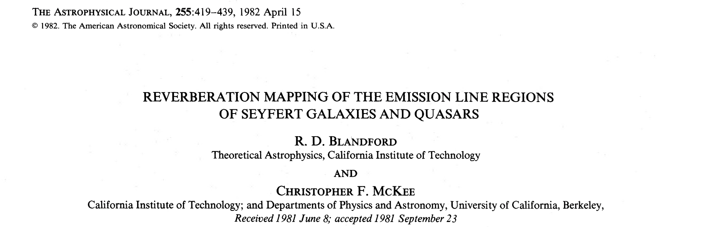

Slide 9
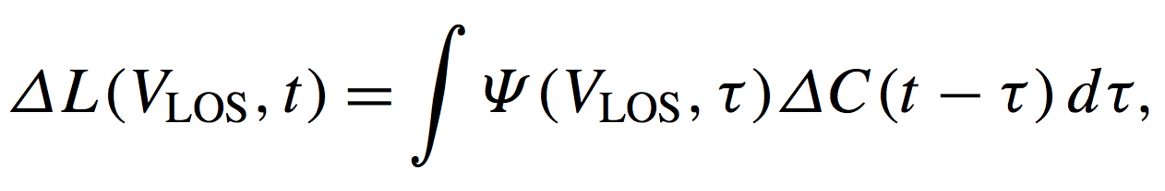
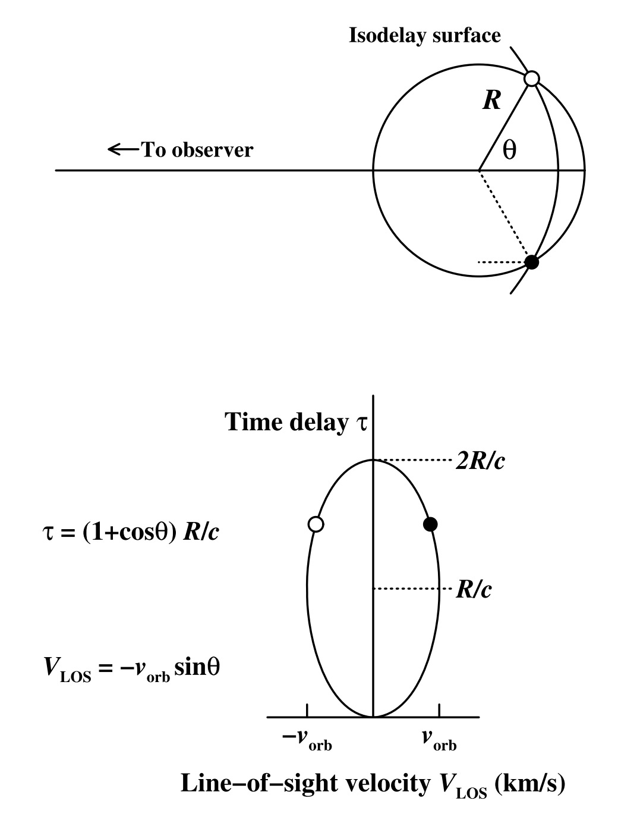
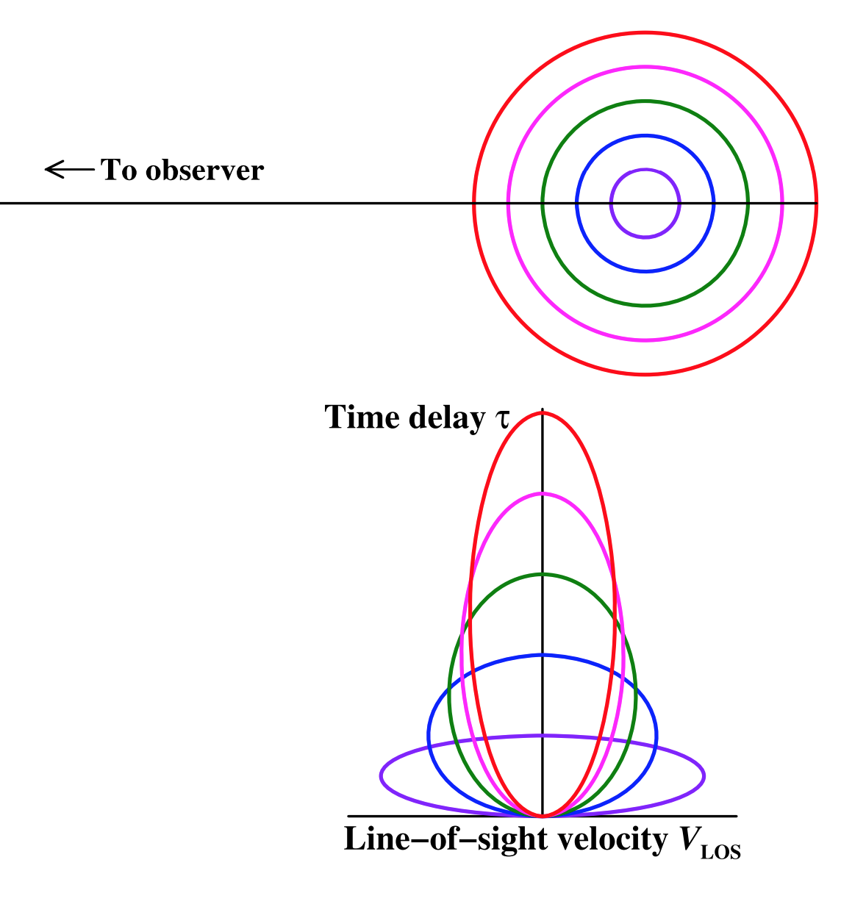
Geometry and kinematics of the BLRs
Transfer function / velocity-delay map
Peterson et al. (2011)

Slide 10
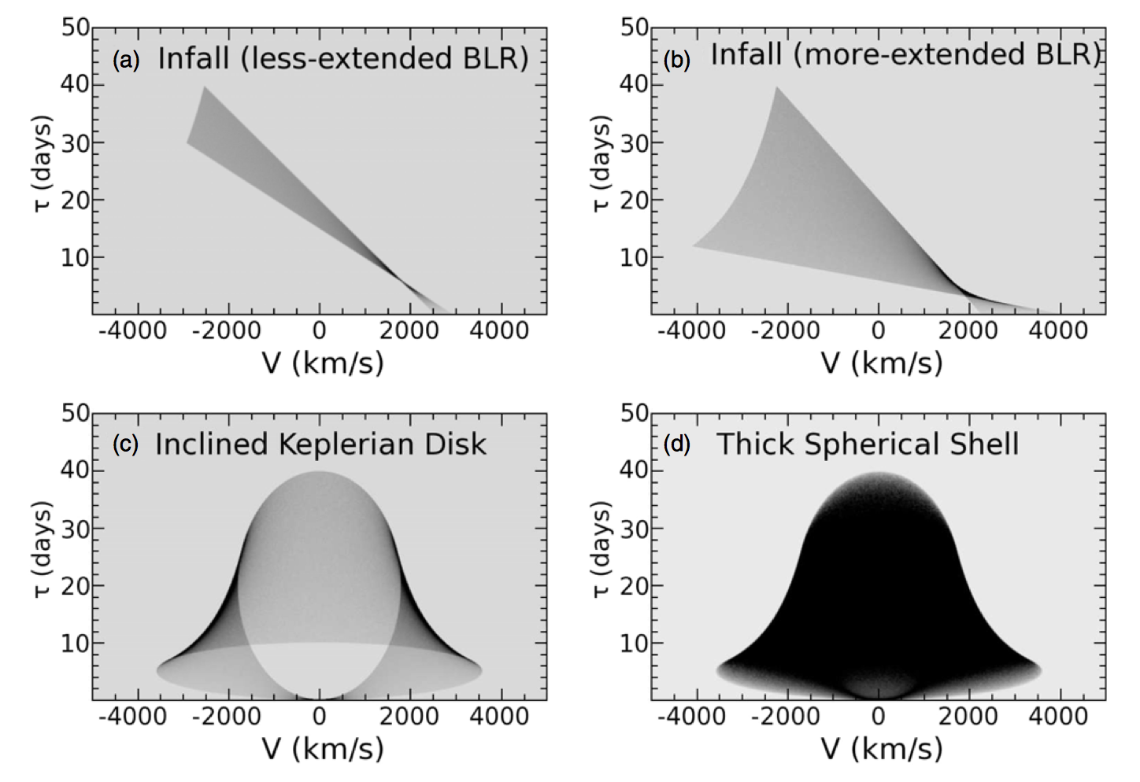
Reverberation Mapping Theory:
Transfer Functions & Velocity-Resolved Time Lags
Stuff here
More Stuff here.
Grier et al. 2013

Slide 11
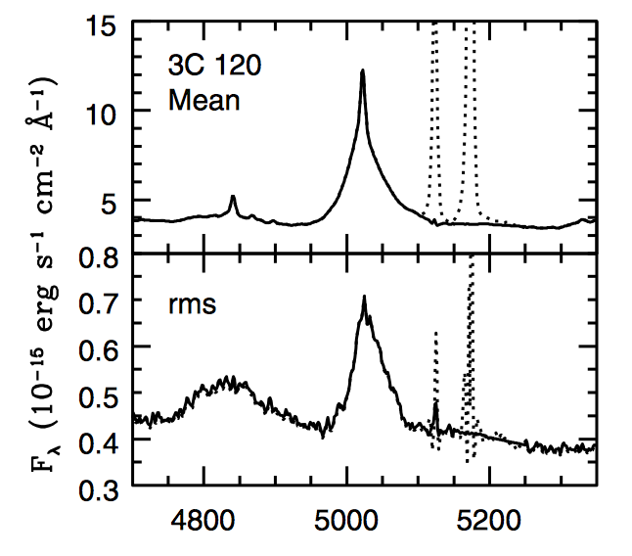
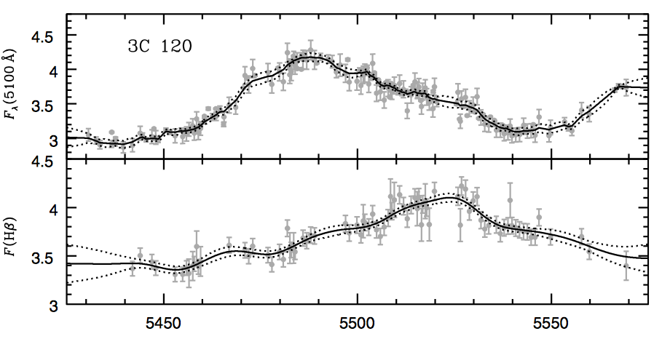
About 100 AGNS Reverberation Mapped
Example: 3C 120 from 2010 (Grier et al. 2012), delay ~26 days, log M_{BH} = 7.75
Broad lines are photoionized by the central continuum, which varies. The line flux follows the continuum with a time lag t which is set by the size of the broad-line emitting region and the speed of light. Recombination timescales are very short and the continuum source small and central. Essentially micro arcsecond resolution.

Slide 12
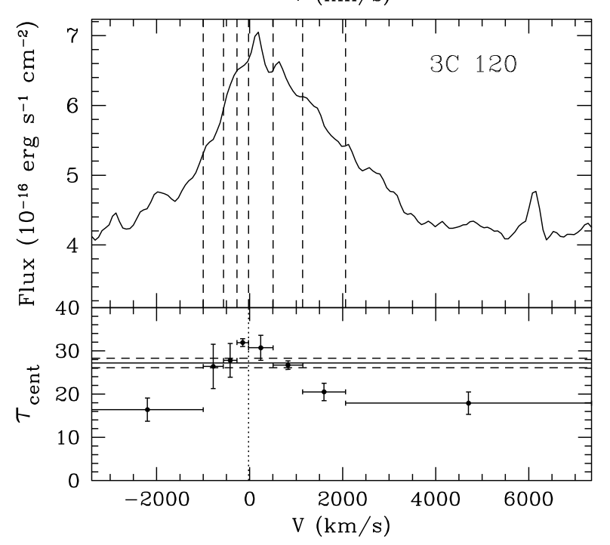
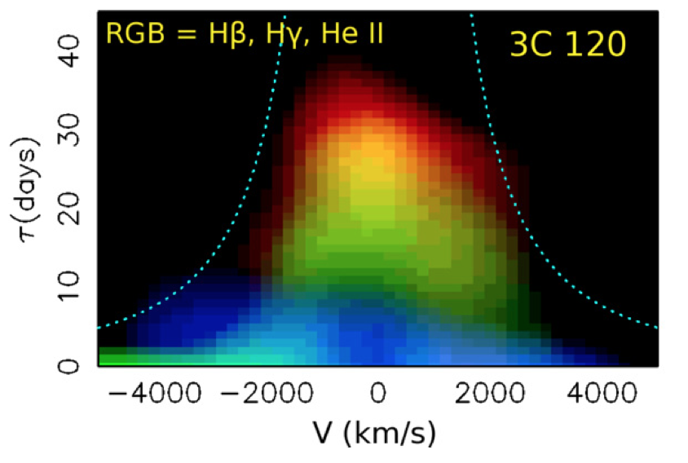
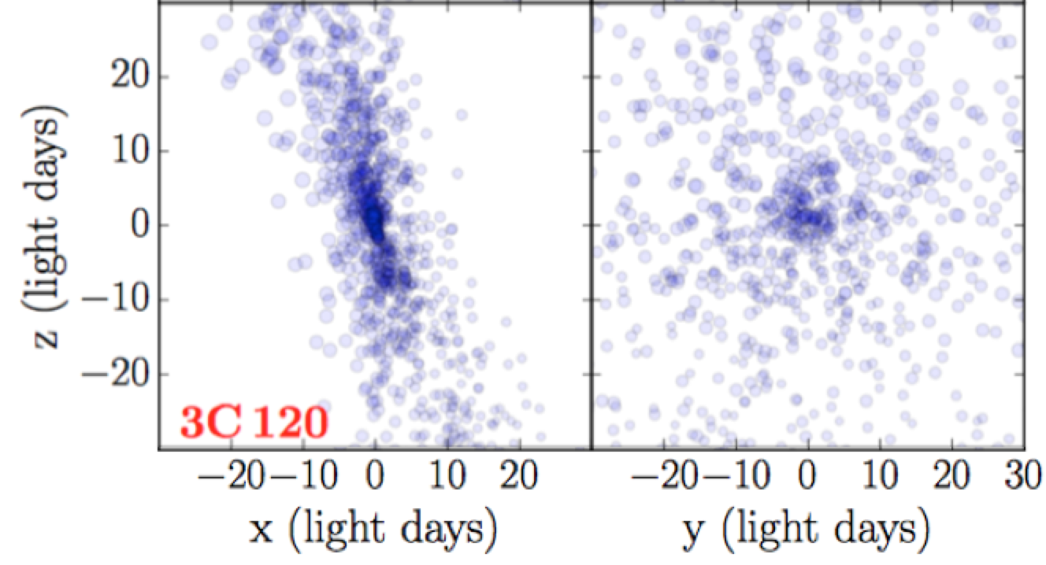
Beyond Mass: Velocity-Resolved Time Lags,
2D Velocity-Delay Maps, and Dynamical Modeling
Grier et al. 2013, 2017

Slide 13
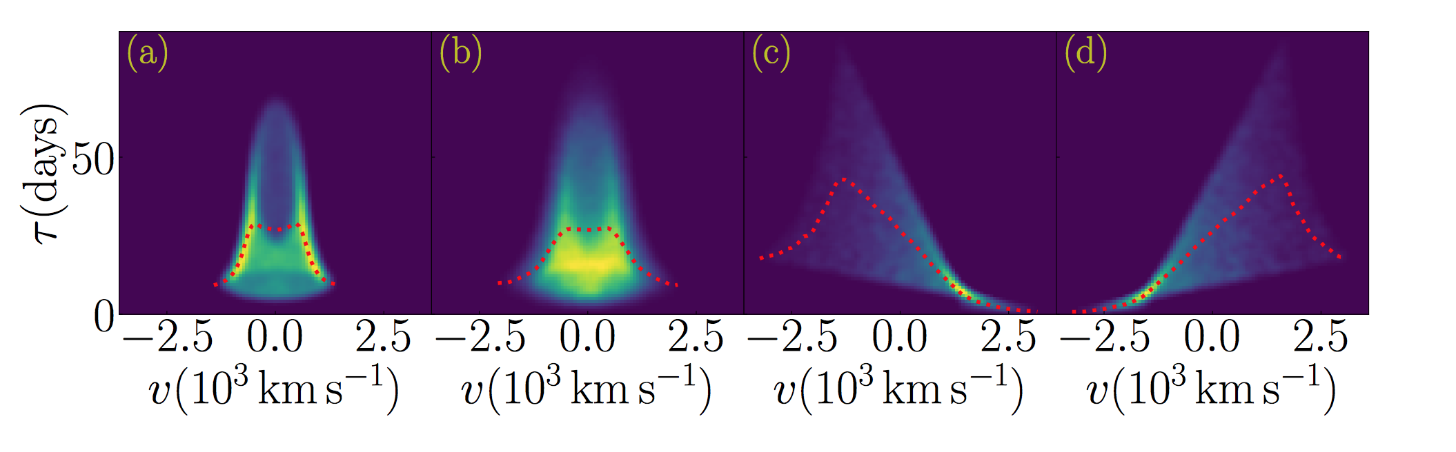
Example Theoretical 2D Velocity-Delay Maps
Thin Disk Thicker Disk Inflow Outflow
Wang et al. 2018

Slide 14
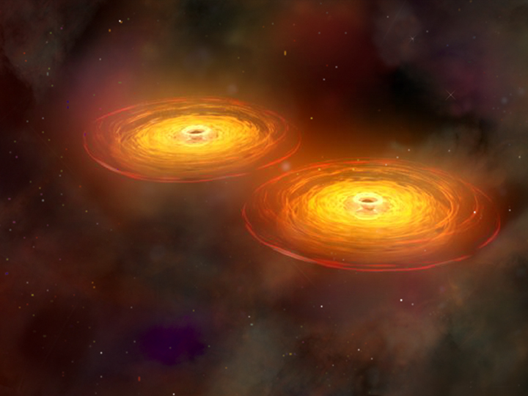
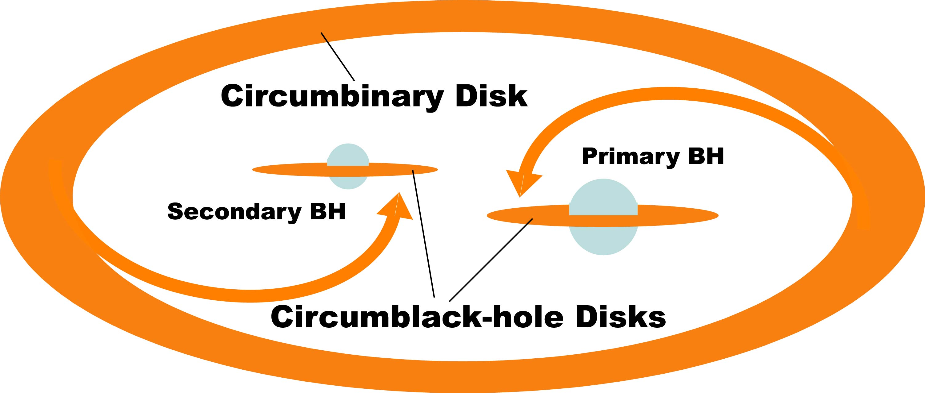
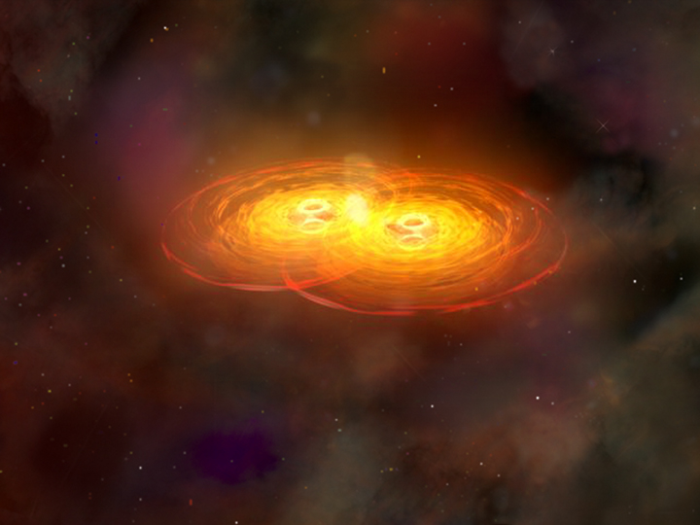
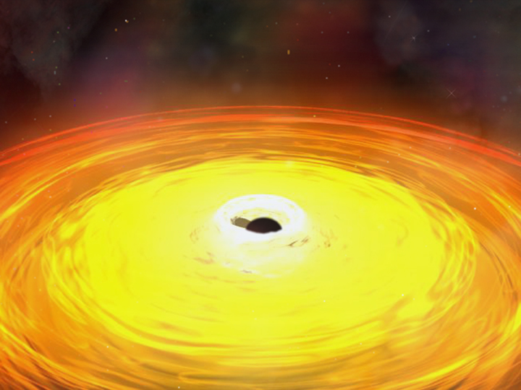
Close Binary Supermassive Black Holes?
CXC/NASA/M. Weiss

Slide 15
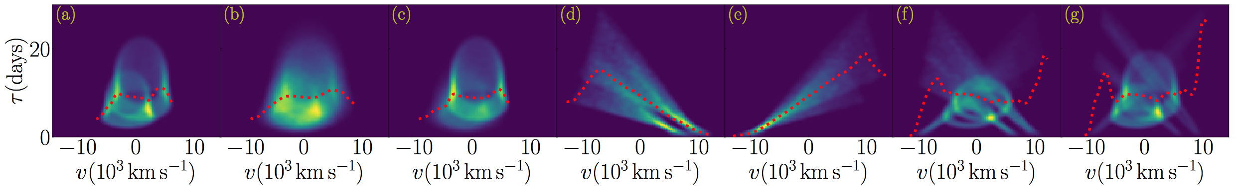
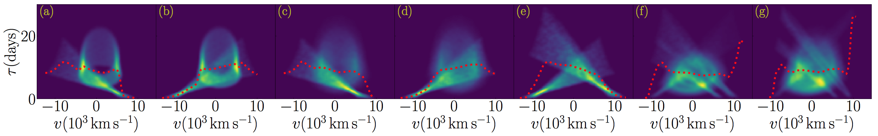
Theoretical Binary 2D Velocity-Delay Maps
a: 2⊗thin-disk; b: 2⊗thick-disk; c: (thin⊗thick)-disks; d: 2⊗inflow; e: 2⊗outflow; f and g: 2⊗(thin-disk+inflows+outflows)
a: thin-disk⊗inflow; b: thin-disk⊗outflow; c: thick- disk⊗inflow; d: thick-disk⊗outflow; e: inflows⊗outflow; f & g: 2⊗(thick-disk+inflow+outflow)
Wang et al. 2018

Slide 16
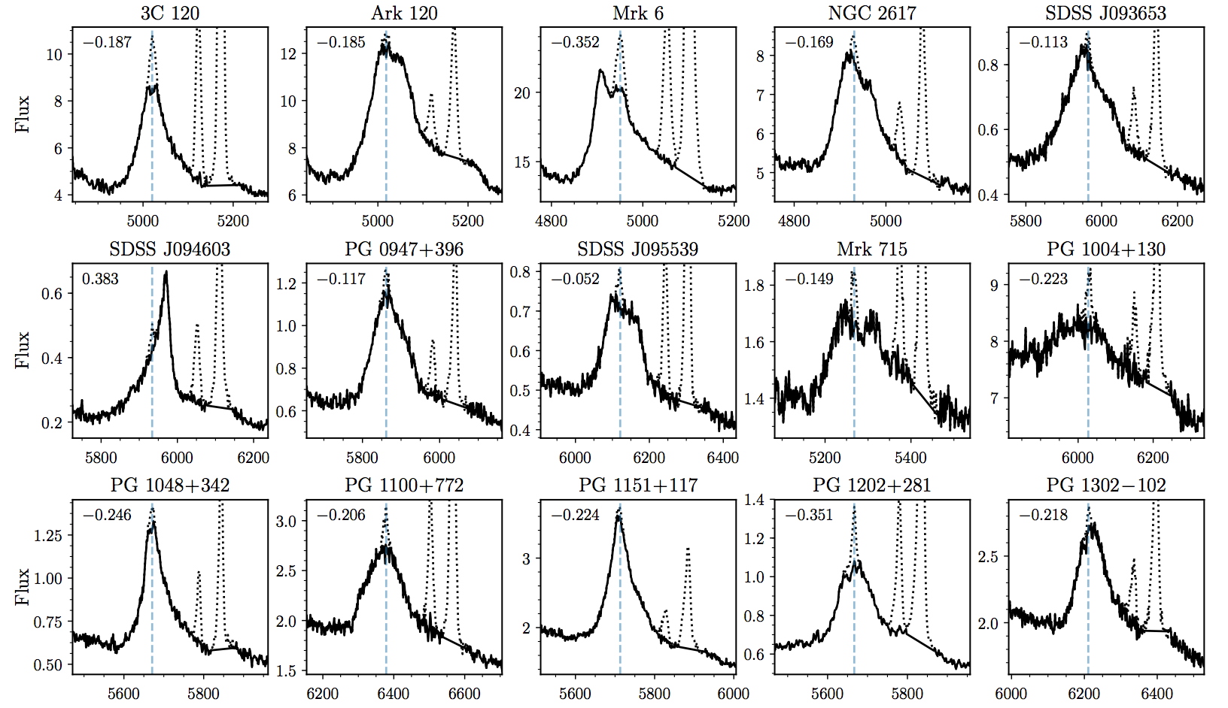
Monitoring AGN with Hbeta Asymmetry (MAHA)
~30 AGN with z < 0.4, V < 17, see WIRO spectra below:
Asymmetric Hbeta profiles
Double-Peaked Hbeta profiles
Binary Black Hole Candidates (e.g., periodicities, line shifts)
Other Interesting Behavior (e.g., changing asymmetries)

Slide 17
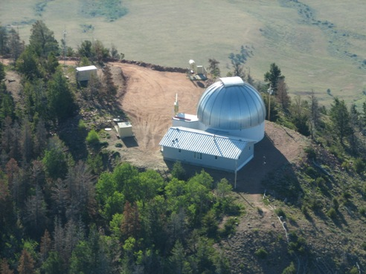
Monitoring AGN with Hbeta Asymmetry (MAHA)
Wyoming Infrared* Observatory (WIRO)
2.3 meter telescope
Wide slit, longslit spectroscopy
1.5 Angstrom/pix, 4000-7000A
1: Dec 2016-May 2017
2: Oct 2017-May 2018

Slide 18

WIRO Movie

Slide 19
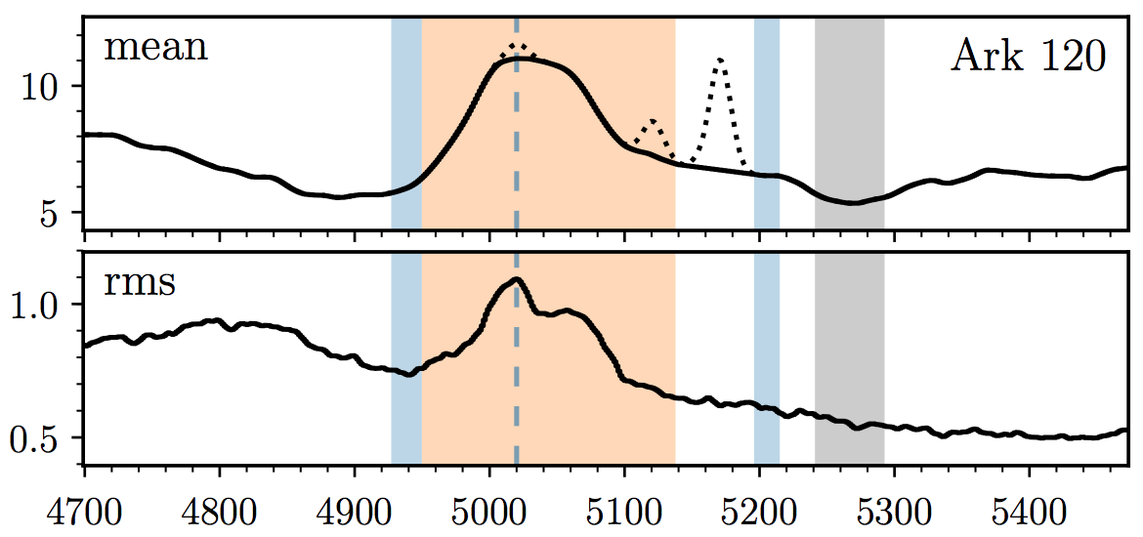
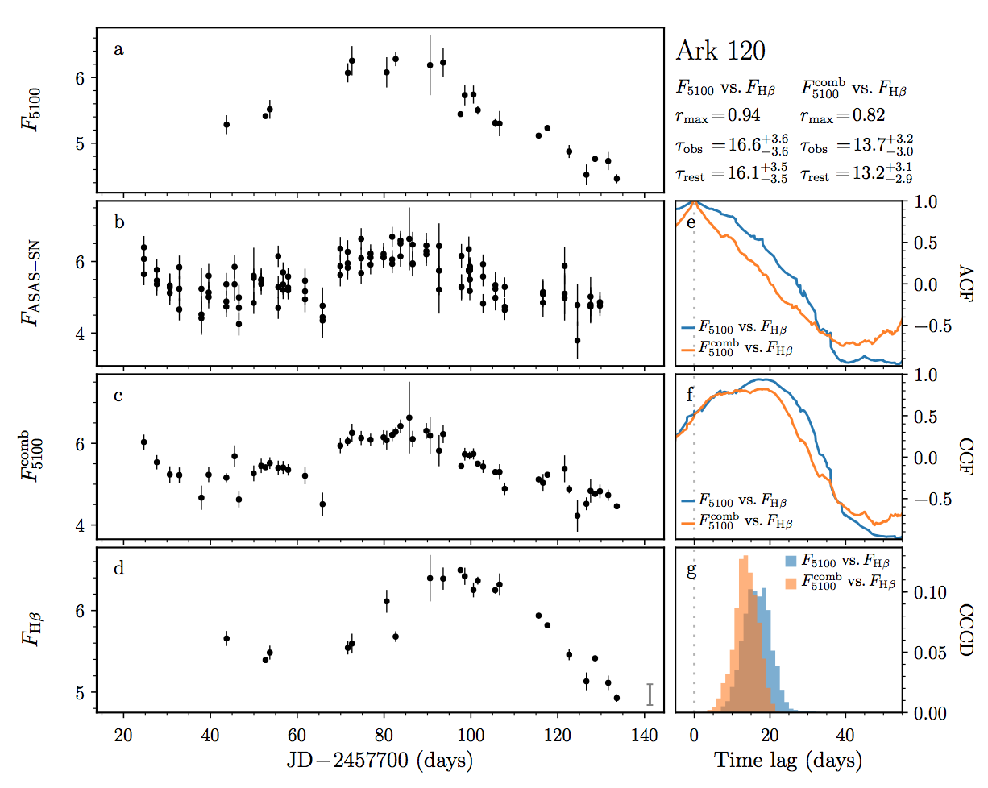
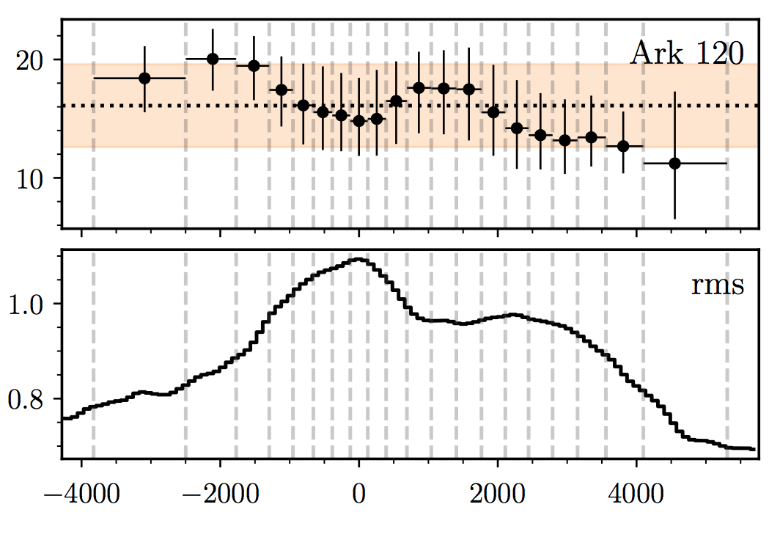
MAHA First Results: Ark 120
MAHA, Du et al. 2018

Slide 20
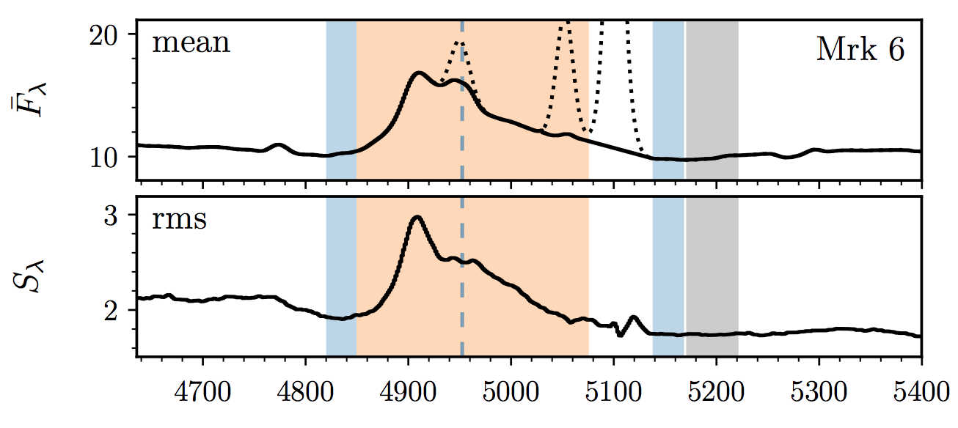
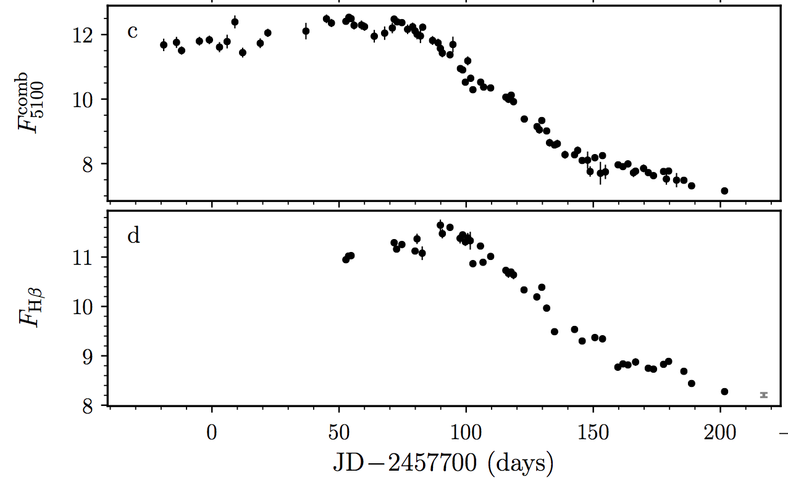
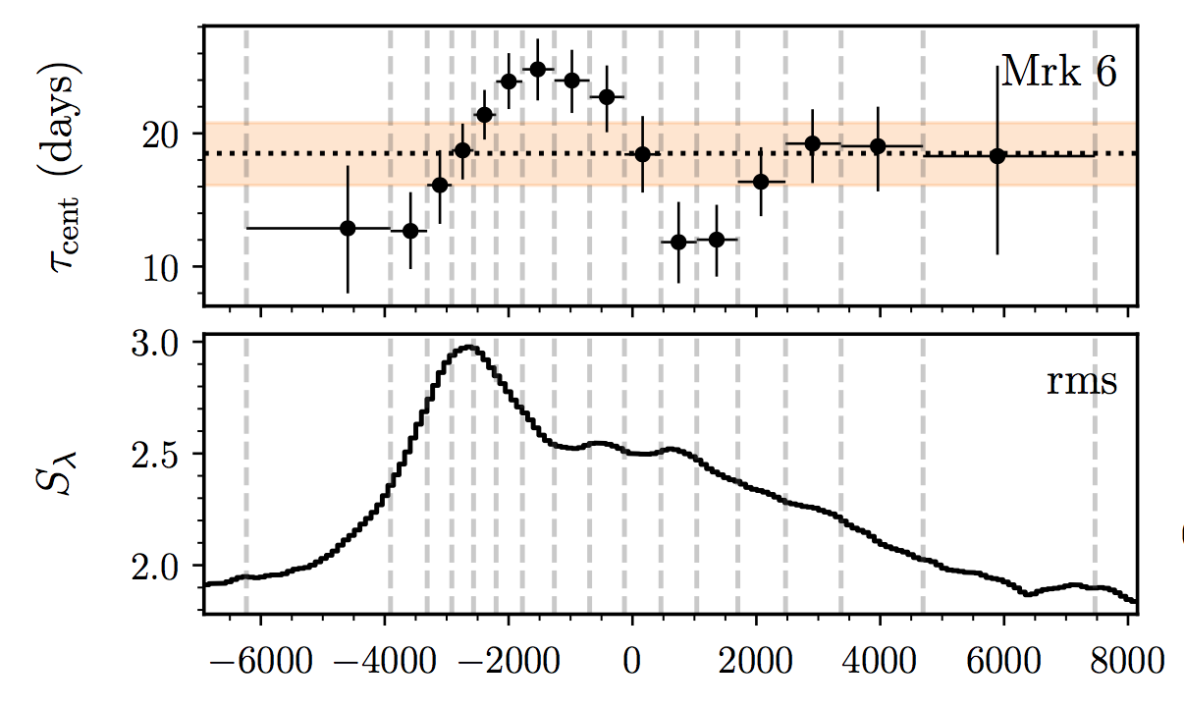
MAHA First Results year 1: Mrk 6
MAHA year 1, Du et al. 2018

Slide 21
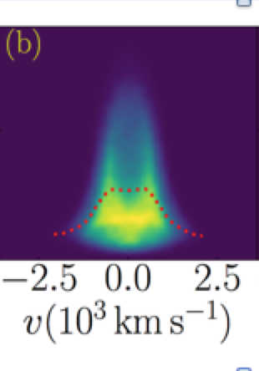
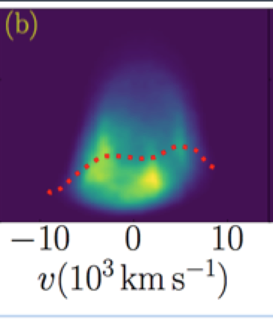
MAHA Preliminary Results year 1: Mrk 6
Single or Binary?

Slide 22
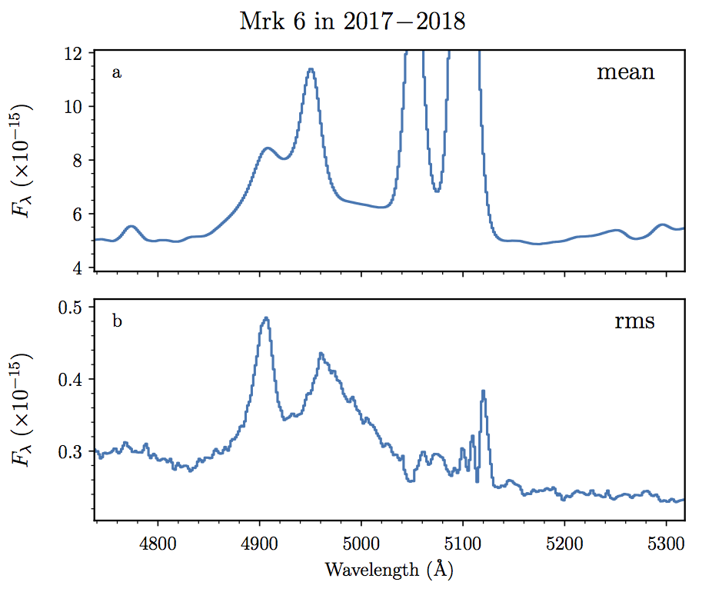
MAHA Preliminary Results year 2: Mrk 6

Slide 23
MAHA Preliminary Results year 2: Mrk 6
Single or Binary?

Slide 24
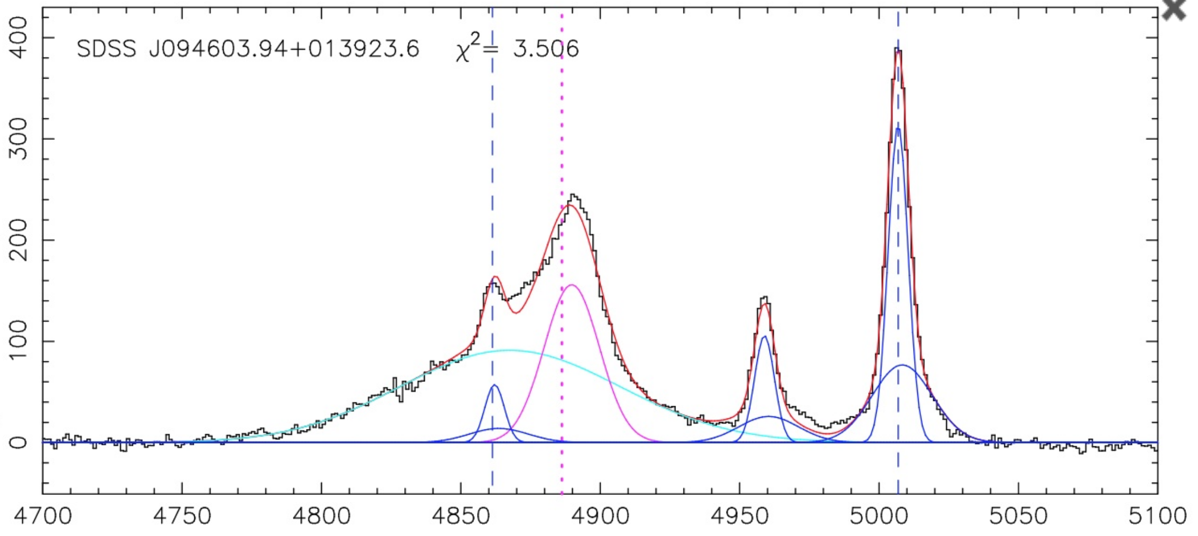
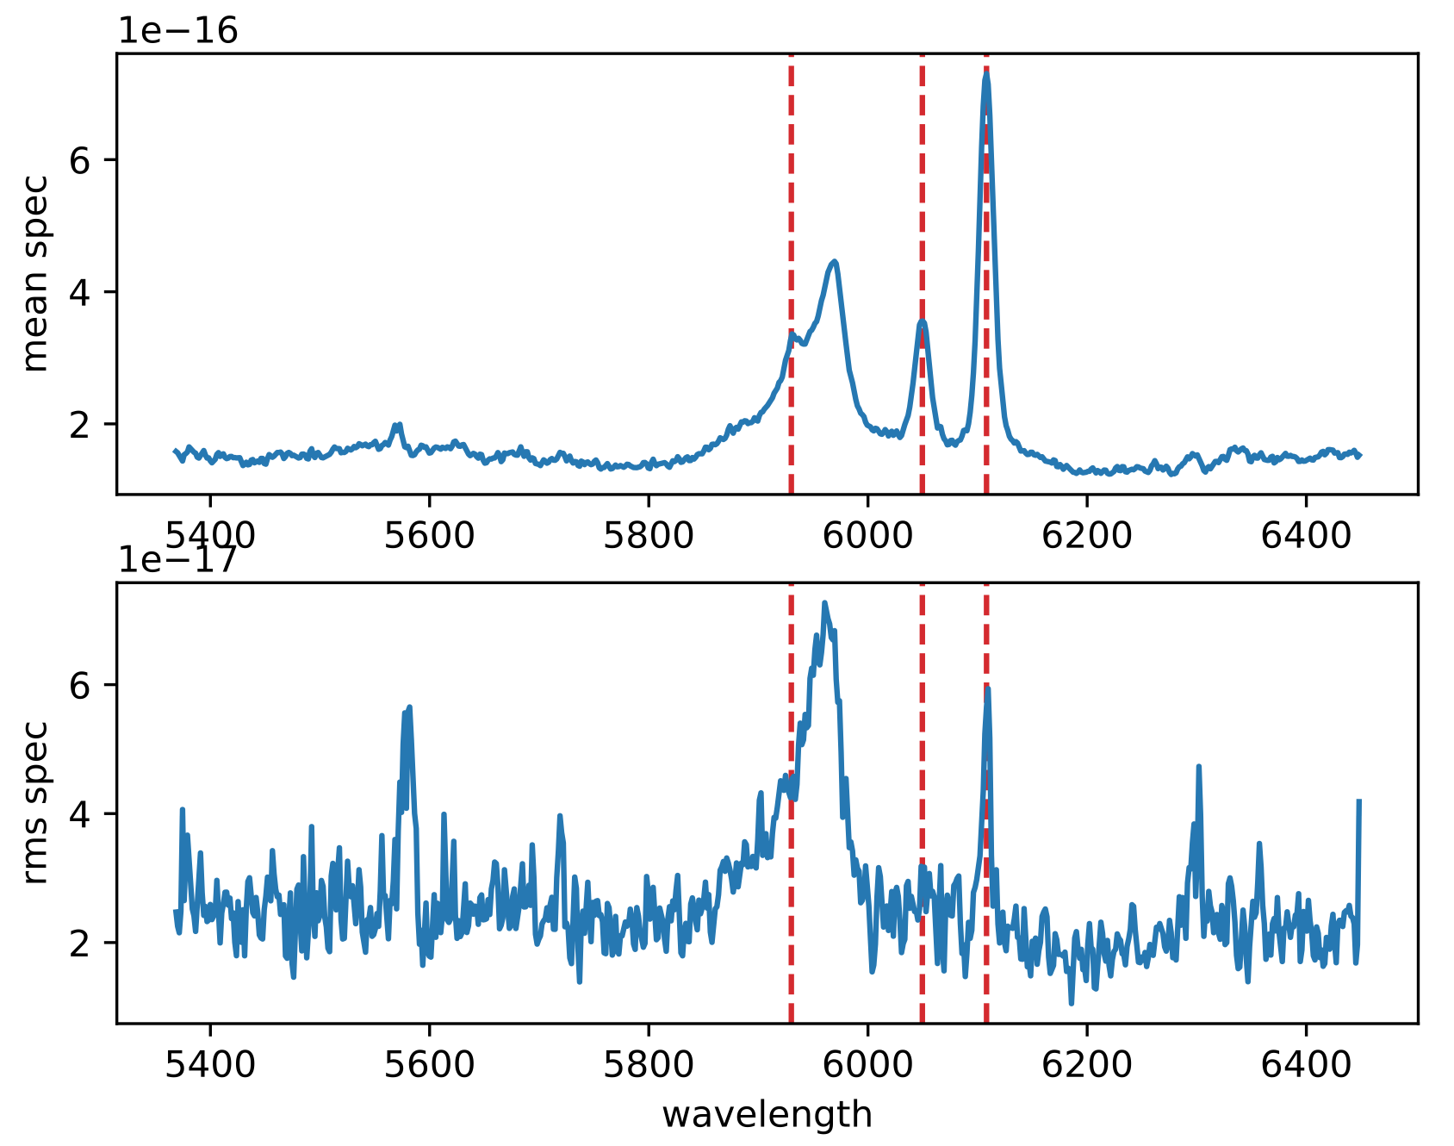
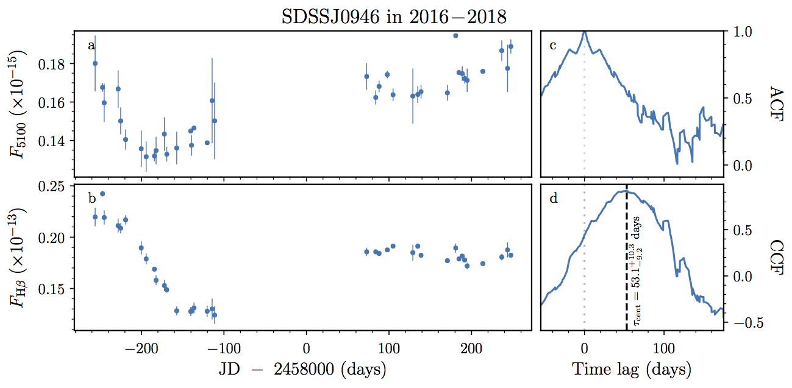
MAHA Preliminary Results:
SDSS J094603.94+013923.6
Binary quasar candidate from Eracleous et al. (2012) and Runnoe et al. (2017). Analagous to a spectroscopic binary star.
Time delay is about 60 days.

Slide 25
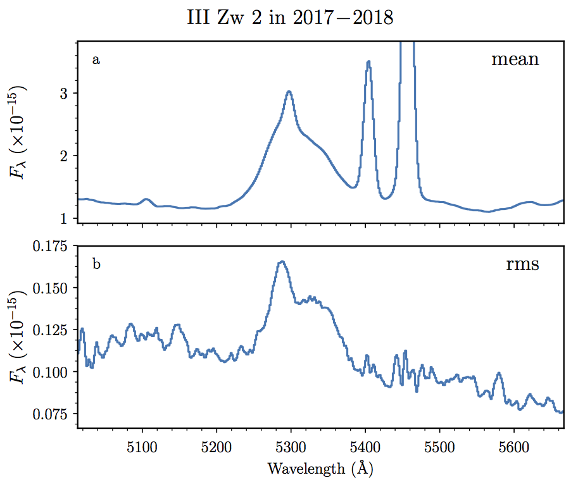
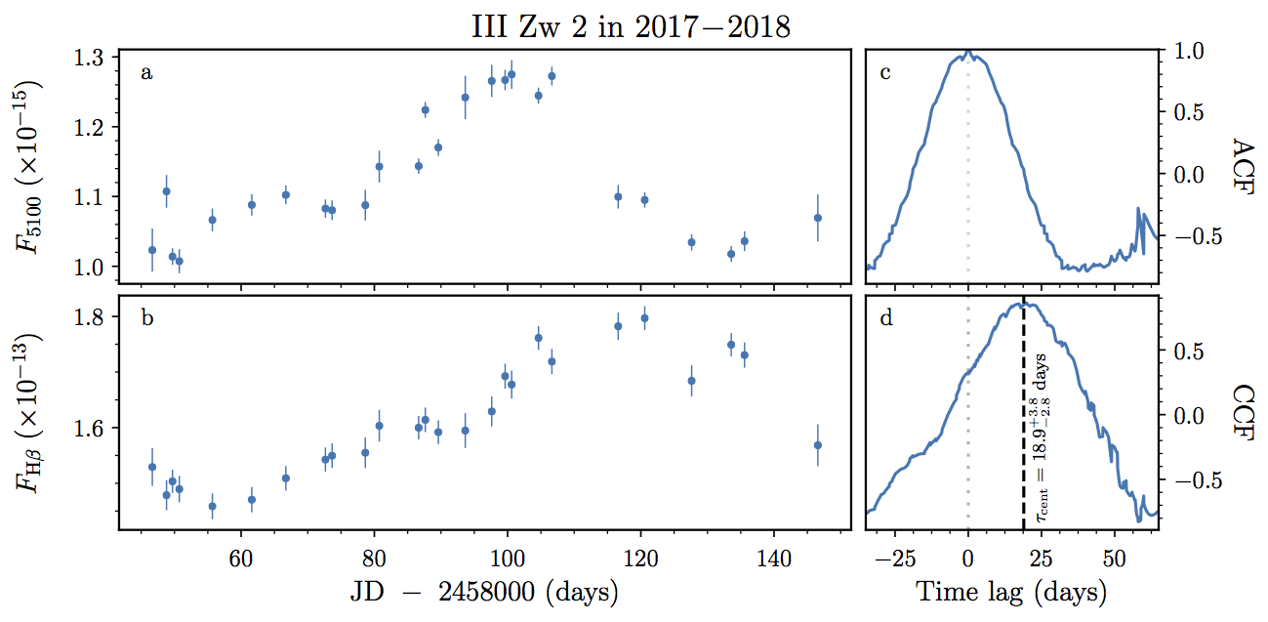
MAHA Preliminary Results year 2: III Zw 2

Slide 26
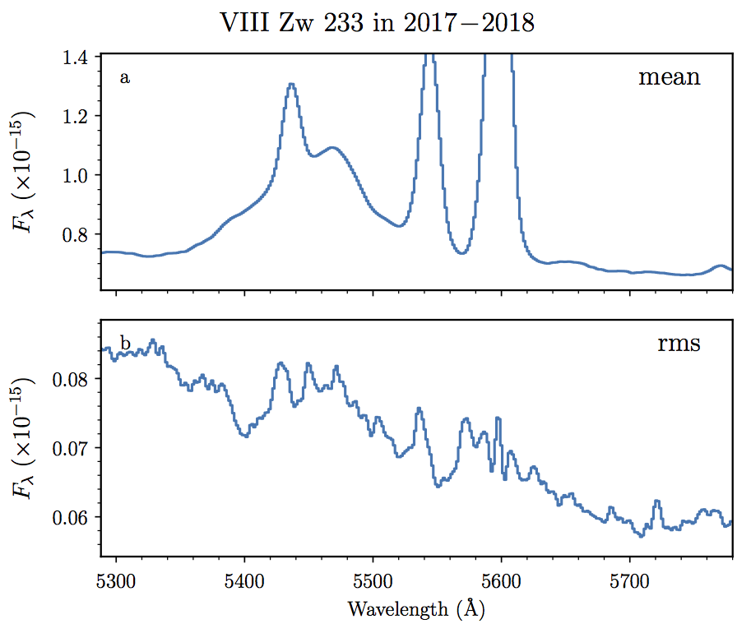
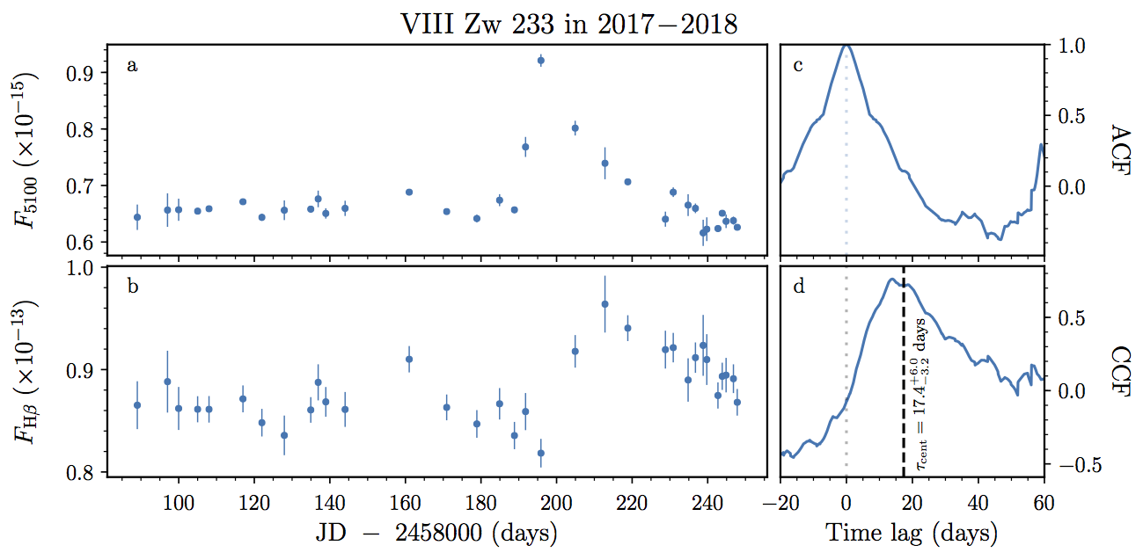
MAHA Preliminary Results year 2:
VIII Zw 233

Slide 27
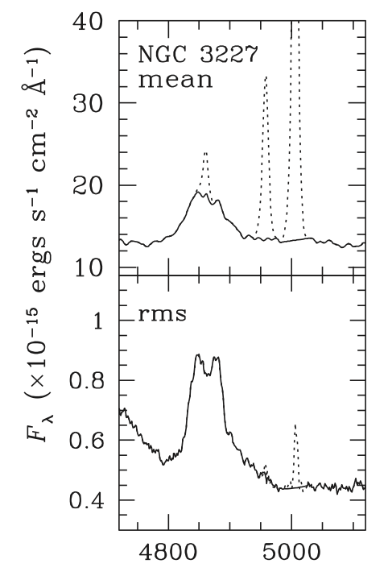
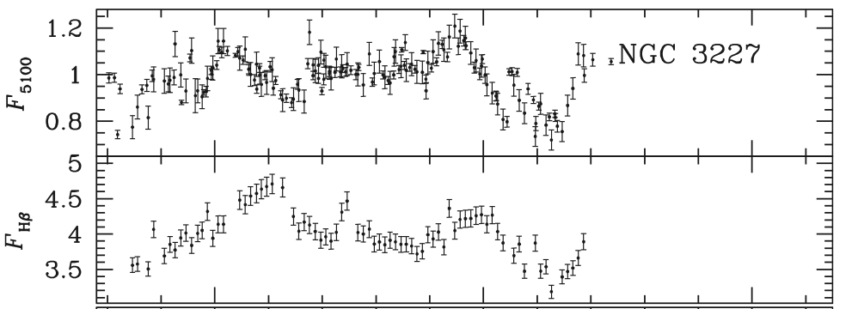
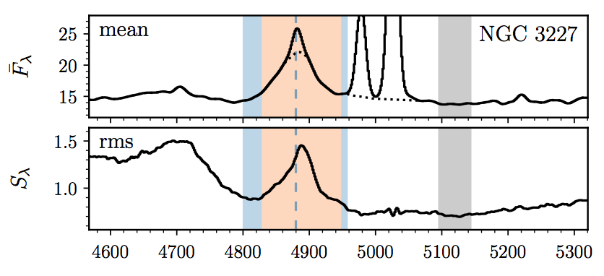
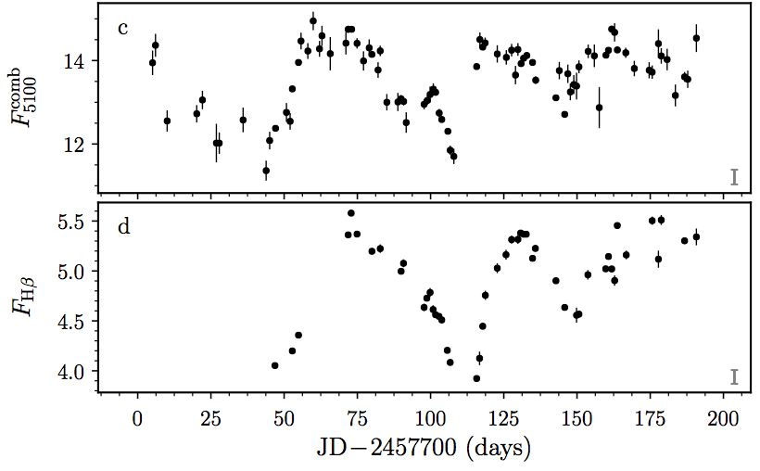
MAHA First Results: NGC 3227
Changing BLR
(Denney et al. 2009)
(Brotherton et al. 2018)

Slide 28
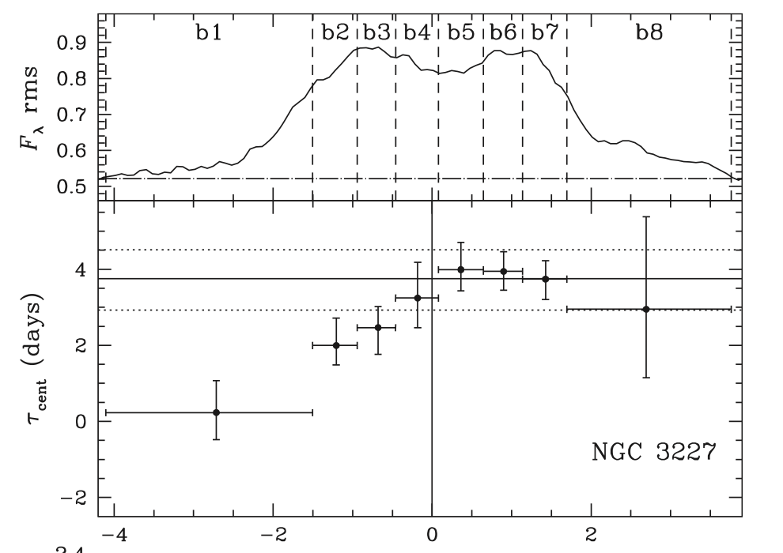
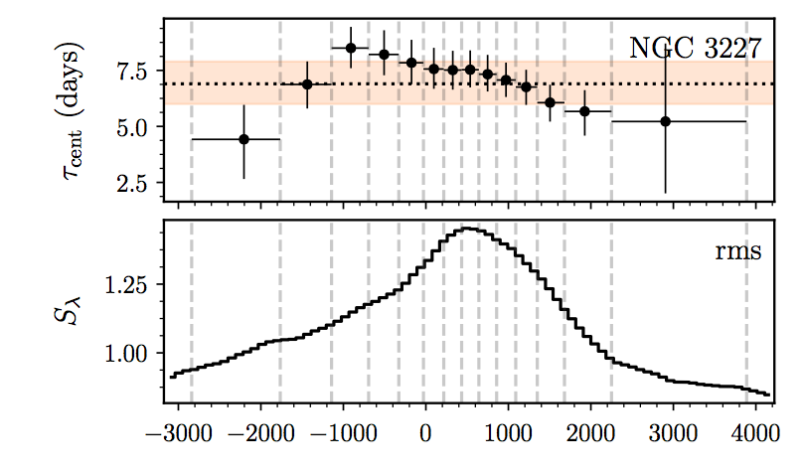
MAHA First Results: NGC 3227
Changing BLR
(Denney et al. 2009)
(Brotherton et al. 2018)

Slide 29
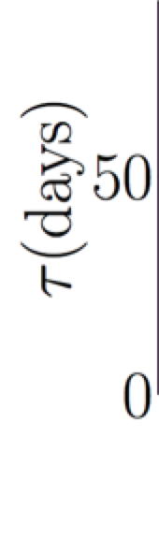
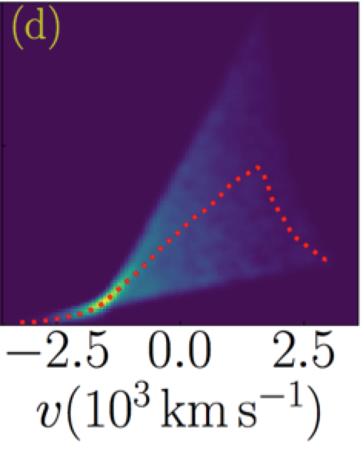
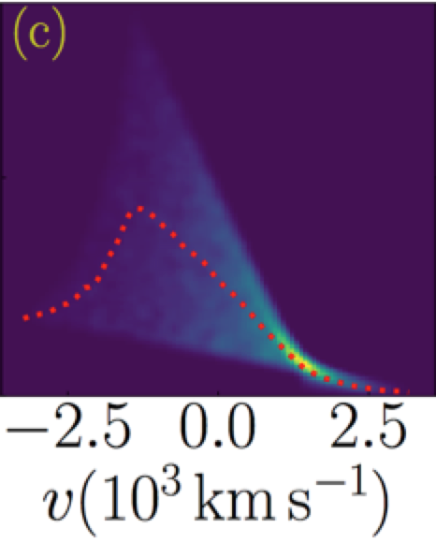
MAHA First Results: NGC 3227
Changing BLR
Left:
Velocity-Delay Maps (Wang et al. 2018)
Outflow
Inflow

Slide 30
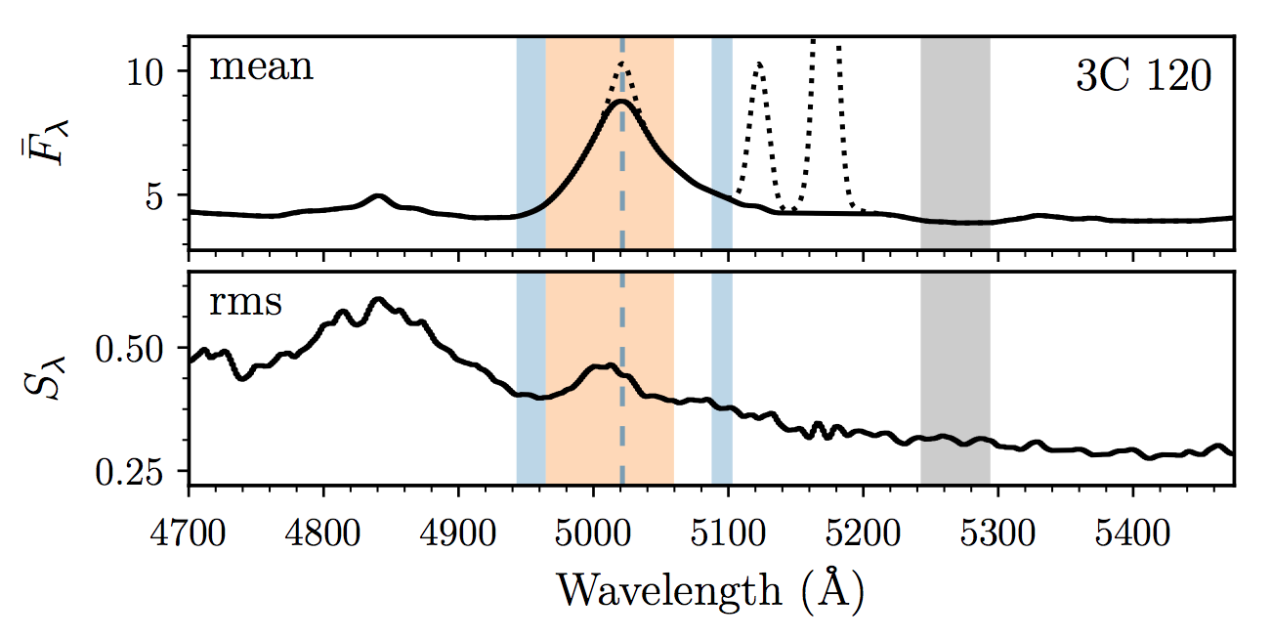

MAHA First Results: 3C 120
Changing BLR
(Grier et al. 2012)
MAHA (Du et al. 2018)

Slide 31

MAHA First Results: 3C 120
Changing BLR
(Grier et al. 2012)
MAHA (Du et al. 2018)

Slide 32

MAHA Preliminary Results year 2: Mrk 1148
A BLR “Holiday?” Mysteries to explore…

Slide 33
Future Work
Revise Target List for Next Campaign (August 2018--?)
Initial Papers: Velocity-Resolved Time Lags (x2 in Prep.)
Velocity-Delay Maps
Dynamical Modeling
Radius-Luminosity Relationship
Individual Objects of Interest
Sub-parsec Binary Quasars?

Slide 34
Summary
MAHA has about 15-17 Time Lags so far, with High-Quality Data, and more are coming, along with more sophisticated analyses.
AGN BLR origin and evolution not yet understood in detail. Exploring the full diversity of AGN profiles will provide insight.
The details are important for understanding black hole masses. Do asymmetric profiles signify fundamentally different BLR structures? Inflows, outflows? Binary black holes?

Slide 35

Does the BLR obey the Virial Theorem?
Four well studied AGNs, RM of multiple emission lines shows the expected relationship (slope = -2) between time lags and velocities (note each of the three will have different central black hole masses).
NGC7469: 8.4x10⁶ M☼
NGC3783: 8.7x10⁶ M☼
NGC5548: 5.9x10⁷ M☼
3C 390.3: 3.2x10⁸ M☼
Peterson (2011)

Slide 36

How to calibrate the (average) f factor?
RM-derived masses follow the same M-sigma relationship (fitting f) as seen for normal galaxies that have black hole masses measured from HST spatially resolved gas or stellar dynamics.
Good to 0.5 dex in plot, 0.3 dex in more recent work.
Ferrarese et al. (2001)

Slide 37



The Future of RM: Binary Black Holes
PG 1302-102
Runnoe et al. 2016
Graham et al. 2015
WIRO 2017

Slide 38

2D Velocity Delay Maps &
Velocity-Resolved Time Lags
Stuff here
More Stuff here.
Grier et al. 2017a

Slide 39


About 100 AGNS Reverberation Mapped
Mrk 335 from 2010 (Grier et al. 2012), delay ~14 days
Broad lines are photoionized by the central continuum, which varies. The line flux follows the continuum with a time lag t which is set by the size of the broad-line emitting region and the speed of light. Recombination timescales are very short and the continuum source small and central.

Slide 40

Reverberation Mapping (RM)
Fassnaugh et al. (2016)
Broad lines are photoionized by the central continuum, which varies. The line flux follows the continuum with a time lag t which is set by the size of the broad-line emitting region and the speed of light. Recombination timescales are very short, BLR stable, and continuum source small and central.

Slide 41
The Future of RM: Binary Black Holes
PG 1302-102
Runnoe et al. 2016
Graham et al. 2015
WIRO 2017

