Slide 1
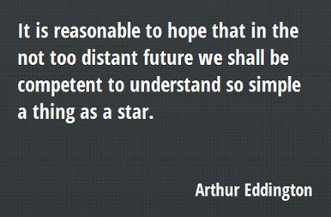
ASTR 2320
General Astronomy II
Professor Mike Brotherton
Properties of Stars
Chapter 11, 12 (Dobson), Chapter 13 (Ryden & Peterson)

Slide 2
Equatorial Coordinates
Right Ascension is like longitude on the sky. Divides the sky into 24 HOURS.
Declination is like latitude on the sky. Divides the sky into 360 degrees. Then arc minutes and arc seconds, NOT equivalent to minutes and seconds of RA.
Epochs (B1950) and (J2000) due to precession
Examples from Simbad Astronomical Database: Polaris, Sirius
See Chapter 3 (on Dobson’s website) for more details, or look up even more details online.

Slide 3
Distance, Parallax, and Parsec
Derivation of trigonometric parallax: d (pc) = 1/p (arcseconds) (θ in the diagram, but p is also commonly used)
Example: Visit Simbad again for Sirius.
What if the star is not in the plane of the ecliptic as shown?

Slide 4
Distance, Parallax, and Parsec
The Millenium Falcon made the Kessel Run in 11 parsecs. Huh?
What is a parsec in light-years?
What is a light-year? Let’s calculate…
Will use both parsecs and light-years for stellar distances. Will go to Mpc and Gpc for cosmological distances.
Figure still NOT TO SCALE

Slide 5
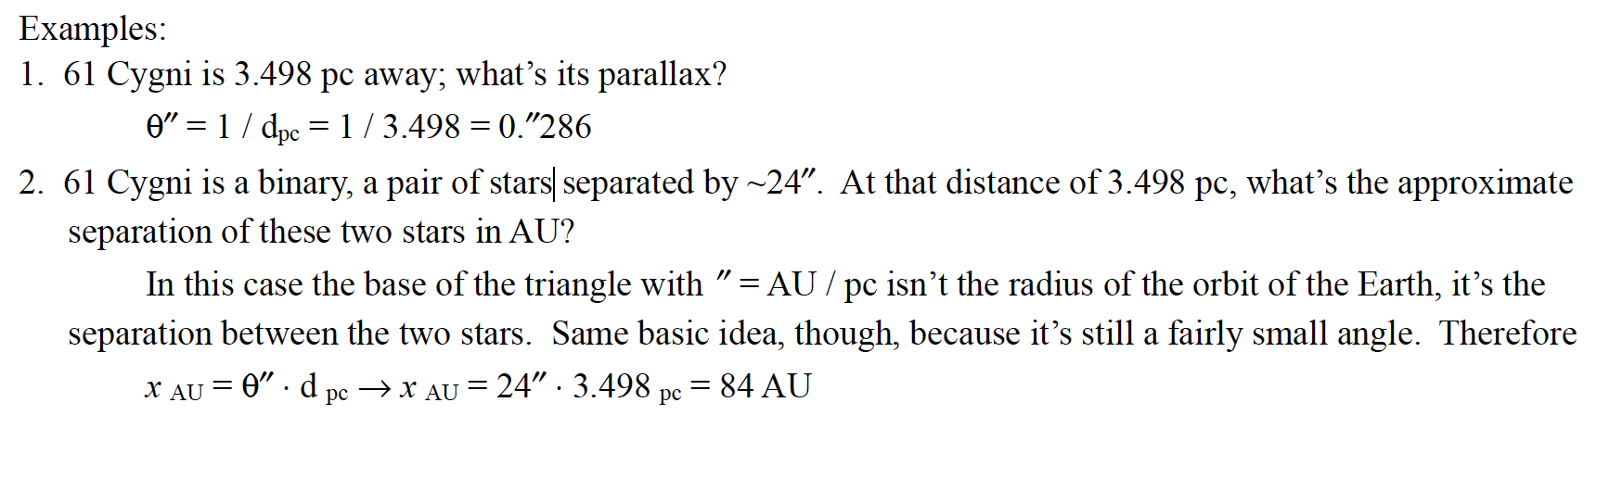
Distance, Parallax, and Parsec

Slide 6
Proper Motion
Stars in the sky, and the sun itself, are MOVING. We can see non-parallax motion in the sky and call it proper motion (μ) and characterize it in arcseconds per year.
V_{tan}(AU/yr)= μ(’’/yr) x d (pc)
V_{tan}(km/s)= 4.74 μ(’’/yr) x d (pc)
Proper motion has a magnitude, but often broken down into RA and DEC components. Issue of LSR (local standard of rest).
Figures Not to Scale

Slide 7

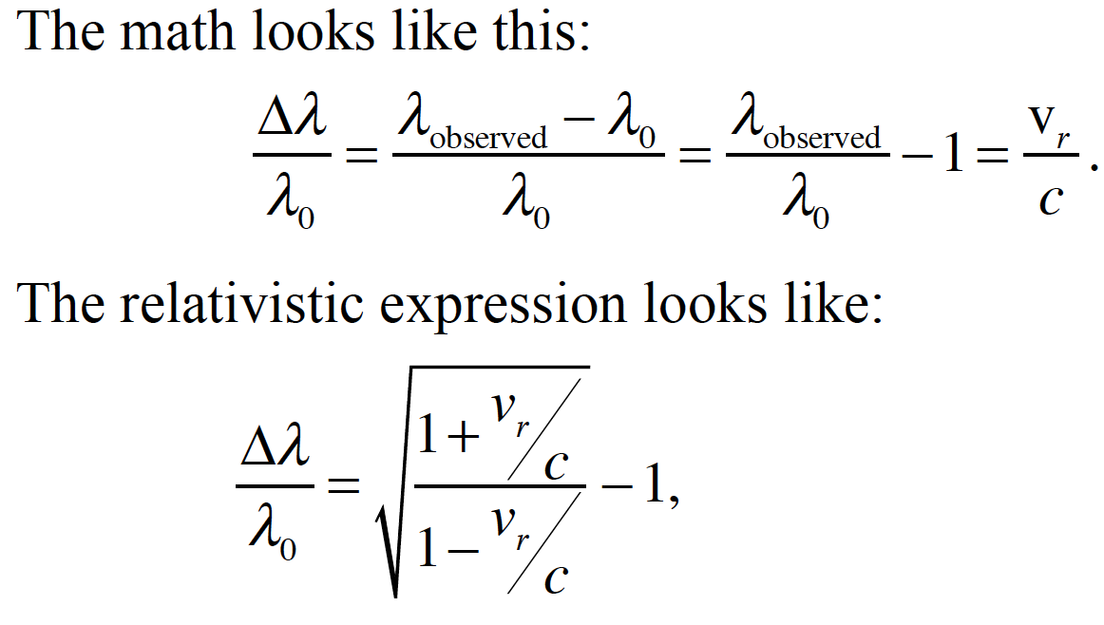
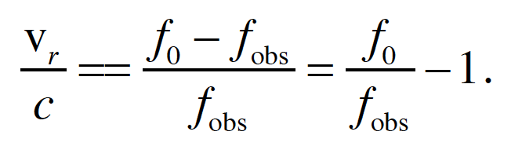
Doppler Effect (Radial Velocity)

Slide 8
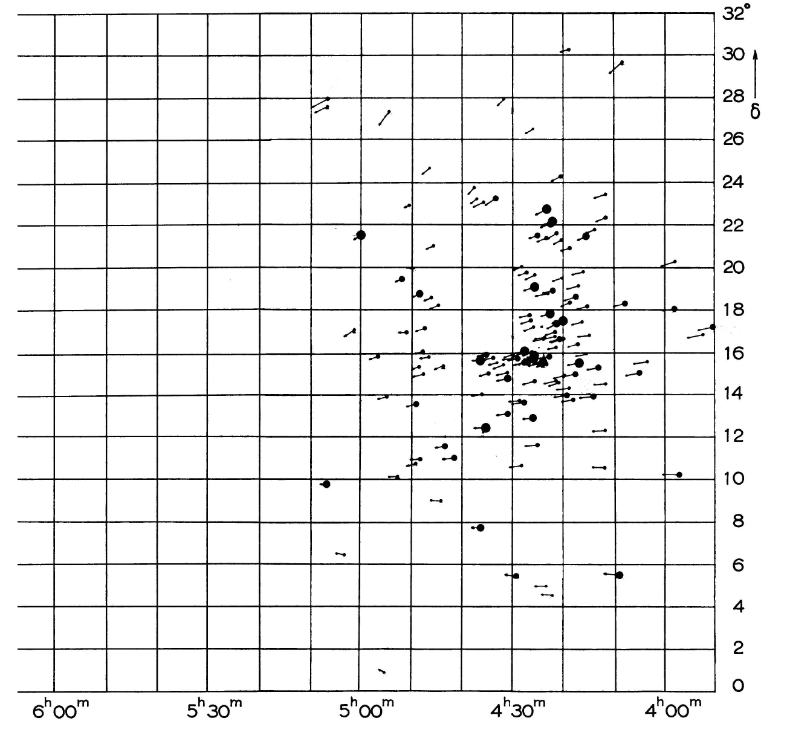
Other Parallax Methods
Exploit solar motion. Solar apex and antapex. “Roughly, we’re moving nearly toward the star Vega and away from the star Sirius. The solar motion with respect to the LSR is ~20 km/s; the LSR moves at ~220 km/s around the galaxy.”
Statistical methods developed historically.
Statistical parallax: average tranverse velocities can, for a group of stars, can give average distance. On average same as radial velocity.
Secular parallax. Exploit fact that sun is moving about 4 AUs/yr through Milky Way, longer baseline.
Moving Cluster method. Exploit convergence point for cluster like the Hyades (right).

Slide 9
Direct Trigonometric Parallax via Gaia
Now we just have space satellites with excellent astrometry. Hipparcos in past, now Gaia. Wiki. Current state of the art!
Fraser Cain video. 10 minutes.
PBS video. 10 minutes. Slightly preferred, but a bit beyond the material in this chapter, although we will get to it.

Slide 10
Light from Stars
Luminosity (J/s) is energy emitted per second, often assumed to be isotropic. (Note often astronomers will use cgs units rather than mks units. We’ll use mks units here usually for consistency with the textbook.)
Inverse square law and Flux: f (J/s/m²) = L/(4πd²) – this is what we can measure with a telescope, modulated by atmosphere, extinction, etc.

Slide 11
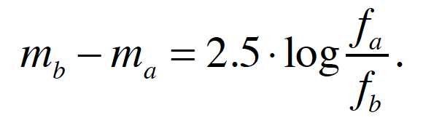
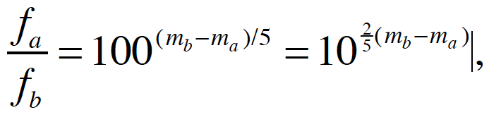
Magnitudes
A visual system derived from the Greeks. Every five magnitudes is a factor of 100 in brightness. One magnitude is the 5th root of 100, or 2.512. Fainter objects have larger magnitudes.
Magnitudes based on observed brightness are apparent magnitudes.
Measuring relative magnitudes isn’t so hard. Absolute calibration is tricky however. Standard scales (e.g., Vega system – more later).
Relating magnitudes to fluxes then for stars a and b:

Slide 12
More Magnitudes
The log nature of magnitudes kind of makes them annoying to work with. For example, if you have a binary star system with star a, which has a magnitude of 8.9, and star b with a magnitude of 11.4, what is the magnitude of the system if spatially unresolved?
More in text, can do more in class and homework. Straightforward but takes a little practice to build intuition.

Slide 13
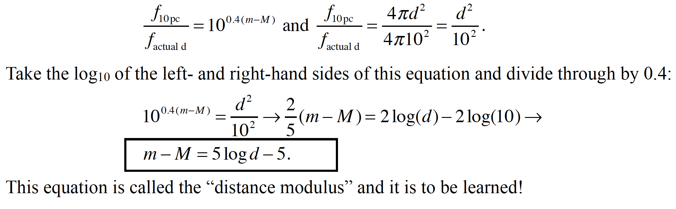
Absolute Magnitude and Distance Modulus
Absolute magnitude (use a capital M) is a standardized magnitude if an object were at 10 pc distance. It’s a way to compare luminosities of objects using the magnitude scale and is not uncommon.

Slide 14
Stellar Colors and Photometric Filters
Through a telescope, or by eye for some bright stars, we see they can differ in color.
Astronomers quantify this by measuring magnitudes through different colored filters. Magnitudes often then get subscripts, or the filter name itself might be used, e.g., m_{v} or v.
Many filter systems, like Johnson, Sloan, etc., slightly different.
Different magnitude zero points, too. One popular one is Vega, which has an apparent magnitude of zero in every band.

Slide 15
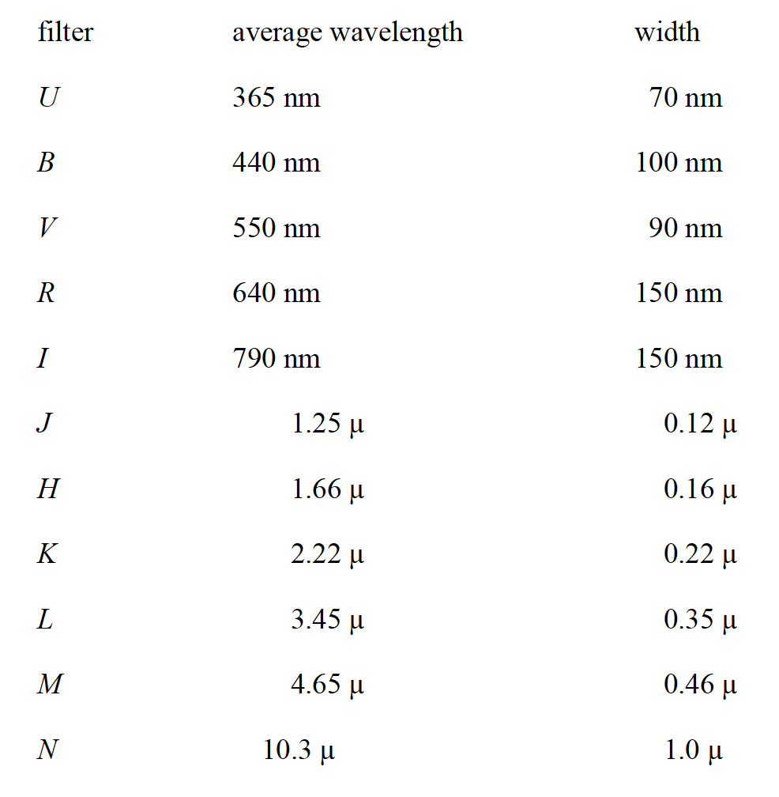
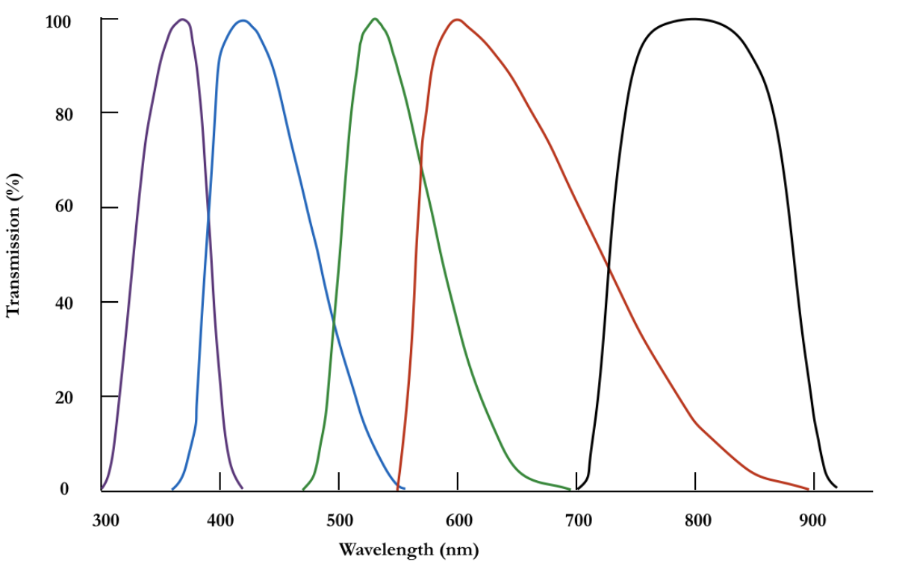
Example: Johnson-Cousin Photometric Filters

Slide 16
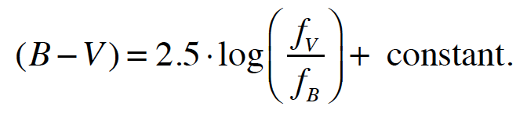
Color Indices
Just the difference between magnitudes through different filters.
For example:
It is customary to use the bluer color first. Then smaller indices indicate bluer colors. Color-color and color-magnitude diagrams are often useful in astronomy as we’ll see.
That constant takes care of different bandpasses and zero points.

Slide 17
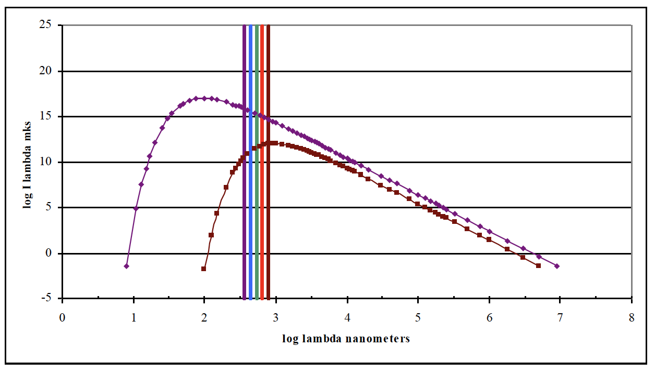
The Color of Stars
Stars are not exactly blackbodies as we’ll see but they are approximately.
Stars have different effective temperatures, and hence different colors.
See chapter 1 for more on blackbodies. Below are 3,000K and 30,000K BBs. Can look up colors for stars on Simbad, too.

Slide 18
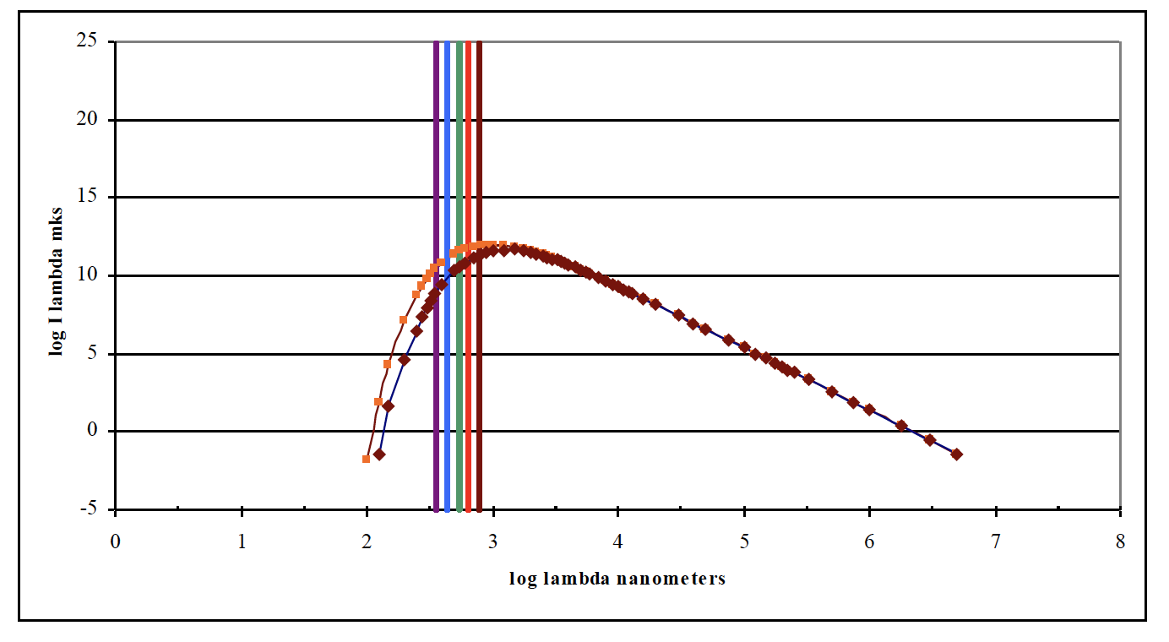
Blackbody Spectra with Extinction
There is atmospheric extinction that depends on airmass that can be corrected for. There is also interstellar dust that causes extinction (and reddening like a sunset).
Below is 3000 K blackbody with 1 magnitude of extinction in V band.

Slide 19
The Math of Extinction
m_{V} − M_{V} = 5 log d − 5 + A_{V} .
In the Galactic plane extinction in the V band is about 1 mag/kpc.
Extinction reddens objects! There is a “color excess”:
E_{(B – V)} = (B – V)_{observed} – (B – V)_{intrinsic}.
Roughly related to A_{V}, but varies with type of dust. A_{V} ≈ 3.1 E_{(B – V)}

Slide 20
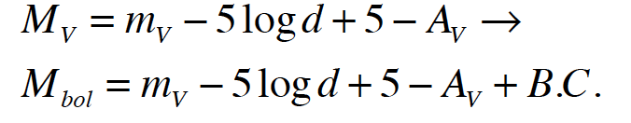
Bolometric magnitudes and corrections
For some purposes, we’d like to know the total brightness (apparent or absolute magnitudes) for a star across the ENTIRE spectrum.
For the sun, which we can measure: M_{V} is 4.83 and its M_{bolometric} = 4.75; the Sun’s bolometric correction is –0.08. Most of the sun’s photons come out in the visual part of the spectrum.

Slide 21
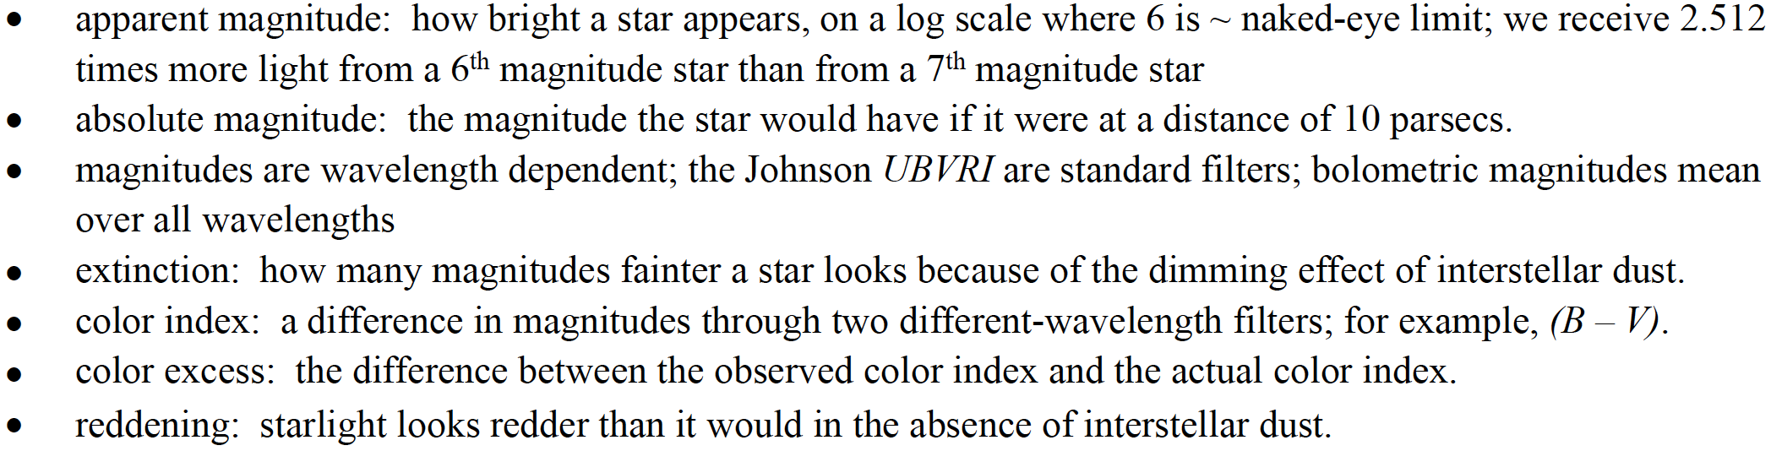
Summary of terms/concepts

