Slide 1
ASTR 2320
General Astronomy II
Professor Mike Brotherton
Chapter 19 – Cosmology
We shall not cease from exploration, and the end of all our exploring will be to arrive where we started and know the place for the first time. --T. S. Eliot

Slide 2
Cosmology
GREAT WEB RESOURCE: http://www.astro.ucla.edu/~wright/cosmolog.htm
Contains a cosmological calculator
A tutorial
FAQ list
Also Wayne Hu’s webpage at http://background.uchicago.edu/~whu/
American Museum of Natural History video: The Known Universe
Continue overview, after we will dive deeper!

Slide 3
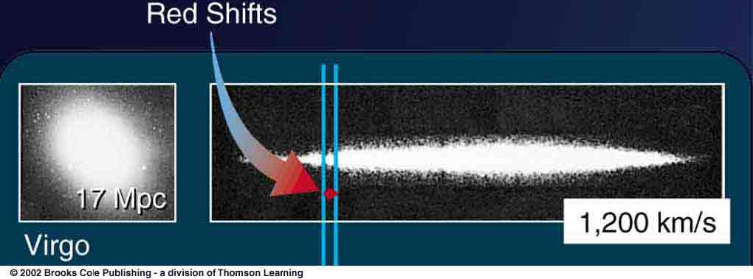
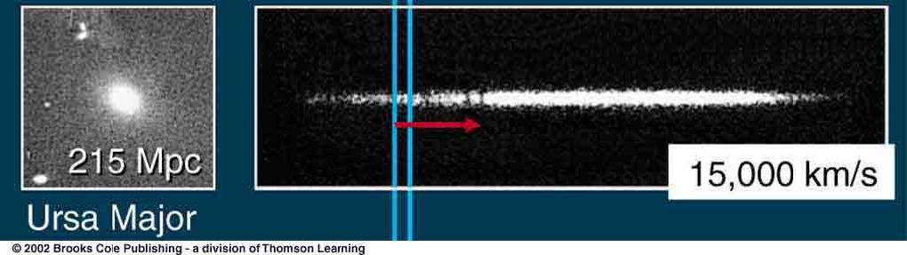
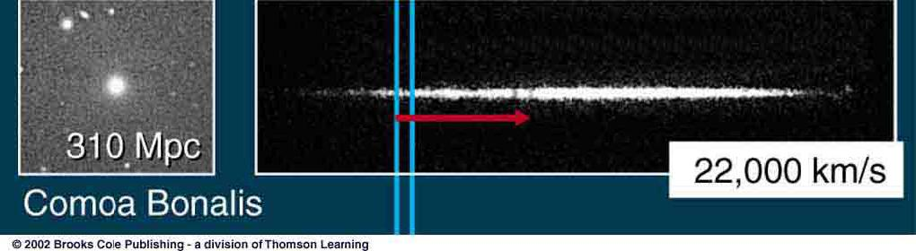
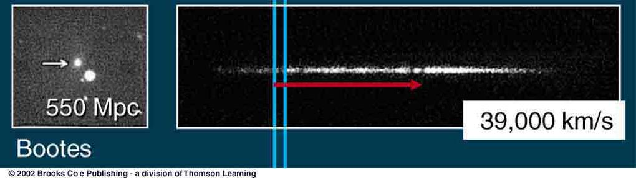
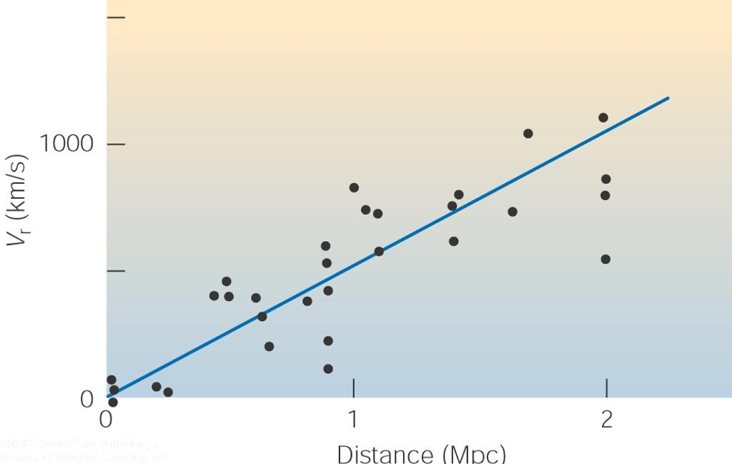
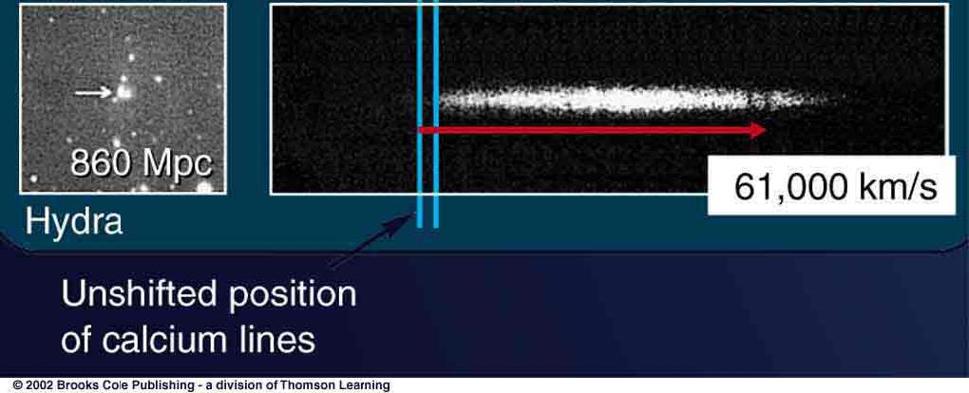
Hubble’s Law
0
Distant galaxies are receding from us with a speed proportional to distance

Slide 4
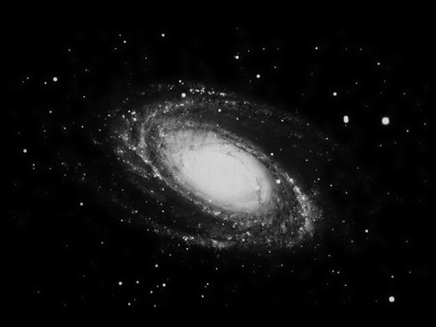
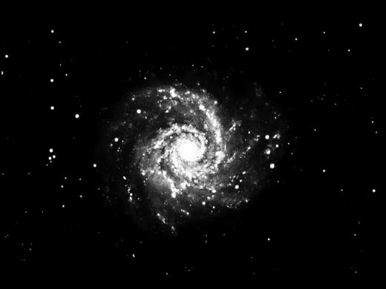
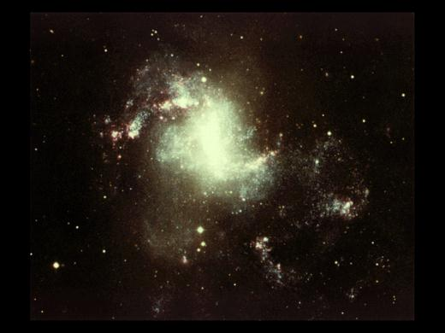
The Expanding Universe
0
On large scales, galaxies are moving apart, with velocity proportional to distance.
It’s not galaxies moving through space.
Space is expanding, carrying the galaxies along!
The galaxies themselves are not expanding!

Slide 5
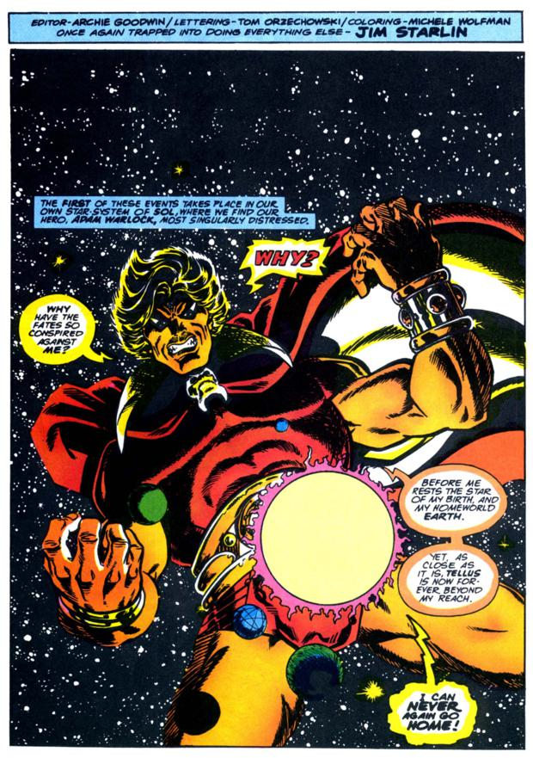
The Expanding Universe (II)
0
Neither is Adam Warlock!

Slide 6
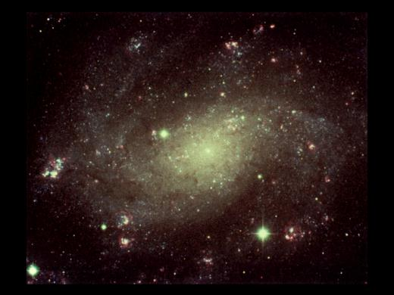
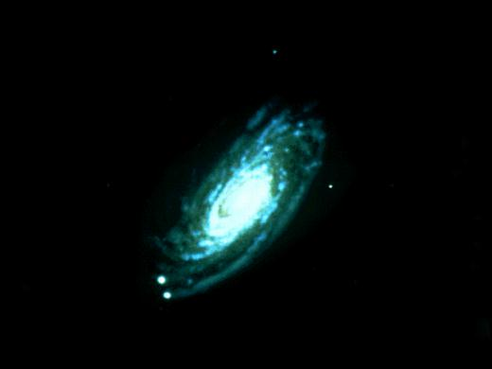
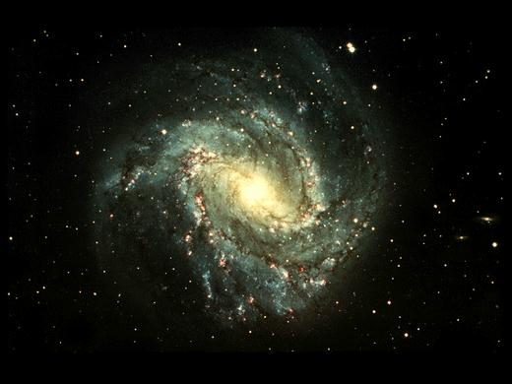
The Expanding Universe (III)
0
This does not mean that we are at the center of the universe!
You have the same impression from any other galaxy as well.

Slide 7
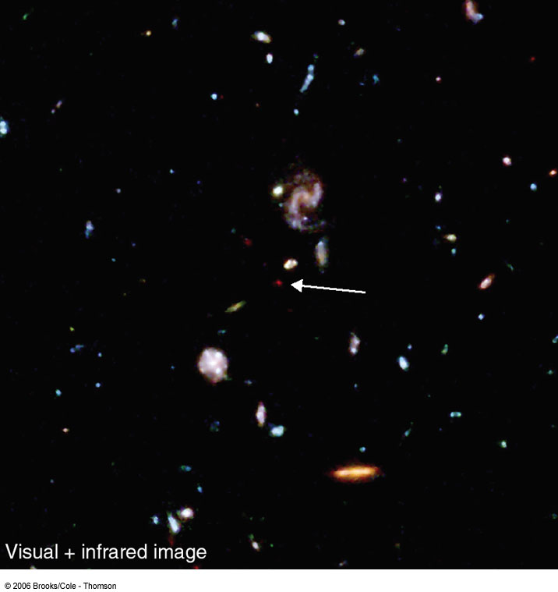
The Age of the Universe
0
Knowing the current rate of expansion of the universe, we can estimate the time it took for galaxies to move as far apart as they are today:
Time = distance / velocity
velocity = (Hubble constant) * distance
T ≈ d/v = 1/H ~ 14 billion years
Light we see today left this galaxy when the universe was only ~ 1 billion years old!

Slide 8

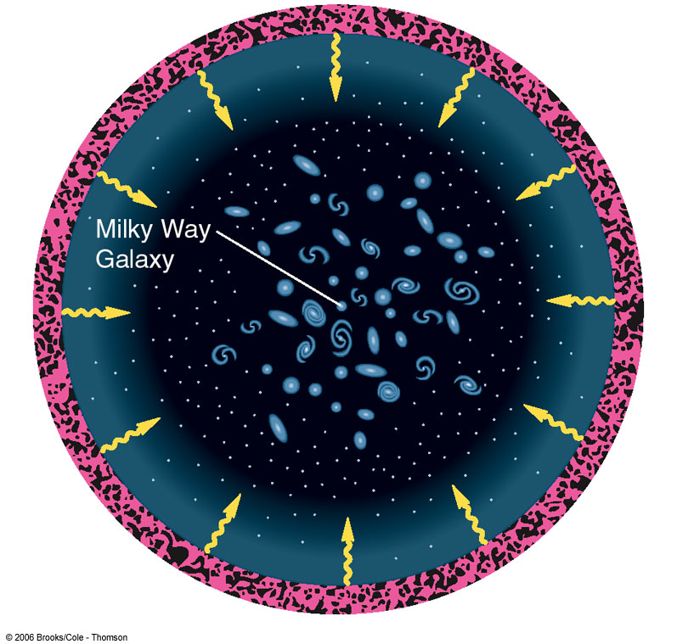
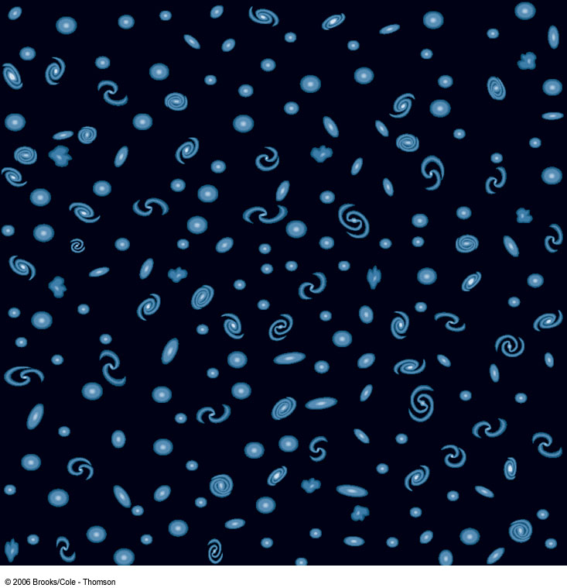
Looking Back Towards the Early Universe
0
The more distant the objects we observe, the further back into the past of the universe we are looking.

Slide 9
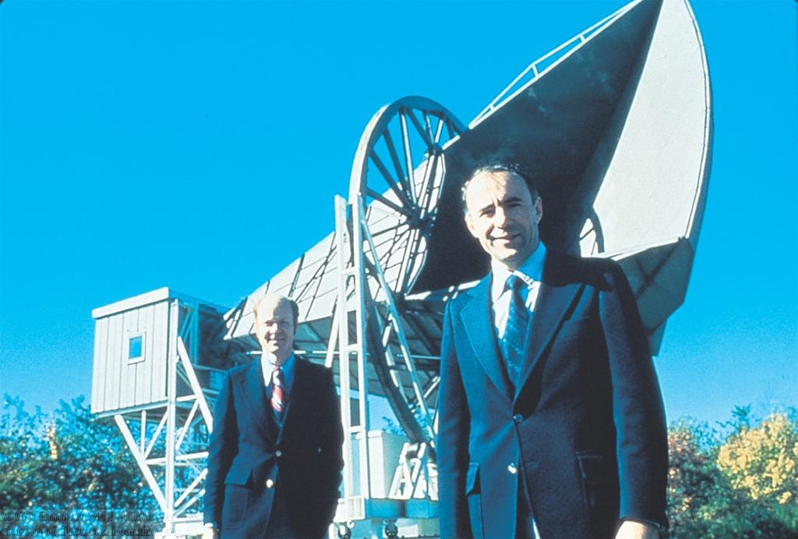
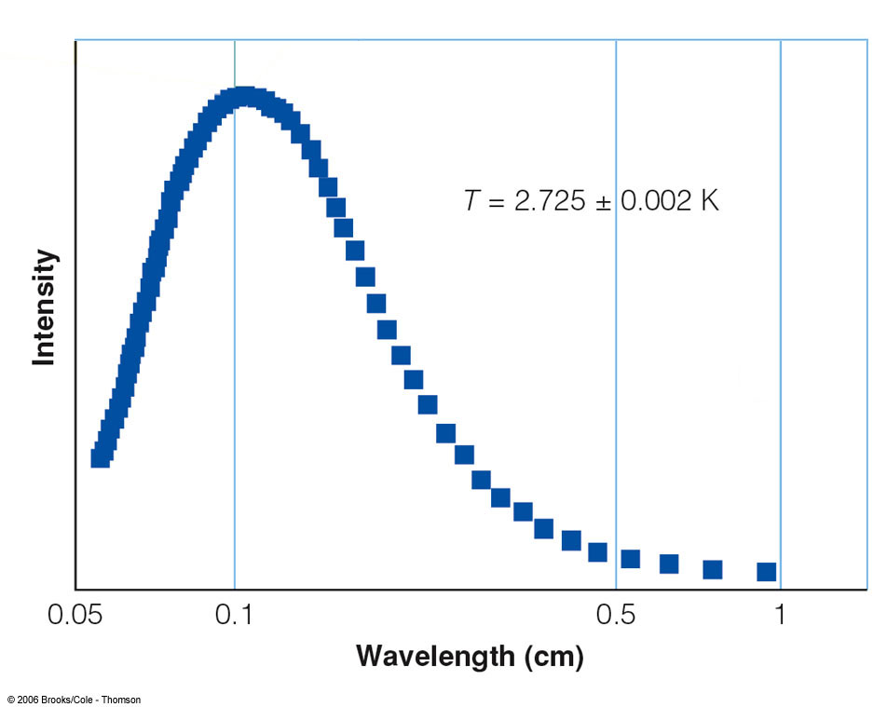
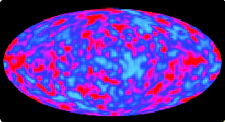
The Cosmic Background Radiation
0
The radiation from the very early phase of the universe should still be detectable today
Was discovered in mid-1960s as the Cosmic Microwave Background Radiation:
R. Wilson & A. Penzias
Black body radiation with a temperature of T = 2.73 K

Slide 10
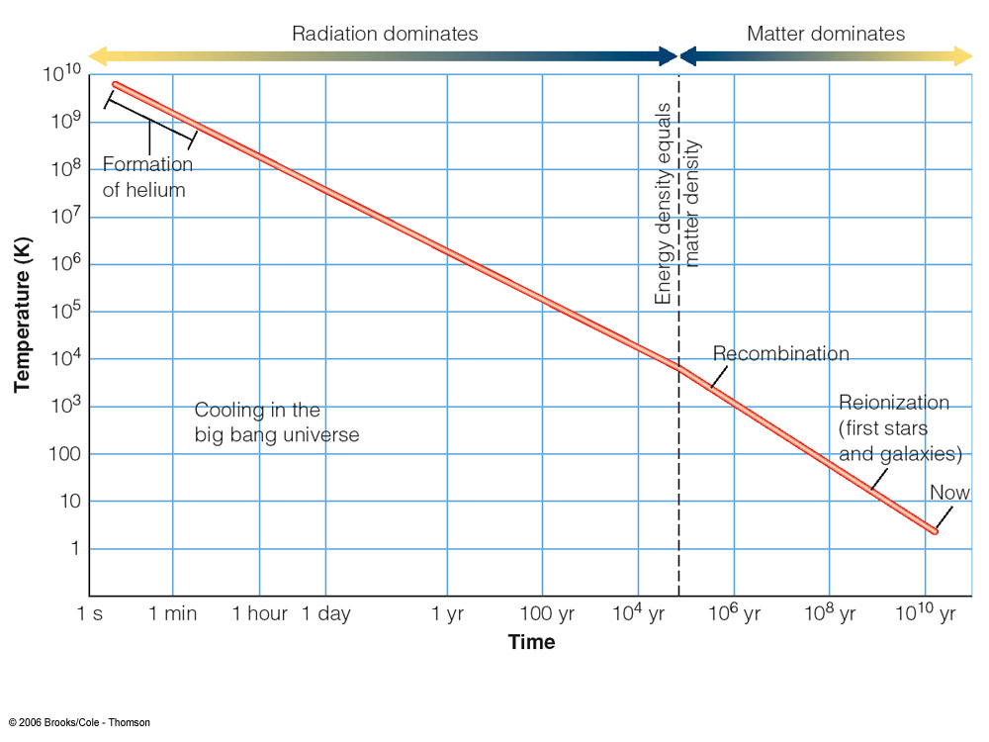
The History of the Universe
0
Universe cools down as time passes
Universe expands as time passes

Slide 11
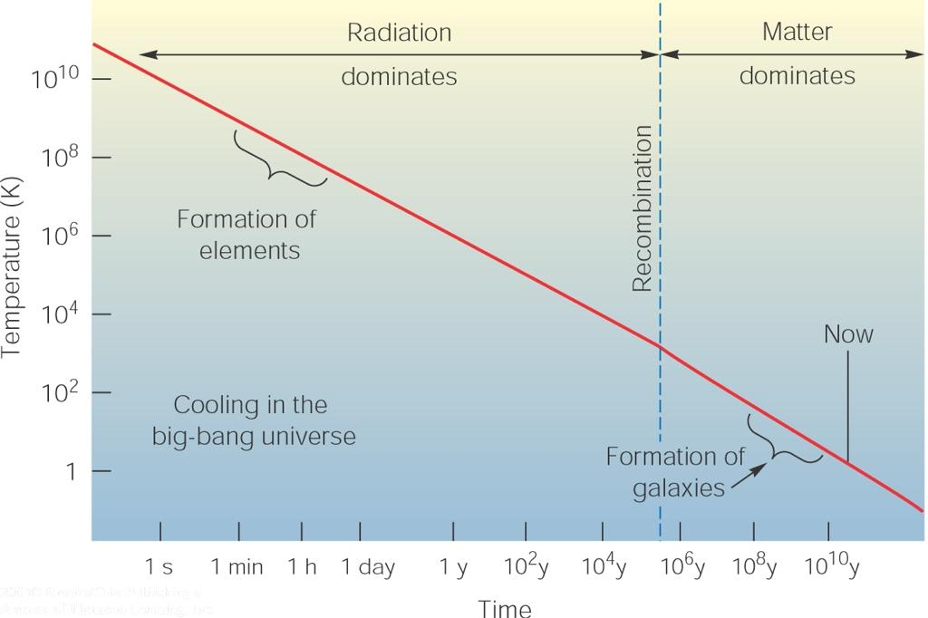
The Early History of the Universe
0
Electron
Positron
Gamma-ray photon
Electrons, positrons, and gamma-rays in equilibrium between pair production and annihilation

Slide 12
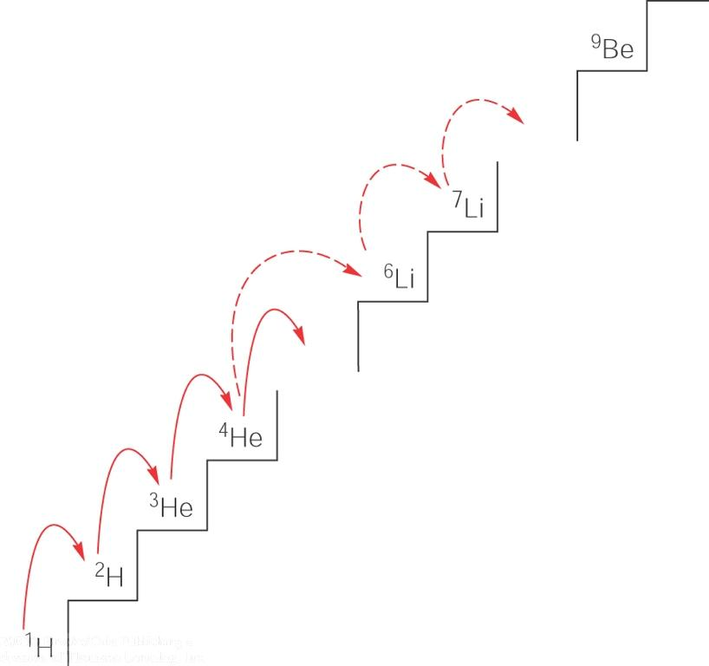
The Early History of the Universe (II)
0
Protons and neutrons form a few helium nuclei; the rest of protons remain as hydrogen nuclei
25 % of mass in helium 75 % in hydrogen
No stable nuclei with 5 – 8 protons
→ Almost no elements heavier than helium are produced.

Slide 13
The Early History of the Universe (III)
0
Photons are incessantly scattered by free electrons; photons are in equilibrium with matter
Photons have a black body spectrum at the same temperature as matter.
Radiation dominated era

Slide 14
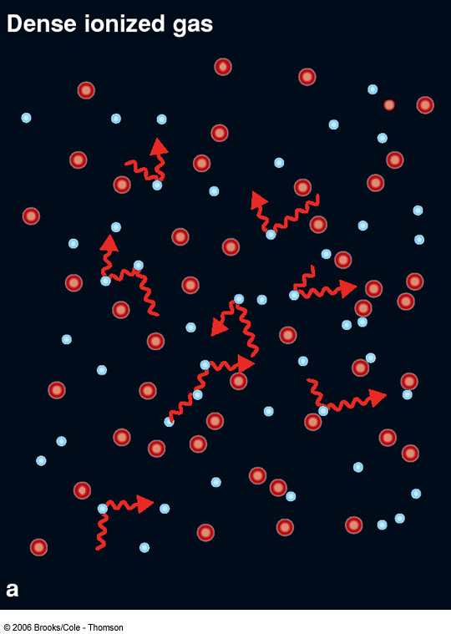
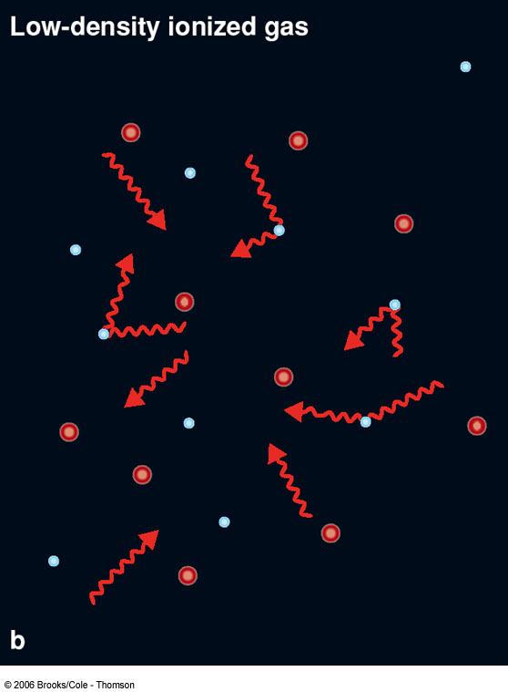
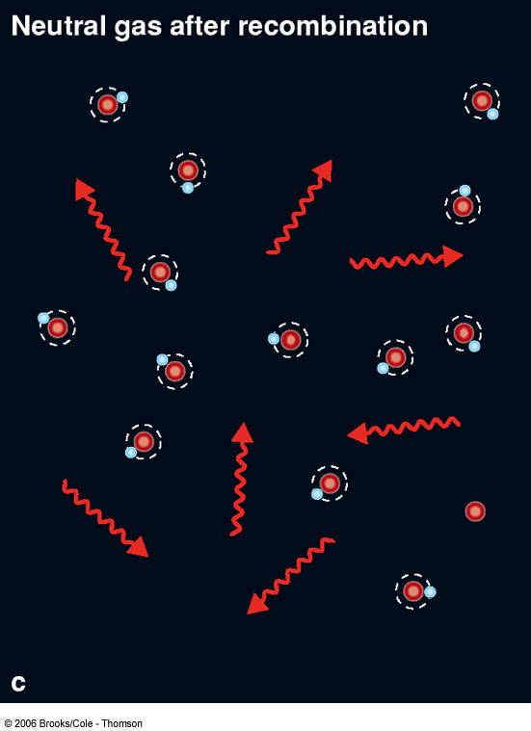
Recombination
0
Protons and electrons recombine to form atoms => Universe becomes transparent for photons
z ≈1000
Transition to matter dominated era

Slide 15
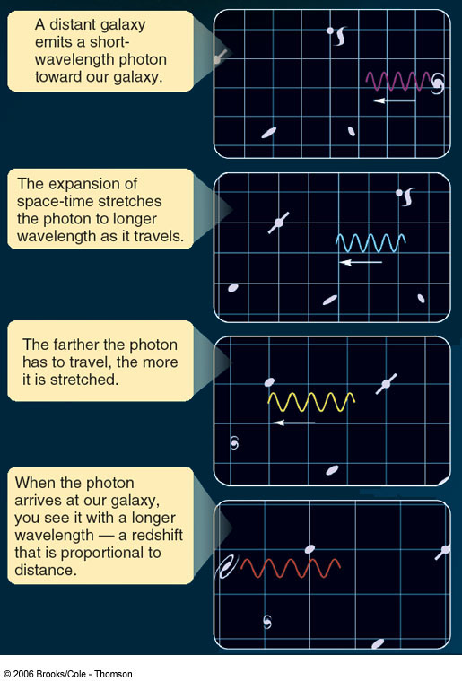
The Cosmic Background Radiation
0
After recombination, photons can travel freely through space.
Their wavelength is only stretched (redshifted) by cosmic expansion.
Recombination:
z = 1000; T = 3000 K
This is what we can observe today as the cosmic background radiation!

Slide 16
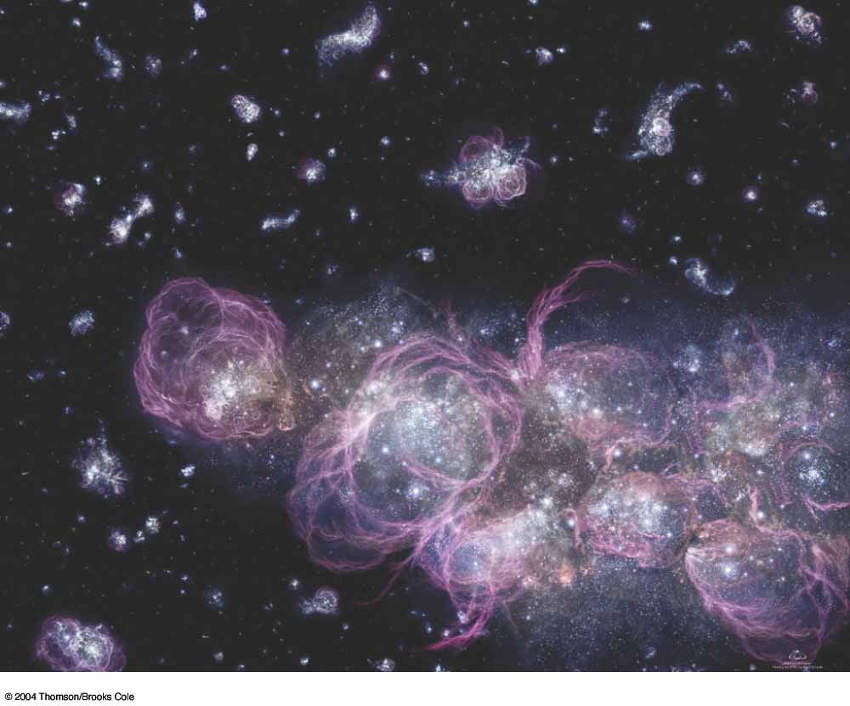
Reionization
0
After less than ~ 1 billion years, the first stars form.
Ultraviolet radiation from the first stars re-ionizes gas in the early universe
Formation of the first stars
Reionization
→ Universe becomes opaque again.

Slide 17
The Cosmological Principle
0
Considering the largest scales in the universe, we make the following fundamental assumptions:
1) Homogeneity: On the largest scales, the local universe has the same physical properties throughout the universe.
Every region has the same physical properties (mass density, expansion rate, visible vs. dark matter, etc.)
2) Isotropy: On the largest scales, the local universe looks the same in any direction that one observes.
You should see the same large-scale structure in any direction.
3) Universality: The laws of physics are the same everywhere in the universe.

Slide 18
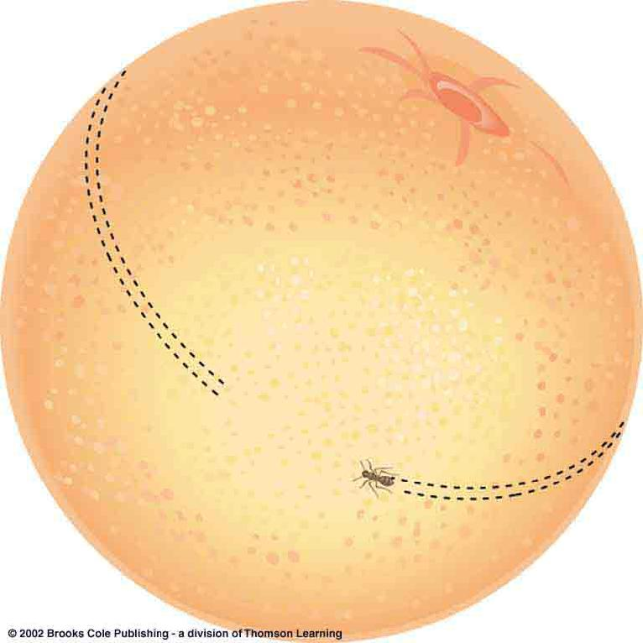
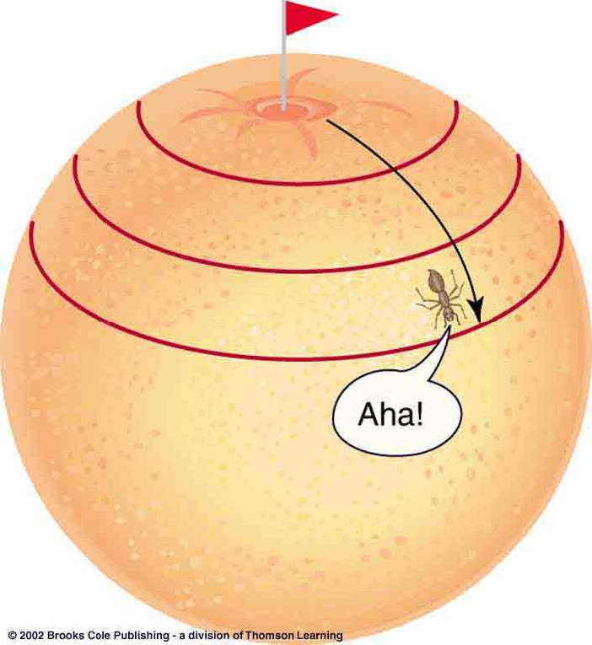
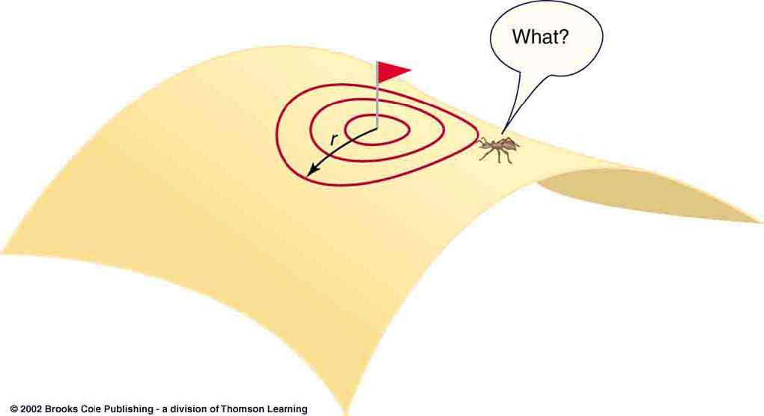
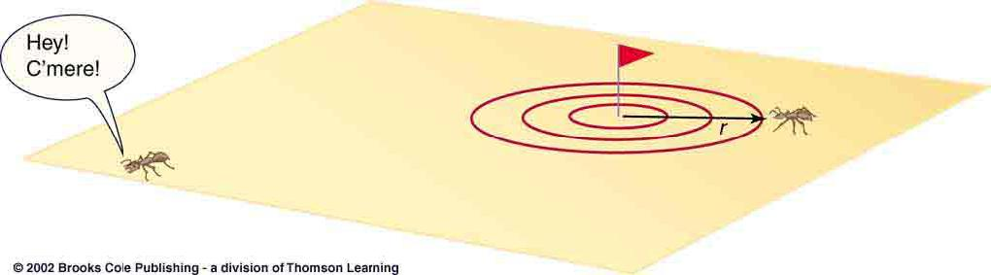
Shape and Geometry of the Universe
0
Back to our 2-dimensional analogy:
How can a 2-D creature investigate the geometry of the sphere?
Measure curvature of its space!
Closed surface
Flat surface
Open surface
(positive curvature)
(zero curvature)
(negative curvature)

Slide 19
Cosmology and
General Relativity
0
According to the theory of general relativity, gravity is caused by the curvature of space-time.
The effects of gravity on the largest cosmological scales should be related to the curvature of space-time!
The curvature of space-time, in turn, is determined by the distribution of mass and energy in the universe.
Space-time tells matter how to move;
matter tells space-time how to curve.

Slide 20
Deceleration of the Universe
0
Expansion of the universe should be slowed down by mutual gravitational attraction of the galaxies.
Fate of the universe depends on the matter density in the universe.
Define “critical density”, ρ_{c}, which is just enough to slow the cosmic expansion to a halt at infinity.

Slide 21
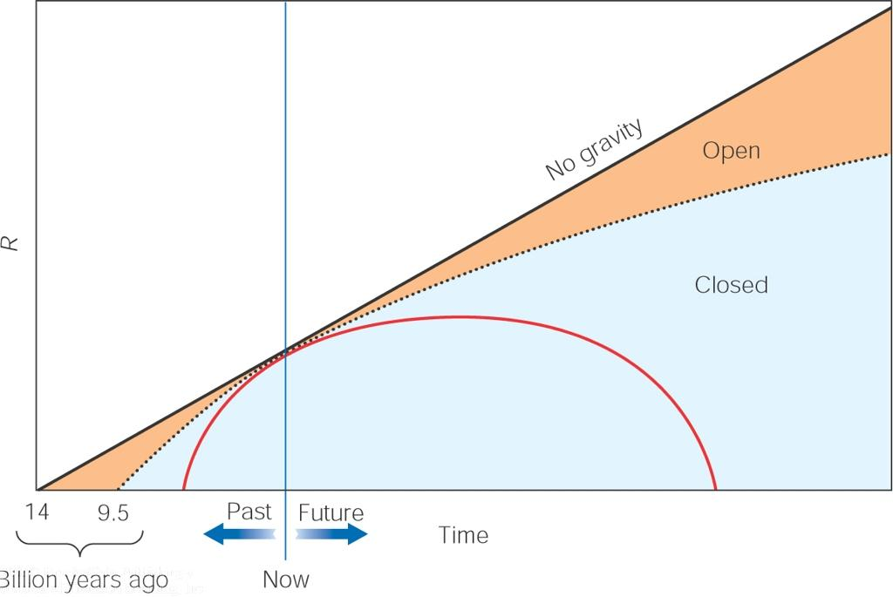
Model Universes
0
ρ < ρ_{c} => universe will expand forever
Maximum age of the universe:
~ 1/H₀
ρ = ρ_{c} => Flat universe
Size scale of the universe
ρ > ρ_{c} => universe will collapse back
Time
If the density of matter equaled the critical density, then the curvature of space-time by the matter would be just-so sufficient to make the geometry of the universe flat!

Slide 22
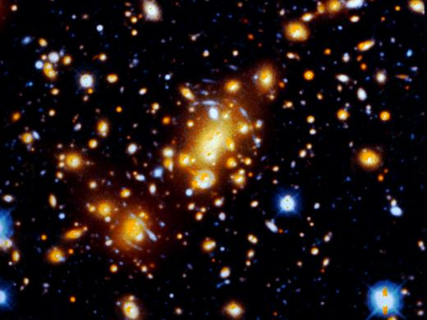
Dark Matter
0
Combined mass of all “visible” matter (i.e. emitting any kind of radiation) in the universe adds up to much less than the critical density.
Gravitational lensing shows that some clusters contain 10 times as much mass as directly visible

Slide 23
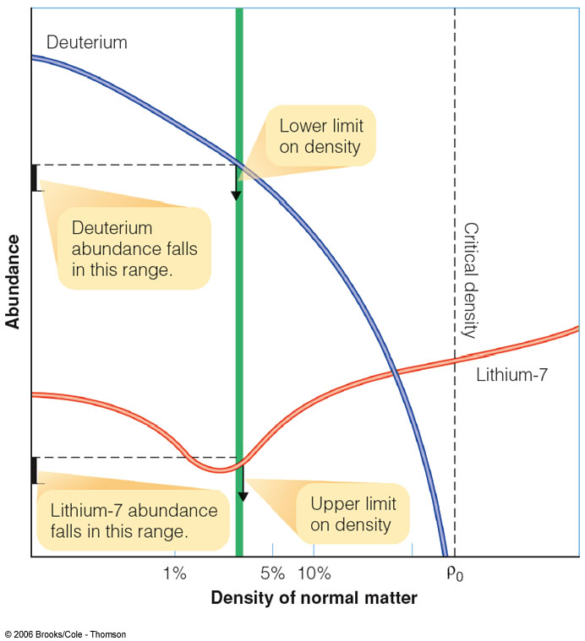
The Nature of Dark Matter
0
Can dark matter be composed of normal matter?
If so, then its mass would mostly come from protons and neutrons = baryons
The density of baryons right after the big bang leaves a unique imprint in the abundances of deuterium and lithium.
Density of baryonic matter is only ~ 4 % of critical density.
Most dark matter must be non-baryonic!

Slide 24
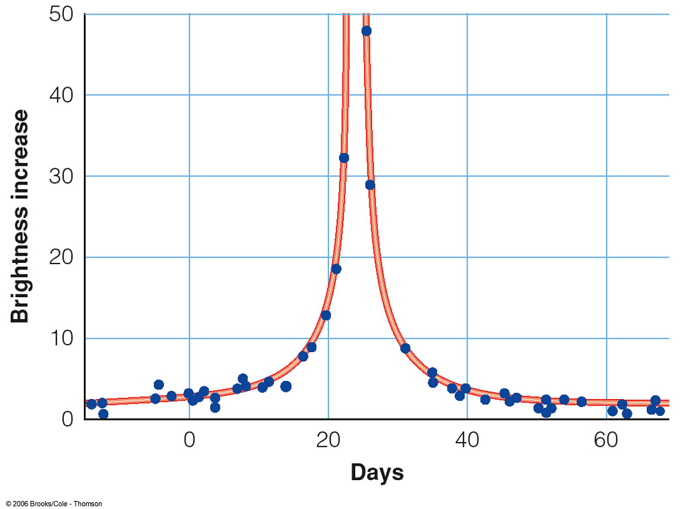
Baryonic Dark Matter
0
Nature of baryonic dark matter still very uncertain and speculative.
One component: Massive Compact Halo Objects = “MACHOs”:
Brightness of background star
Small compact objects (e.g., brown dwarfs, small black holes) acting as gravitational lenses.
Time
Earth
MACHO
Distant background star

Slide 25
Problems with the Classical, Decelerating Universe:
0
The flatness problem:
The universe seems to be nearly flat.
Even a tiny deviation from perfect flatness at the time of the Big Bang should have been amplified to a huge deviation today.
=> Extreme fine tuning required!
2) The isotropy of the cosmic background:
If information can only travel through the universe at the speed of light, then structure in the cosmic background should not be correlated over large angular scales!
Contradiction to almost perfect isotropy of the cosmic background!

Slide 26
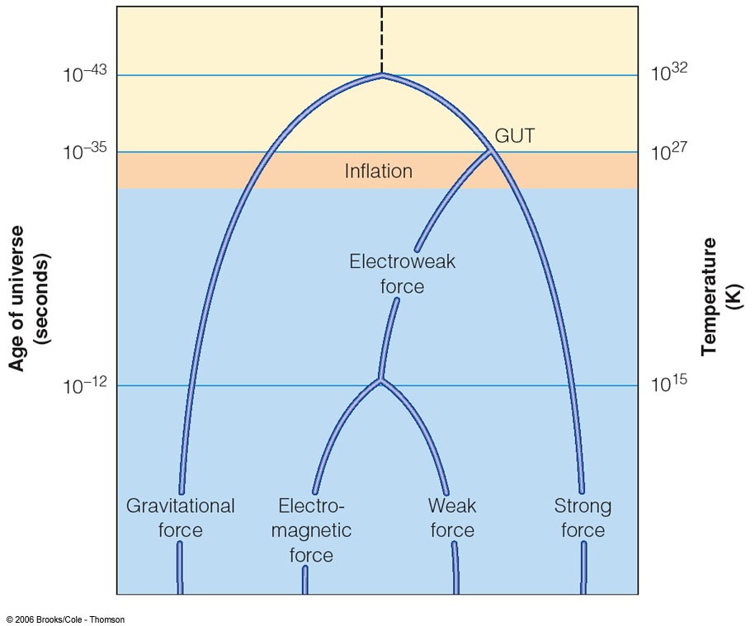
21st Century Cosmology
0
The solution: Inflation!
Inflation = period of sudden expansion during the very early evolution of the universe
triggered by the sudden energy release from the decoupling of the strong and electroweak forces

Slide 27
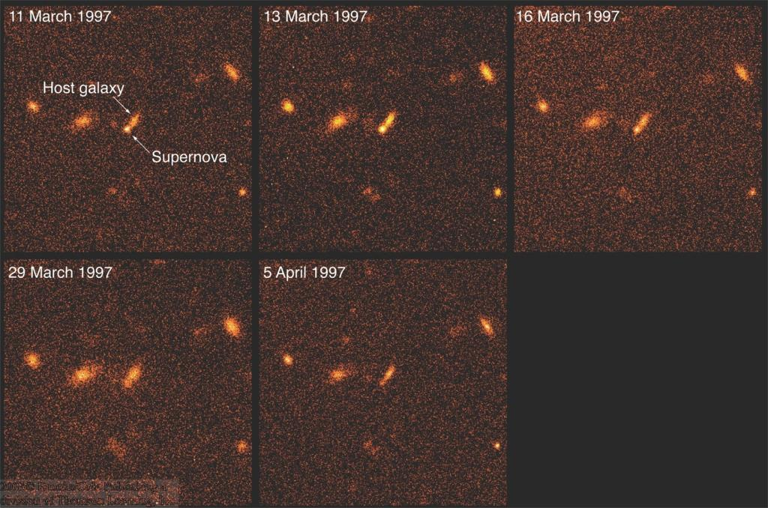
Measuring the “Deceleration” of the Universe …
0
By observing type Ia supernovae, astronomers can measure the Hubble relation at large distances
Distance ↔ recession speed
Size scale of the universe ↔ rate of expansion
It was expected that this would measure the deceleration of the universe, but …

Slide 28
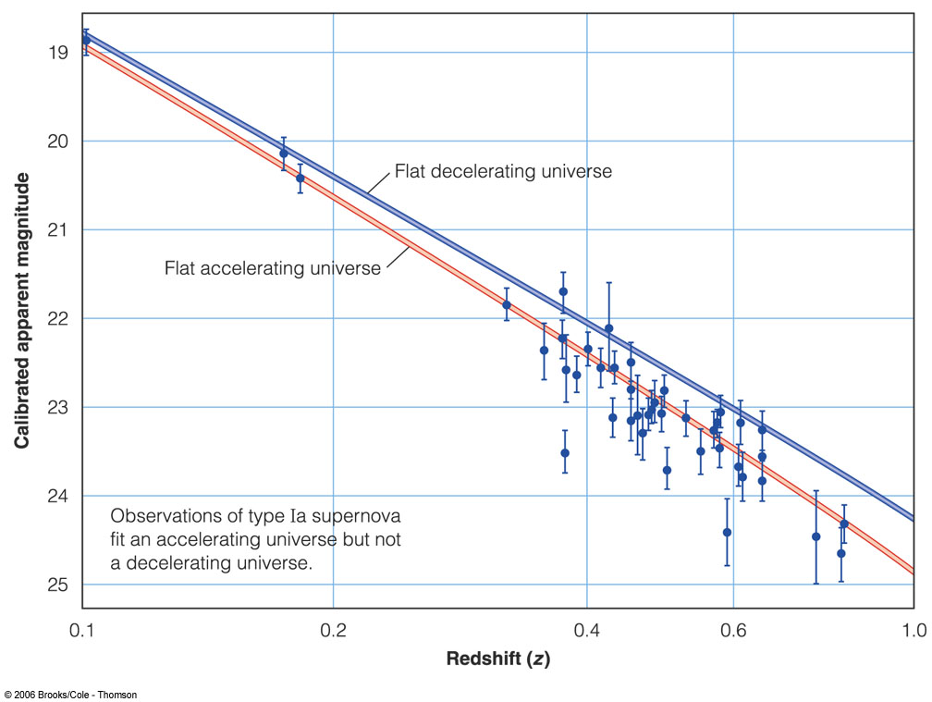
The Accelerating Universe
0
Flat decelerating universe
Apparent Magnitude of Type Ia Supernovae
Flat accelerating universe
Red Shift z
In fact, SN Ia measurements showed that the universe is accelerating!

Slide 29
The Cosmological Constant
0
Cosmic acceleration can be explained with the cosmological constant, Λ
(“Lambda”)
Λ is a free parameter in Einstein’s fundamental equation of general relativity; previously believed to be 0.
Energy corresponding to Λ can account for the missing mass/energy (E = m*c²) needed to produce a flat space-time.
→ “dark energy”

Slide 30
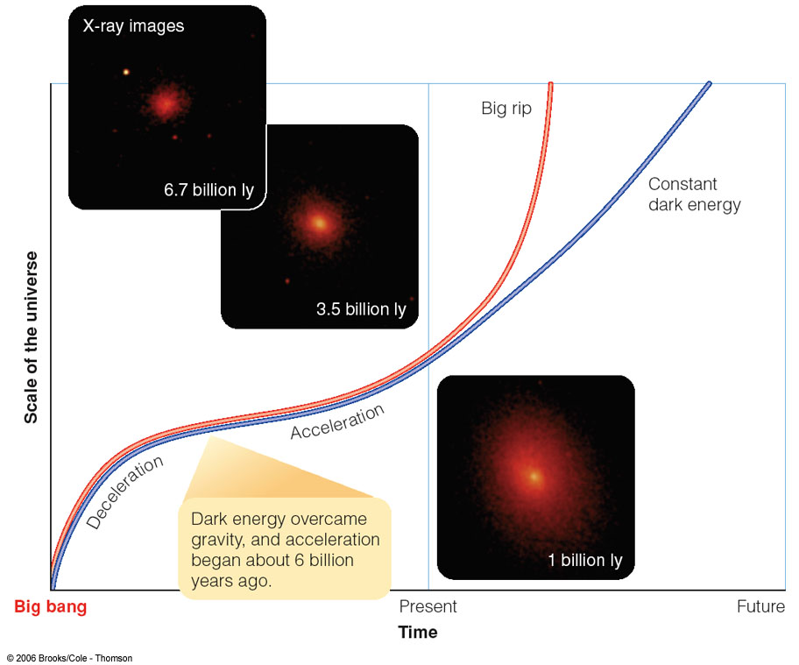
The Evolution and Ultimate Fate of the Universe
0
Today, acceleration due to dark energy dominates.
Until ~ 6 billion years ago, gravity of matter was stronger than acceleration

Slide 31
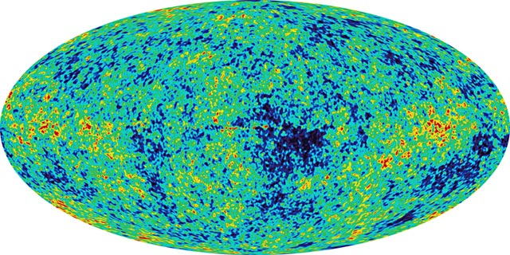
Cosmology with the
Cosmic Microwave Background
0
If the universe was perfectly homogeneous on all scales at the time of reionization (z = 1000), then the CMB should be perfectly isotropic over the sky.
Instead, it shows small-scale fluctuations:

Slide 32
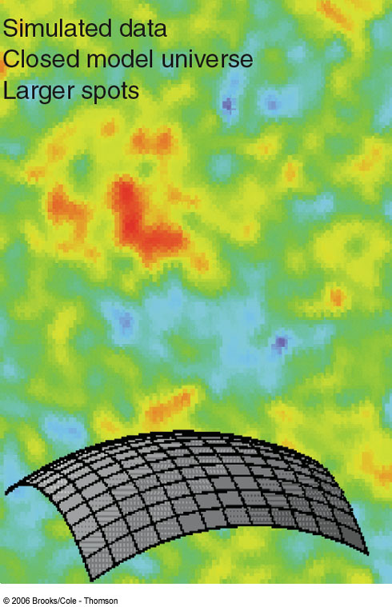
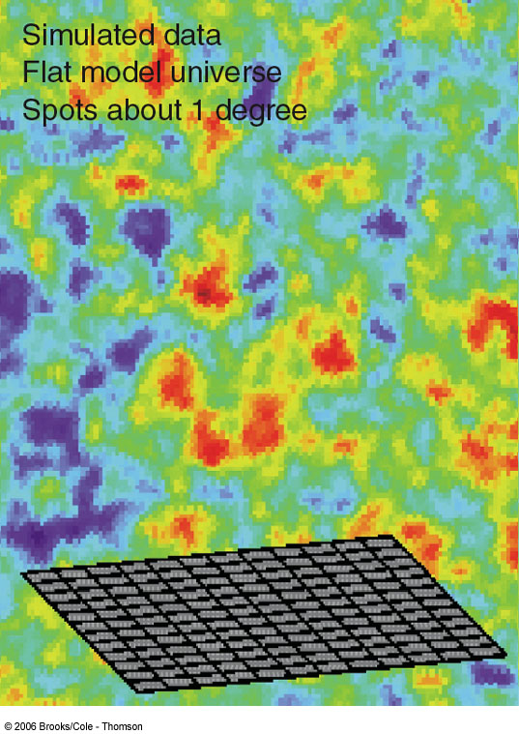
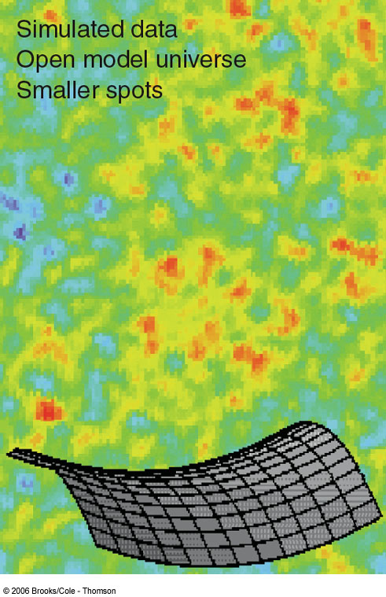
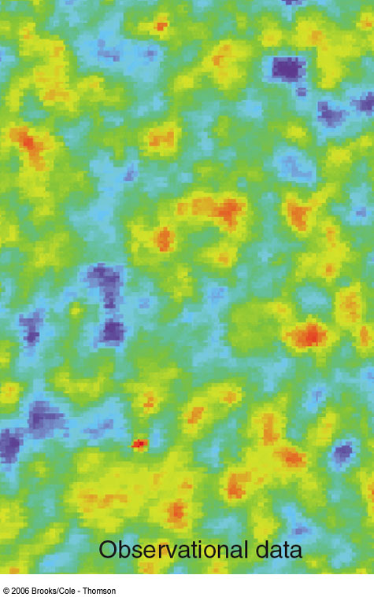
Fluctuations in the Cosmic Microwave Background
0
Angular size of the CMB fluctuations allows us to probe the geometry of space-time!
CMB fluctuations have a characteristic size of 1 degree.

Slide 33
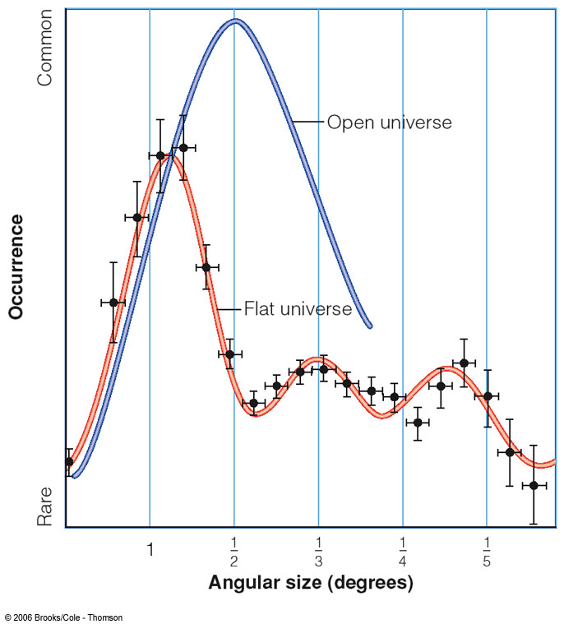
Analysis of the Cosmic Background Fluctuations
0
Analyze frequency of occurrence of fluctuations on a particular angular scale
→ Universe has a flat geometry
For more: Wayne Hu’s webpage at http://background.uchicago.edu/~whu/
For latest from Planck, go to https://www.cosmos.esa.int/web/planck

Slide 34
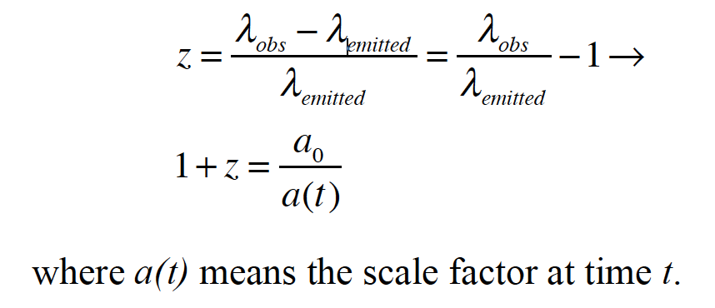
Redshift z, Scale Factor a, and World Models
Define scale factor today as a₀=1.
This means that the Hubble PARAMETER H = (da/dt)/a
This is why we write Hubble constant v_{r} = cz = H₀d
Also note that scale factor a is inversely proportional to T_{CMB}

Slide 35
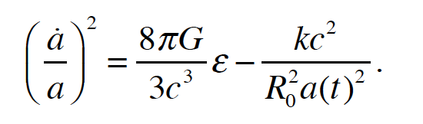
Friedmann Equation from General Relativity
On left hand side, Hubble parameter squared.
Right hand side: Energy density for whole universe and curvature term.
Represents kinetic energy, potential energy, and curvature balance.

Slide 36
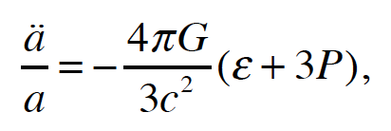
Also Need Acceleration Eq. to solve for a(t)
Derived from Friedmann eq. plus fluid equation from fluid dynamics
P is the pressure. P=0 for cold dark matter (i.e. “dust”), P = 1/3 energy density for relativistic particles (photons and neutrinos), and –(energy density) for dark energy.

Slide 37
Also Need Acceleration Eq. to solve for a(t)
Derived from Friedmann eq. plus fluid equation from fluid dynamics
P is the pressure. P=0 for cold dark matter (i.e. “dust”), P = 1/3 energy density for relativistic particles (photons and neutrinos), and –(energy density) for dark energy.

Slide 38
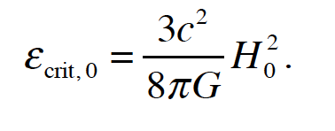
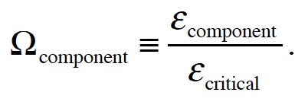
Rewrite by defining critical density
This density is balancing kinetic and gravitational energies:
Now define new terms:

Slide 39
Energy Density Evolution Visually

Slide 40

Rewrite by defining critical density
New Friedmann equation:
Values of radiation, matter, and Lambda terms at present day, respectively: 8x10⁻⁵, 0.32, and 0.68 (see defaults in Ned Wright calculator). These add up to the total of 1, a flat universe with critical density met. Again note the different dependencies on a(t)

Slide 41
Graphical solutions for a(t) and components

Slide 42

Proper distance once a(t) determined…
Distances very weird to do correctly in cosmology
Equation is from Dobson, but it has an error! Can you spot it? Check the units…. You must multiply the right hand side by c!
There is a closely related effect that can be derived: cosmological time dilation. Time will be seen to move a factor of 1+z slower than the present! See, for example Goldhaber et al. (2002).

Slide 43

Other distances
Distances are very weird to do correctly in cosmology
For a spatially flat universe, which we think we have, can simply relate angular diameter distance (d_{A} = L/(theta)), proper distance, and luminosity distance (d_{L} = (L/4πf)^{0.5}) by:
You must use luminosity distance to get luminosities right
You must use angular distance to get angles and linear sizes right

Slide 44
Nuts & Bolts of Cosmology Calculations
Already have Ned Wright’s page
Here is David Hogg’s very practical (and not officially even published!) paper, cited about 600 times, on Distance Measures in Cosmology

Slide 45
Cosmology and Scales of the Universe
0
We shall not cease from exploration, and the end of all our exploring will be to arrive where we started and know the place for the first time. --T. S. Eliot
American Museum of Natural History video:
The Known Universe

