Slide 1
ASTR 2320 General Astronomy II
Professor Mike Brotherton
Chapter 18 – Galaxies
My God, they’re full of stars! (But more dark matter.)

Slide 2
Galaxies
Hubble type & characteristics of different types of nearby galaxies; introduction to galaxy clusters
Introduction to the expansion of the universe; Cepheids; the Hubble relation
Galaxy evolution; active galaxies; interacting galaxies
Large-scale structure of the universe

Slide 3
Hubble Types and Galaxy Classification

Slide 4
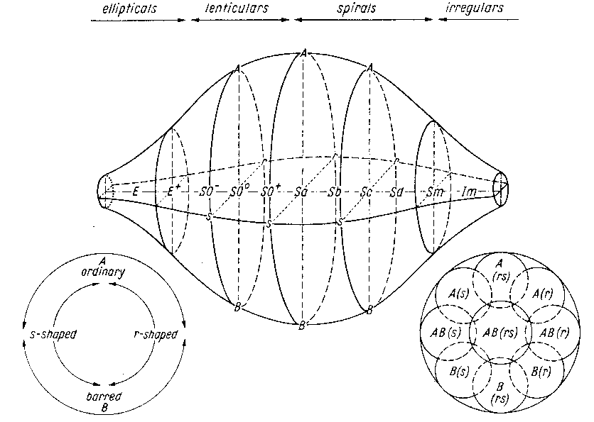
Others, e.g., De Vaucouleur’s Scheme

Slide 5
The Hubble Heritage Gallery. Let’s have a look!
NGC 981 (APOD, composite image, from Dodson)

Slide 6
The NASA/IPAC Extragalactic Database (NED)
It’s like SIMBAD for extragalactic objects (i.e. galaxies, quasars, etc.).
Compiles lots of catalogs and ancillary information about galaxies.
Distances! Redshifts! SEDs! Spectra! Images! References! Reddening!
Let’s take a look!

Slide 7



Galaxy azimuthally averaged radial light profiles
Elliptical:
Disk:
Sersic (1963):

Slide 8
Surface Brightness
For example, magnitudes per square arcsecond.
Conserved with distance!
Light gets fainter by inverse square law
Geometry means physical area increases by the square of distance per square arcsecond
General property of galaxies to be measured and understood
Note that the SKY has a surface brightness. In optical, affected by moonlight. In infrared, by atmospheric temperature. Darker in space but there is light there, too (e.g., Zodiacal light).
For Galaxies, Holmberg radius is where galaxy gets to 26.5 mag/sq. arcsecond in the B band. One measure of a galaxy size.

Slide 9
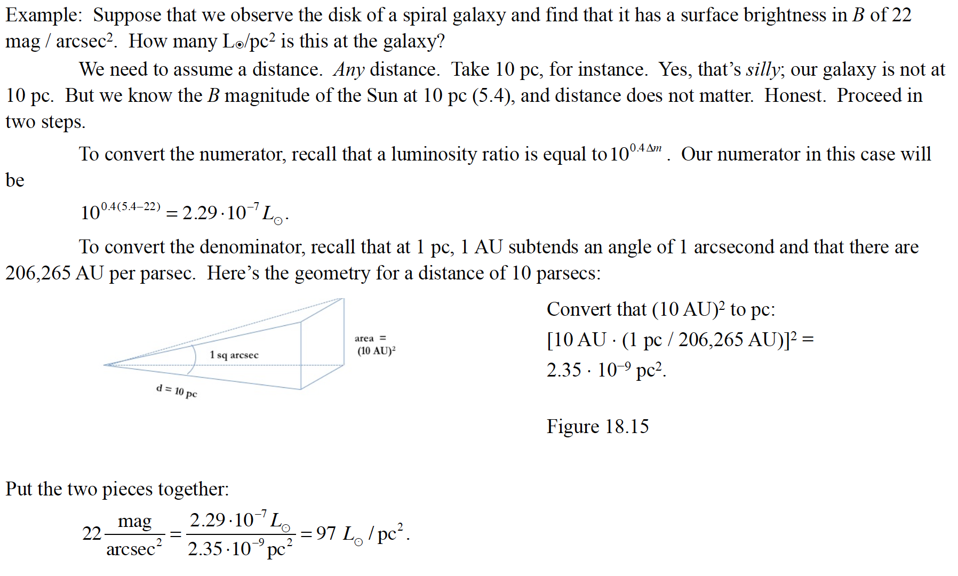
Surface Brightness Example

Slide 10
Spirals vs. Ellipticals re: gas and dust
Spirals have more dust and gas, can see dust lanes, and correspondingly have more star formation. Look back at the pictures to verify.
Many large ellipticals are “old, dead, and red” without much new star formation, and lots of older evolved stars. Can look a bit more transparent in some pictures.

Slide 11
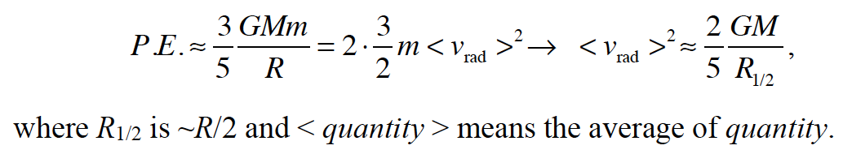
Galaxy Properties
Spiral masses as we’ve seen from velocity curves
Elliptical masses from virial theorem (the kinetic energy is half the potential energy):
Sizes, luminosities, etc., all need DISTANCES, just like for stars. How do we do that?

Slide 12
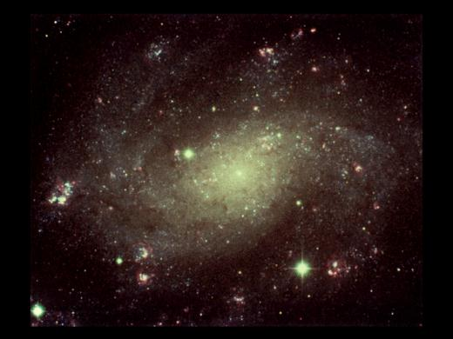
Distance Measurements to Other Galaxies (I)
0
Cepheid method: Using period – Luminosity relation for classical Cepheids:
Measure Cepheid’s period → Find its luminosity → Compare to apparent magnitude → Find its distance
b) Type Ia supernovae (collapse of an accreting white dwarf in a binary system):
Type Ia supernovae have well known standard luminosities → Compare to apparent magnitudes → Find its distances
Both are “Standard-candle” methods:
Know absolute magnitude (luminosity) → compare to apparent magnitude → find distance.

Slide 13
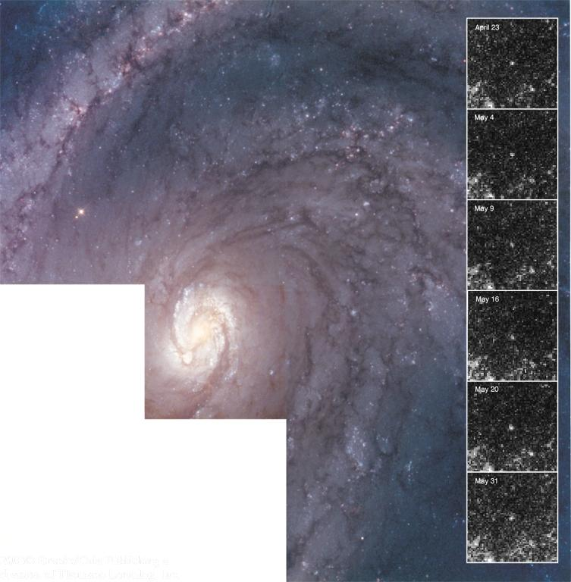
Cepheid Distance Measurement
0
Repeated brightness measurements of a Cepheid allow the determination of the period and thus the absolute magnitude.
→ distance

Slide 14
Cepheid Distance Measurement
0
Repeated brightness measurements of a Cepheid allow the determination of the period and thus the absolute magnitude.
→ distance

Slide 15
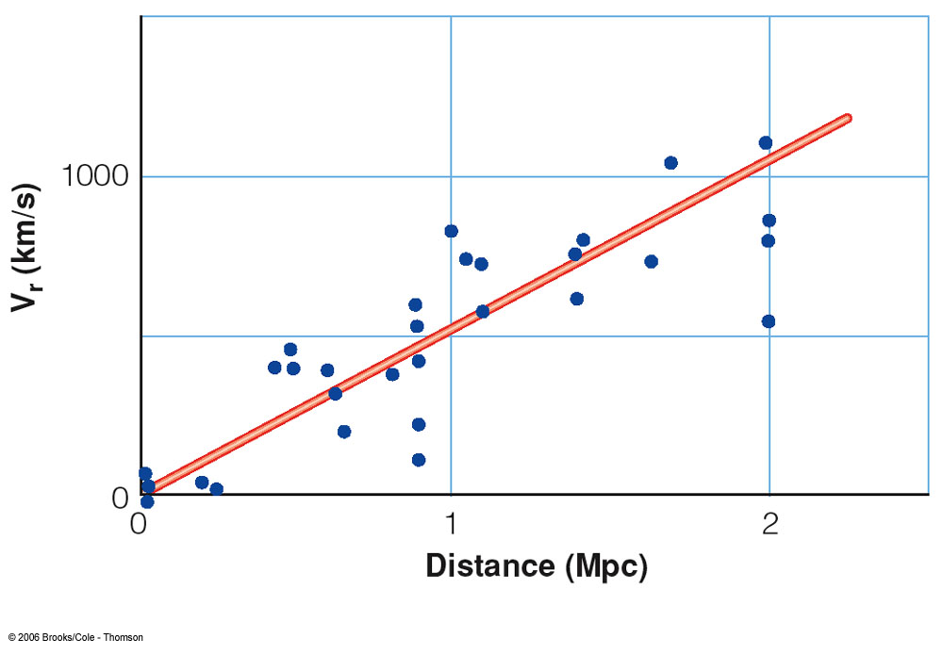
Distance Measurements to Other Galaxies (II): The Hubble Law
0
E. Hubble (1929):
Distant galaxies are moving away from our Milky Way, with a recession velocity, v_{r}, proportional to their distance d:
v_{r} = H₀*d
H₀ ≈ 70 km/s/Mpc is the Hubble constant.
=> Measure v_{r} through the Doppler effect → infer the distance.

Slide 16
Issues around the Hubble Constant
Great for distances, but also fundamental to expansion of the universe and its age. We will see when we get to cosmology.
Hubble Space Telescope Key Project to get H₀ to 10% (they did! 72!)
Analyses from CMB gets smaller value 67, with smaller error bars (3!).
A legacy website from John Hucra covering some history of the Hubble constant, how it went from Hubble’s 500 km/s/Mpc to modern values. Well worth reading!

Slide 17



Redshift-Independent Distances
We’ve already discussed things like Cepheid variables and briefly Supernovas type 1a (more in Chapter 19). There are others. Important to calibrate Hubble Constant in the first place, and can help deal with issues like peculiar motions (the scatter around the Hubble Law)
Tully-Fisher (spirals):
Correct for inclination, dust, to get absolute magnitude ( )
Faber-Jackson/Fundamental Plane (ellipticals)
Surface Brightness fluctuations, others
NED gives these for individual galaxies with references! It’s great!
Issue of K-corrections

Slide 18
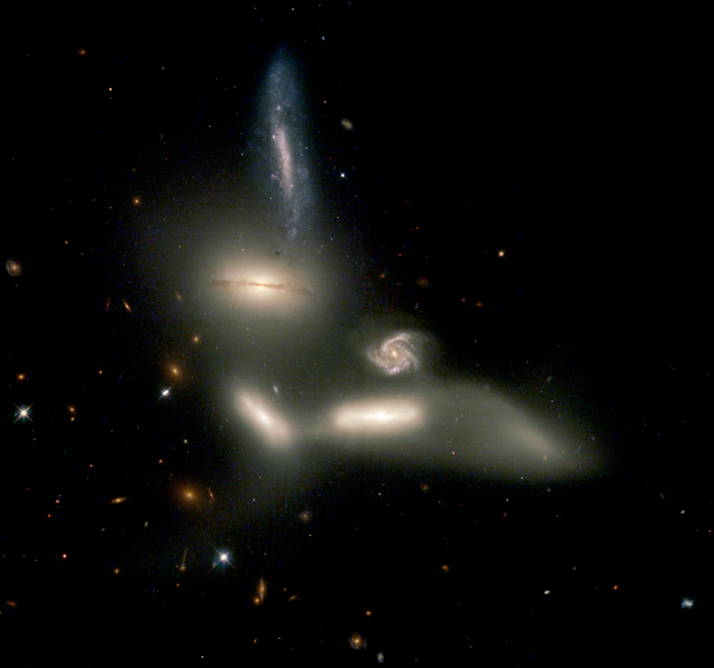
The Extragalactic Distance Scale
0
Many galaxies are typically millions or billions of parsecs from our galaxy.
Typical distance units:
Mpc = megaparsec = 1 million parsecs
Gpc = gigaparsec = 1 billion parsecs
Distances of Mpc or even Gpc ⬄ The light we see has left the galaxy millions or billions of years ago!!
⬄ “Look-back times” of millions or billions of years

Slide 19
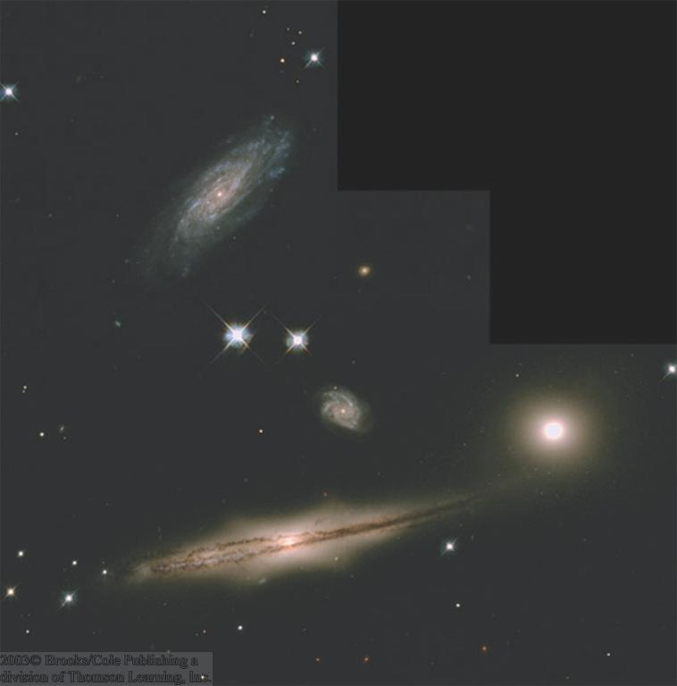
Galaxy Sizes and Luminosities
0
Vastly different sizes and luminosities:
From small, low-luminosity irregular galaxies (much smaller and less luminous than the Milky Way) to giant ellipticals and large spirals, a few times the Milky Way’s size and luminosity

Slide 20
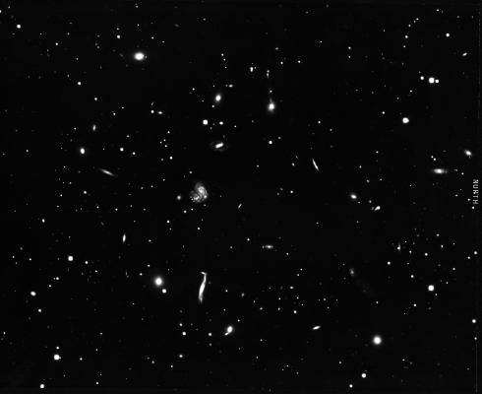
Clusters of Galaxies
0
Galaxies do not generally exist in isolation, but form larger clusters of galaxies.
Rich clusters:
1,000 or more galaxies, diameter of ~ 3 Mpc, condensed around a large, central galaxy
Poor clusters:
Less than 1,000 galaxies (often just a few), diameter of a few Mpc, generally not condensed towards the center

Slide 21
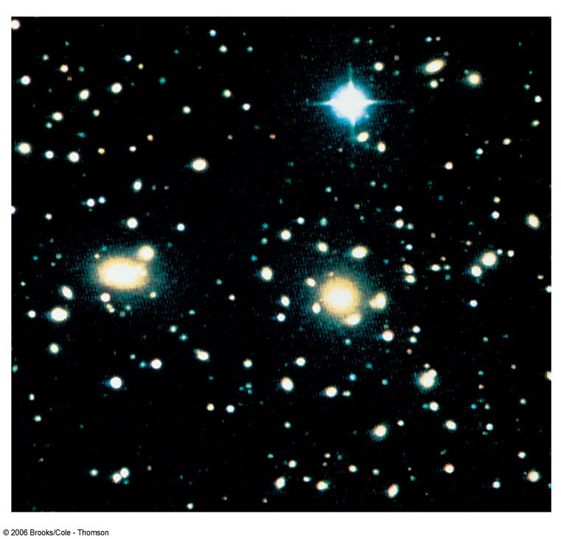
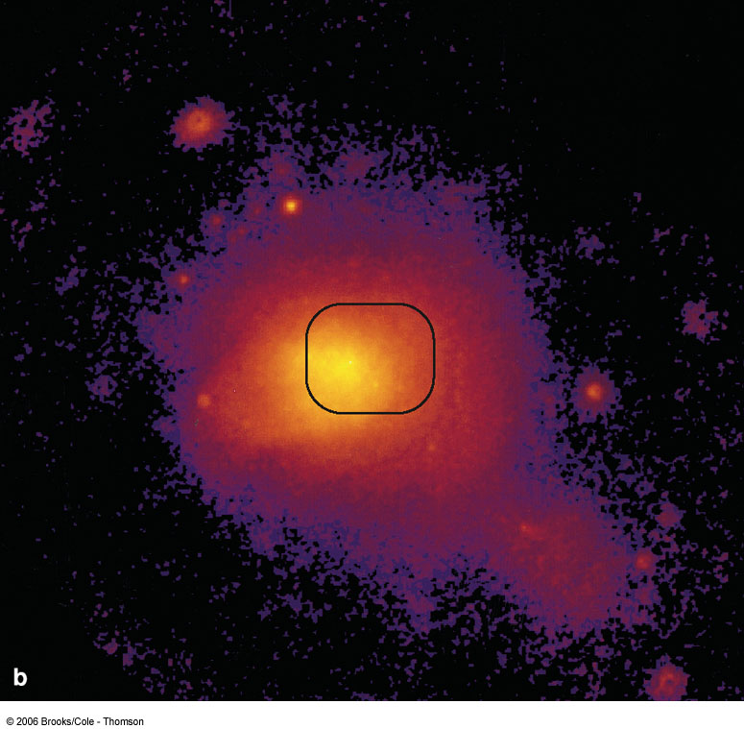
Hot Gas in Clusters of Galaxies
0
Space between galaxies is not empty, but filled with hot gas (observable in X rays)
That this gas remains gravitationally bound, provides further evidence for dark matter.
Visible light
X rays
Coma Cluster of Galaxies

Slide 22
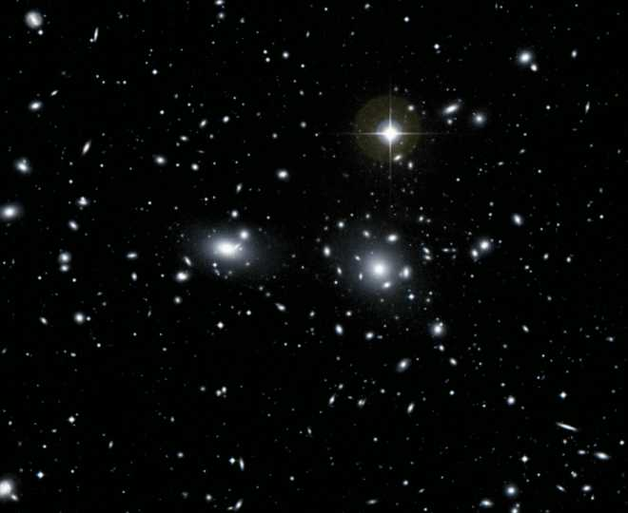
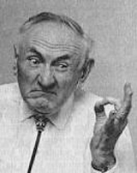
The Father of Dark Matter
In 1933, Fritz Zwicky checked out the Coma Cluster. The galaxies were flying around too fast (as measured by the Doppler effect) for their visible mass to keep them together, so he proposed dark matter was present.

Slide 23
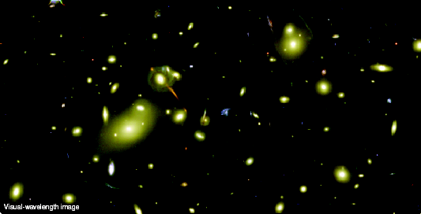
Gravitational Lensing
0
The huge mass of gas in a cluster of galaxies can bend the light from a more distant galaxy.
Image of the galaxy is strongly distorted into arcs. Also consistent with large amounts of dark matter.

Slide 24
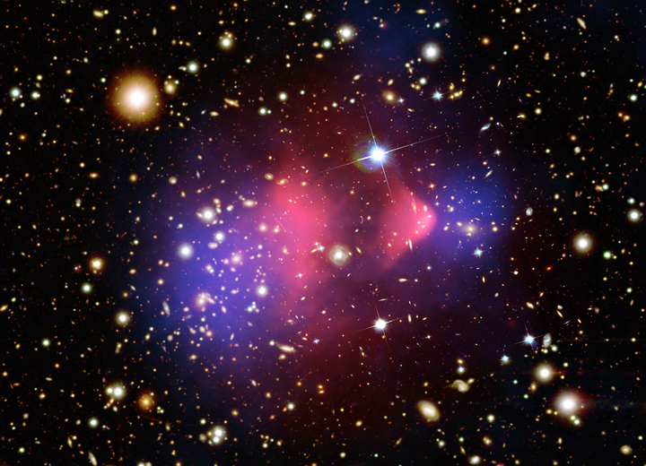
The Bullet Cluster
Given what we know about gravitational lensing (tracing the total mass in blue), hot X-ray gas in (the dominant baryonic mass, red), we can show that dark matter exists in at least one system:
Images from Clowe et al. 2006 and the Chandra press release

Slide 25
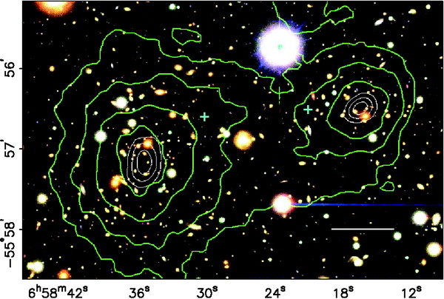
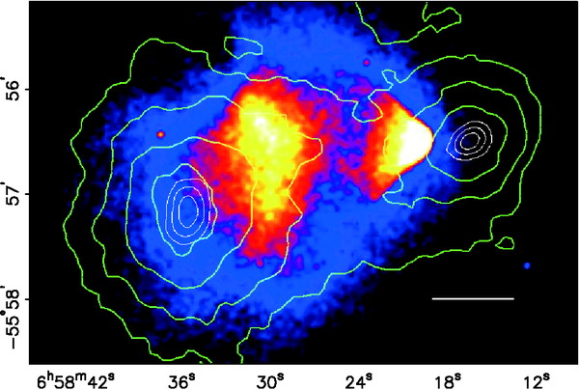
The Bullet Cluster
Lensing of background galaxies seen in the optical images lets the mass distribution be mapped.
The X-rays trace the hot gas, the dominant source of baryons in this cluster merger.
They don’t line up! Why? Dark Matter seems to not interact with itself the way diffuse gas does during a cluster collision.
Video

Slide 26
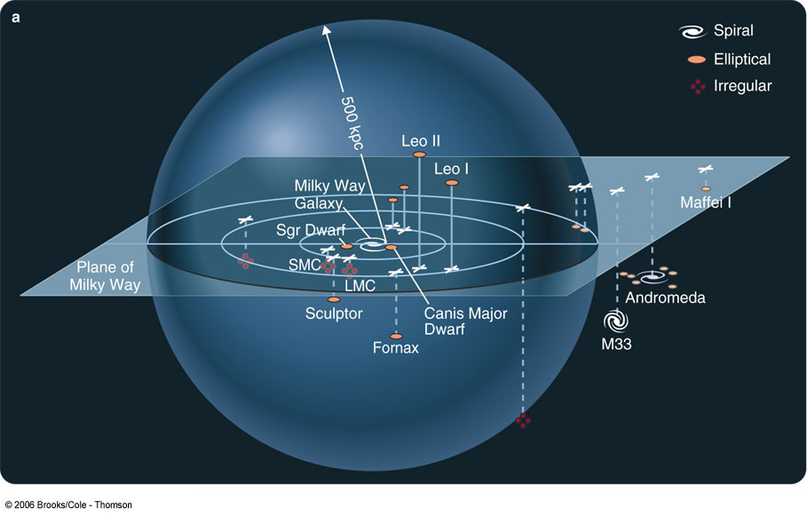
Our Galaxy Cluster: The Local Group
0
Milky Way
Andromeda Galaxy
Small Magellanic Cloud
Large Magellanic Cloud

Slide 27
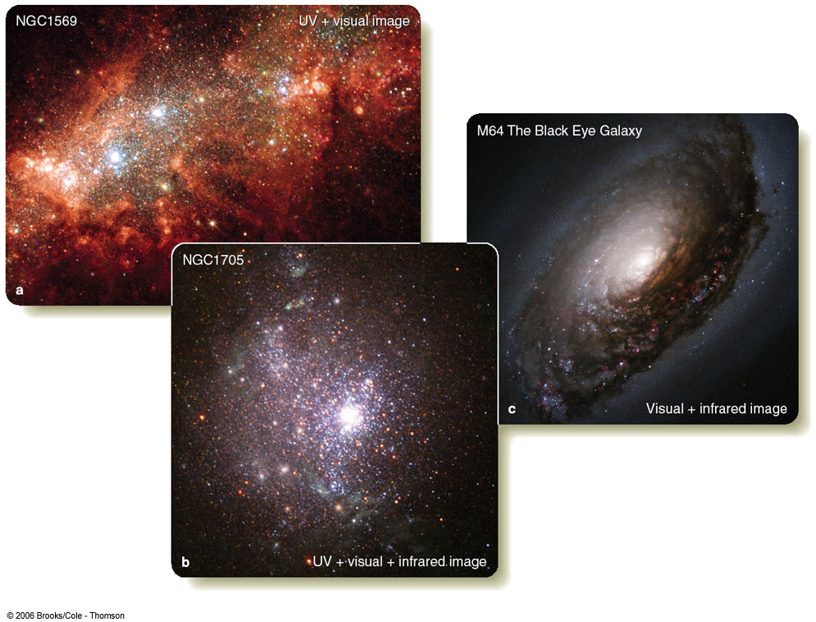
Starburst Galaxies
0
Starburst galaxies are often very rich in gas and dust; bright in infrared:
Ultraluminous infrared galaxies

Slide 28
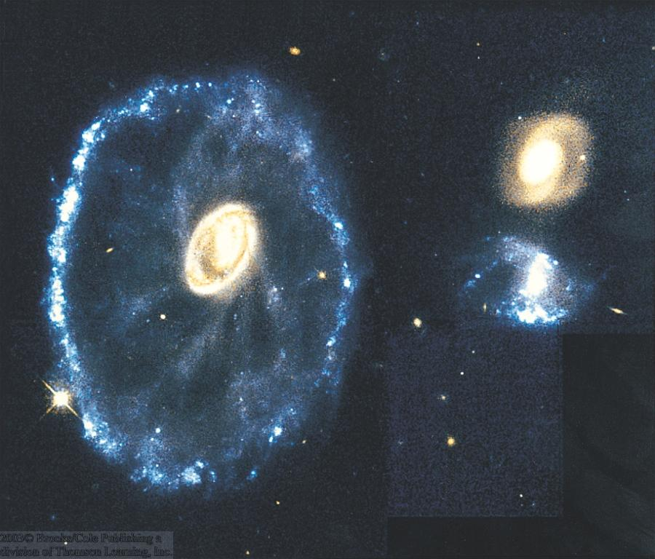
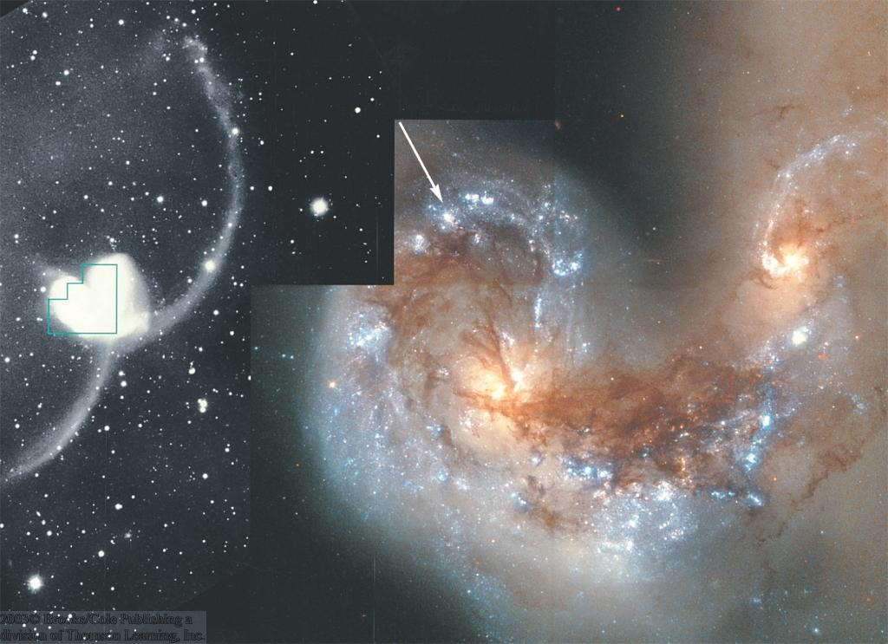
Interacting Galaxies
0
Cartwheel Galaxy
Particularly in rich clusters, galaxies can collide and interact.
Galaxy collisions can produce
ring galaxies and
tidal tails.
NGC 4038/4039
Often triggering active star formation: Starburst galaxies

Slide 29
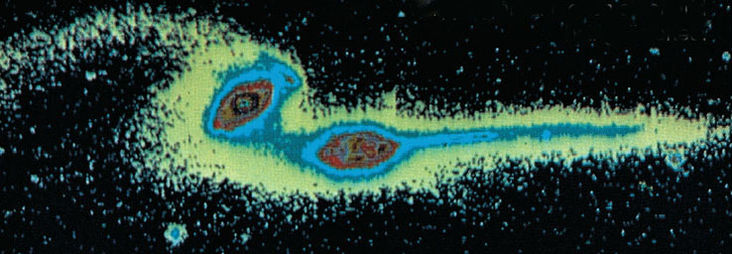

Tidal Tails
0
Example for galaxy interaction with tidal tails:
The Mice
Computer simulations produce similar structures.

Slide 30
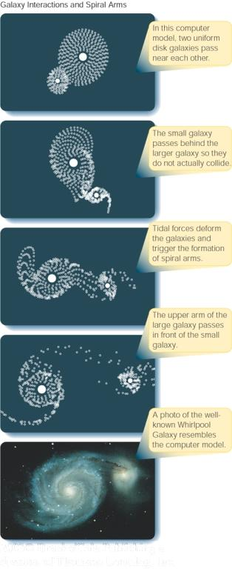
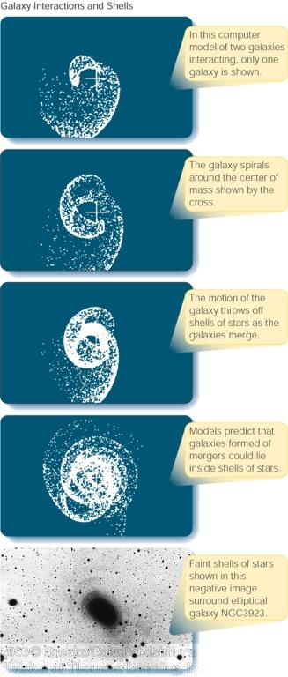
Simulations of Galaxy Interactions
0
Numerical simulations of galaxy interactions have been very successful in reproducing tidal interactions like bridges, tidal tails, and rings.

Slide 31
Galactic Interaction Simulations
Joshua Barnes: http://www.ifa.hawaii.edu/faculty/barnes/transform.html
John Dubinksi:
http://www.cita.utoronto.ca/~dubinski/nbody/
Chris Mihos:
http://burro.astr.cwru.edu/models/models.html
Bob Berrington (Wyoming):
http://physics.uwyo.edu/~rberring/
There are others…

Slide 32
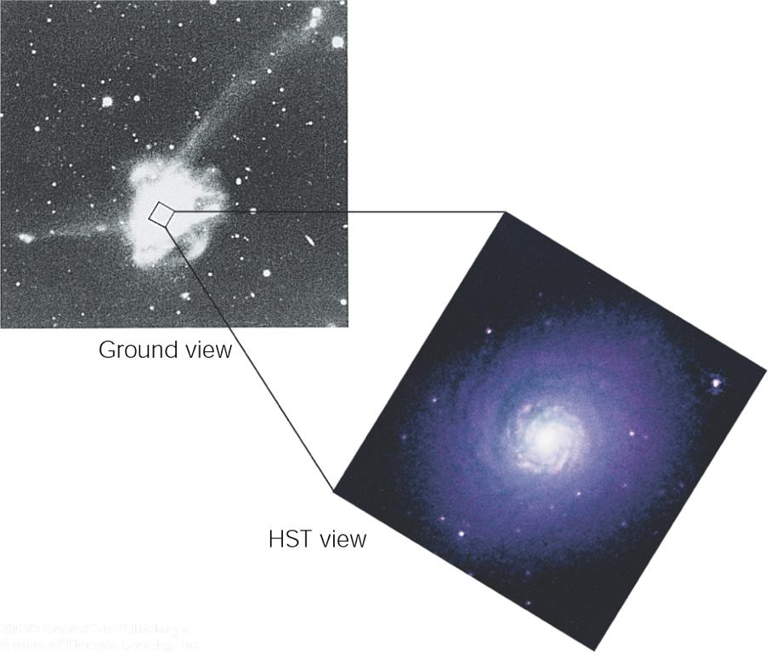
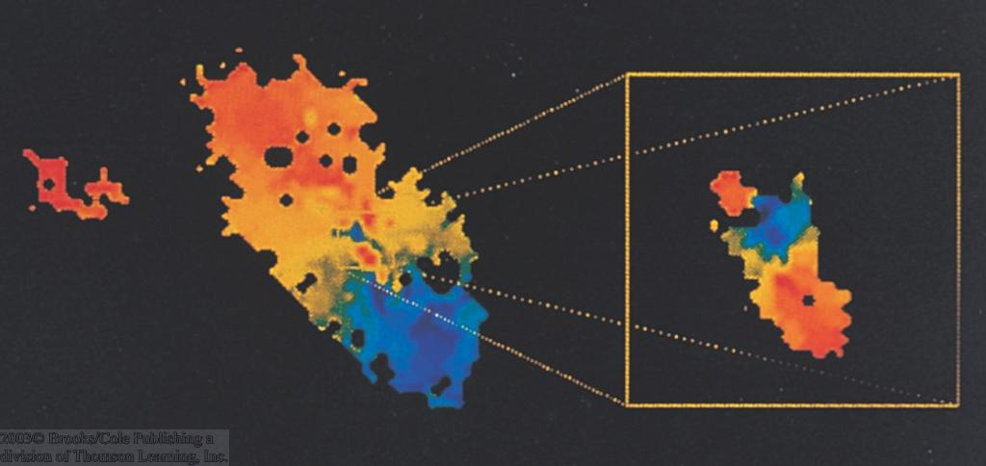
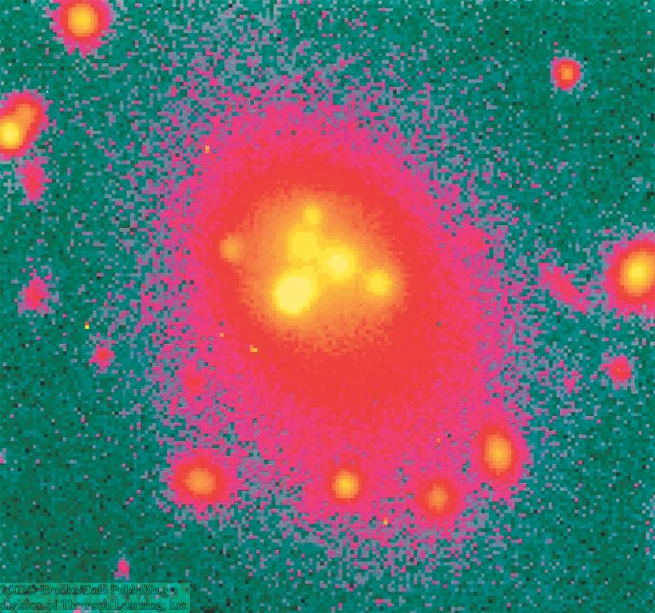
Mergers of Galaxies
0
Radio image of M64: Central regions rotating backwards!
NGC 7252: Probably result of merger of two galaxies, ~ a billion years ago:
Small galaxy remnant in the center is rotating backwards!
Multiple nuclei in giant elliptical galaxies

Slide 33
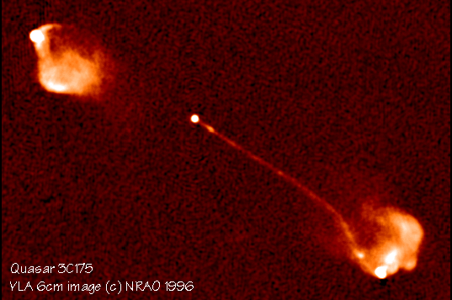
Active Galaxies
0
Galaxies with extremely violent energy release in their nuclei (pl. of nucleus).
→ “active galactic nuclei” (= AGN)
Up to many thousand times more luminous than the entire Milky Way; energy released within a region approx. the size of our solar system!

Slide 34
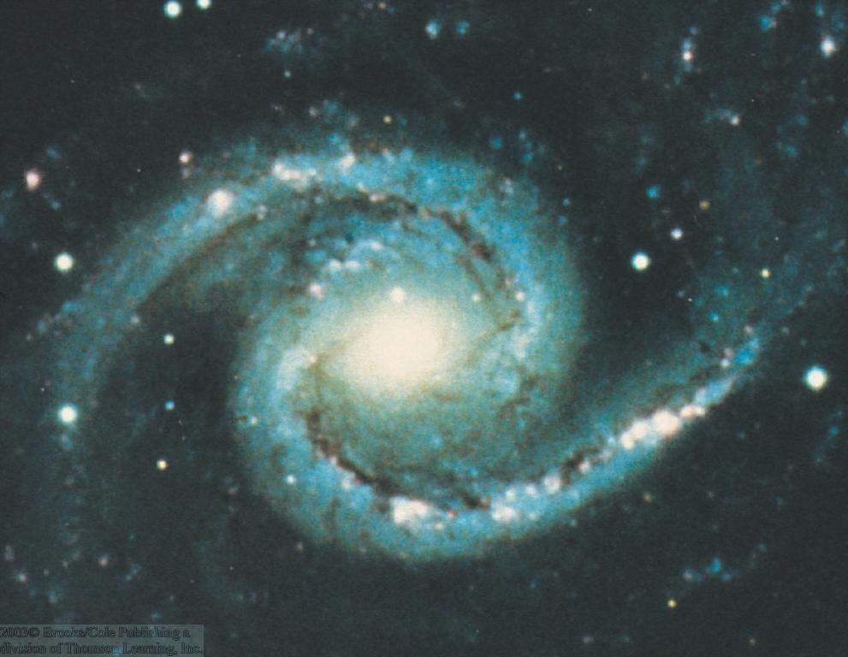
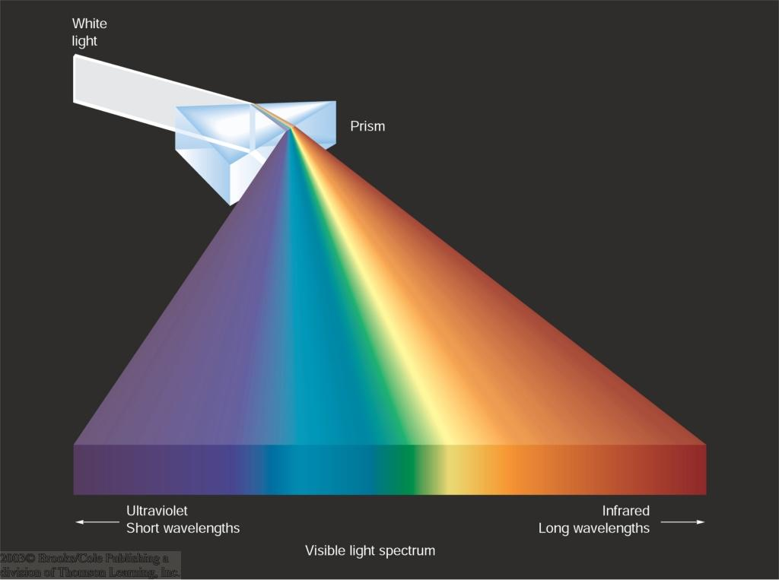
Line Spectra of Galaxies
0
Taking a spectrum of the light from a normal galaxy:
The light from the galaxy should be mostly star light, and should thus contain many absorption lines from the individual stellar spectra.

Slide 35
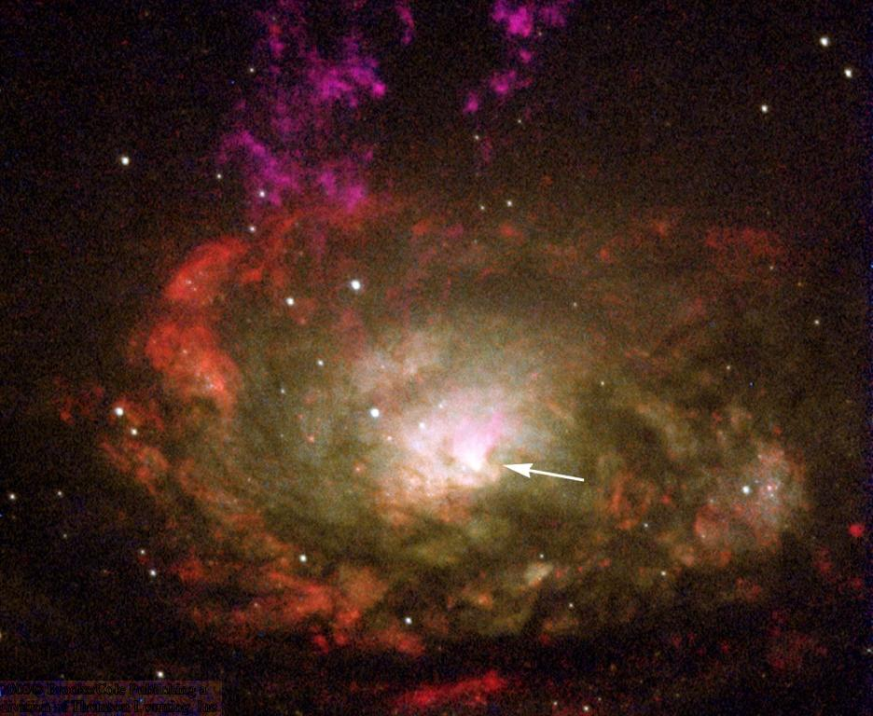
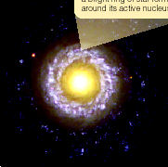
Seyfert Galaxies
0
Unusual spiral galaxies:
Very bright cores
Emission line spectra.
Variability: ~ 50 % in a few months
NGC 1566
Most likely power source:
Accretion onto a supermassive black hole (~10⁷ – 10⁸ M_{sun})
Circinus Galaxy
NGC 7742

Slide 36
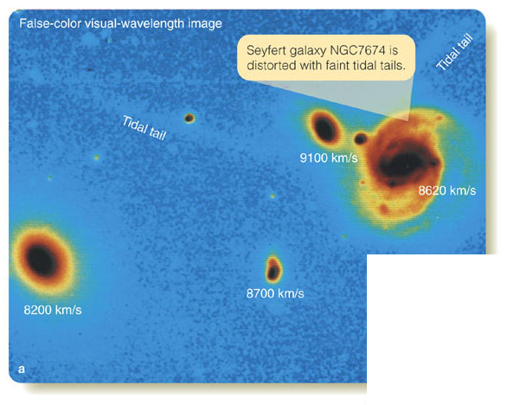
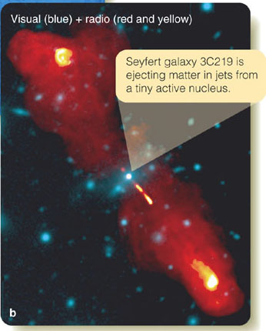
Interacting Galaxies
0
Seyfert galaxy NGC 7674
Seyfert galaxy 3C219
Active galaxies are often associated with interacting galaxies, possibly result of recent galaxy mergers.
Often: gas outflowing at high velocities, in opposite directions

Slide 37
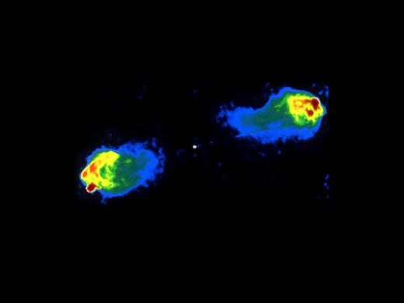
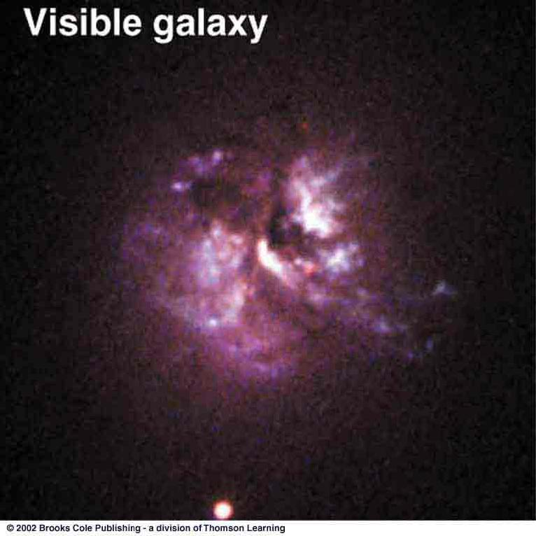
Cosmic Jets and Radio Lobes
0
Many active galaxies show powerful radio jets
Hot spots:
Energy in the jets is released in interaction with surrounding material
Radio image of Cygnus A
Material in the jets moves with almost the speed of light (“relativistic jets”).

Slide 38
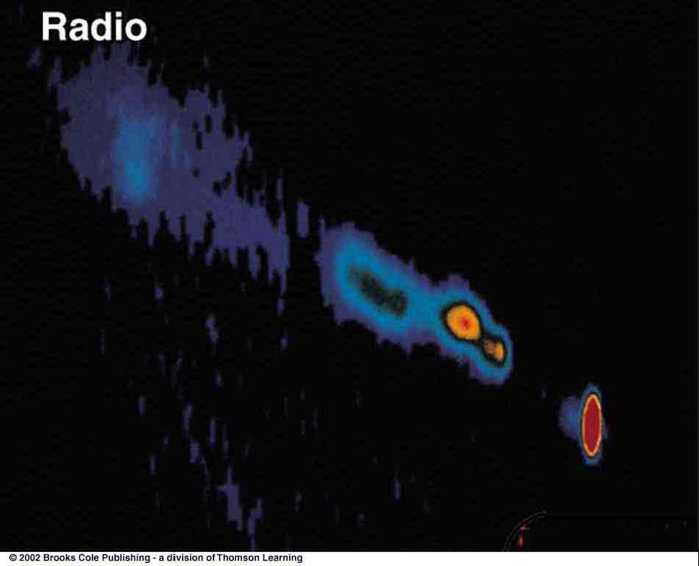
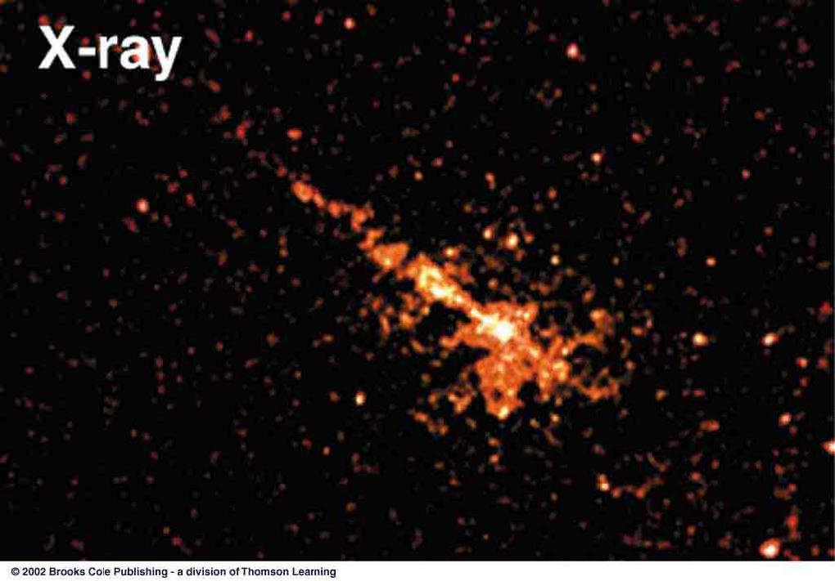
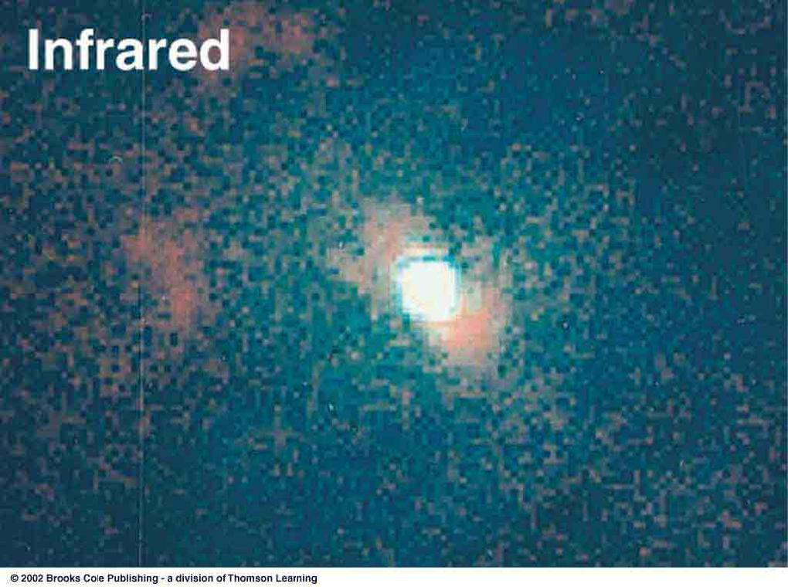
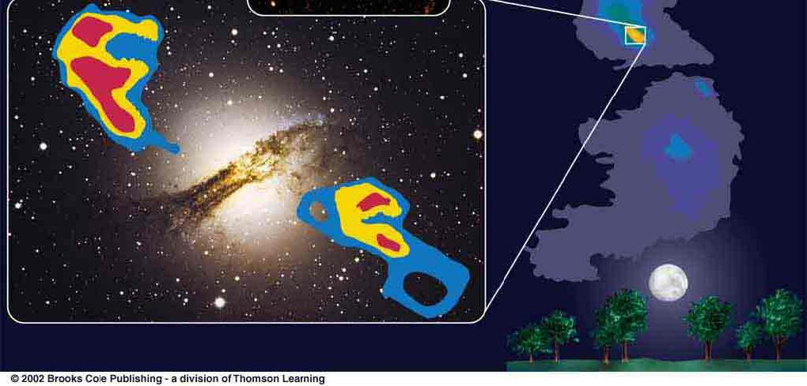
Radio Galaxies
0
Centaurus A (“Cen A” = NGC 5128): the closest AGN to us.
Jet visible in radio and X-rays; show bright spots in similar locations.
Infrared image reveals warm gas near the nucleus.
Radio image superposed on optical image

Slide 39
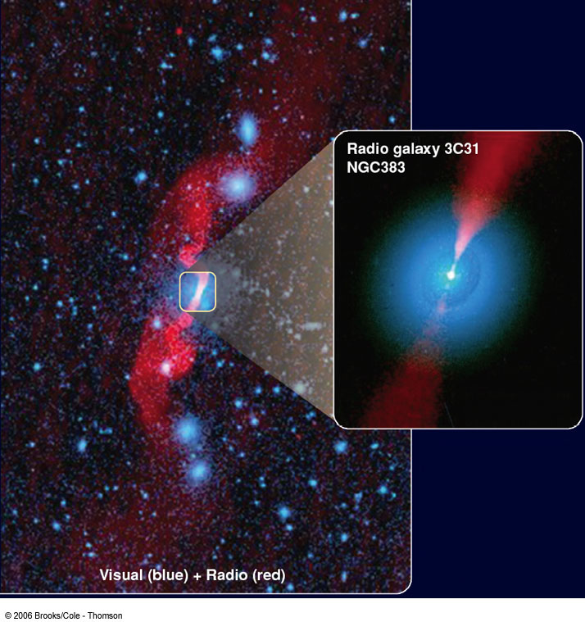
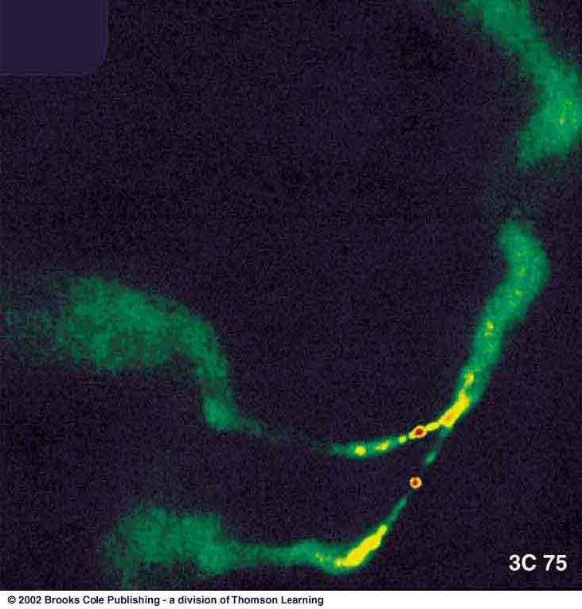
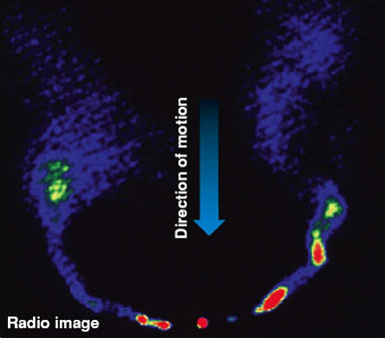
Radio Galaxies (II)
Visual + radio image of 3C31
0
Radio image of 3C75
Radio image of NGC 1265
Evidence for the galaxy moving through intergalactic material
3C75: Evidence for two nuclei → recent galaxy merger

Slide 40
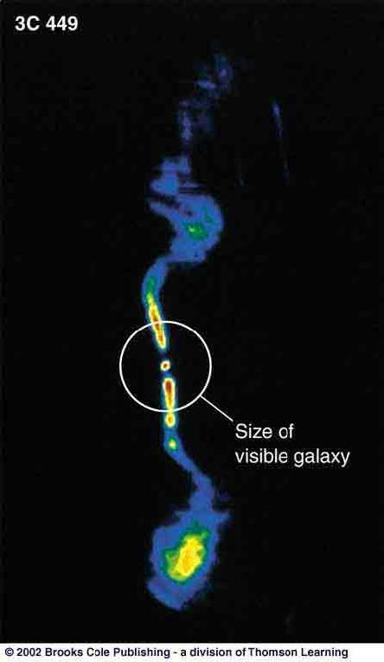
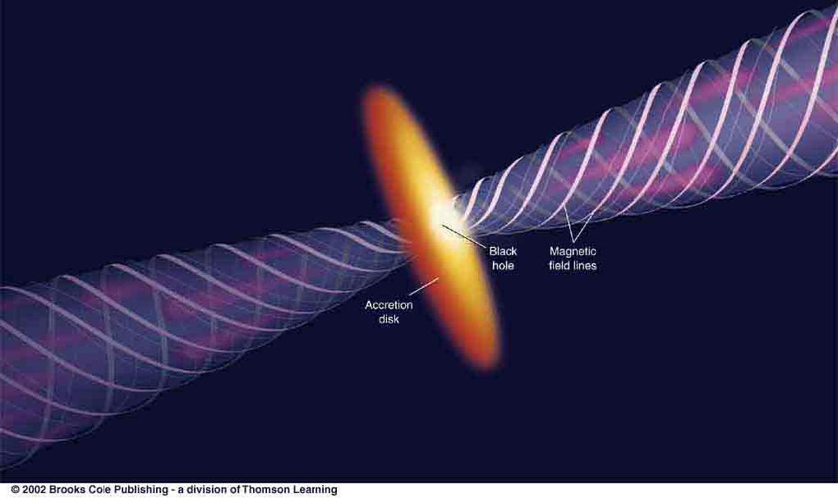
Formation of Radio Jets
0
Jets are powered by accretion of matter onto a supermassive black hole.
Black Hole
Accretion Disk
Twisted magnetic fields help to confine the material in the jet and to produce synchrotron radiation.

Slide 41
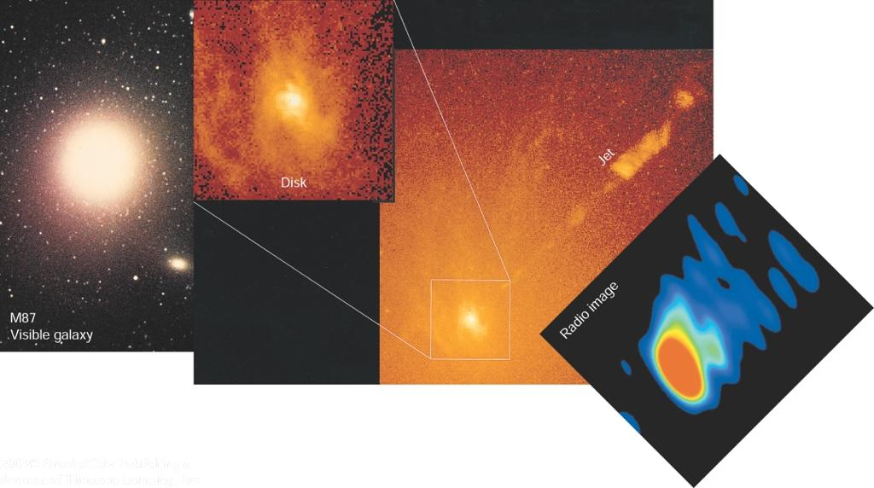
The Jets of M87
0
Jet: ~ 2.5 kpc long
M87 = Central, giant elliptical galaxy in the Virgo cluster of galaxies
Optical and radio observations detect a jet with velocities up to ~ 1/2 c.

Slide 42
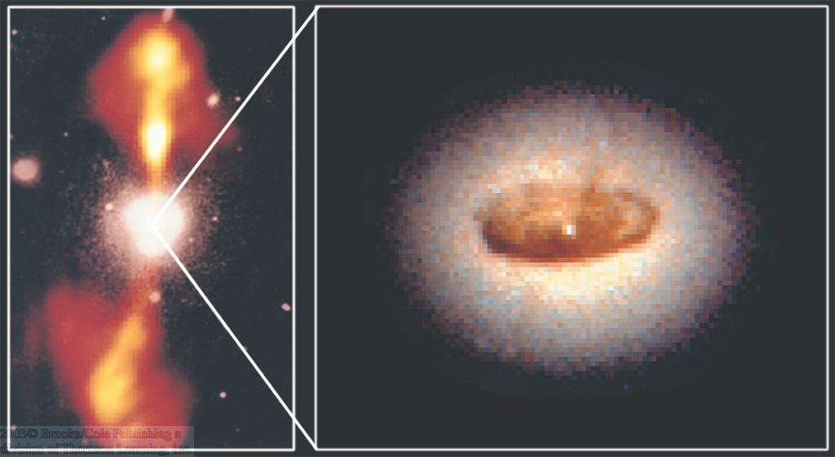
The Dust Torus in NGC4261
0
Dust torus is directly visible with Hubble Space Telescope

Slide 43
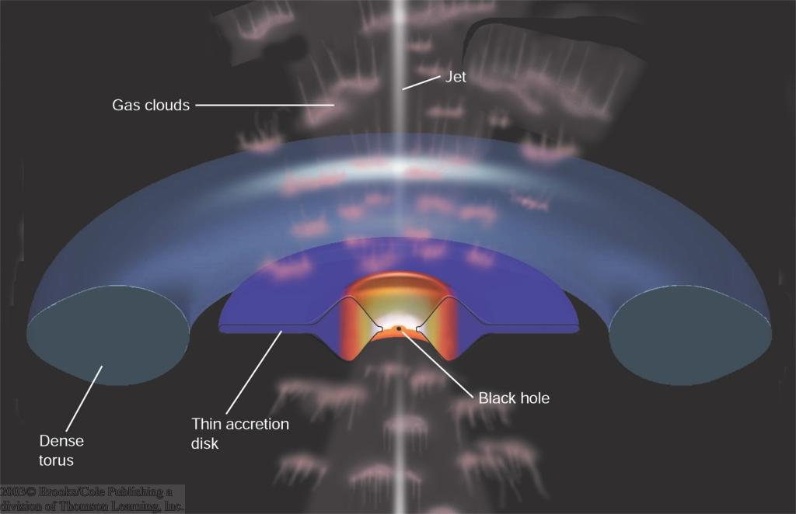
Model for Seyfert Galaxies
0
Seyfert I:
Strong, broad emission lines from rapidly moving gas clouds near the black hole
Gas clouds
Emission lines
UV, X-rays
Seyfert II:
Weaker, narrow emission lines from more slowly moving gas clouds far from the black hole
Supermassive black hole
Accretion disk
dense dust torus

Slide 44
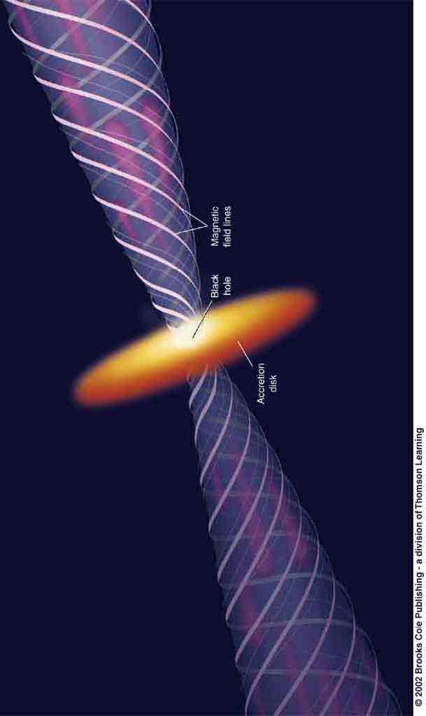
Other Types of AGN and AGN Unification
0
Observing direction
Cyg A (radio emission)
Radio Galaxy:
Powerful “radio lobes” at the end points of the jets, where power in the jets is dissipated.

Slide 45
Other Types of AGN and AGN Unification
0
Quasar or BL Lac object (properties very similar to quasars, but no emission lines)
Emission from the jet pointing towards us is enhanced (“Doppler boosting”) compared to the jet moving in the other direction (“counter jet”).
Observing direction

Slide 46
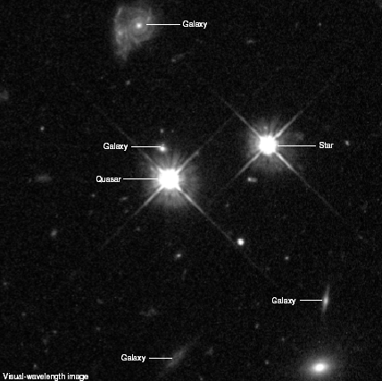
Quasars
0
Active nuclei in elliptical galaxies with even more powerful central sources than Seyfert galaxies.
Also show strong variability over time scales of a few months.
Also show very strong, broad emission lines in their spectra.

Slide 47


The Spectra of Quasars
0
The Quasar 3C273
Spectral lines show a large redshift of
z = Δλ / λ₀ = 0.158

Slide 48

Quasar Red Shifts
0
Quasars have been detected at the highest redshifts, up to
z ~ 6
z = 0
z = 0.178
z = 0.240
z = Δλ/λ₀
z = 0.302
Our old formula
Δλ/λ₀ = v_{r}/c
is only valid in the limit of low speed, v_{r} << c
z = 0.389

Slide 49
Studying Quasars
0
The study of high-redshift quasars allows astronomers to investigate questions of
1) Large scale structure of the universe
2) Early history of the universe
3) Galaxy evolution
4) Dark matter
Observing quasars at high redshifts
⬄ distances of several Gpc
Look-back times of many billions of years
⬄ Universe was only a few billion years old!

Slide 50



Probing Dark Matter with High-z Quasars: Gravitational Lensing
0
Light from a distant quasar is bent around a foreground galaxy
→ two images of the same quasar!
Light from a quasar behind a galaxy cluster is bent by the mass in the cluster.
Use to probe the distribution of matter in the cluster.

Slide 51

Gravitational Lensing of Quasars
0

Slide 52

Gallery of Quasar Host Galaxies
0
Elliptical galaxies; often merging / interacting galaxies

Slide 53

My Post-Starburst Quasar Images from Hubble:
0

Slide 54
Large Scale Structure
Galaxies are in clusters, which make up superclusters, and there exists essentially “bubbles” or “webs” of structure up to about 100 Mpc scales.
Understanding this is essential to understanding how the universe formed and evolved.
Test with simulations that require right mix of matter (baryonic and dark) as well as dark energy. Without right mix, simulations will not resemble the universe. Our current mix looks pretty good and consistent with observerations.

Slide 55

Virgo Supercluster & larger supercluster Laniakea.
Credit: Brent Tully. https://www.youtube.com/watch?v=rENyyRwxpHo (4 m)

Slide 56
Issue of non-Hubble Flow Velocities.
Virgo and dispersions and net flow.

Slide 57
Even Larger Scales.
CFA Survey. 15000 km/s corresponds to z=0.05 or about 200 Mpc.

Slide 58
Even Larger Scales.
SDSS. Outer edge is about 2 billion light years away.
Wow!

Slide 59
Simulations
Scale bar is 180 Mpc

