Slide 1
ASTR 2320 General Astronomy II
Professor Mike Brotherton
Chapter 17 – The Milky Way
There’s a restaurant at the end of the universe, and a bar at the center of the galaxy.

Slide 2
The Milky Way
History
The H-R diagram
Star clusters
Structure & components of the galaxy (including H II regions and neutral H clouds)
Multiwavelength views, central bar, etc.
Spiral arms with their H II regions and Stromgren spheres
LSR and Oort constants
More on dust and extinction
Dark Matter, MaCHOs and WIMPs
Synchrotron radiation (save for AGN probably)
(Many Slides based on Horizons by Michael Seeds and other sources)

Slide 3
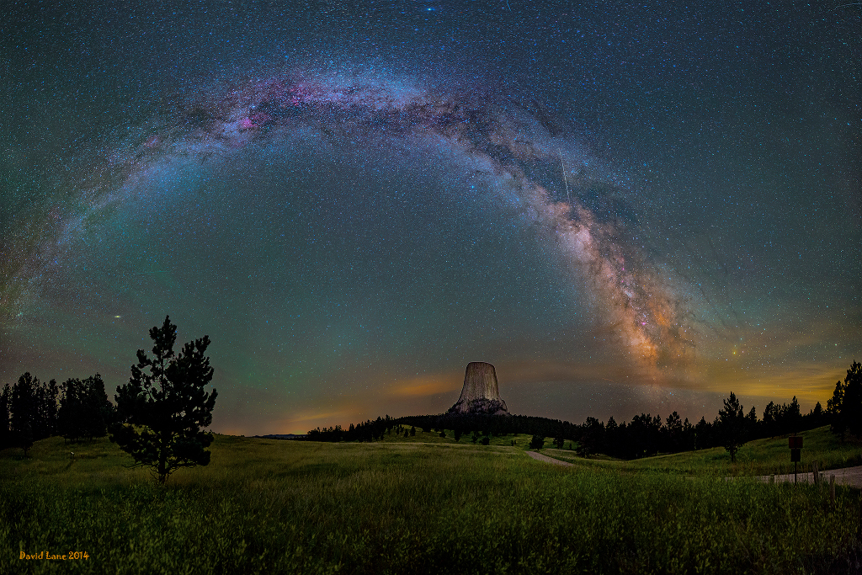
The Milky Way
0
Almost everything we see in the night sky belongs to the Milky Way.
From outside, our Milky Way might very much look like our cosmic neighbor, the Andromeda Galaxy. How do we know that?
We see most of the Milky Way as a faint band of light across the sky.

Slide 4
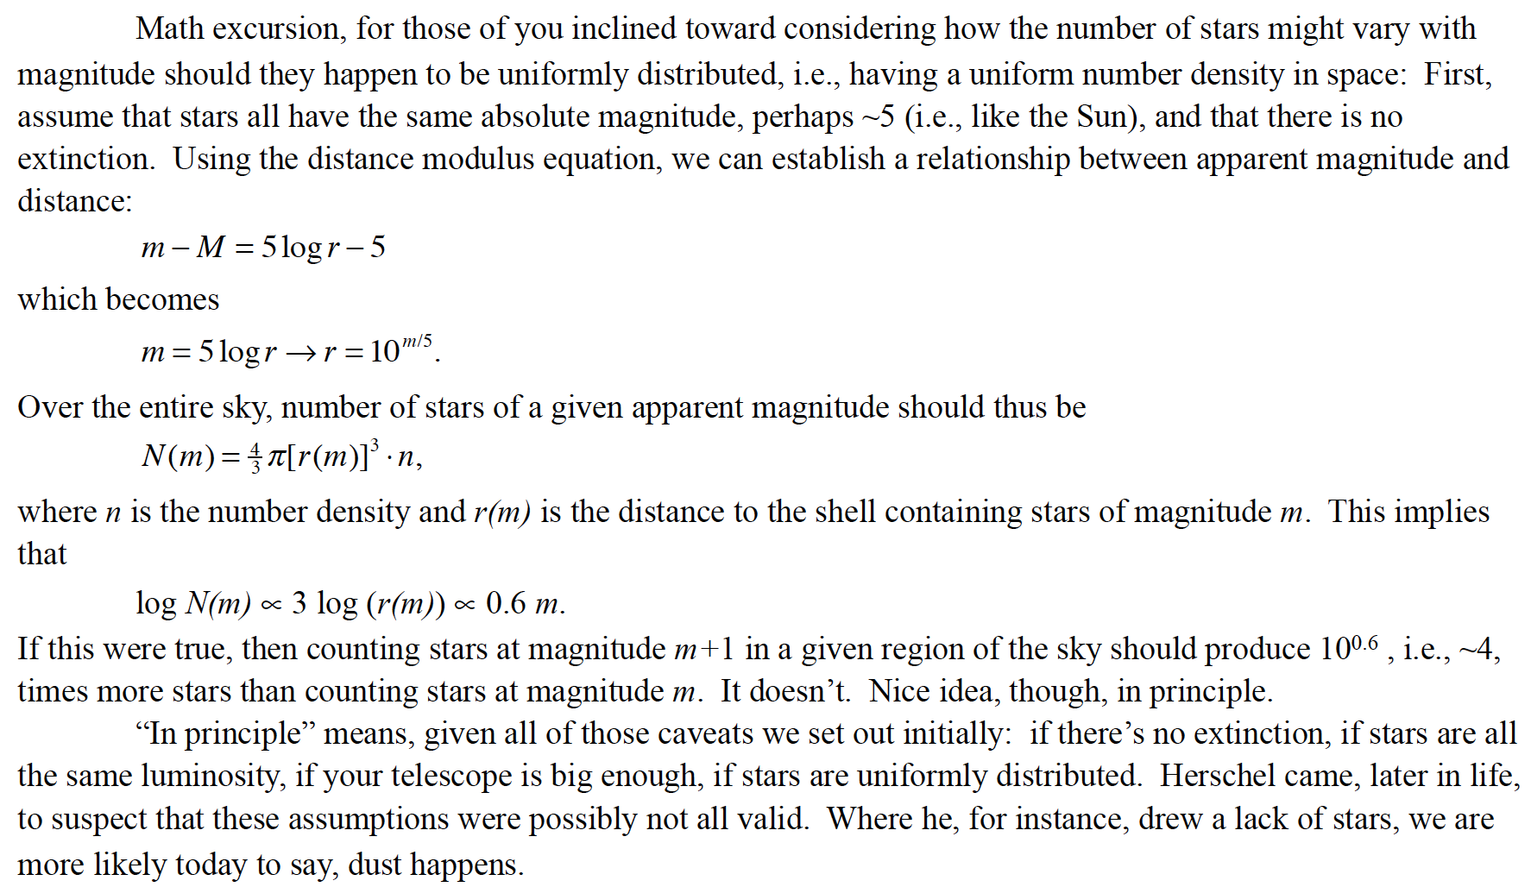
Early Attempts at Mapping the Milky Way
In 1700s, no parallax measured yet! What to do?
Assume stars have similar absolute magnitude to sun, no dust, then…

Slide 5
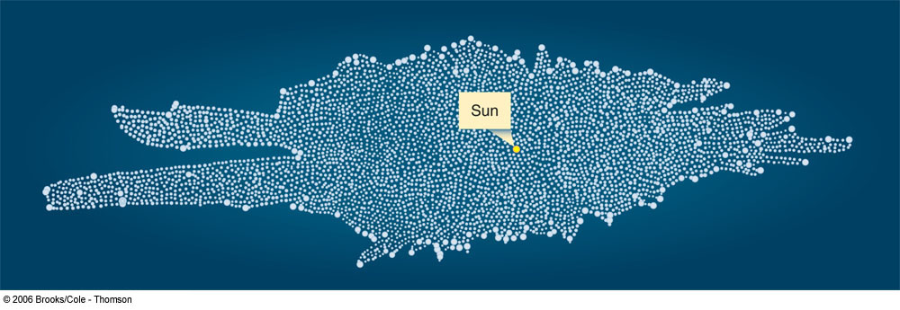
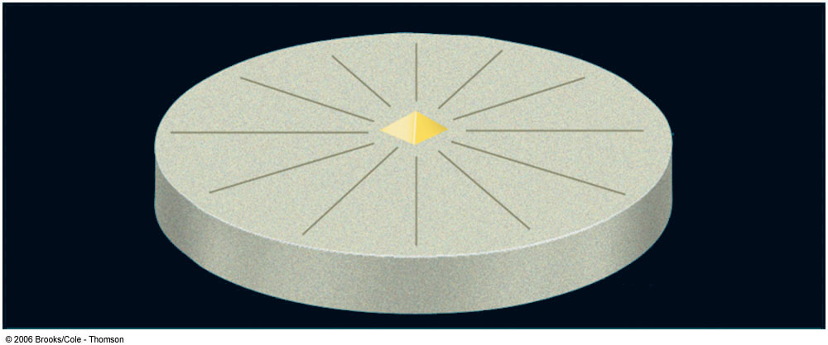
First Studies of the Galaxy
0
First attempt to unveil the structure of the galaxy by William Herschel (1785), based on optical observations.
The shape of the Milky Way was believed to resemble a grindstone, with the sun close to the center

Slide 6
Strategies to explore the structure of our Milky Way
0
I. Select bright objects that you can see throughout the Milky Way and trace their directions and distances.
II. Observe objects at wavelengths other than visible (to circumvent the problem of optical obscuration), and catalog their directions and distances.
III. Trace the orbital velocities of objects in different directions relative to our position.

Slide 7
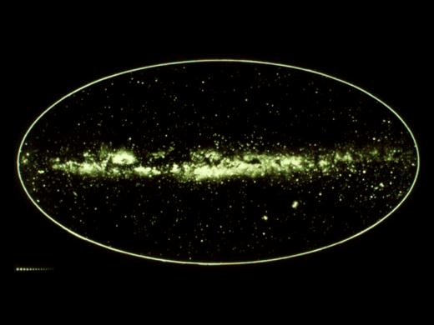
Determining the Structure of the Milky Way
0
Galactic Plane
Galactic Center
The structure of our Milky Way is hard to determine because:
1) We are inside.
2) Distance measurements are difficult.
3) Our view towards the center is obscured by gas and dust.

Slide 8
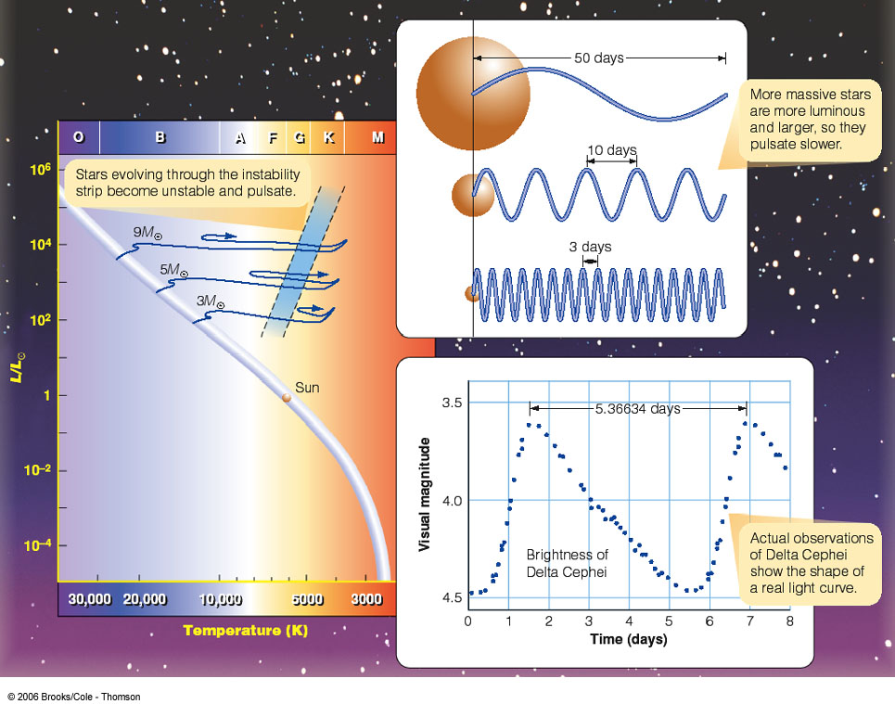
Measuring Distances: The Cepheid Method
0
The more luminous a Cepheid variable, the longer its pulsation period.
Instability Strip
Observing the period yields a measure of its luminosity and thus its distance!

Slide 9
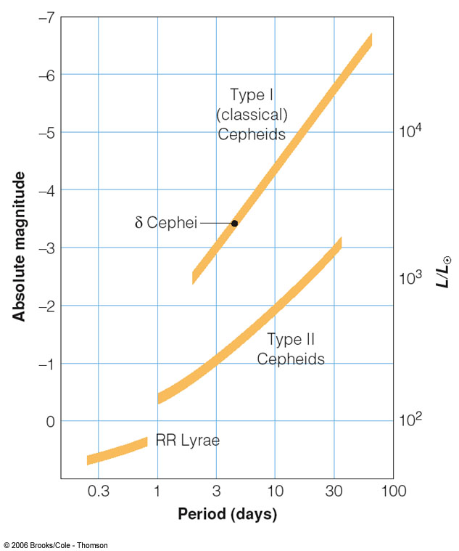
The Cepheid Method
0
Allows us to measure the distances to star clusters throughout the Milky Way

Slide 10
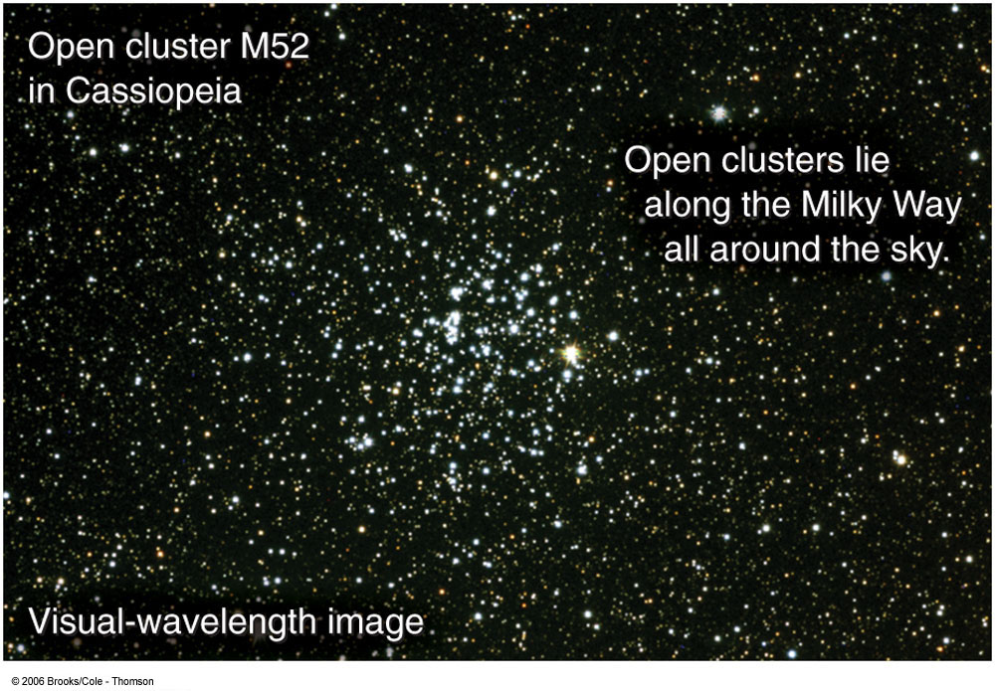
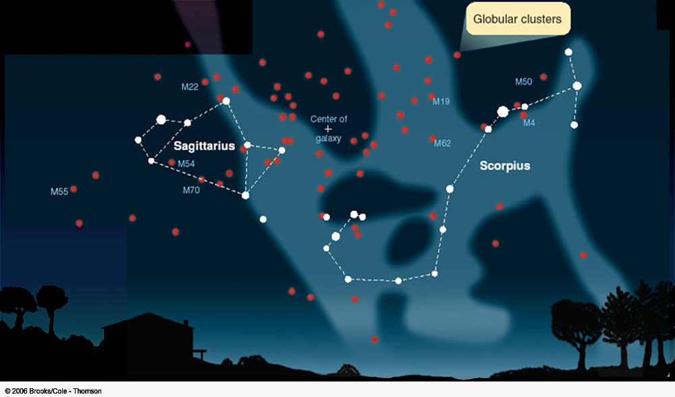
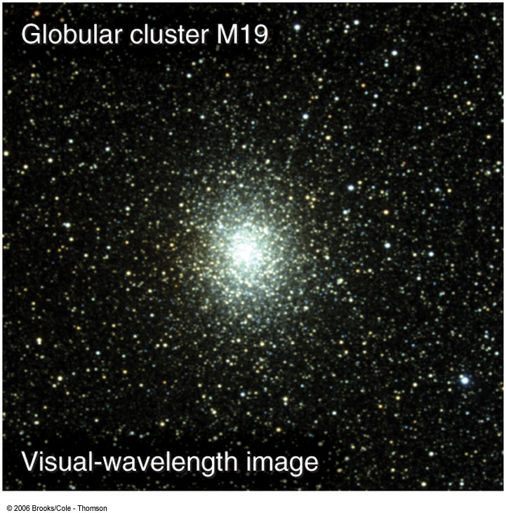
Exploring the Galaxy Using Clusters of Stars
0
Two types of clusters of stars:
1) Open clusters = young clusters of recently formed stars; within the disk of the Galaxy
Open clusters h and χ Persei
Globular Cluster M 19
2) Globular clusters = old, centrally concentrated clusters of stars; mostly in a halo around the galaxy

Slide 11
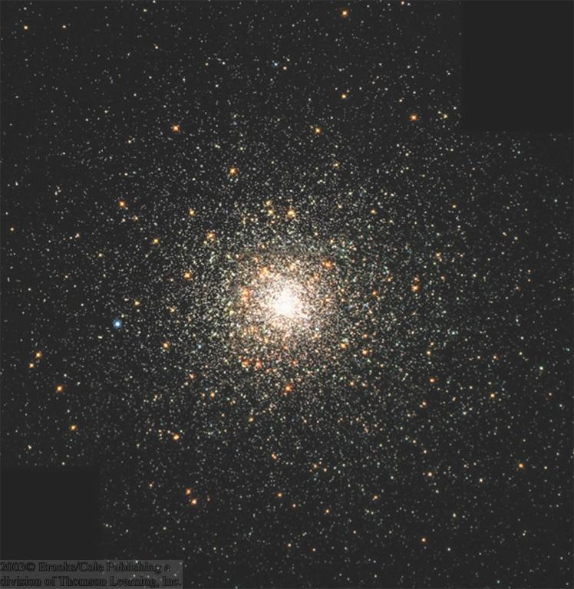
Globular Clusters
0
Globular Cluster M80
Dense clusters of 50,000 – a million stars
Old (~ 11 billion years), lower-main-sequence stars
Approx. 200 globular clusters in our Milky Way

Slide 12
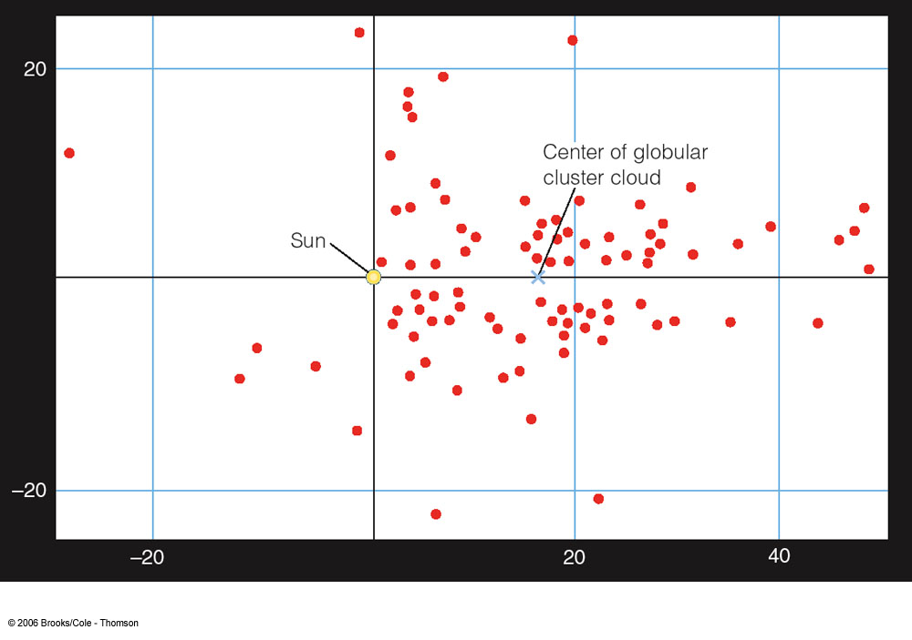
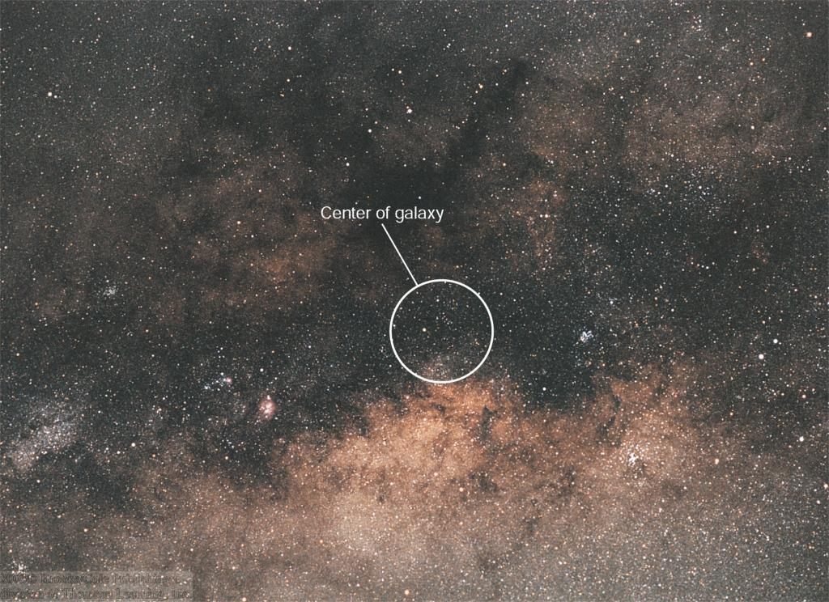
Locating the Center of the Milky Way
0
Distribution of globular clusters is not centered on the sun,
but on a location which is heavily obscured from direct (visual) observation.

Slide 13
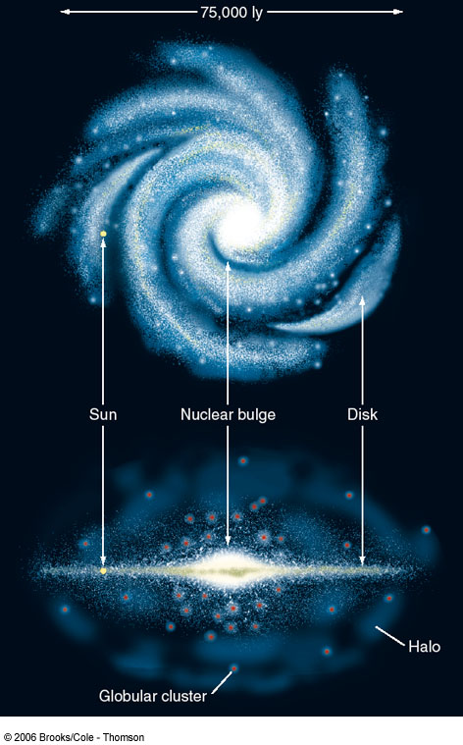
The Structure of the Milky Way
0
~50 kpc
Disk
Nuclear Bulge
Sun
Halo
Open Clusters, O/B Associations
Globular Clusters

Slide 14
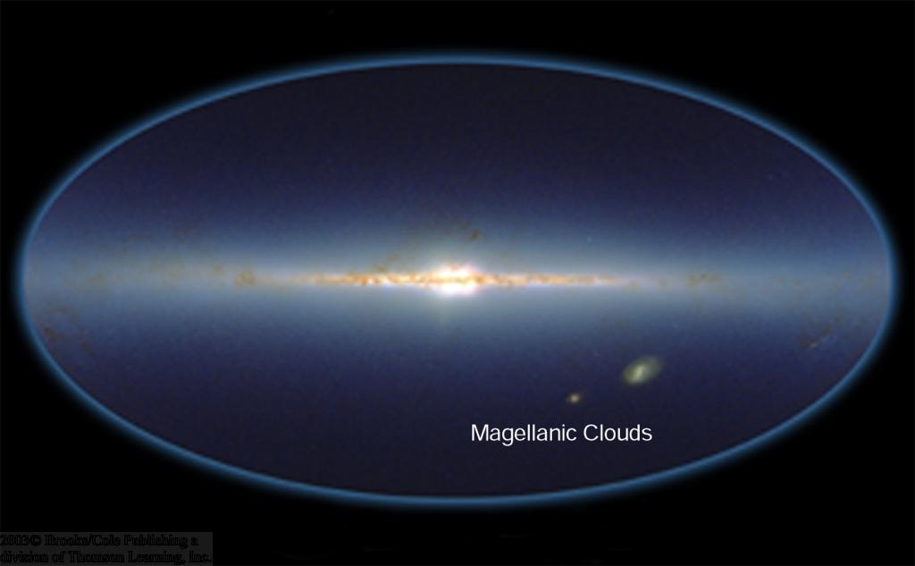
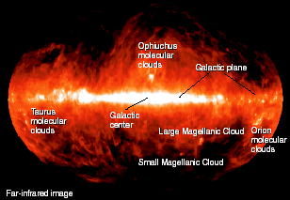
Infrared View of the Milky Way
0
Near-infrared image
Galactic plane
Interstellar dust (absorbing optical light) emits mostly infrared.
Nuclear bulge
Infrared emission is not strongly absorbed and provides a clear view throughout the Milky Way
Far-infrared image

Slide 15
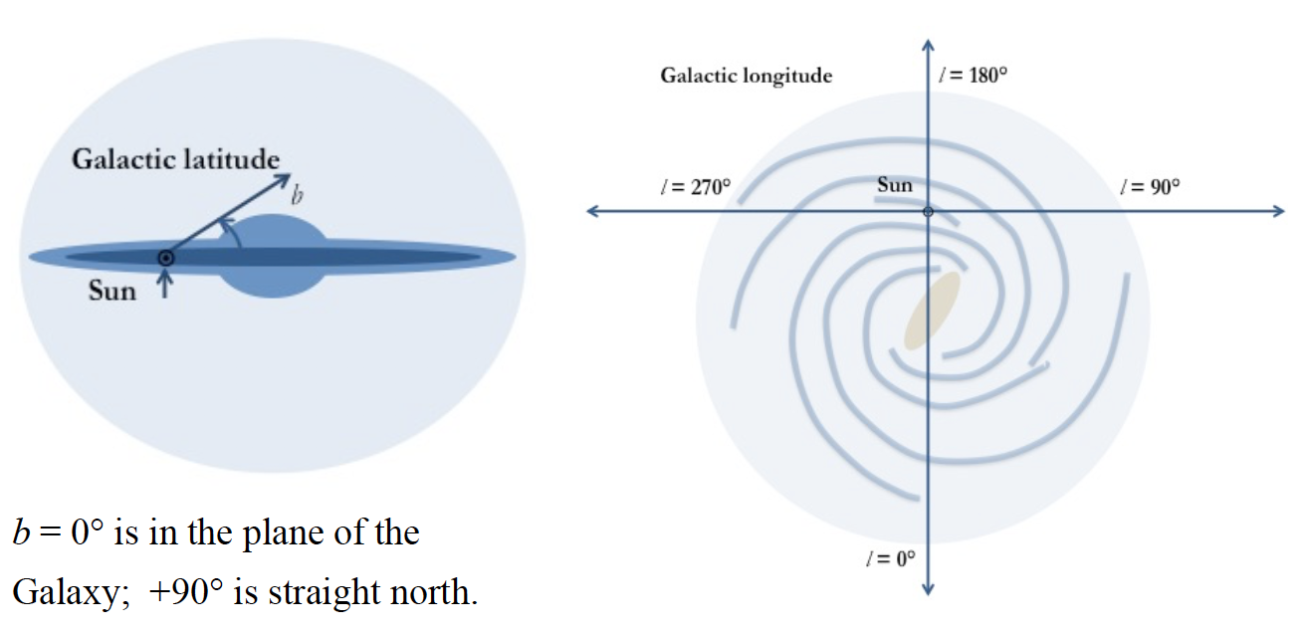
Galactic Coordinates
Galactic latitude (b) and longitude (l) are sometimes useful.

Slide 16
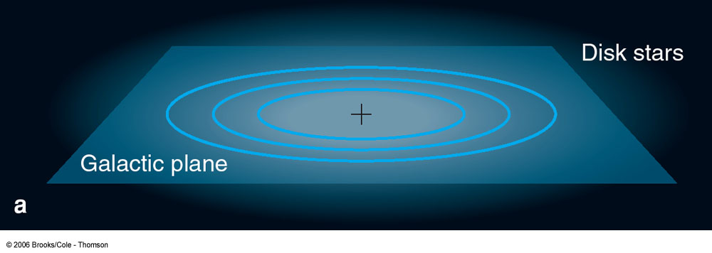
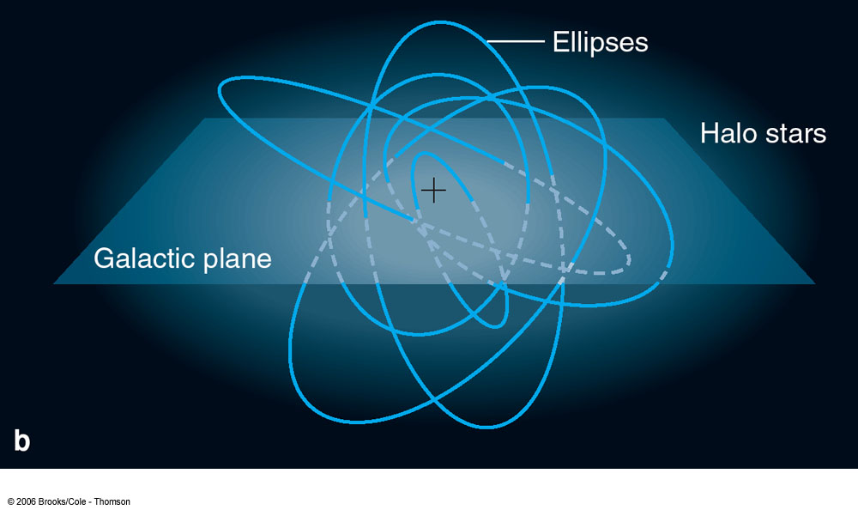
Orbital Motions in the Milky Way (I)
0
Disk stars:
Nearly circular orbits in the disk of the galaxy
Halo stars:
Highly elliptical orbits; randomly oriented

Slide 17
Orbital Motions in the Milky Way
0
See textbook for discussion of local standard of rest and Oort coefficients. We will defer this level of detail probably to ASTR 4610.

Slide 18
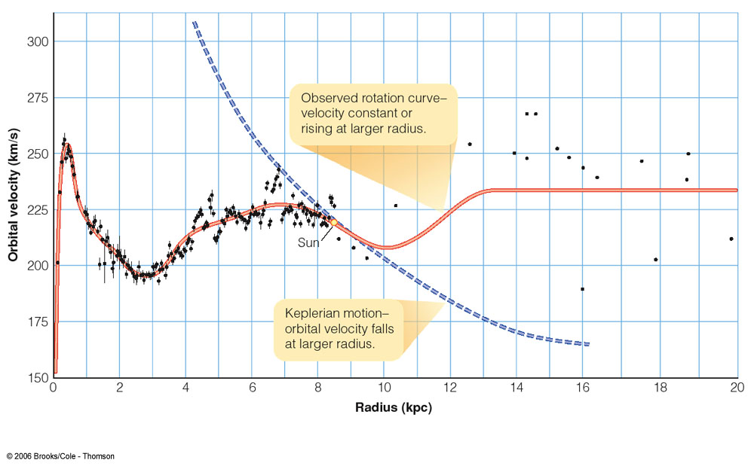
The Mass of the Milky Way
0
If all mass was concentrated in the center, Rotation curve would follow a modified version of Kepler’s 3rd law.
Rotation Curve = orbital velocity as function of radius.

Slide 19
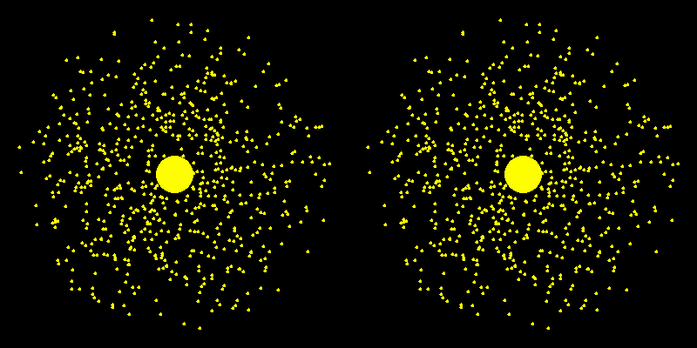
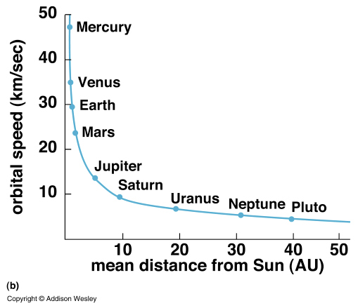
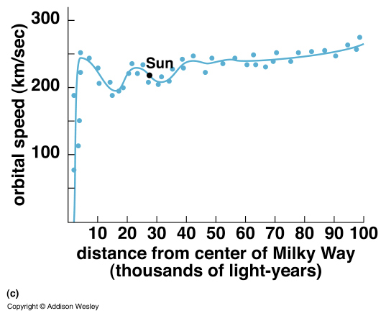
Flat Rotation Curves – so what?
Following Rieke, images from Bennett and Pryke

Slide 20
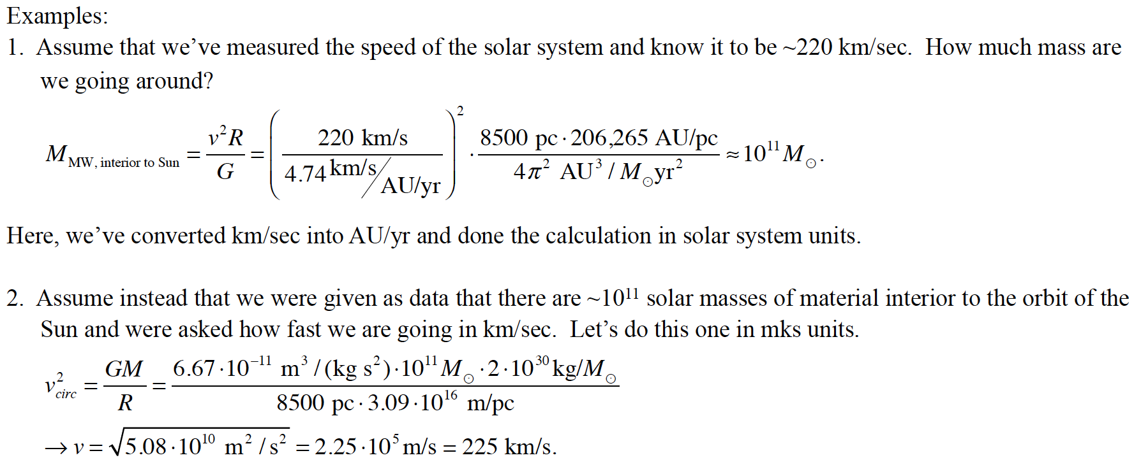
Interior mass estimation

Slide 21
The Mass of the Milky Way (II)
0
Total mass in the disk of the Milky Way:
Approx. 200 billion solar masses
Additional mass in an extended halo:
Total: Approx. 1 trillion solar masses
Most of the mass is not emitting any radiation:
dark matter!
The LATEST (Video)

Slide 22
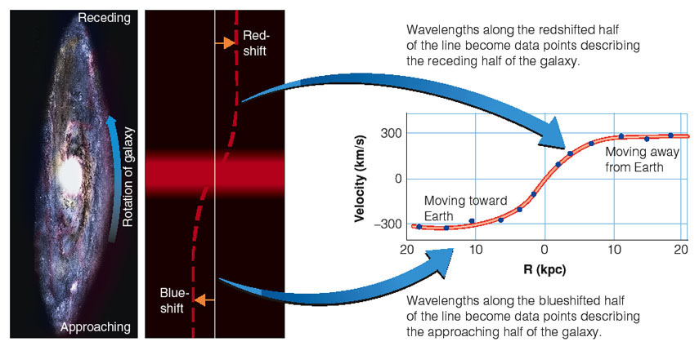
Rotation Curves of Galaxies
0
From blue / red shift of spectral lines across the galaxy → infer rotational velocity
Observe frequency of spectral lines across a galaxy.
Plot of rotational velocity vs. distance from the center of the galaxy:
rotation curve

Slide 23
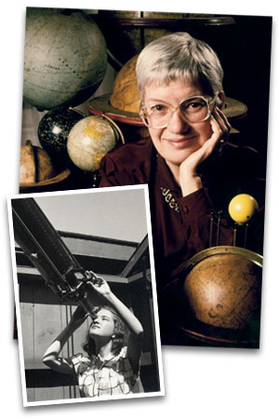
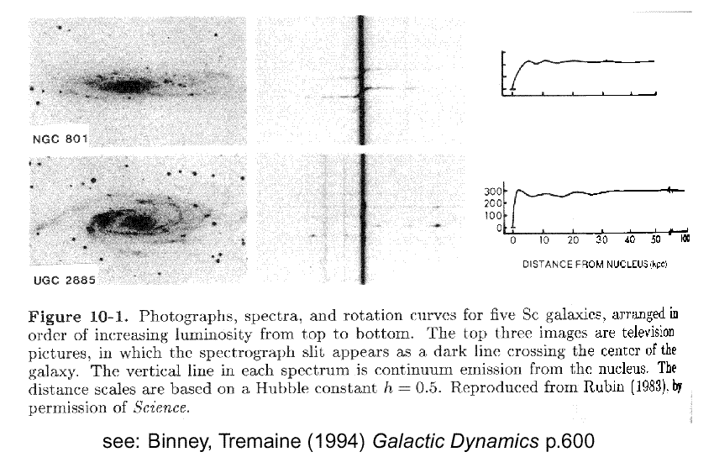
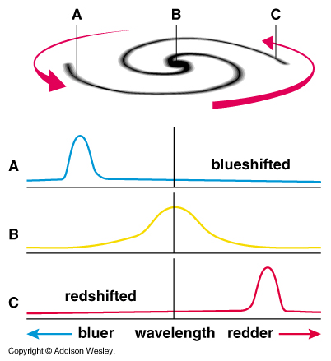
The Mother of Dark Matter
Pioneered by Vera Rubin who started to report these FLAT rotation curves in spiral galaxies.

Slide 24
Dark Matter
0
Adding “visible” mass in
stars,
interstellar gas,
dust,
etc., we find that most of the mass is “invisible”!
The nature of this “dark matter” is not understood at this time.
Some ideas:
Brown dwarfs, small black holes, exotic elementary particles (e.g. WIMPs).

Slide 25
WIMPs???
“WIMP” = Weakly interactive massive particle
Neutrinos?
Seem to have mass, but too small.
Axions?
From Wikipedia, “The axion is a hypothetical elementary particle postulated by Peccei-Quinn theory in 1977 to resolve the strong-CP problem in quantum chromodynamics (QCD).”
As yet, not detected (axions are predicted to change to and from photons in the presence of strong magnetic fields, and this property is used for creating experiments to detect axions)

Slide 26
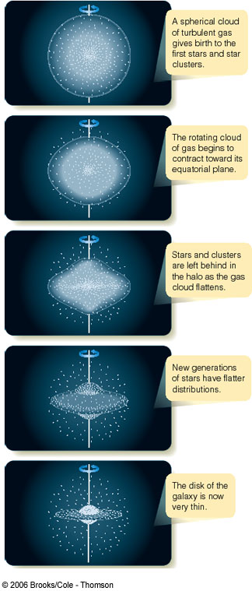
The History of the Milky Way
0
The traditional theory:
Quasi-spherical gas cloud fragments into smaller pieces, forming the first, metal-poor stars (pop. II);
Rotating cloud collapses into a disk-like structure
Later populations of stars (pop. I) are restricted to the disk of the galaxy

Slide 27
Multiwavelength Views of the Milky Way

Slide 28
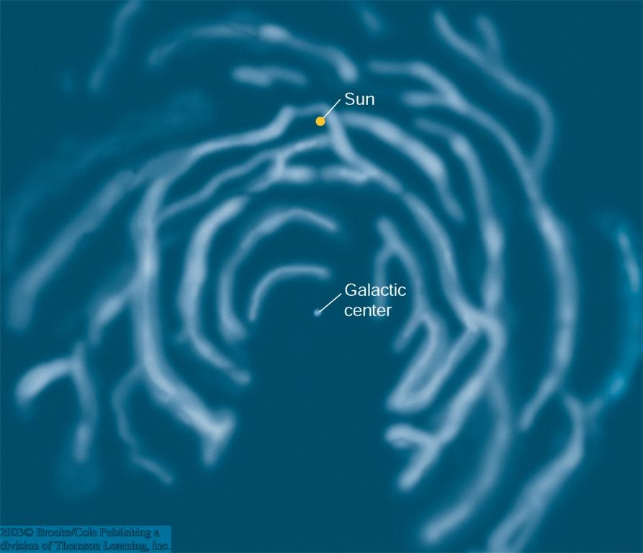
Radio Observations
0
21-cm radio observations reveal the distribution of neutral hydrogen throughout the galaxy.
Distances to hydrogen clouds determined through radial-velocity measurements (Doppler effect!) and modeling
Sun
Neutral hydrogen concentrated in spiral arms
Galactic center

Slide 29
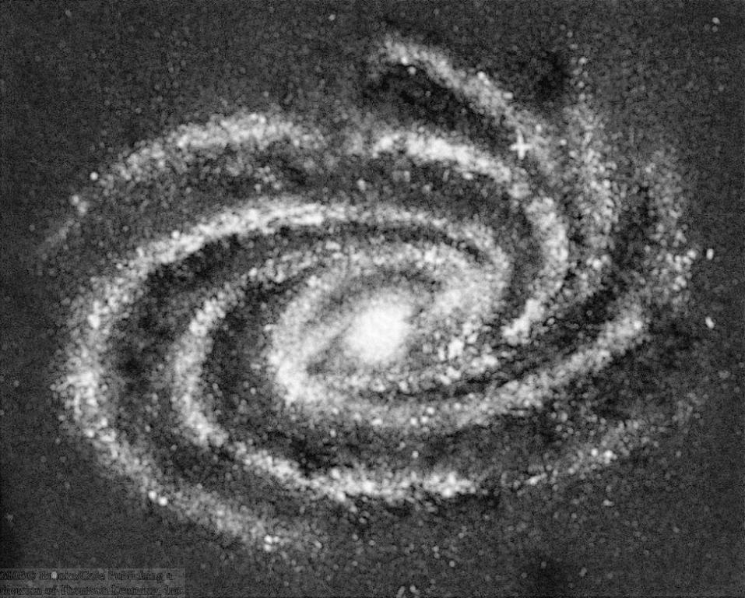
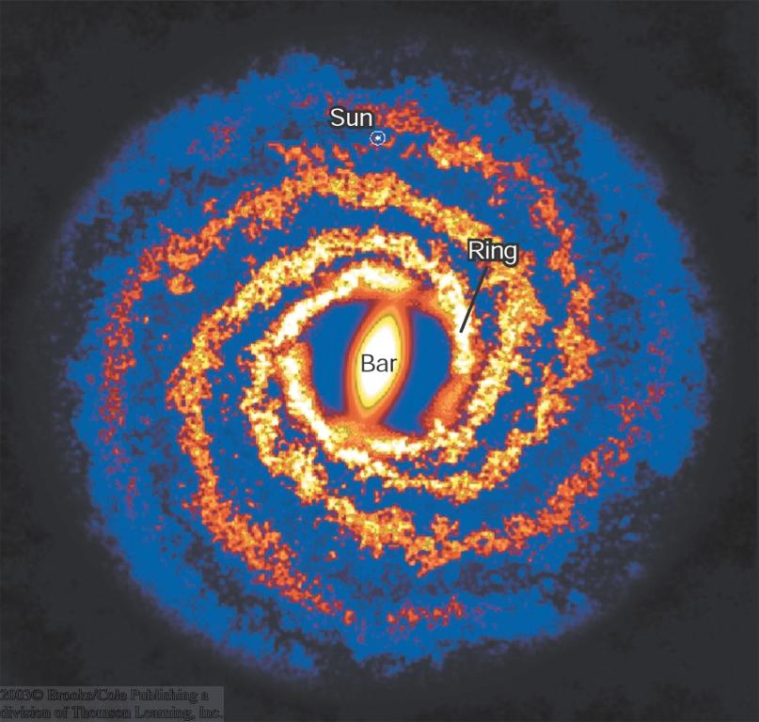
The Structure of the Milky Way Revealed
0
Distribution of stars and neutral hydrogen
Distribution of dust
Sun
Bar
Ring

Slide 30
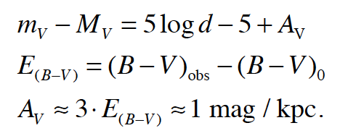
Review of distance modulus and dust

Slide 31
More details on dust reddening
Description: The 0.2 μm bump seems to be due to carbon grains. Farther out in the infrared we find spectral features due to absorption by water ice (at ~3 μm) and silicates (at ~9-10 μm). Some distinct emission features in the IR can be identified with PAHs, large hydrocarbon molecules containing several 10s of carbon atoms.

Slide 32
Another top view reconstruction
Top view of Milky Way.
Credit: R. Hurt (SSC), JPLCaltech,
NASA.
https://www.nasa.gov/mission_pages/spitzer/multimedia/20080603a.html

Slide 33
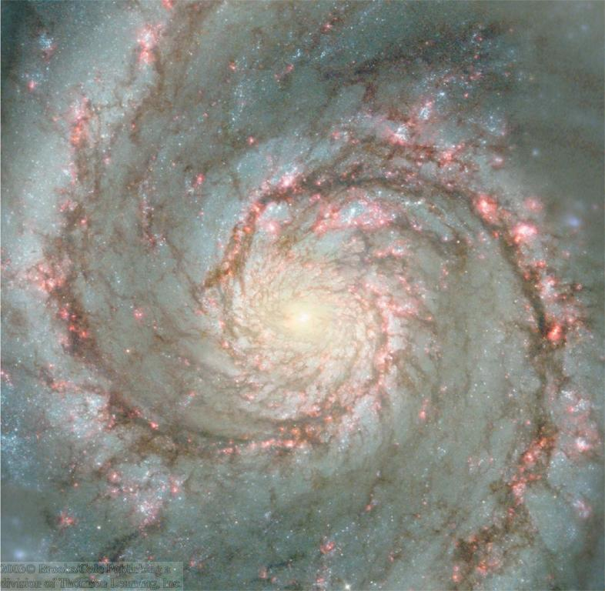
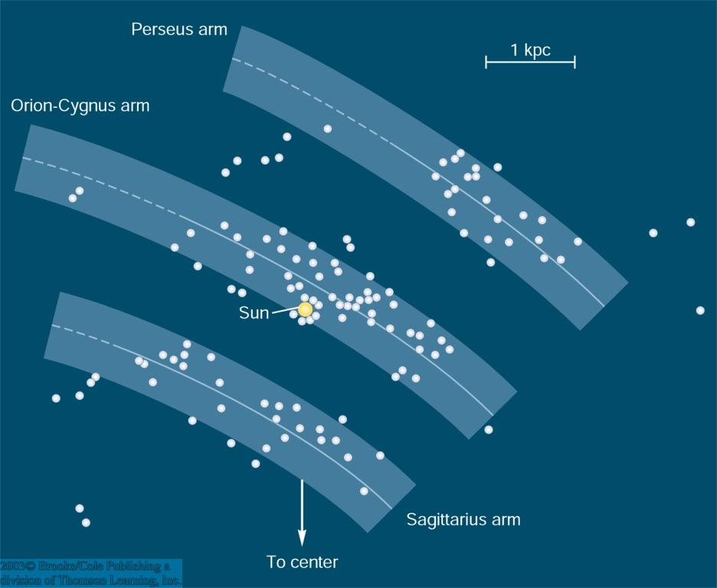
Exploring the structure of the Milky Way with O/B Associations
0
O/B Associations
Perseus arm
Orion-Cygnus arm
Sun
Sagittarius arm
O/B Associations trace out 3 spiral arms near the sun.
Distances to O/B Associations determined using Cepheid variables

Slide 34
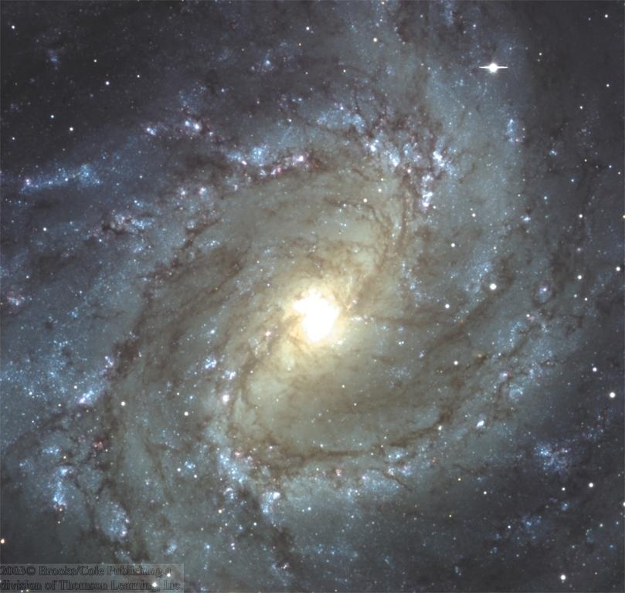
Star Formation in Spiral Arms (I)
0
Shock waves from supernovae, ionization fronts initiated by O and B stars, and the shock fronts forming spiral arms trigger star formation.
Spiral arms are stationary shock waves, initiating star formation.

Slide 35
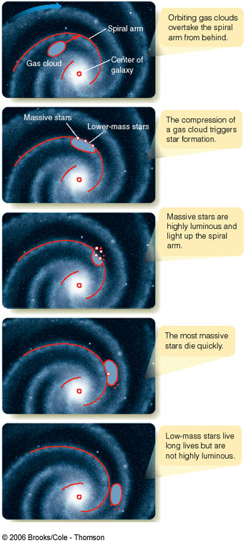
Star Formation in Spiral Arms (II)
0
Spiral arms are basically stationary shock waves.
Stars and gas clouds orbit around the galactic center and cross spiral arms.
Shocks initiate star formation.
Star formation self-sustaining through O/B ionization fronts and supernova shock waves.

Slide 36
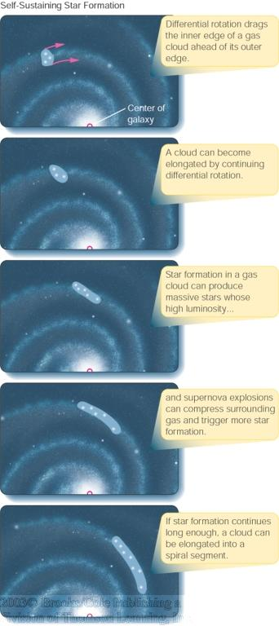
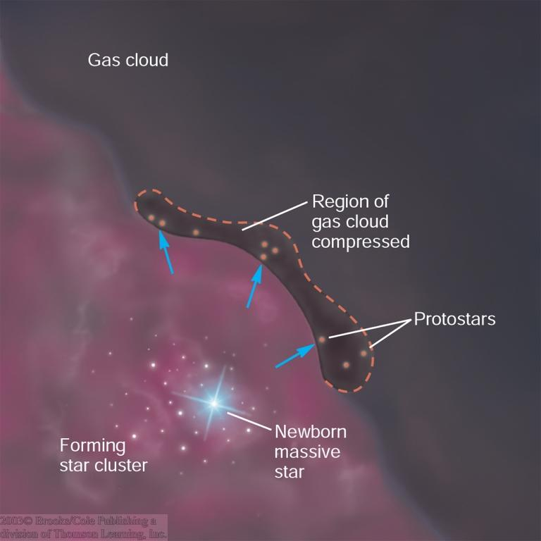
Self-Sustained Star Formation in Spiral Arms
0
Star forming regions get elongated due to differential rotation.
Star formation is self-sustaining due to ionization fronts and supernova shocks.

Slide 37

H II Regions and Stromgren Spheres
Simplified
N is the number of H ionizing photons (energy > 13.6 eV) = Number of recombinations
Lower case n are number densities
Alpha (2) is probability of recombinations that don’t go back to ground state in cm³/s
Can use to calculate sizes of H II regions and/or ionizing photons from OB stars

Slide 38
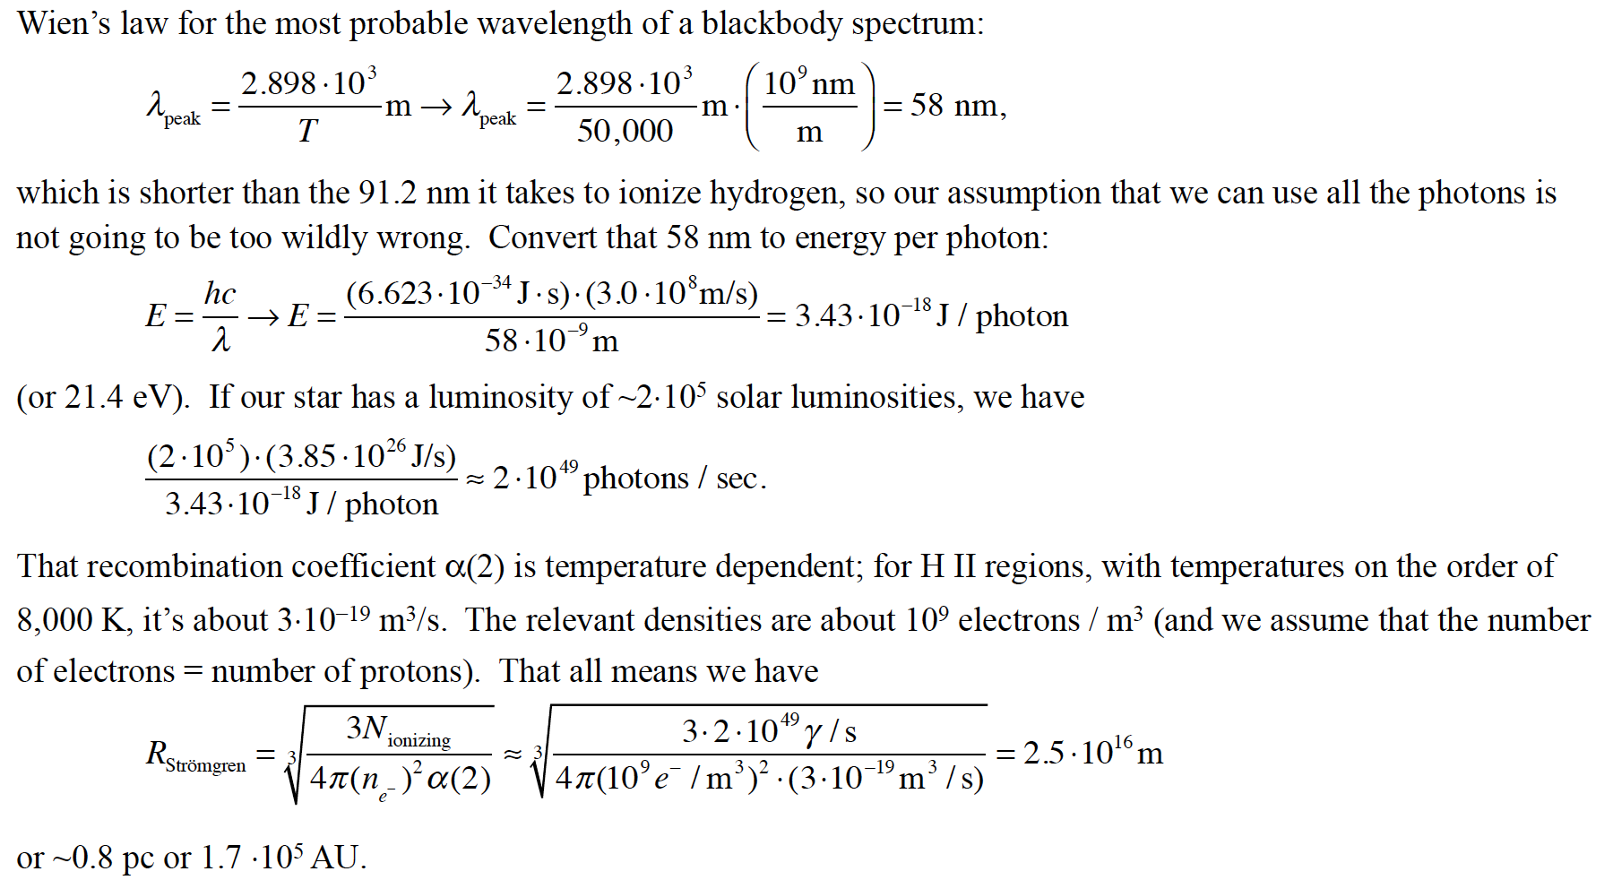
H II Regions and Stromgren Spheres

Slide 39
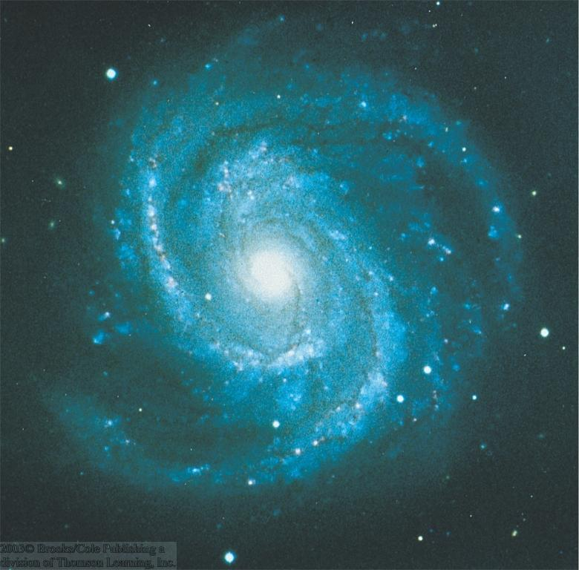
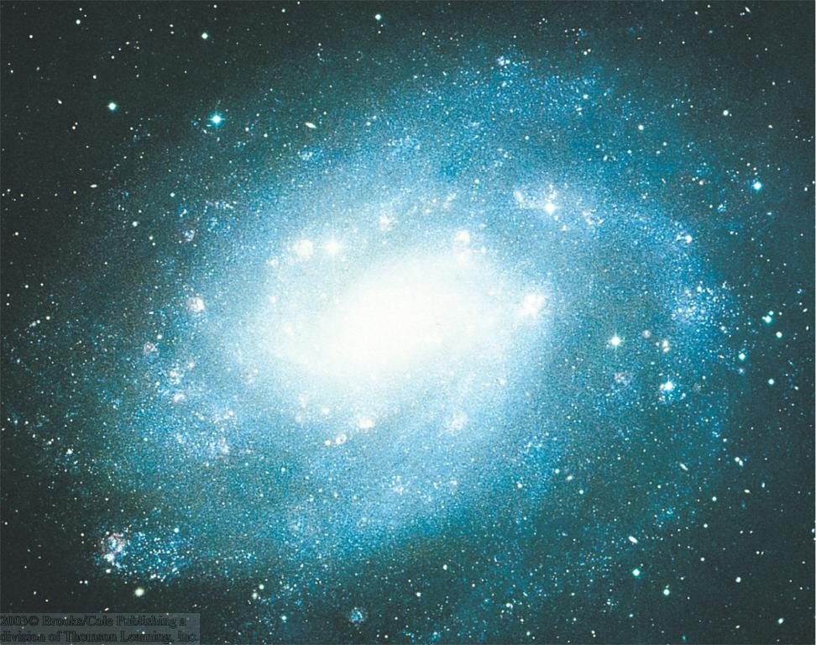
Grand-Design Spiral Galaxies
0
Grand-design spirals have two dominant spiral arms.
Flocculent (woolly) galaxies also have spiral patterns, but no dominant pair of spiral arms.
M 100
NGC 300

Slide 40
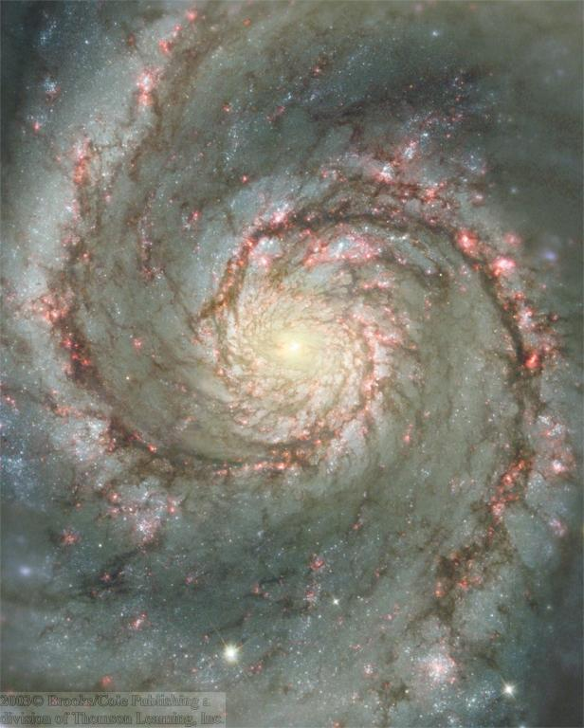
The Whirlpool Galaxy
0
Grand-design galaxy M 51 (Whirlpool Galaxy):
Self-sustaining star forming regions along spiral arm patterns are clearly visible.

Slide 41
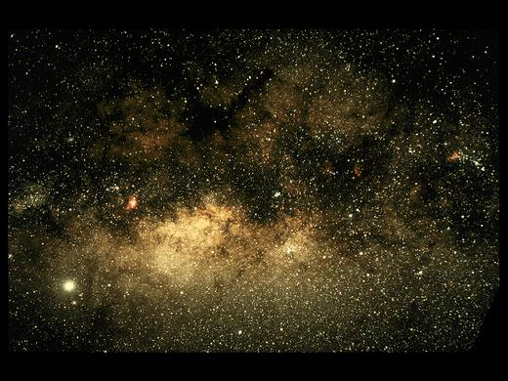
The Galactic Center (I)
0
Our view (in visible light) towards the Galactic center (GC) is heavily obscured by gas and dust:
Extinction by 30 magnitudes
⬄ Only 1 out of 10¹² optical photons makes its way from the GC towards Earth!
galactic center
Wide-angle optical view of the GC region

Slide 42
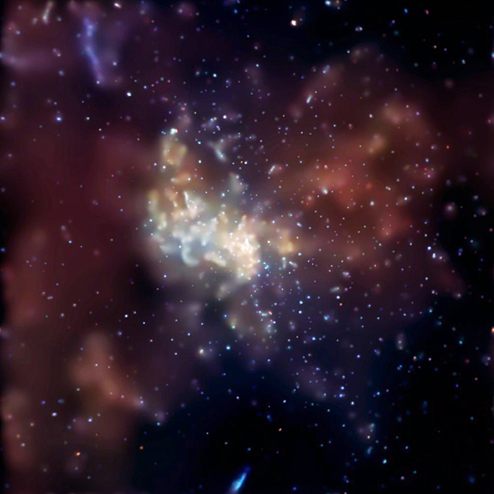
X-Ray View of the Galactic Center
0
Galactic center region contains many black-hole and neutron-star X-ray binaries.
Supermassive black hole in the galactic center is unusually faint in X rays, compared to those in other galaxies.
Chandra X ray image of Sgr A*

Slide 43
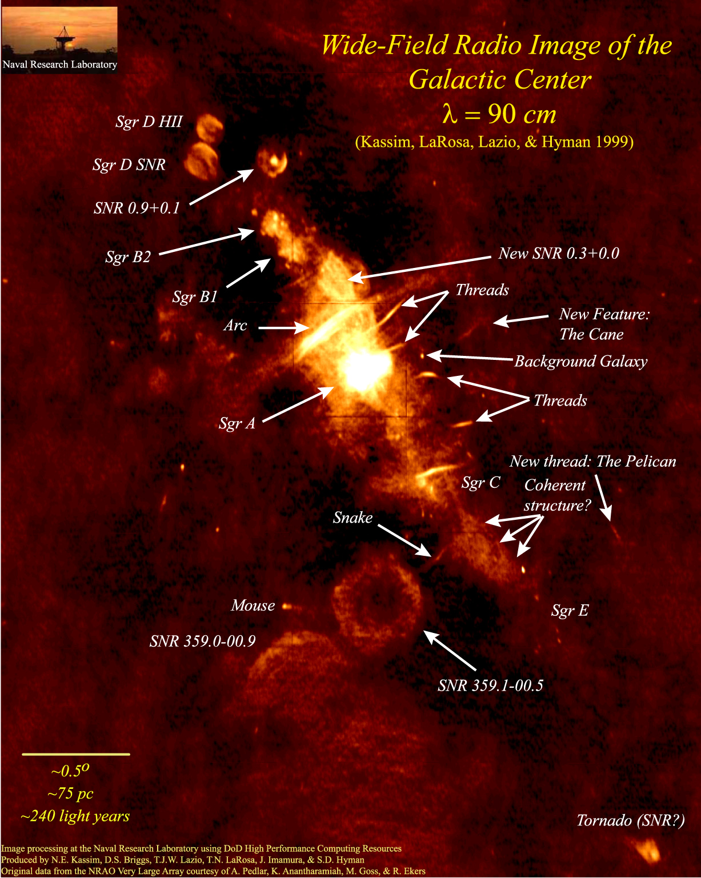
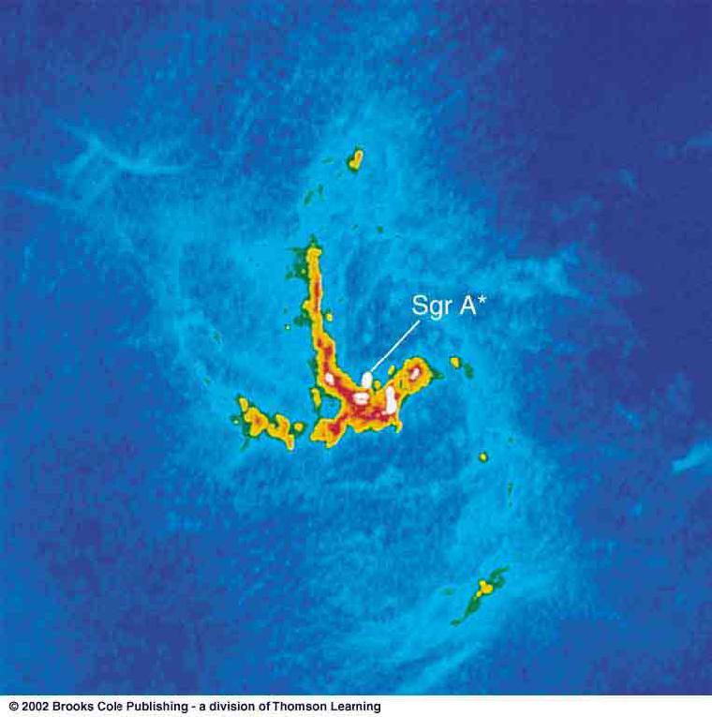
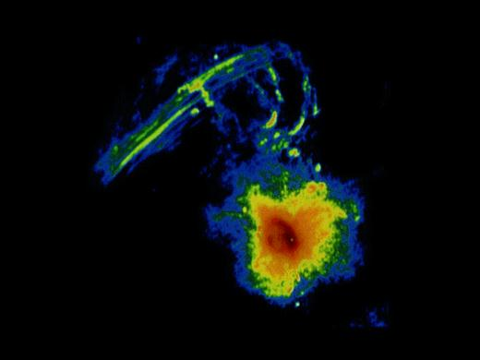
Radio View of the Galactic Center
0
Many supernova remnants; shells and filaments
Arc
Sgr A
Sgr A
Sgr A*: The center of our galaxy
The galactic center contains a supermassive black hole of approx. 4.3 million solar masses.

Slide 44
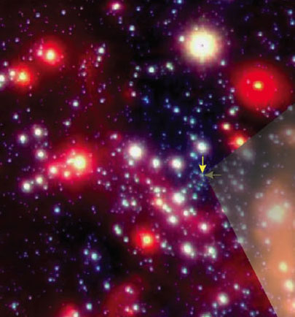
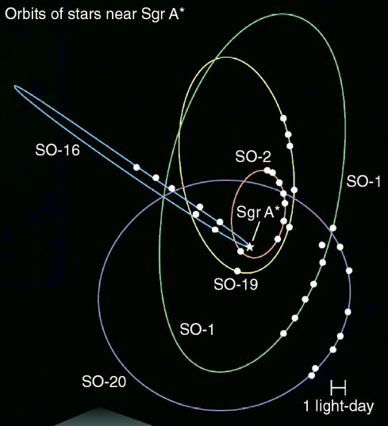
Measuring the Mass of the Black Hole in the Center of the Milky Way
0
By following the orbits of individual stars near the center of the Milky Way, the mass of the central black hole could be determined to be ~ 4.3 million solar masses.
Animated movie.

Slide 45
The Event Horizon Telescope
WATCH THIS SPACE!

Slide 46
Magnetic Fields and Synchrotron Radiation
Deferred…

