Slide 1
ASTR 2320 General Astronomy II
Professor Mike Brotherton
Chapter 16 – Stellar Remnants
Is it better to burn out, or fade away?

Slide 2
Stellar Remnants
white dwarfs & planetary nebulae: fate of all but the most massive stars
neutron stars and supernova remnants
stellar-mass black holes

Slide 3
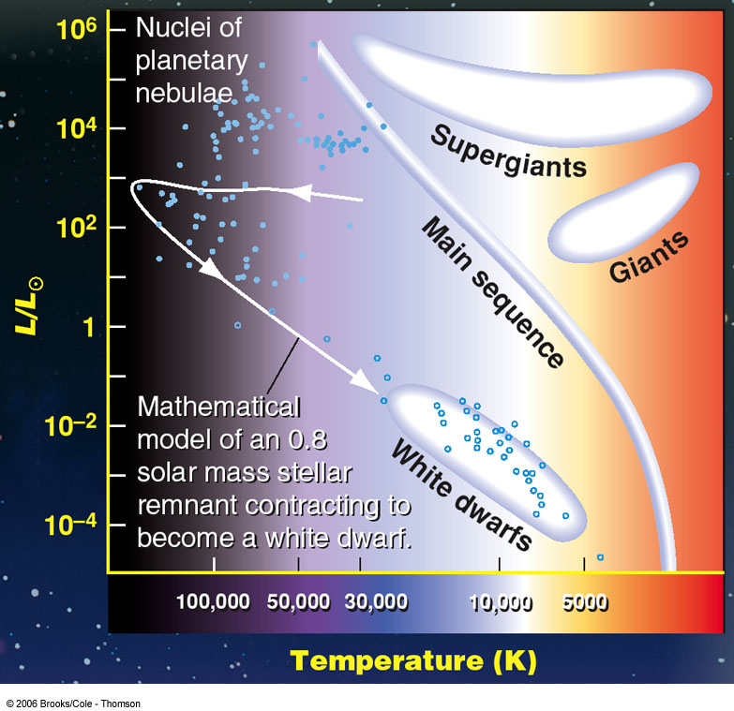
Low luminosity; high temperature => White dwarfs are found in the lower center/left of the H-R diagram.

Slide 4
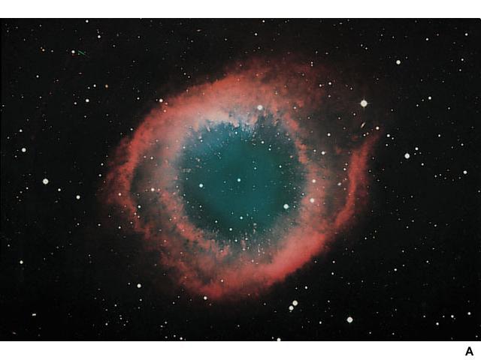
The Final Breaths of Sun-Like Stars: Planetary Nebulae
Remnants of stars with ~ 1 – several M_{sun}
Radii: R ~ 0.2 - 3 light years
Expanding at ~10 – 20 km/s (← Doppler shifts)
Less than 10,000 years old
Have nothing to do with planets!
The Helix Nebula

Slide 5
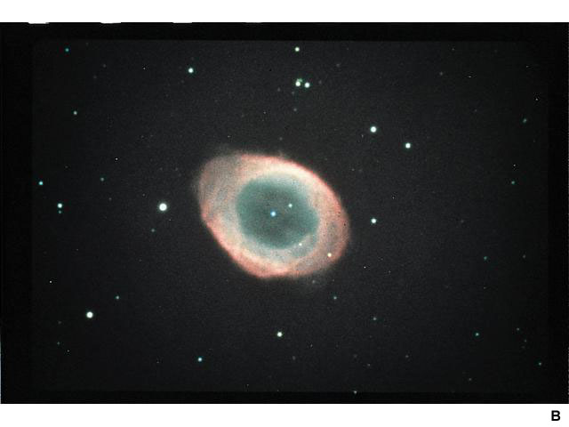
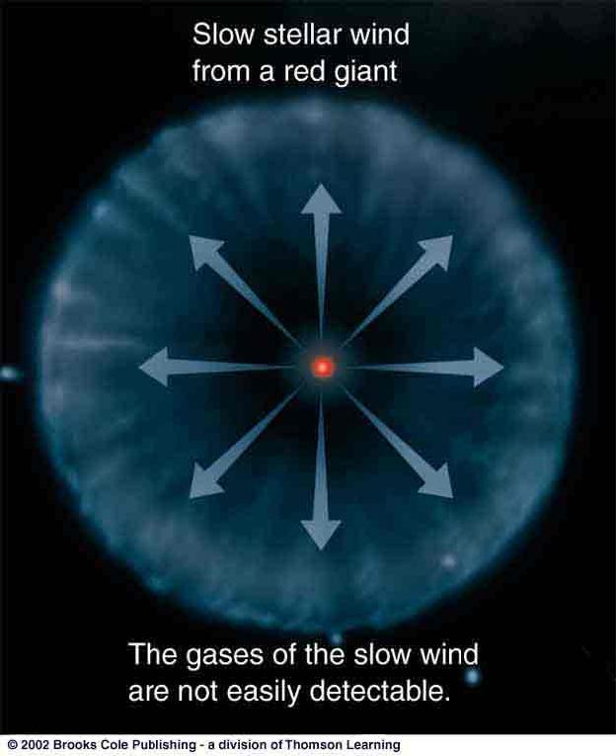
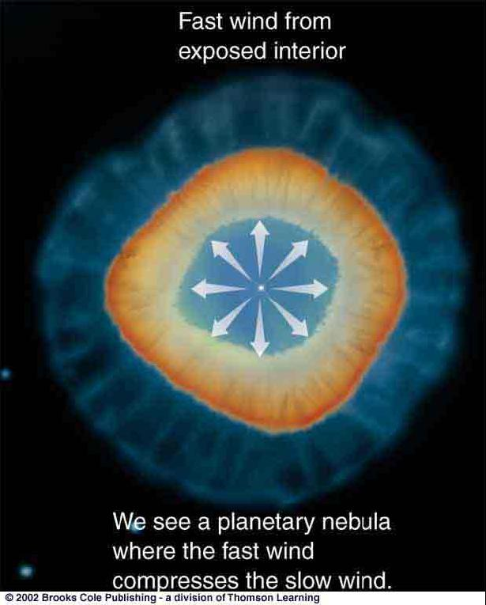
The Formation of Planetary Nebulae
Two-stage process:
Slow wind from a red giant blows away cool, outer layers of the star
The Ring Nebula in Lyra
Fast wind from hot, inner layers of the star overtakes the slow wind and excites it => planetary nebula

Slide 6
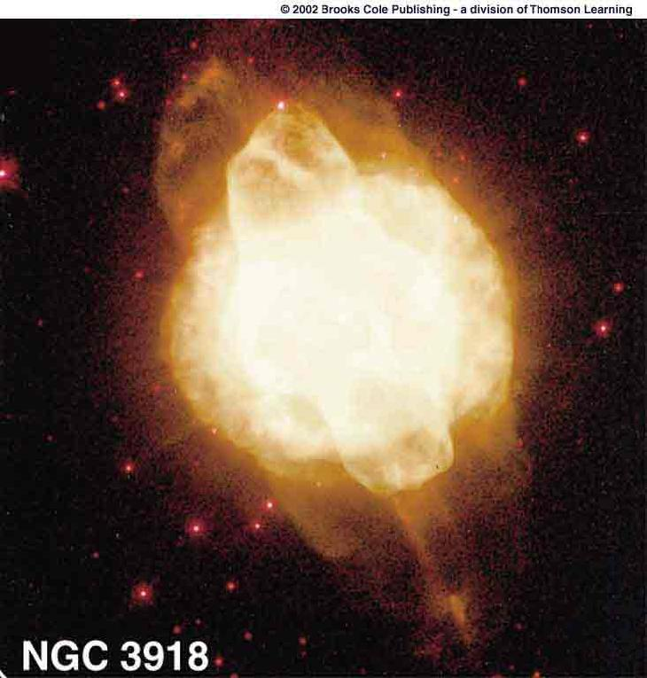
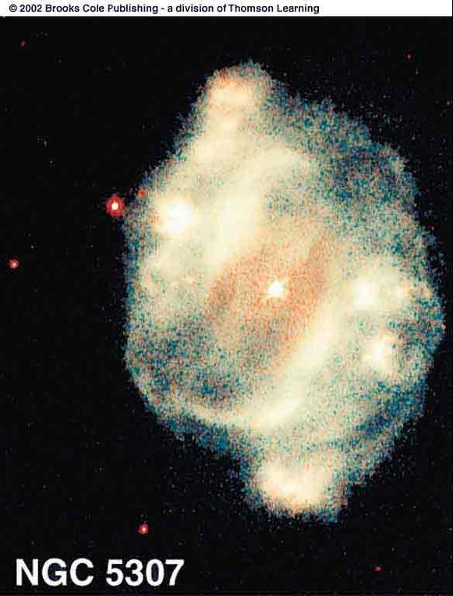
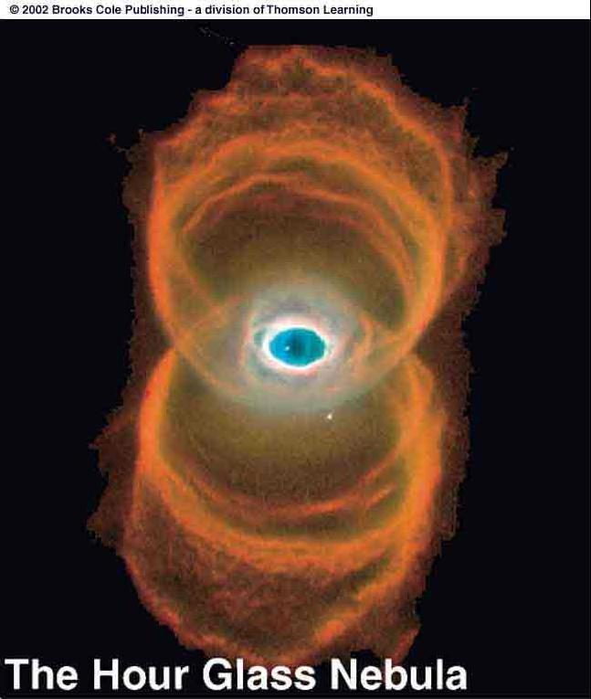
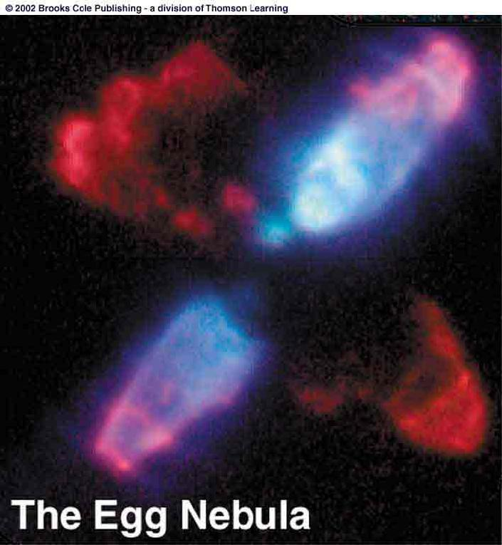
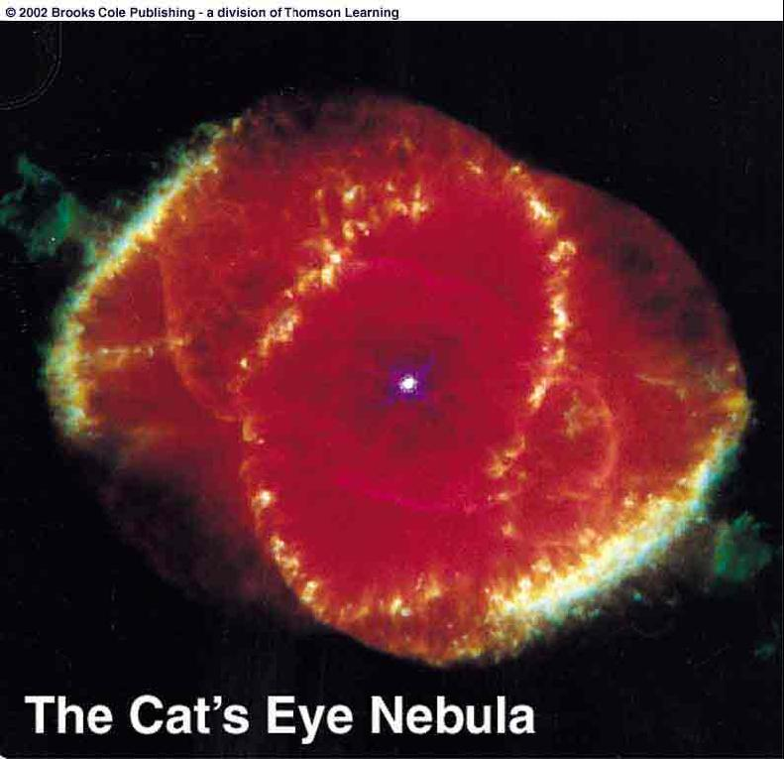
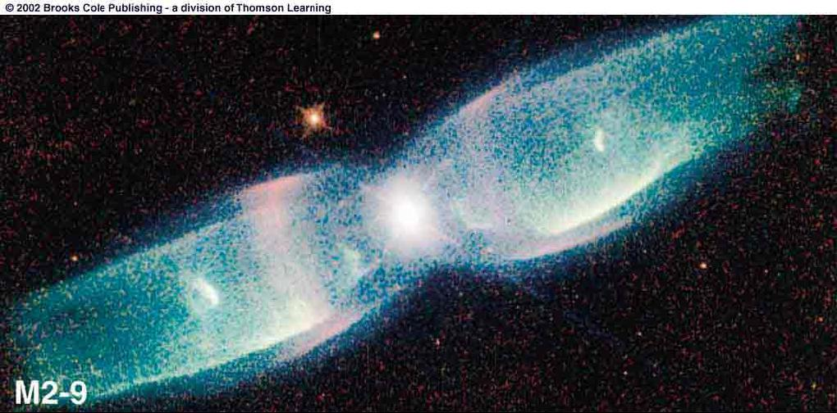
Planetary Nebulae
Often asymmetric, possibly due to
Stellar rotation, binaries
Magnetic fields
Dust disks around the stars
The Butterfly Nebula

Slide 7
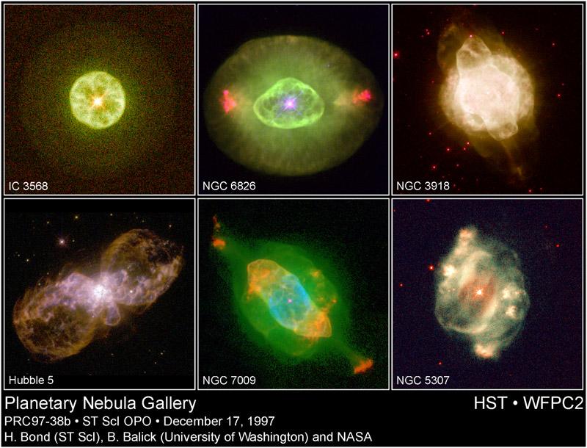
A Gallery of P-N from Hubble

Slide 8
White Dwarfs – the leftover cores of fusion
The cores will radiatively cool over billions of years, redder and darker
Measured masses for white dwarfs lie between ~0.2 and 1.3 M⦿
Measured radii of ~0.008 - 0.02 R⦿. Earth has about 1/100 the radius of the sun.
White dwarf densities are roughly 100³ or a million times the density of the Sun.
White dwarfs are expected to have masses below ~1.4 M⦿, the Chandrasekhar limit
Less massive white dwarfs have the larger radii. See the mathematical discussion in the textbook and following slide.

Slide 9
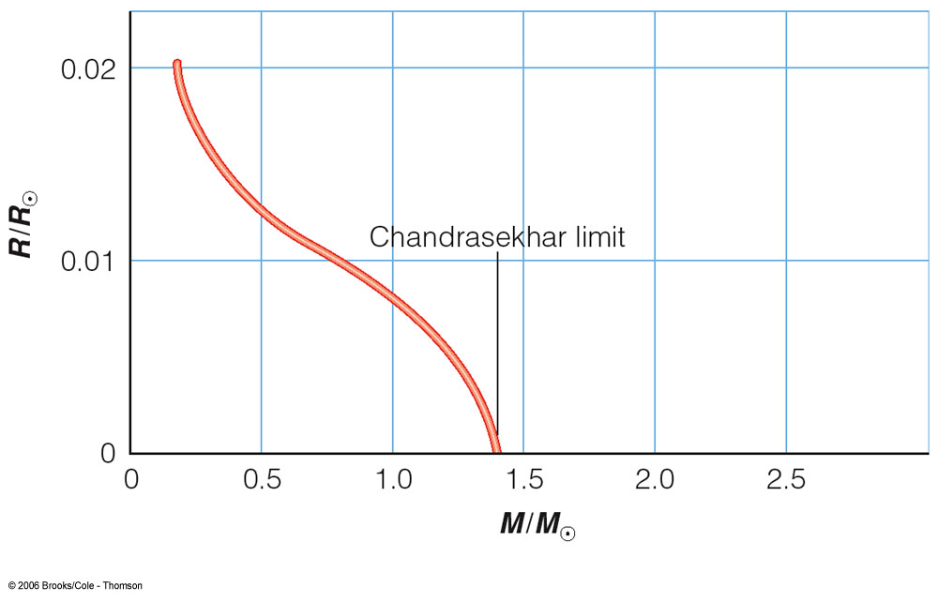
The Chandrasekhar Limit
The more massive a white dwarf, the smaller it is.
→ Pressure becomes larger, until electron degeneracy pressure can no longer hold up against gravity.
WDs with more than ~ 1.4 solar masses can not exist!

Slide 10
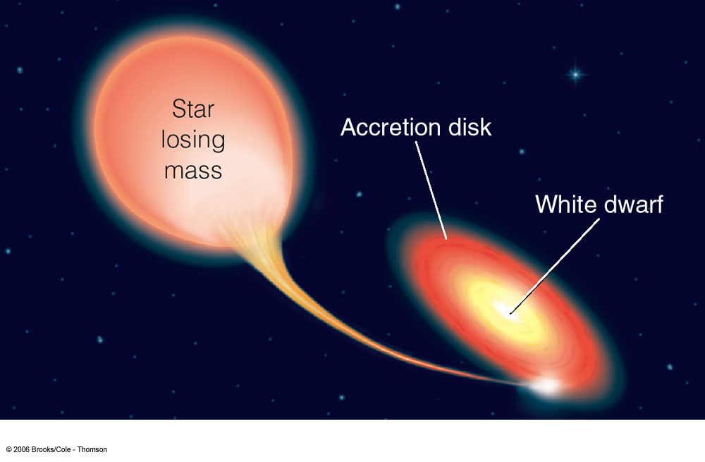

White Dwarfs in Binary Systems
Binary consisting of white dwarf + main-sequence or red giant star => WD accretes matter from the companion
X ray emission
Angular momentum conservation => accreted matter forms a disk, called accretion disk.
T ~ 10⁶ K
Matter in the accretion disk heats up to ~ 1 million K => X ray emission => “X ray binary” or XRB

Slide 11
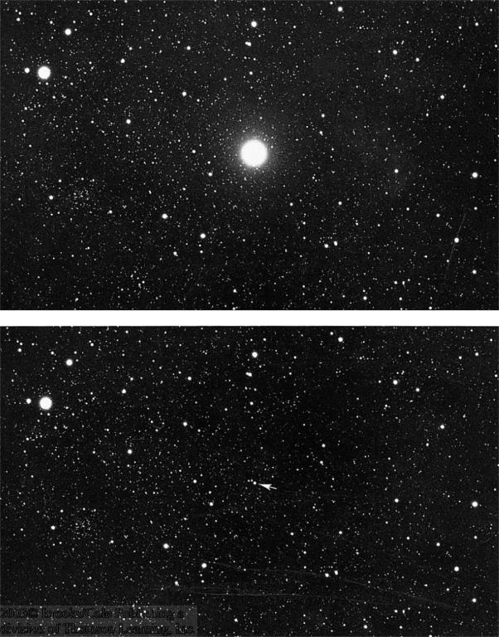
Nova Explosions
Hydrogen accreted through the accretion disk accumulates on the surface of the white dwarf
Very hot, dense layer of non-fusing hydrogen on the white dwarf surface
Nova Cygni 1975
Explosive onset of H fusion
Nova explosion

Slide 12
Nova light curve (from text)

Slide 13
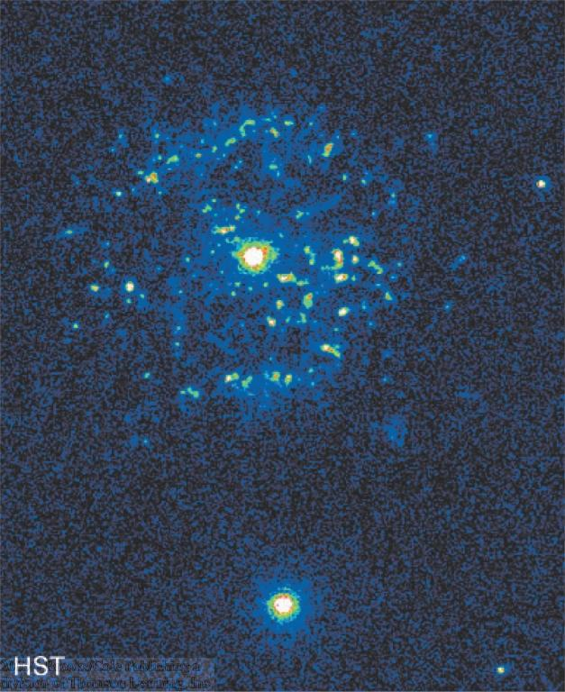
Recurrent Novas
T Pyxidis
In many cases, the mass transfer cycle resumes after a nova explosion.
→ Cycle of repeating explosions every few years – decades.

Slide 14
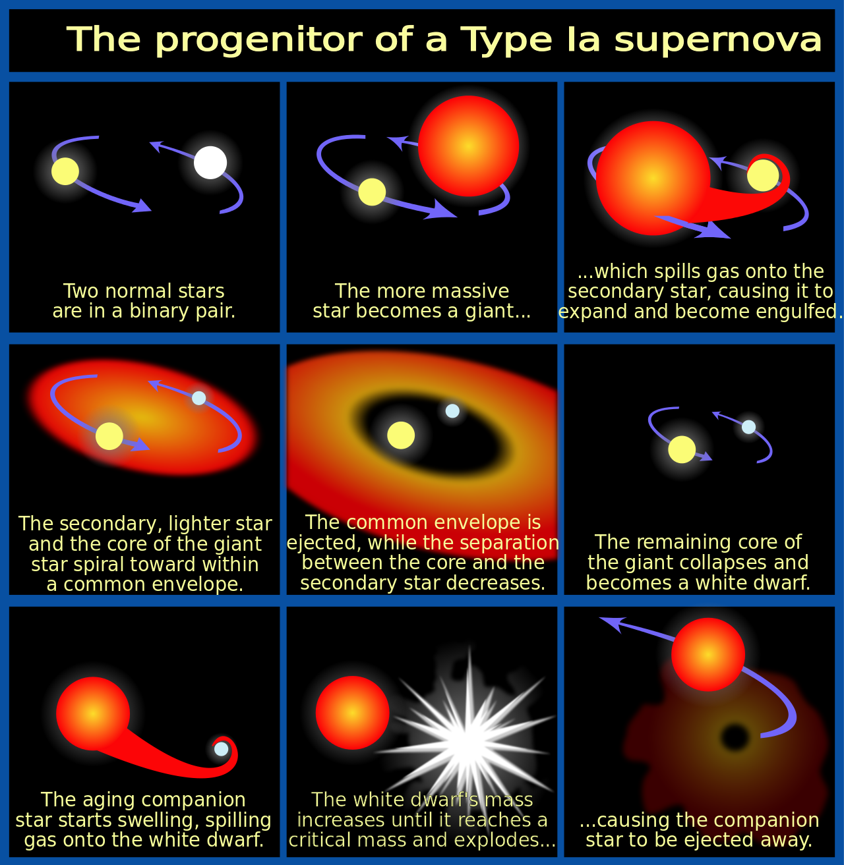
White Dwarfs – Supernova 1a precursors?
What if mass accretion or stellar merger leads to a mass greater than Chandrasekhar’s limit?
From Wiki (see link). More on supernova coming up.

Slide 15
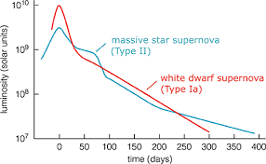
Core collapse supernovas: stars more than ~8 M⦿
Some discussion last chapter. Light curve plot from IOPscience.

Slide 16
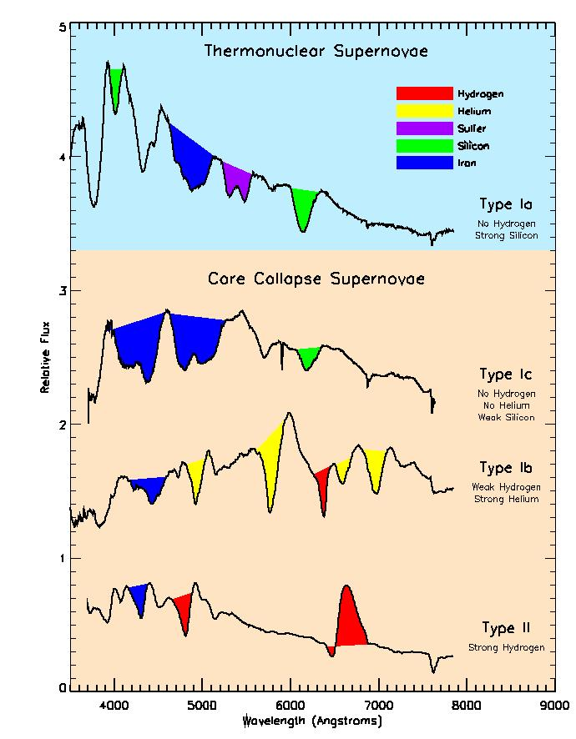
Supernovas – Spectra
Type 1a from perhaps white dwarfs exceeding 1.4 solar masses. Type 1s have no hydrogen in spectra.
Other types. Type II has hydrogren, is core collapse. Other supernova type 1s may also be from core collapse.
See Supernova Spectra Page.

Slide 17

The Crab Nebula–Supernova from 1050 AD
Can see expansion between 1973 and 2001
Kitt Peak National Observatory Images

Slide 18
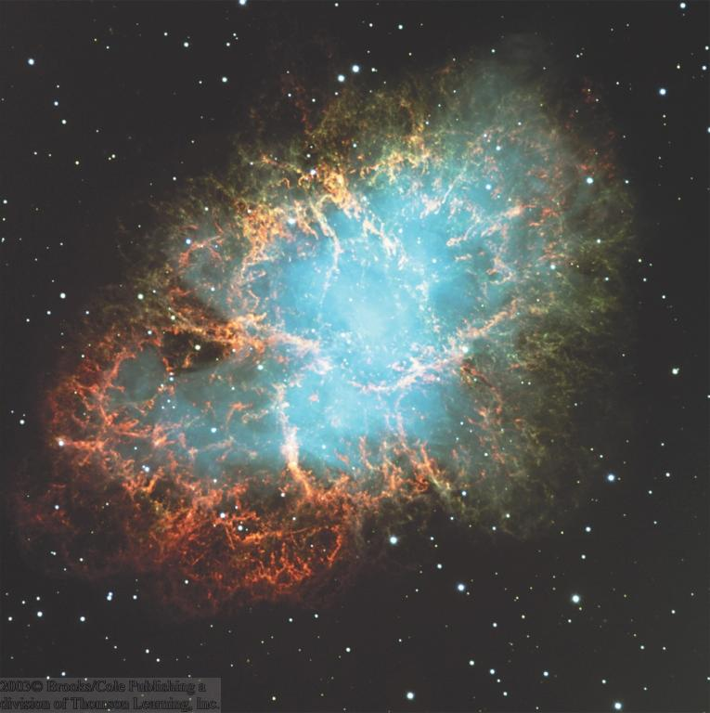
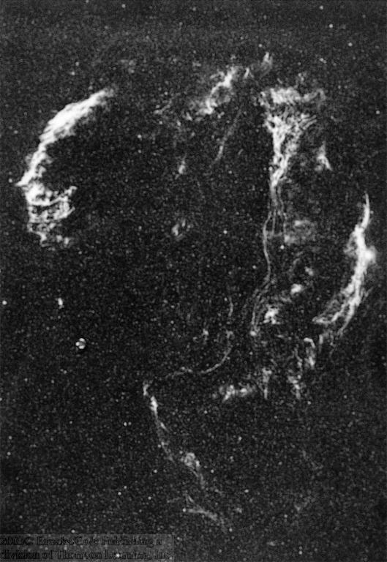
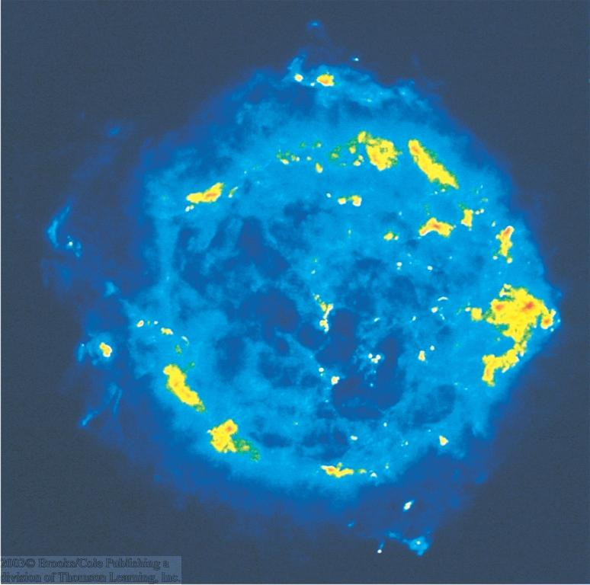
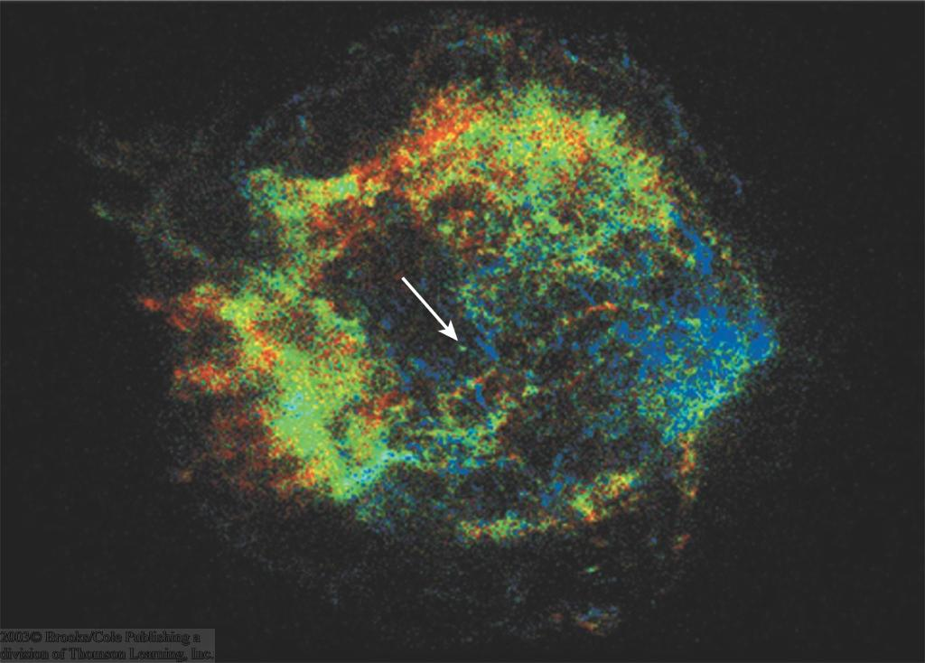
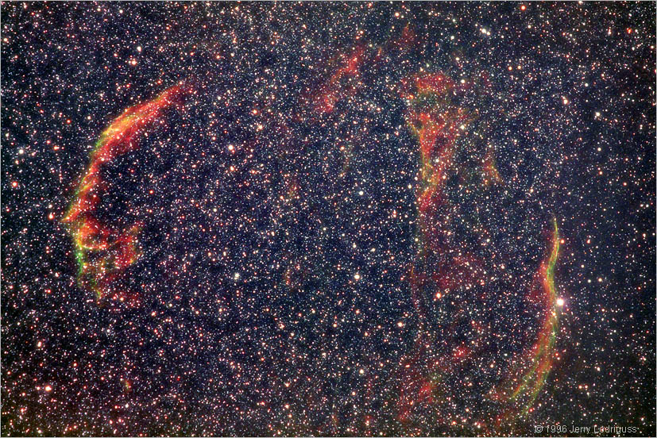
Supernova Remnants in Milky Way
X rays
The Crab Nebula:
Remnant of a supernova observed in a.d. 1054
Optical
The Veil Nebula
Cassiopeia A
The Cygnus Loop

Slide 19
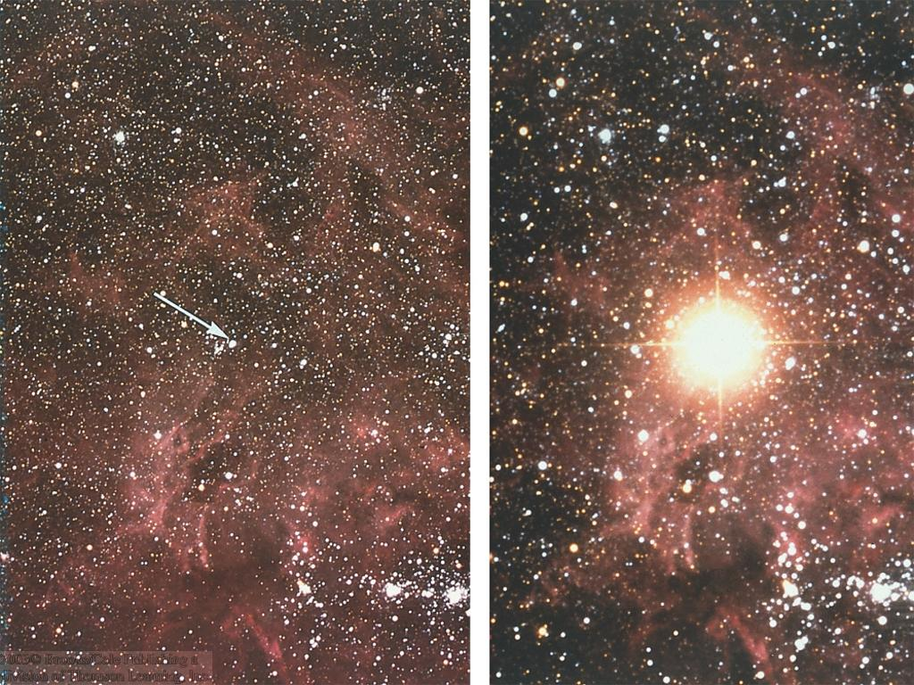
The Famous Supernova of 1987: Supernova 1987A
Before
At maximum
Unusual type II supernova in the Large Magellanic Cloud in Feb. 1987

Slide 20
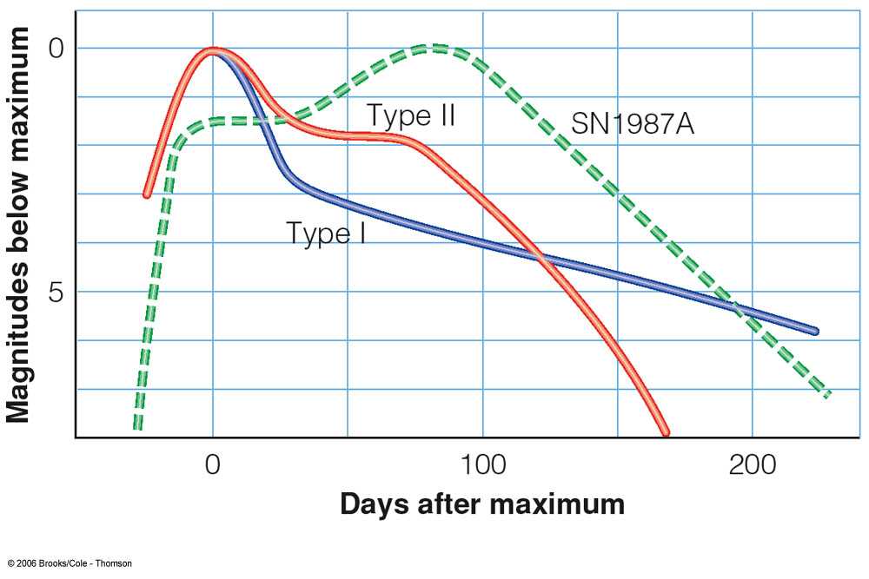
Type I and II Supernovae
Core collapse of a massive star: type II supernova
If an accreting white dwarf exceeds the Chandrasekhar mass limit, it collapses, triggering a type Ia supernova.
Type I: No hydrogen lines in the spectrum
Type II: Hydrogen lines in the spectrum

Slide 21
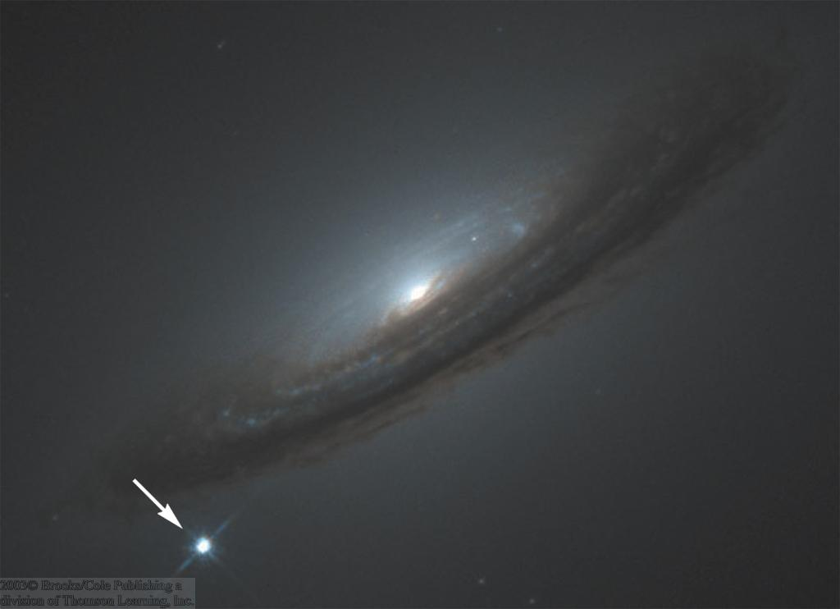
Observations of Supernovae
Supernovae can easily be seen in distant galaxies.
Supernova 1994D in NGC 4526

Slide 22

Neutron Stars
A supernova explosion of an M > 8 M_{sun} star blows away its outer layers.
Pressure becomes so high that electrons and protons combine to form stable neutrons throughout the object.
The central core will collapse into a compact object of ~ a few M_{sun}.
Typical size: R ~ 10 km
Mass: M ~ 1.4 – 3 M_{sun}
Density: ρ ~ 10¹⁴ g/cm³
→ Piece of neutron star matter of the size of a sugar cube has a mass of ~ 100 million tons!!!

Slide 23

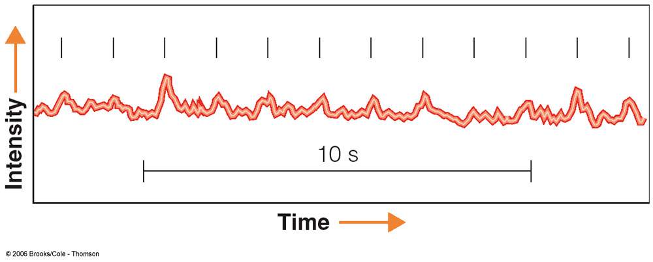
Discovery of Pulsars
Angular momentum conservation
=> Collapsing stellar core spins up to periods of ~ a few milliseconds.
Magnetic fields are amplified up to B ~ 10⁹ – 10¹⁵ G.
(up to 10¹² times the average magnetic field of the sun)
=> Rapidly pulsed (optical and radio) emission from some objects interpreted as spin period of neutron stars

Slide 24
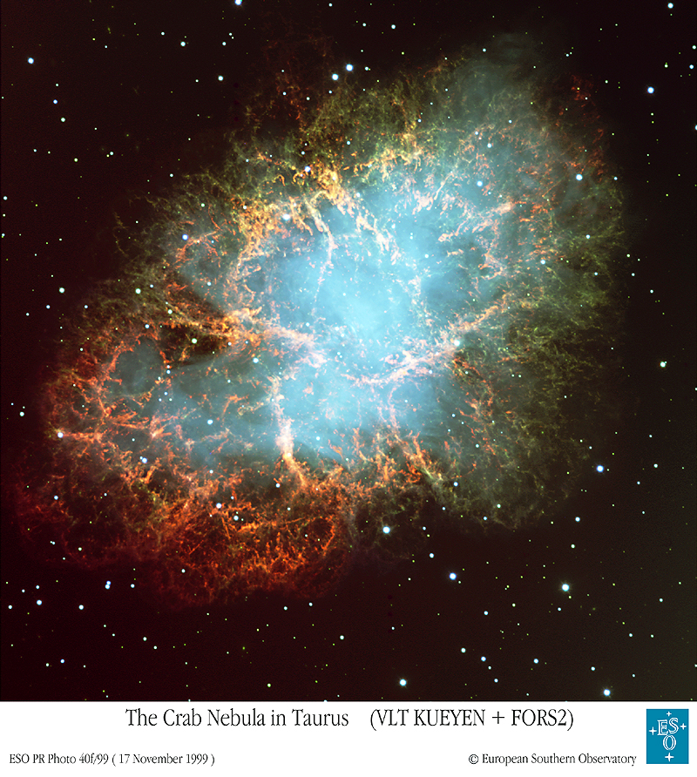
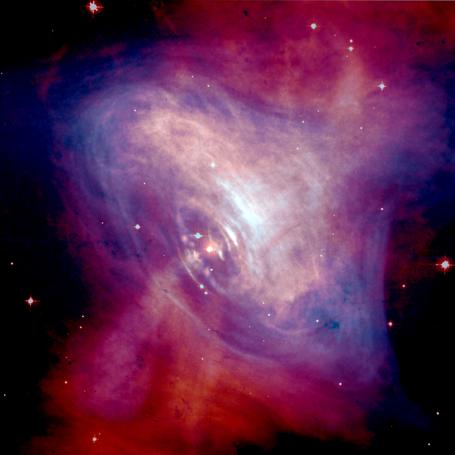
The Crab Pulsar
Pulsar wind + jets
Remnant of a supernova observed in A.D. 1054

Slide 25
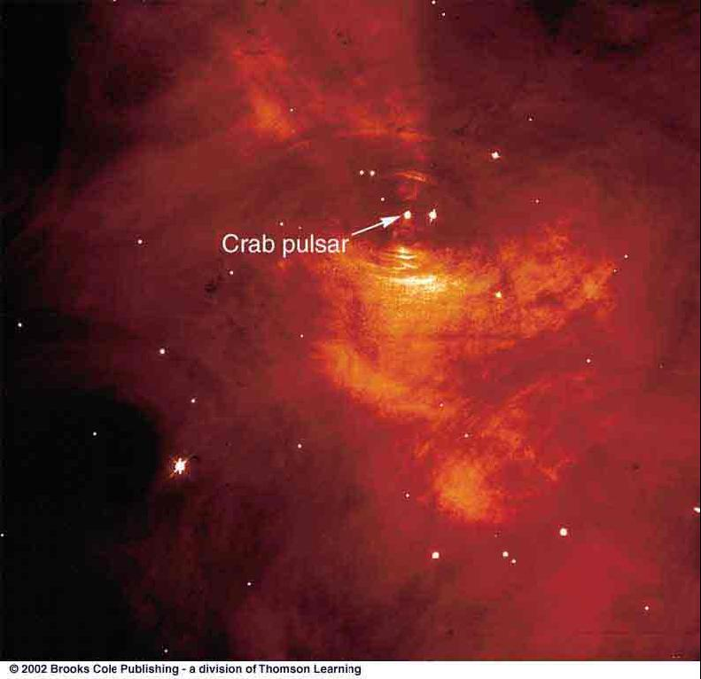
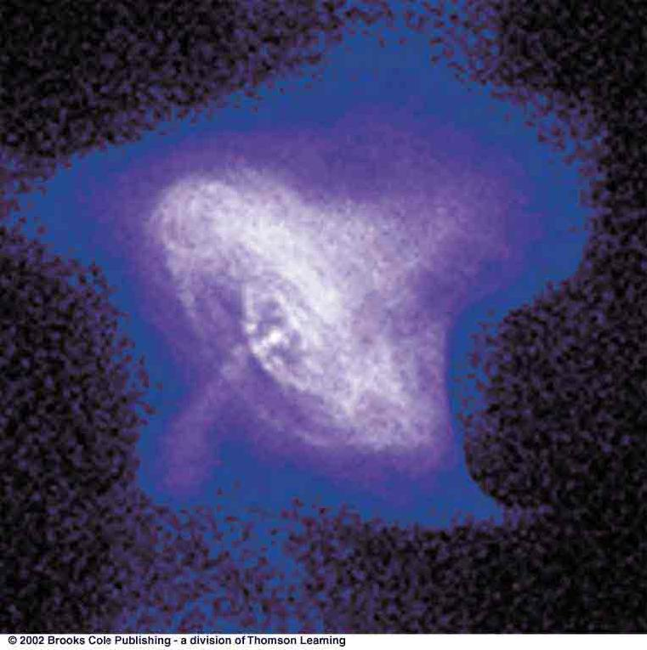
The Crab Pulsar – Chandra movie
Visual image
X-ray image

Slide 26
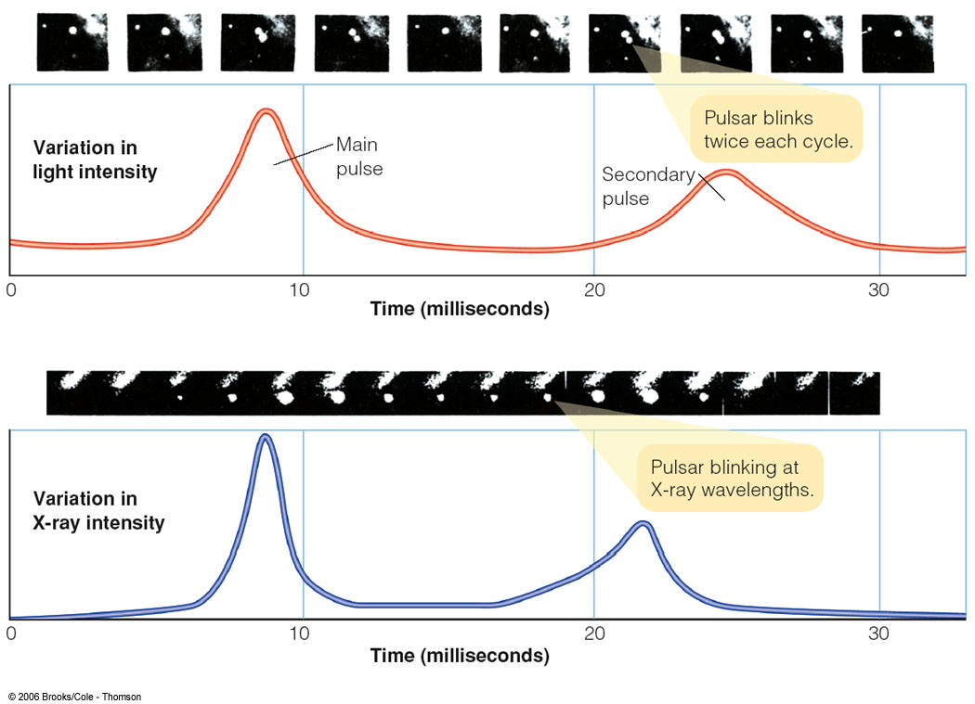
Light curves of the Crab Pulsar

Slide 27
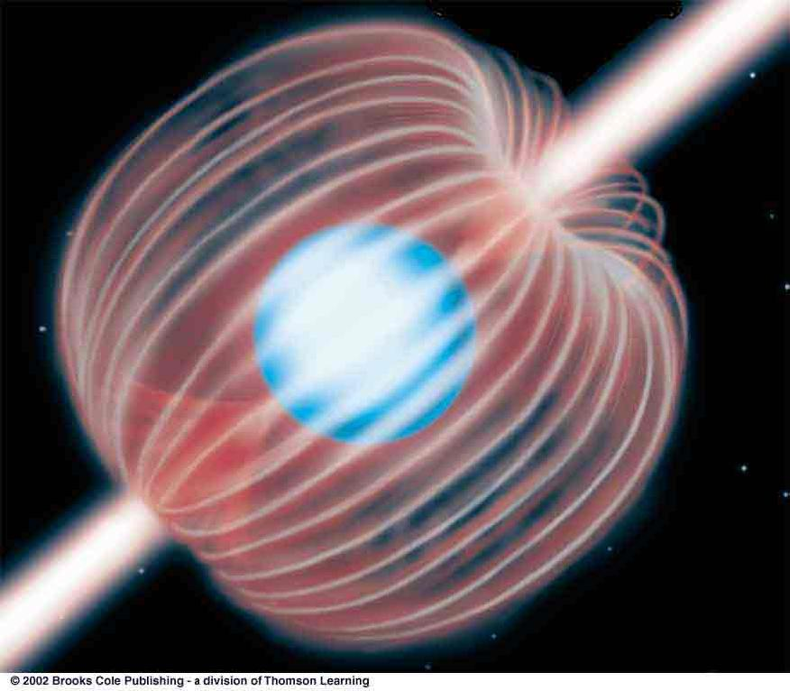
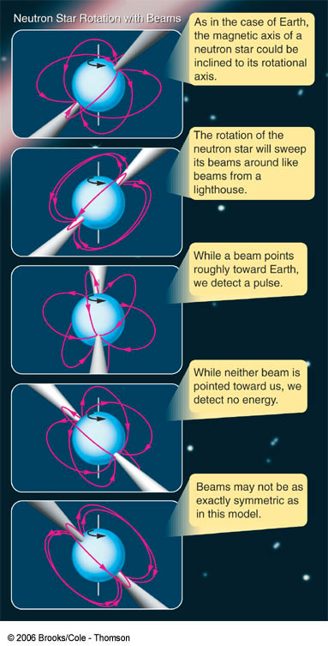

The Lighthouse Model of Pulsars
A pulsar’s magnetic field has a dipole structure, just like Earth.
Radiation is emitted mostly along the magnetic poles.
See animation here. NASA video.

Slide 28
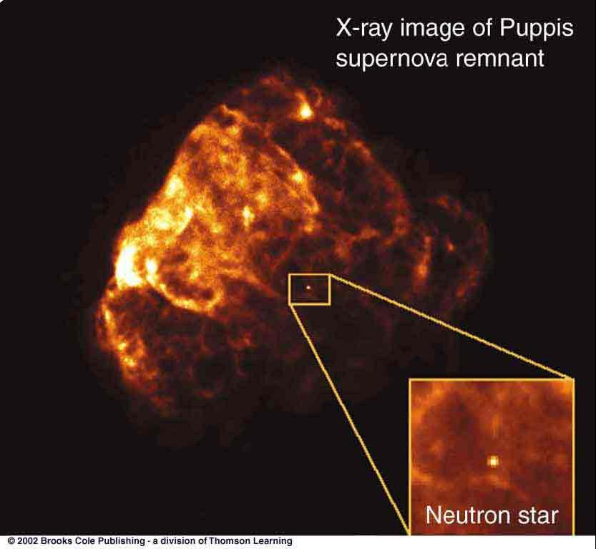
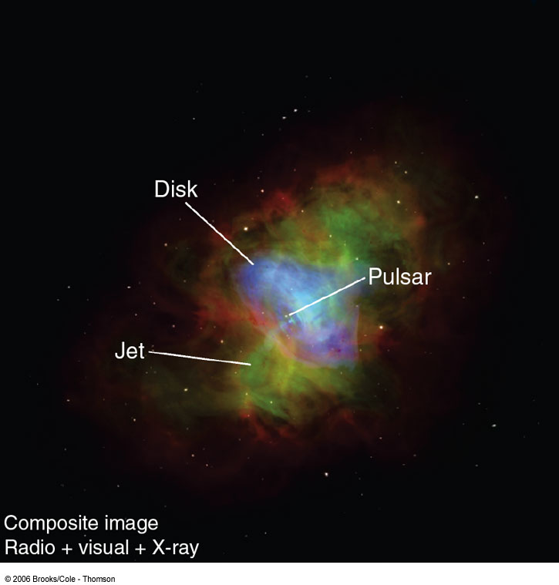
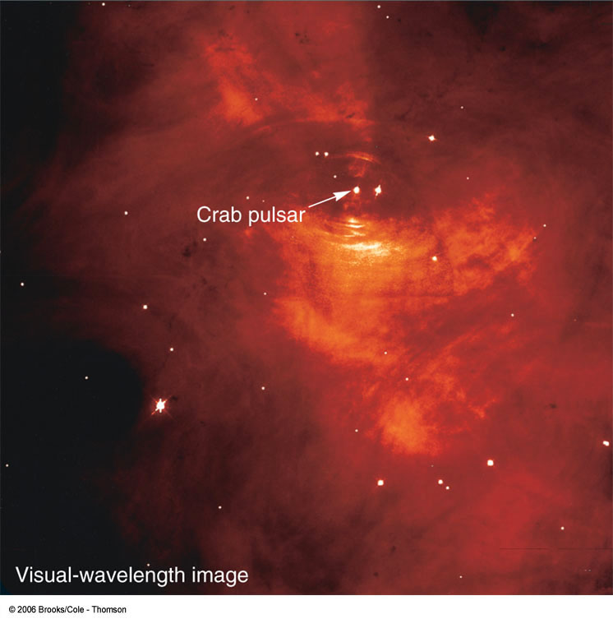
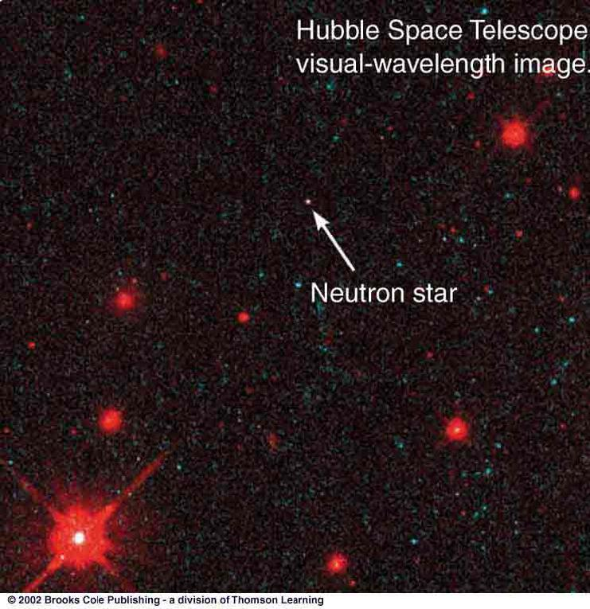
Images of Pulsars and other Neutron Stars
The Vela pulsar moving through interstellar space
The Crab Nebula and pulsar

Slide 29
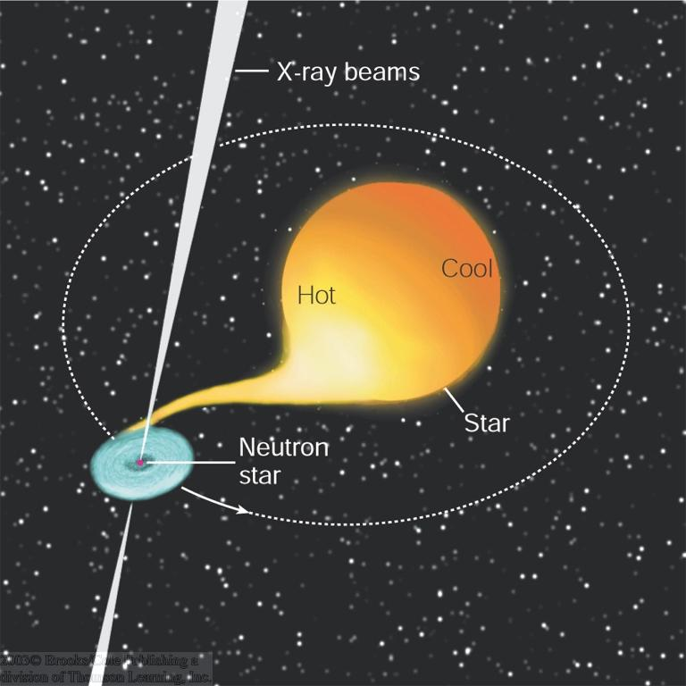
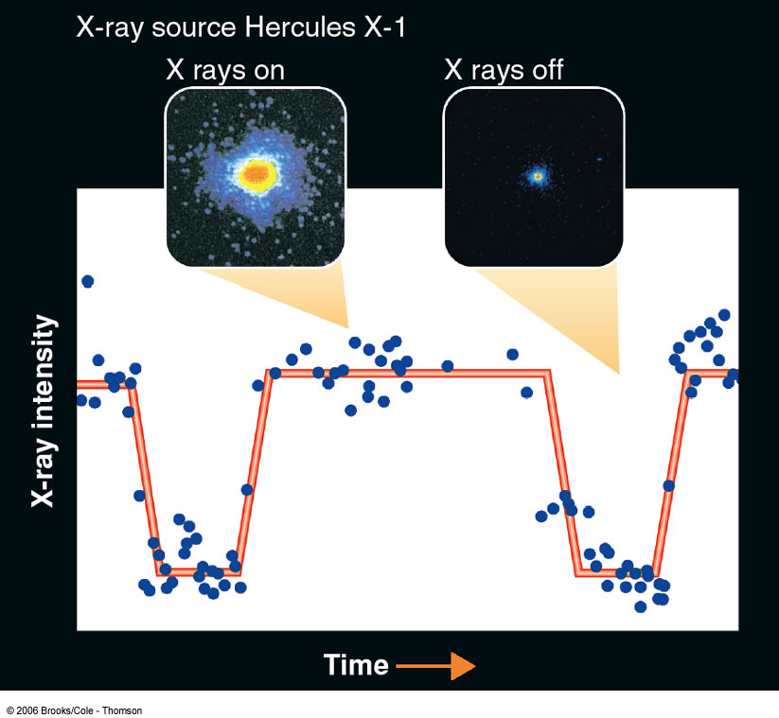
Neutron Stars in Binary Systems: X-ray binaries
Example: Her X-1
Star eclipses neutron star and accretion disk periodically
2 M_{sun} (F-type) star
Neutron star
Orbital period = 1.7 days
Accretion disk material heats to several million K => X-ray emission

Slide 30
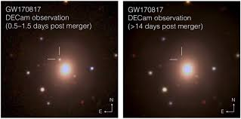
Other end events: GW170817
A merger of two neutron stars as part of a multi-messenger study.
Gravitational waves detected
Short duration Gamma-Ray Burst or GRB
Veritasium Video
Ligo PR image

Slide 31

Black Holes
Just like white dwarfs (Chandrasekhar limit: 1.4 M_{sun}), there is a mass limit for neutron stars:
Neutron stars can not exist with masses > 3 M_{sun}
We know of no mechanism to halt the collapse of a compact object with > 3 M_{sun}.
It will collapse into a single point – a singularity:
=> A black hole!

Slide 32

Escape Velocity – let’s review derivation
Velocity needed to escape Earth’s gravity from the surface: v_{esc} ≈ 11.6 km/s.
v_{esc}
Now, gravitational force decreases with distance (~ 1/d²) => Starting out high above the surface => lower escape velocity.
v_{esc}
If you could compress Earth to a smaller radius => higher escape velocity from the surface.
v_{esc}

Slide 33
The Schwarzschild Radius
=> There is a limiting radius where the escape velocity reaches the speed of light, c:
2GM
V_{esc} = c
____
R_{s} =
c²
G = gravitational constant
M = mass
R_{s} is called the Schwarzschild radius.

Slide 34
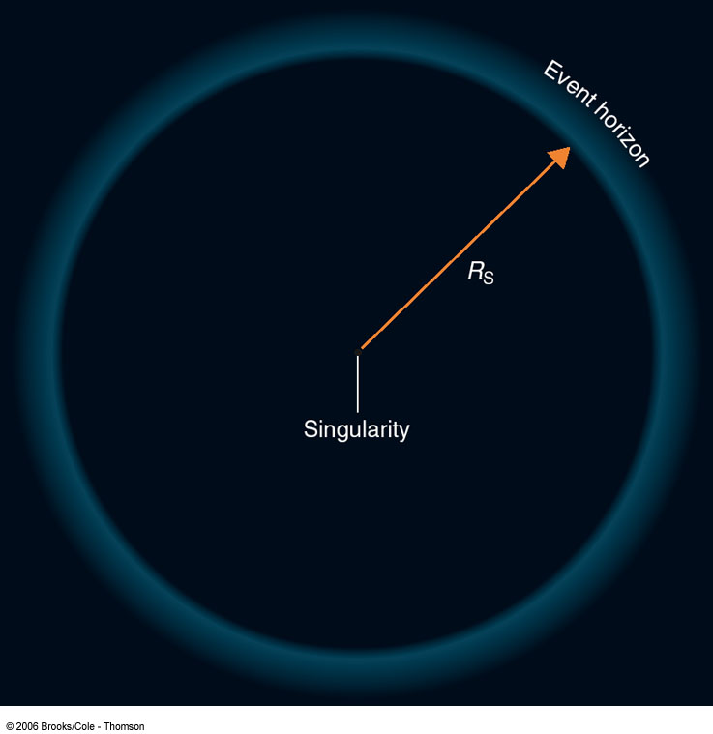
Schwarzschild Radius and Event Horizon
No object can travel faster than the speed of light
=> nothing (not even light) can escape from inside the Schwarzschild radius
We have no way of finding out what’s happening inside the Schwarzschild radius.
“Event horizon”

Slide 35
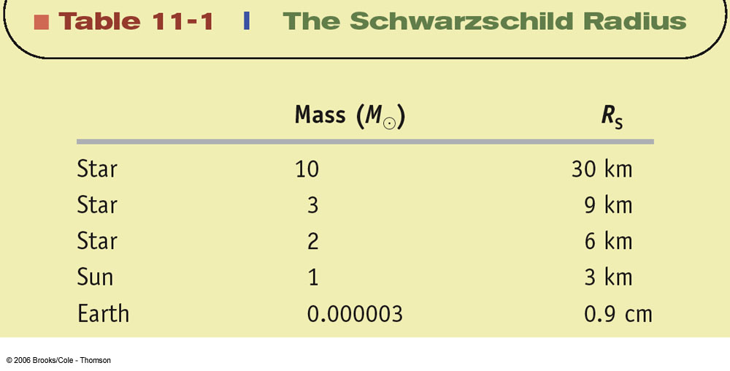

Slide 36
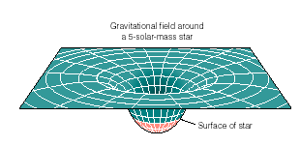
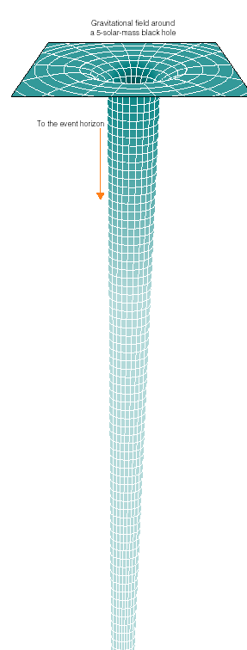
The Gravitational Field of a Black Hole
Gravitational Potential
Distance from central mass
The gravitational potential (and gravitational attraction force) at the Schwarzschild radius of a black hole becomes infinite.

Slide 37
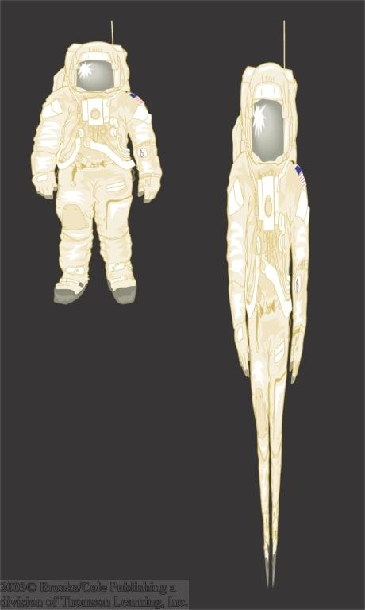
Tidal Forces Near Stellar-Mass Black Holes
An astronaut descending down towards the event horizon of the black hole will be stretched vertically (tidal effects) and squeezed laterally.
Can estimate this, right?
Homework provides the chance.

Slide 38
General Relativity Effects Near Black Holes
Time dilation
Clocks starting at 12:00 at each point.
After 3 hours (for an observer far away from the black hole):
Clocks closer to the black hole run more slowly.
Time dilation becomes infinite at the event horizon.
Event horizon

Slide 39
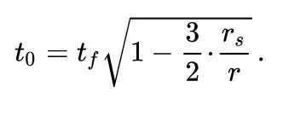
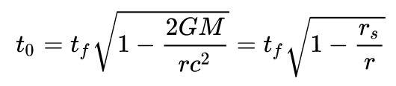
General Relativity Effects Near Black Holes
Time dilation
Outside non-rotating sphere:
In circular orbits (can’t be too close or unstable):

Slide 40
General Relativity Effects Near Black Holes (II)
gravitational redshift
All wavelengths of emissions from near the event horizon are stretched (redshifted).
⬄ Frequencies are lowered.
Event horizon

Slide 41
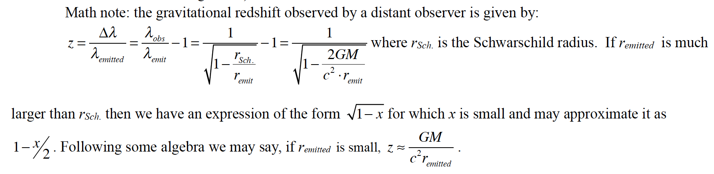
General Relativity Effects Near Black Holes (II)
gravitational redshift from text

Slide 42

Observing Black Holes
No light can escape a black hole
=> Black holes can not be observed directly.
If an invisible compact object is part of a binary, we can estimate its mass from the orbital period and radial velocity.
Mass > 3 M_{sun}
=> Black hole!

Slide 43

Compact object with > 3 M_{sun} must be a black hole!

Slide 44
Other strange effects associated with black holes
Hawking radiation (aka evaporation)
Loss of information? (“The Black Hole War”)
Frame dragging (rotating black holes)
Supermassive black holes – more soon!

