Slide 1
ASTR 2320
General Astronomy II
Professor Mike Brotherton
Chapter 15 – Stellar Evolution
Make Dust or Eat Dust

Slide 2
Stellar Evolution
The interstellar medium and star formation
Modelling stellar interiors
Main sequence and Post-Main Sequence evolution for stars of various mass ranges and compositions

Slide 3
The Interstellar Medium (ISM)
Space is a vacuum, right? Yes, and no…
99% of ISM is gas, with only about 1% (by mass) being in dust particles. “DUST?!”
Most of the gas is hydrogen, although metals also present
Much of the gas is hot and ionized, with n ≲ 0.01 / cm³ and T ≳ 10⁵ K,
Also gas that is warm and fractionally ionized, with T a few 10³ K, n ~ 0.1 − 1 / cm³. Only a small fraction
Some cooler molecular gas, ranging from CN, CH, and OH to longer hydrocarbons. Most of the molecules are H₂ Hard to detect. Use CO as a tracer for H₂. Dense molecular clouds: Temp ~ 100K, n ~ 1-10⁶ /cm³.

Slide 4
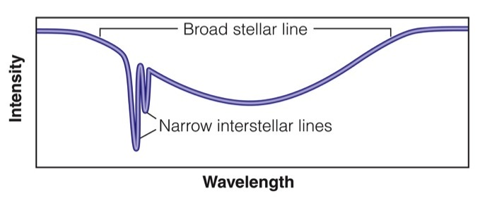
Interstellar Absorption Lines

Slide 5
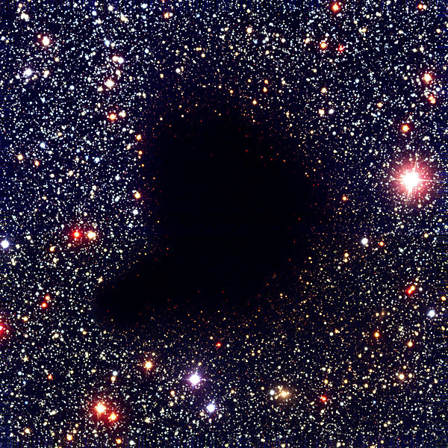
Giant Molecular Clouds
Barnard 68, 500 light years away, 0.5 light years across. (Wiki). Can be much larger. Range from 10³-10⁷ solar masses. Found in Galactic plane. Reservoir for star formation if sufficiently disturbed.

Slide 6
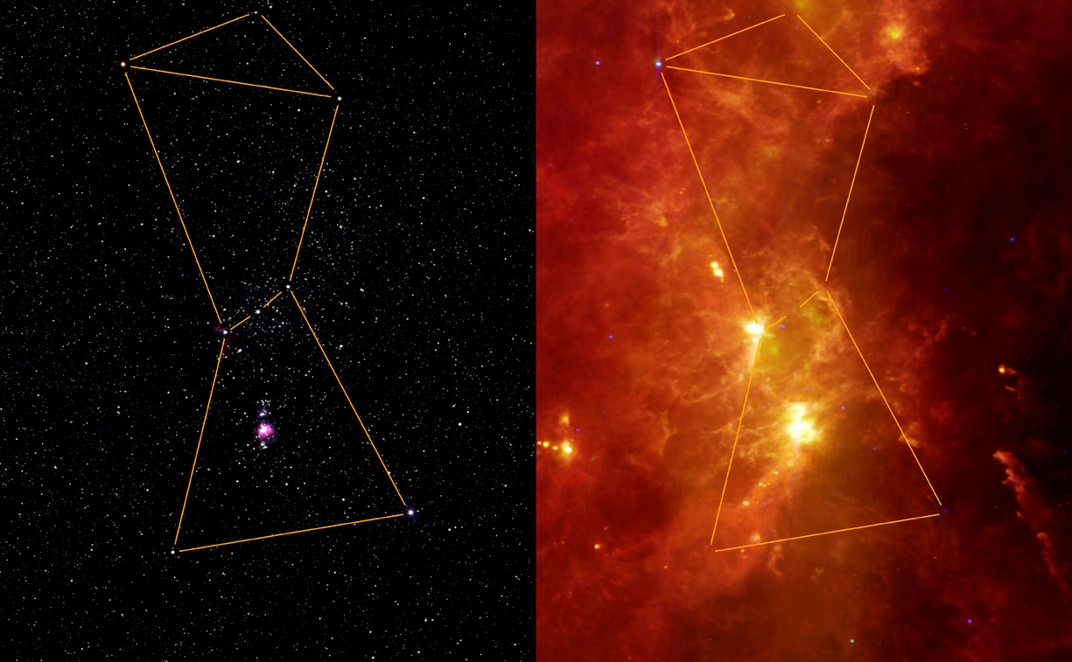
Optical vs. Infrared Views, ISM gas and dust
Stardate online:
Orion!

Slide 7
HII Regions: The Orion Nebula
Left: Optical (HST) Right: mid-IR (Spitzer)

Slide 8
HII Regions: Eagle Nebula
Spitzer image in mid-IR.
Figure 15.1: Eagle nebula / M16
Blue = 4.5 μm;
green = 8.0 μm;
red = 24.0 μm. This image is 28 x 32 arcminutes, or ~16 x 18 1/2 parsecs.

Slide 9
HII Regions: The Eagle Nebula
HST images. Left: Optical emission lines. Right: near-IR

Slide 10
What determines if a cloud collapses into stars?
First, consider the timescale for freefall
Core of mass M, size R, test mass m, some average density
Several approaches. Text uses Kepler’s third law with e=1, no rotation to get free fall time, then examines Jean’s Instability
Go through derivation…
For Milky Way clouds this corresponds to a Jean’s Mass of several thousand solar masses – bigger than any stars observed
There is additional fragmentation when a cloud collapses (density increases)

Slide 11
Collapse starts, Protostars form…
In the real world, angular momentum (mvr) exists, and must be lost to make stars, which shrink by many orders of magnitude
This is lost in part by mass loss, carrying away angular momentum
Natural but challenging feature of accretion
Issues of magnetic fields, too, which must be shed
Protostars will have accretion disks and jets

Slide 12
Protostar Images

Slide 13
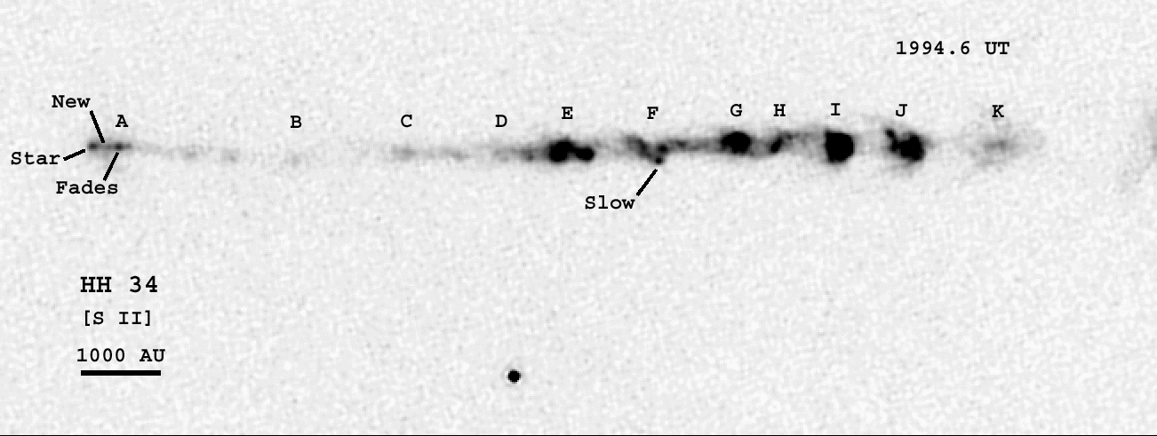
Motion of Herbig-Haro 34 in Orion
Can actually see the knots in the jet move with time
In time jets, UV photons, supernova, will disrupt the stellar nursery
Hubble Space Telescope Image

Slide 14
Protostar Images

Slide 15
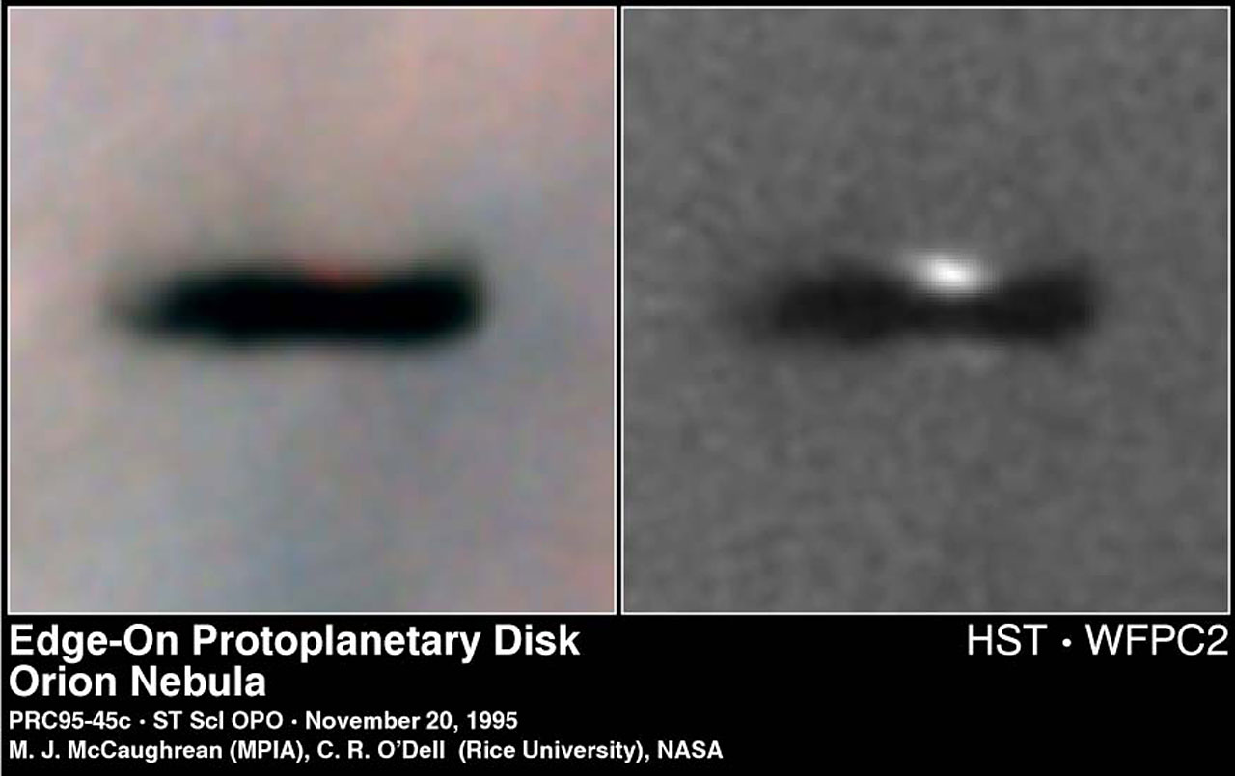
Protostar Images

Slide 16
Protostar types
Like most things in astronomy, an assortment of classifications…
Low-Mass T-Tauri stars
High-Mass Herbig Ae/Be stars.
Already saw Herbig-Haro stars with jets.

Slide 17
Protostar Evolutionary Tracks on HR Diagram
These come out of computer models featuring the key physics, which we will examine. Note the vertical “Hayashi tracks” for low mass convective protostars. Horizontal “Henyey tracks” for higher mass stars.

Slide 18
Zero Age Main Sequence
Sustained hydrogen fusion kicks in and the stars have reached the bottom side of the main sequence – the ZAMS
The lowest mass stars are ~0.08 M⦿ — less than that, no fusion
The highest mass stars are ~100 M⦿ — radiation pressure will not allow more (depends a bit on metallicity, which affects opacity and hence radiation absorption)

Slide 19

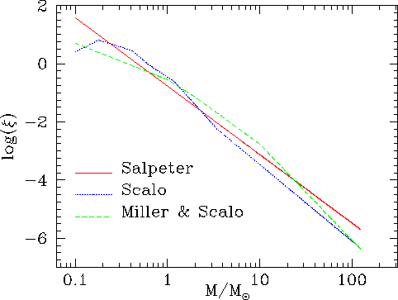
Initial Mass Function
Empirical. Salpeter (1955):
Other forms also proposed (See Wiki Figure). Hard to tell at high and low mass ends. (Why?)

Slide 20
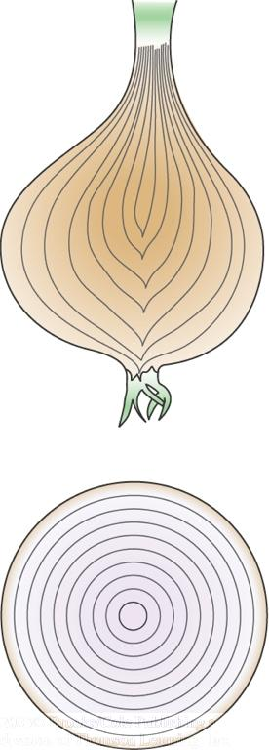
Hydrostatic Equilibrium
Imagine a star’s interior composed of individual shells
Within each shell, two forces have to be in equilibrium with each other:
Gravity, i.e. the weight from all layers above
Outward pressure from the interior

Slide 21
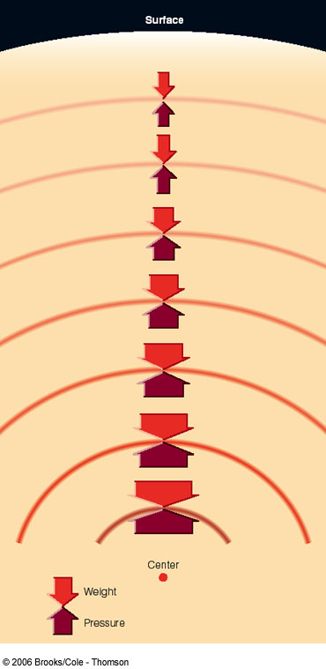
Hydrostatic Equilibrium (II)
0
Outward pressure force must exactly balance the weight of all layers above everywhere in the star.
This condition uniquely determines the interior structure of the star.
This is why we find stable stars on such a narrow strip (main sequence) in the Hertzsprung-Russell diagram.

Slide 22
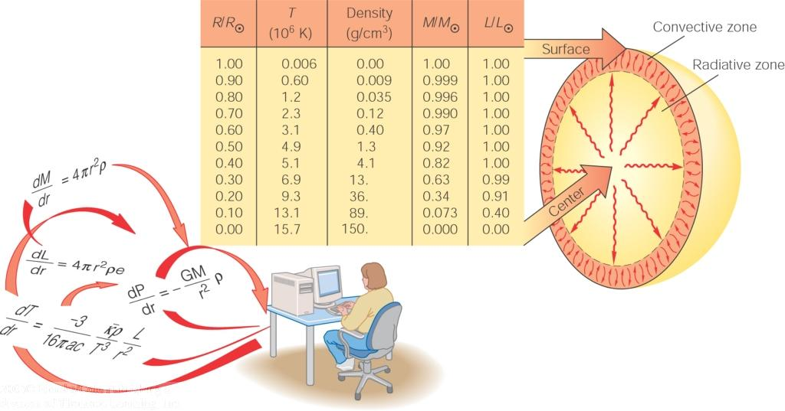
Stellar Models
The structure and evolution of a star is determined by the laws of
Hydrostatic equilibrium
Energy transport
Conservation of mass
Conservation of energy
A star’s mass (and chemical composition) completely determines its properties.
That’s why stars initially all line up along the main sequence.

Slide 23
Modelling Stellar Interiors
Requires solving coupled differential equations
Shell by shell
No analytical solutions
Need to use computers
We can review big picture procedure following the text
There are public stellar structure and evolution codes you can easily access, e.g., EZ-Web (Evolve ZAMS) and MESA-Web. The real deal with help pages if you’re into stars.

Slide 24
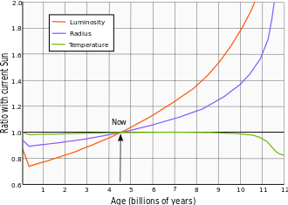
Evolution on the Main Sequence
In general for intermediate mass stars like the sun…
  Hydrogen fusion happens in the core (about 10% of total mass)
  80-90% of total energy producing lifetime on main sequence
  Hydrogen fusion converts 4 H to 1 He, reducing number of particles
  This reduces pressure, causes contraction and temperature increases
  Sun increases L over main sequence lifetime, from Wiki:

Slide 25
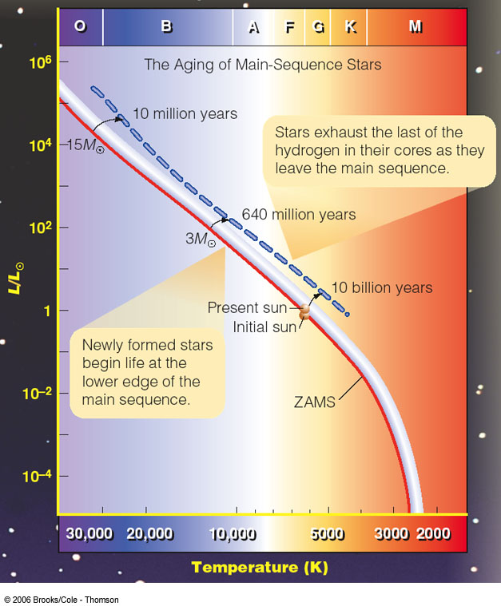
The Life of Main-Sequence Stars
Stars gradually exhaust their hydrogen fuel.
In this process of aging, they are gradually becoming brighter, evolving off the zero-age main sequence.

Slide 26
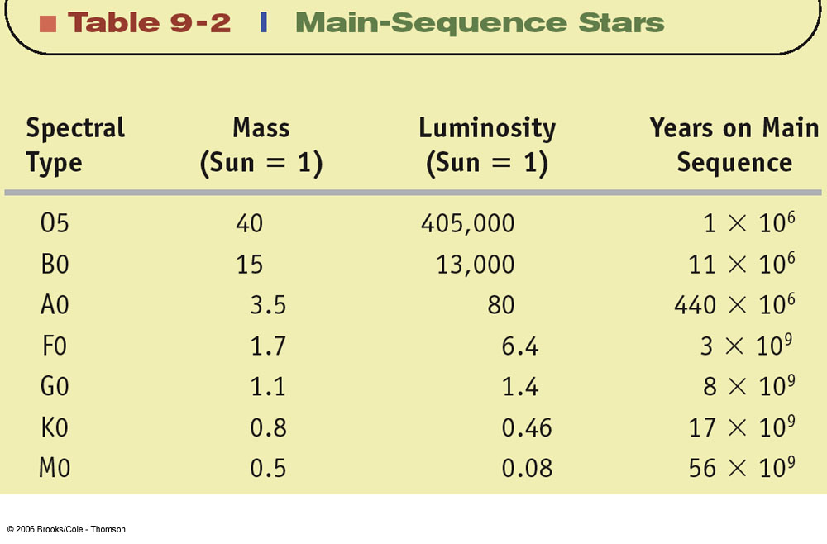
Lifetime on Main Sequence
L ∝ M^{3.5} T ∝ fuel / L = M/M^{3.5 =} M^{-2.5}
Example: M=2 M_{Sun} L = 11.3 L_{Sun} T =1/5.7 T_{Sun}
Spectral Type | Mass (Sun = 1) | Luminosity (Sun = 1) | Years on Main Sequence
O5 | 40 | 405,000 | 1 × 10⁶
B0 | 15 | 13,000 | 11 × 10⁶
A0 | 3.5 | 80 | 440 × 10⁶
F0 | 1.7 | 6.1 | 3 × 10⁹
G0 | 1.1 | 1.4 | 8 × 10⁹
K0 | 0.8 | 0.46 | 17 × 10⁹
M0 | 0.5 | 0.08 | 56 × 10⁹

Slide 27
Post Main Sequence
Evolutionary tracks on HR Diagram, differences by mass

Slide 28
Post Main Sequence Evolution – solar type stars
9-10 billion years burning H on main sequence via p=p chain
Core H is exhausted, but H shell burning
Star adjusts structure, cooler and redder
Cooler temperatures, increased opacity
Convection dominates over radiation
Star moves up red giant branch (RGB)

Slide 29
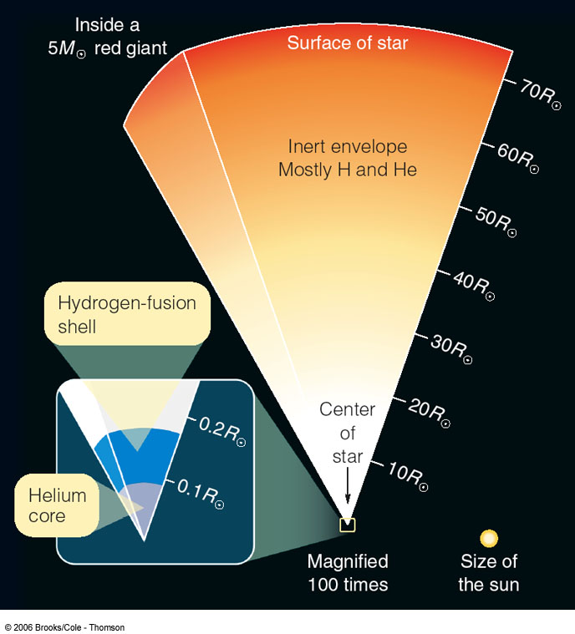
Evolution off the Main Sequence: Expansion into a Red Giant
Hydrogen in the core completely converted into He:
→ “Hydrogen burning” (i.e. fusion of H into He) ceases in the core.
H burning continues in a shell around the core.
He core + H-burning shell produce more energy than needed for pressure support
Expansion and cooling of the outer layers of the star → red giant

Slide 30
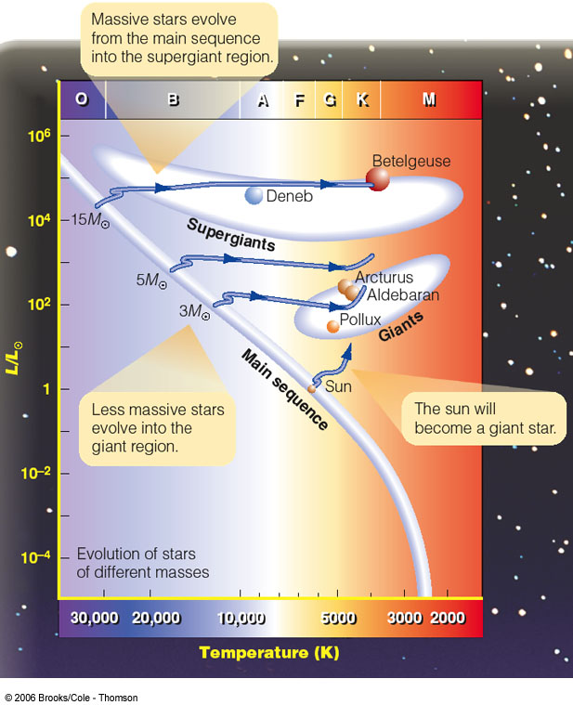
Expansion onto the Giant Branch
Expansion and surface cooling during the phase of an inactive He core and a H-burning shell
Sun will expand beyond Earth’s orbit!

Slide 31
Post Main Sequence Evolution – solar type stars
Issue of the Earth-sized exhausted He core
Equation of State changes
Ideal gas becomes degenerate
Pressure from Pauli Exclusion Principle
Quantum effect
Pressure and temperature decouple
Whole core to tens of millions K
About a billion years to get to a hundred million K for the He Flash

Slide 32
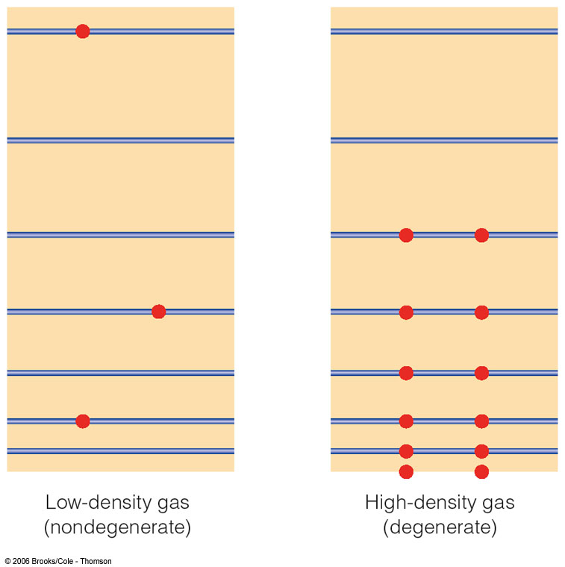
Degenerate Matter
0
Matter in the He core has no energy source left.
→ Not enough thermal pressure to resist and balance gravity
→ Matter assumes a new state, called
degenerate matter
Electron energy
Pressure in degenerate core is due to the fact that electrons can not be packed arbitrarily close together and have small energies.

Slide 33
Post Main Sequence Evolution – solar type stars
He flash – core He burning initiated
Triple alpha process 3xHe -> C
Higher temperature core
Degeneracy relaxed
Structure adjusts, star moves to HB
Horizontal Branch, He burning core
+H burning shell
~Hundred million years there, then exhaust the He and move onto AGB
Instabilities -> thermal pulses blow off atmosphere, PNe, reveal white dwarf

Slide 34
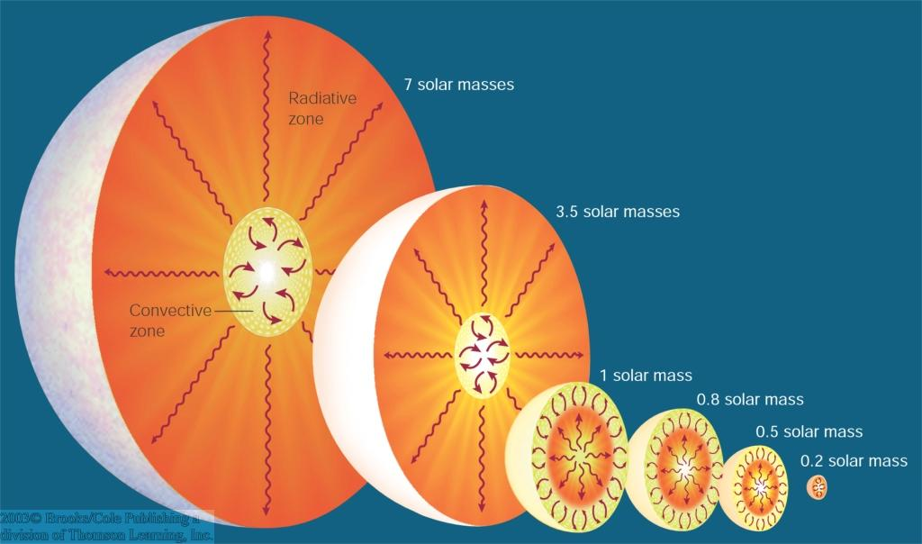
Sunlike Stars
Sunlike stars (~ 0.4 – 4 solar masses) develop a helium core.
Mass
→ Expansion to red giant during H burning shell phase
→ Ignition of He burning in the He core
→ Formation of a degenerate C,O core

Slide 35
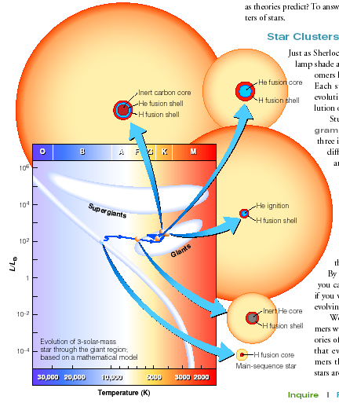
Red Giant Evolution
H-burning shell keeps dumping He onto the core.
He core gets denser and hotter until the next stage of nuclear burning can begin in the core:
He fusion through the
“triple-alpha process”:
⁴He + ⁴He → ⁸Be + γ
⁸Be + ⁴He → ¹²C + γ
The onset of this process is termed the
helium flash

Slide 36
Post Main Sequence Evolution – low mass stars
Very low mass stars deeply convective
This brings H fuel into core
Main Sequence lifetimes much longer than the current age of universe
Will likely never burn He
Will likely leave He White Dwarfs
Less than 0.08 solar masses, brown dwarfs (types L, T, Y), very little fusion, akin to large planets

Slide 37
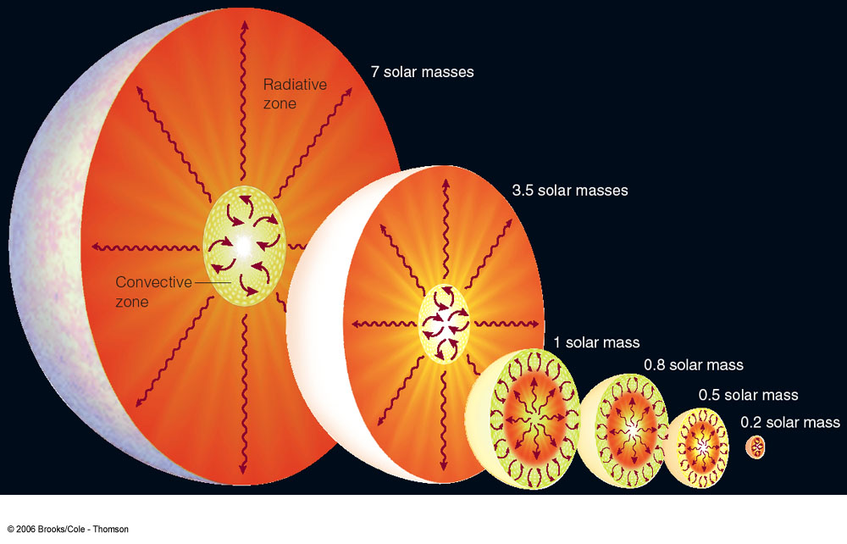
Red Dwarfs
Recall:
Stars with less than ~ 0.4 solar masses are completely convective.
Mass
→ Hydrogen and helium remain well mixed throughout the entire star.
→ No phase of shell “burning” with expansion to giant.
Star not hot enough to ignite He burning.

Slide 38
Post Main Sequence Evolution – High mass stars
O and B stars > 9 Msun will not leave white dwarf cores
Form first and quickly (~Myrs)
Radiation pressure high, strong winds
Main Sequence lifetimes short
Post-Main Sequence shorter
Core collapse supernovas, r-process elements (rapid neutron capture)
Type II (H) and maybe Type I b/c
Core becomes Neutrons, massive flux (10⁵⁷ neutrinos) blows out slower infall
Black holes likely as well as Neutron Stars

Slide 39
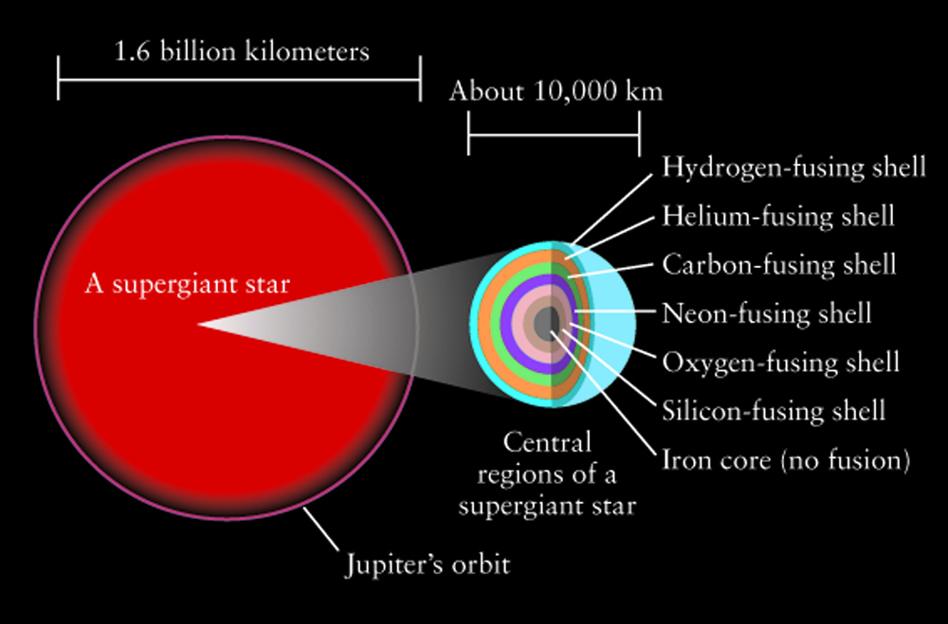
Late Stage Structure of High Mass Stars
GSFC/NASA

Slide 40
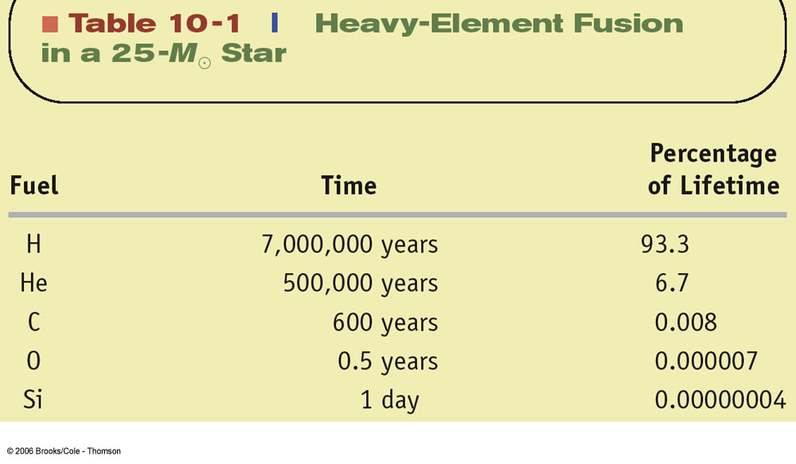
Late Stage Structure of High Mass Stars
Horizons, by Michael Seeds

Slide 41
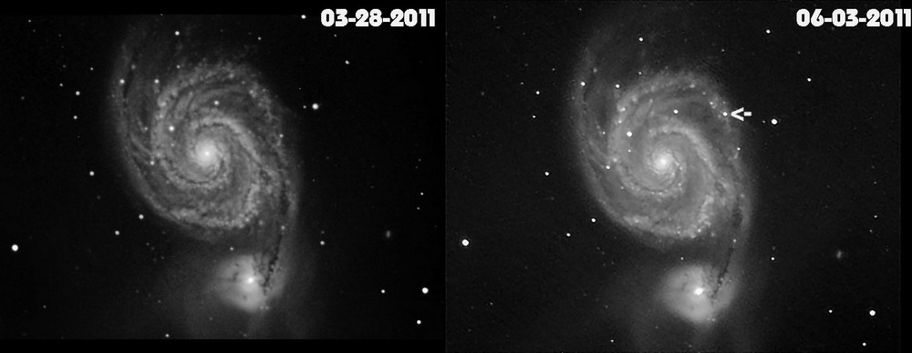
Type II Supernova in M51 in 2011
M51 Supernova | John Buonomo

Slide 42
Instability Strip and Variable Stars
Stars in this region of the HR Diagram literally pulsate and change their size with a regular period.
This has to do with a layer of Helium changing ionization (between singly and doubly ionized. See Wiki link.)

Slide 43
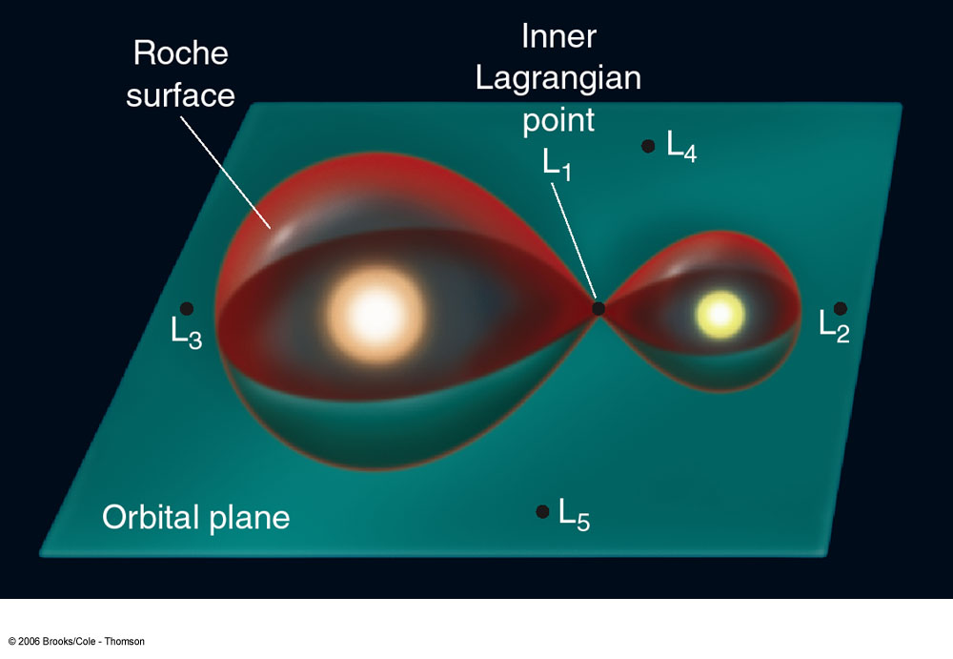
Mass Transfer in Binary Stars
In a binary system, each star controls a finite region of space, bounded by the Roche lobes (or Roche surfaces).
Lagrangian points = points of stability, where matter can remain without being pulled toward one of the stars.
Matter can flow over from one star to another
through the inner lagrange point L1.

Slide 44
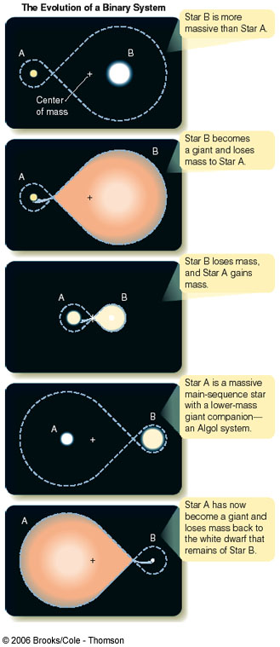
Recycled Stellar Evolution
0
Mass transfer in a binary system can significantly alter the stars’ masses and affect their stellar evolution.

Slide 45
Blue Stragglers
Mass transfer in a binary system can significantly alter the stars’ masses and affect their stellar evolution.
Some objects may appear to violate the expectations of stellar evolution due to their binary nature, and the transfer of mass and momentum.

