Slide 1
ASTR 2320
General Astronomy II
Professor Mike Brotherton
Chapter 14 – Stellar spectra and the Hertzsprung-Russell diagram
“If a picture is worth a thousand words, a spectrum is worth a thousand pictures.” -- Me

Slide 2
Stellar Spectra – absorption lines
Another way to plot a spectrum: continuum-normalized over a small wavelength range.
Typical stellar absorption lines have a core and wings that make a symmetric profile.
Strength of the absorption general measured as Equivalent Width (EW) measured in Angstroms.
Different species, transitions, vary. Lines can be blended. SNR is an issue.

Slide 3
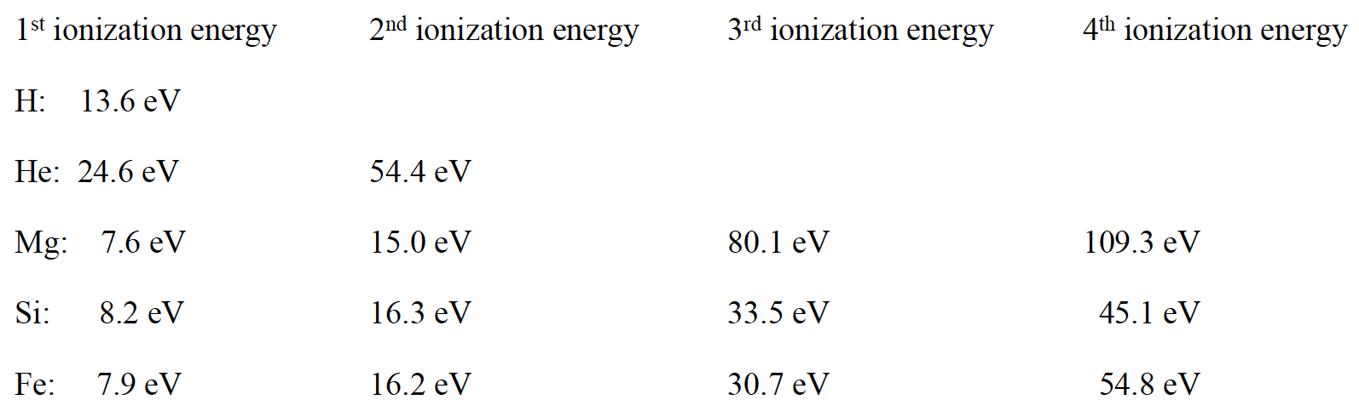
Ionization potentials:
To have a strong absorption line, need to have an element in proper state to absorb a photon. For instance, ionization state, usually temperature related. Also relative abundances important.

Slide 4

Stellar Spectra – absorption lines -- broadening
Natural broadening. Due to quantum effects like Heisenberg Uncertainty Principle for Energy and Time.
Doppler broadening. Stars rotate. Also turbulence and temperature effects. (See figure.)
Pressure broadening. High gravity stars have high pressure/density and broader lines due to electrical interactions of the atoms in the atmosphere. One way to ID giant stars.

Slide 5
Stellar Spectra – absorption lines
Line strengths as a function of effective temperaturefor main sequence stars of roughly solar composition. Why H peaks for mid-temp stars?

Slide 6
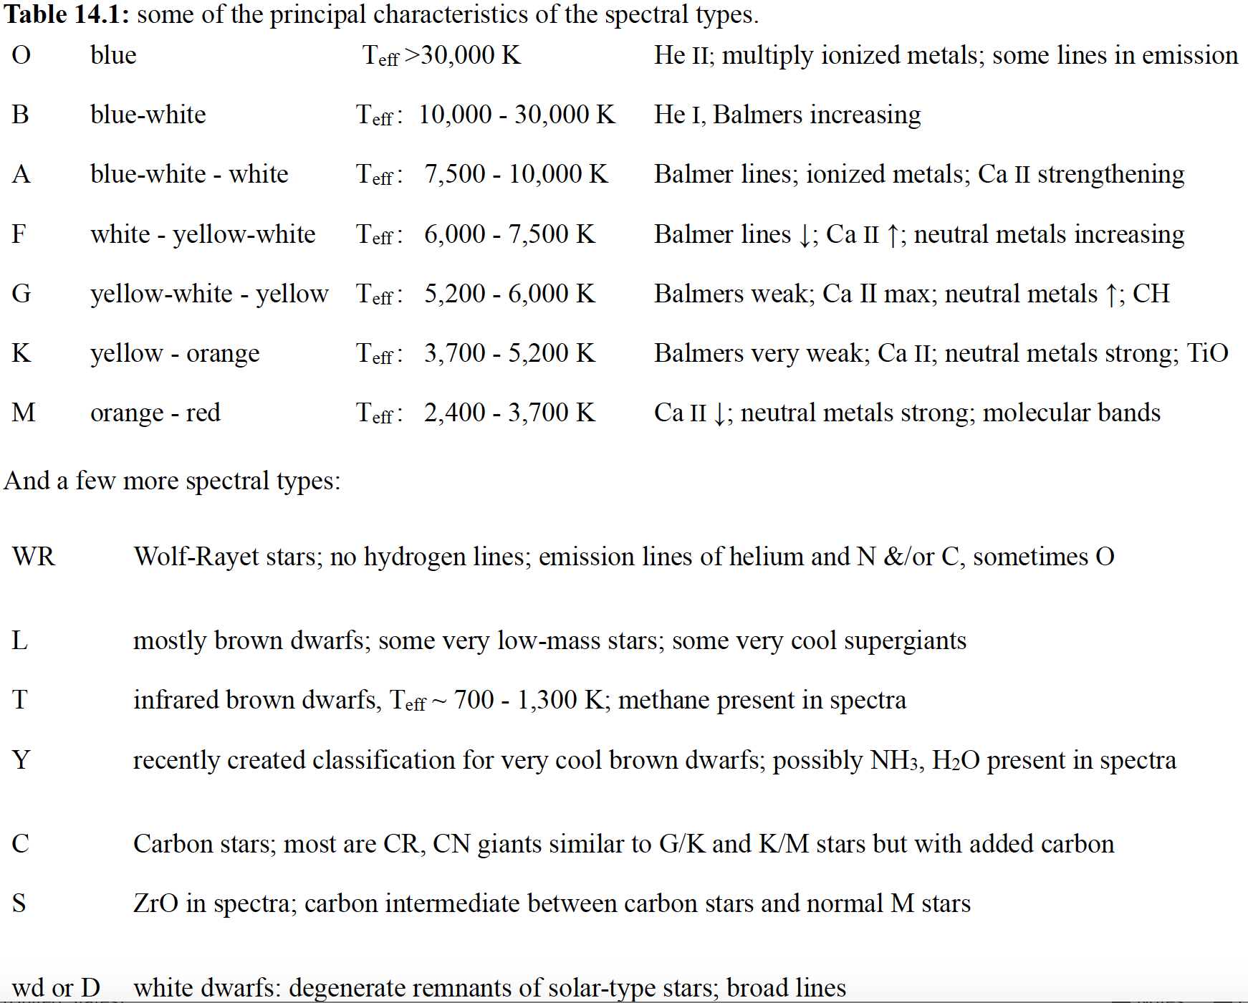
Stellar
Types
Mnemonics

Slide 7
Stellar
Types
Based on Silva & Cornell 1992, ApJS, 81, 865.
NASA ADS to find papers!
Let’s check it out.

Slide 8
The HR Diagram
Orange: brightest stars in our sky;
Blue: nearby (≾10 pc) bright stars;
Gray: nearest (≾8 pc) stars;
plus 2 wd companions.
The Sun is a G2 V star, M_{V} ~4.8.
Note Luminosity Classes (I-V)
A brief video developing the HR Diagram.
A simple but good video explaining some conceptual features of the HR diagram.

Slide 9
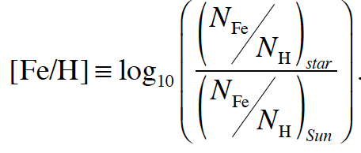
An aside: Stellar Metallicity
Metallicity (Z) is the mass fraction of metals. X+Y+Z = 1. Sun: Z=0.0134.
Also used is the Fe/H ratio of a star relative to the sun:
Population I stars similar to sun. Pop II low metallicity. Pop III sort of hypothetical – think they were the first generation of stars.
Metallicity has some effect on a star’s observable properties, can change color and effective temperature, for instance, due to line blanketing.
Note also the tables of stellar properties at the end of the chapter 14.

Slide 10
Cluster CMDs – stars are similar distances.
Left: Pleiades (open cluster). Right: M15 (globular cluster). Distances?
Globular cluster HST animation by my college lab partner Jay Anderson.

