Slide 1
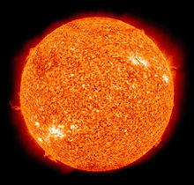
ASTR 2320
General Astronomy II
Professor Mike Brotherton
The Sun – extras from Ryden & Peterson Chapter 7
“Here comes the sun, and I say, It’s all right.”

Slide 2
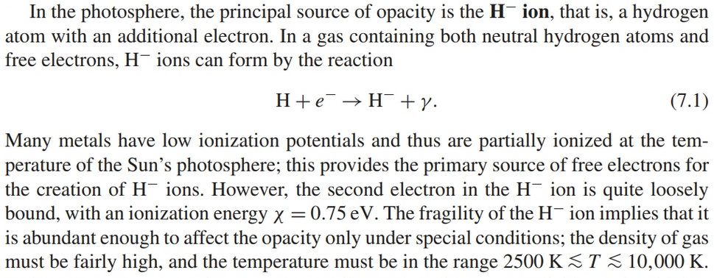
Principle source of opacity
H- ion

Slide 3
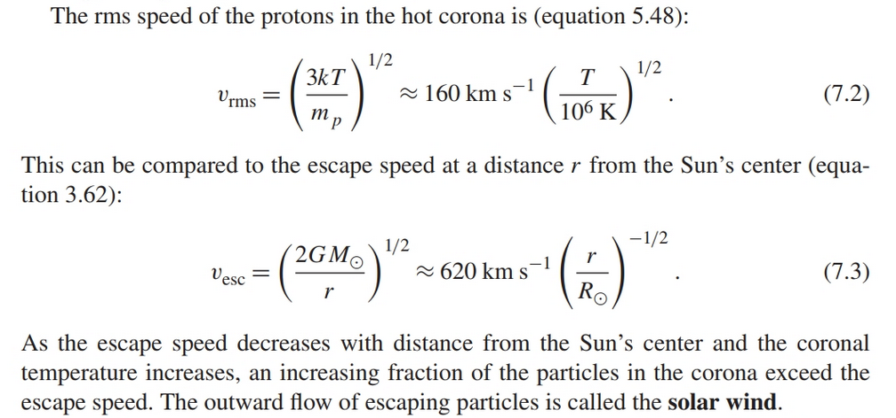
Simple Solar Wind Astrophysics

Slide 4
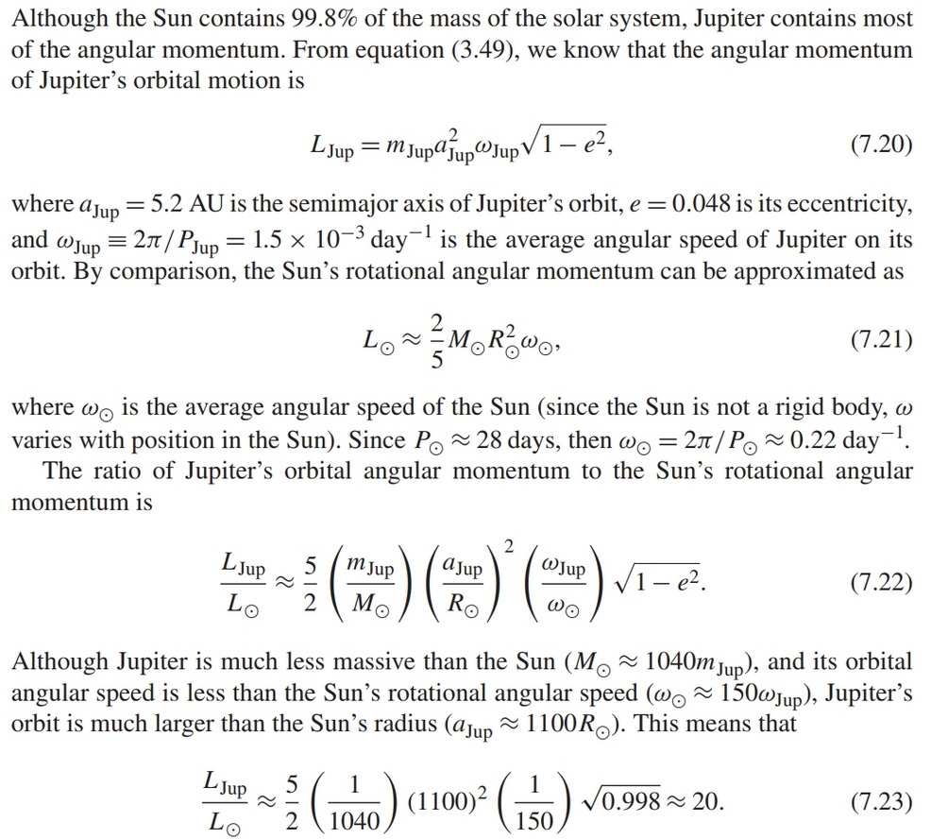
Angular Momentum of the Sun:

Slide 5
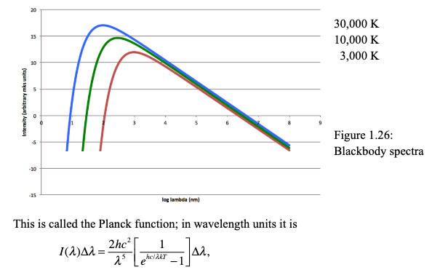
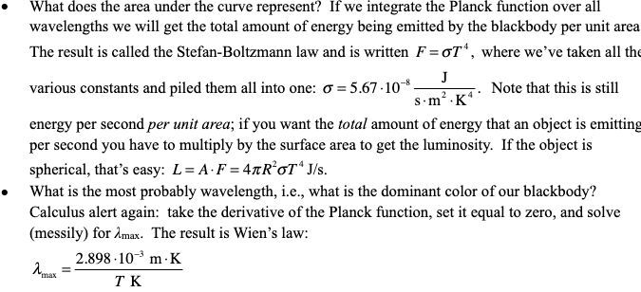
Blackbodies: Planck and other Formulae

